Slide 1
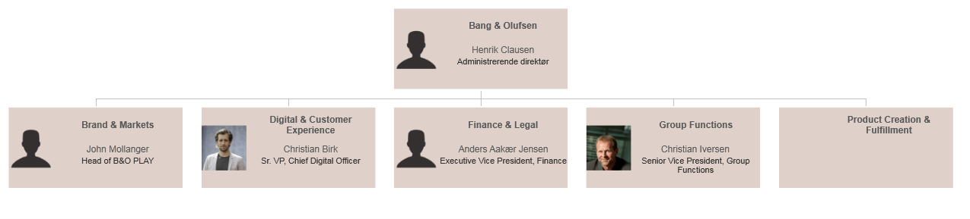

Slide 2
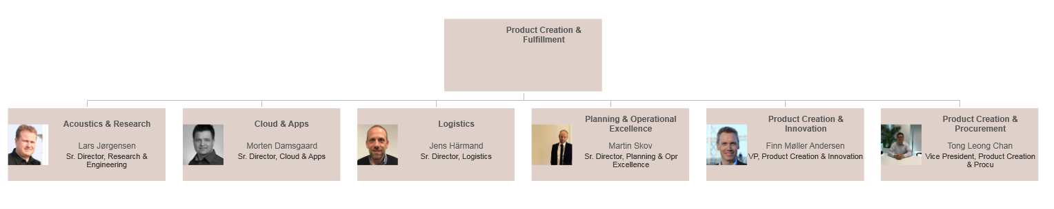

Slide 3











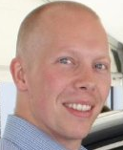
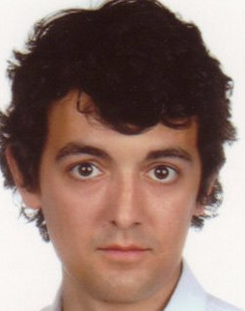
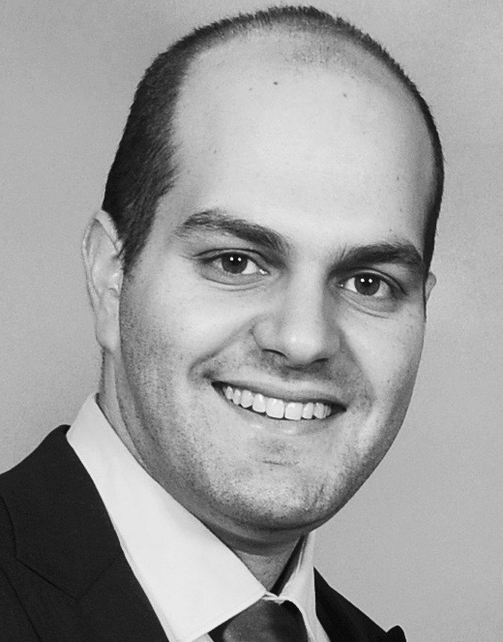







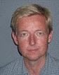

ACOUSTICS & RESEARCH
HEAD of RESEARCH
Lars Jørgensen
LSJ
NPI: Acoustic Portfolio Lead
Søren Bech
SBE
Esbjørn Held
Nørgaard
EHN
Research projects
ELECTRO ACOUSTICS
SOUND QUALITY & DESIGN
NPI projects
RESEARCH
ACOUSTIC DSP
Sven Ewan
Shepstone
SSH
Samuel Moulin
SAE
Geoff Martin
GGM
Knud-Erik Lauridsen
KL
Jens Rahbek
JER
Jakob Dyreby
JDY
Henrik Lund
Jensen
HLJ
John Hammer
Madsen
JHM
Martin Bo
Møller
MIM
Pablo Martinez- Nuevo
PMN
Neo Kaplanis
NEO
Daniel Dalskov
DDA
Søren H.
Viinberg
SHV
Morten Bjerre
MBJ
Lars Nørgaard
LNA
Klaus Kristensen
KRT
Miklas Strøm
Kristoffersen
MKO
Jens
Schönemann
-Paul
JSP
Vacant
Ole Mundbjerg
OMU
Jesper Meldgaard
Pedersen
JME
INTERNS:
EXTDRRE - Dragos Resmerita, host = SSH, Internship 1/2-2018 to 30/6-2018
PILO - Pierre-Louis Pancher, host = JDY, Internship 1/2-2018 – 30/6-2018
ESBL - Ema Souza Blanes, host = NEO, Internship 12/3-2018 – 31/8-2018
PQUI - Pierre Quinton, host = PMN, Inrernship 9/7-2018 – 14/9-2018
KONA - Konstantinos Arsenios Sachos, host = MIM, Internship 14/2-2018 – 30/9-2018
GSUC – Gabriel Suc, host = PMN, Internship 1/4-2018 – 30/9-2018
YZHU – Ye Zhu, host = SSH/PMN, Internship 1/7-2018 – 31/12-2018
Xxx – Lucca Nellemann, host = KSH, Internship 1/9-2018 – 31/12-2018
Xxx – Sarah Nielsen, host = KSH, Internship 1/9-2018 – 31/12-2018
STGO - Stefan Gorzynski, host = NEO, Internship 1/9-2018 – 31/8-2019
Poul Erik
Trabjerg
PTR
TRAINEES:
CLH – Claus Holmgaard
DAE – Daniel Skriver Hansen
HOURLY BASED SUPPORT:
GMU – Gert Munch
ACOUSTIC TEST & VALIDATION

