Slide 1
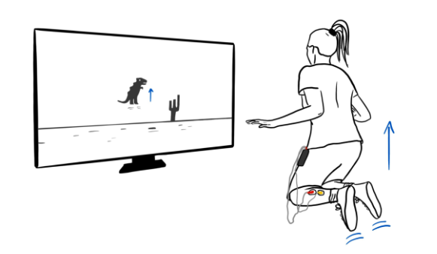

Imprecise but Fun: Playful Interaction Using Electromyography
Presented by:
Vítor Santos nº107186
Gabriel Teixeira nº107876
Class: TP3
Jakob Karolus, Simon Thanheiser, David Peterson, Nicolas Viot, Thomas Kosch, Albrecht Schmidt, and Paweł W. Wozniak. 2022.
Imprecise but Fun: Playful Interaction Using Electromyography. Proc. ACM Hum.-Comput. Interact. 6, MHCI, Article 190 (September 2022), 21 pages.
https://doi.org/10.1145/3546725
Interação Humano-Computador

Slide 2





Motivation
Potential: easy, intuitive and flexible playful interaction
Exotic input modality
Emergence of
Physiological
Input
2

Slide 3




Introduction
Context
Physiological sensing
Insight into user's state of being
Challenge (hard): good robustness and effective deployment
Imprecise readings as a limitation
Using Electromyography (EMG) to turn this limitation into a feature
3

Slide 4



What is Electromyography (EMG)?
EMG measures the electrical activity of muscles
Computer system control with muscles
EMG
Placing electrodes on the skin (sEMG)
or
Inserting fine wire electrodes into the muscle
(EMG)
Input modality for HCI.
4

Slide 5

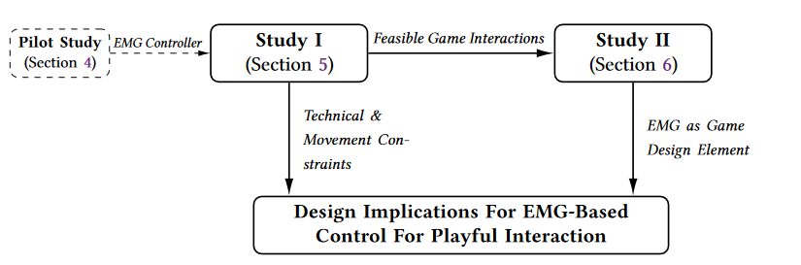
Methodology
RQ1:
What are the constraints of EMG-based input for motor control?
RQ2:
How can we integrate EMG-based control as a game design element?
5

Slide 6
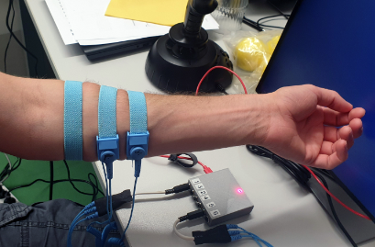
Pilot Study
“EMG-BASED INPUT FOR EXPLICIT CONTROL USING A LOW-COST CONTROLLER”
Basic Steering Task
Keep a ball in line
JOYSTICK or EMG
Participants
10 total (8 m, 2 f)
Avg. Age = 26.9 y
Procedure
Stimulus screen
Strapped Electrodes
Familiarize
Repeat task for each control modality
6

Slide 7
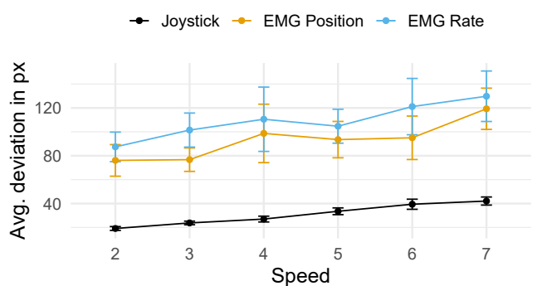
Pilot Study - Results
Explicit control with EMG is possible
More difficult
Less accurate
Linear mixed model
7

Slide 8

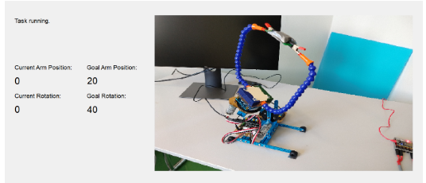
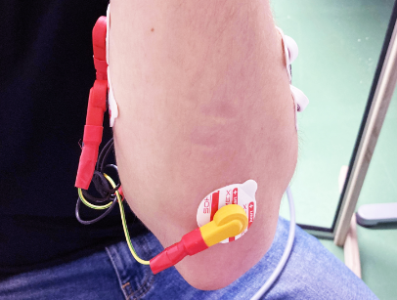
Study I
Task: Soldering with steerable third hand - test fine motor control
Conditions: EMG, Pedal, Manual
Subtasks:
Direct Control
Free Control
12 participants (9 m, 3 f)
Average age 27.5 years
8

Slide 9
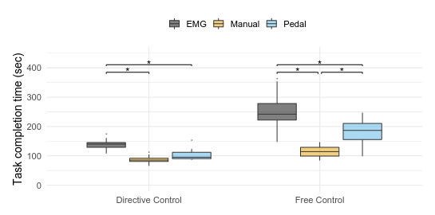
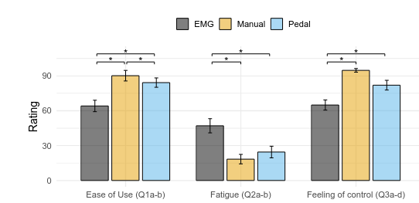
Study I - Results
Accuracy: No difference
Usability and UX
Creepiness: Not particularly creepy
Comfort: Not uncomfortable
Refer to bottom graph
9

Slide 10

Study II
“EMG-BASED INPUT IN GAME DESIGN - VROCKETBOOTS”
VR locomotion chosen:
Immersive potential
Direct muscle input as interaction with the virtual world
Naturally engaging
10

Slide 11
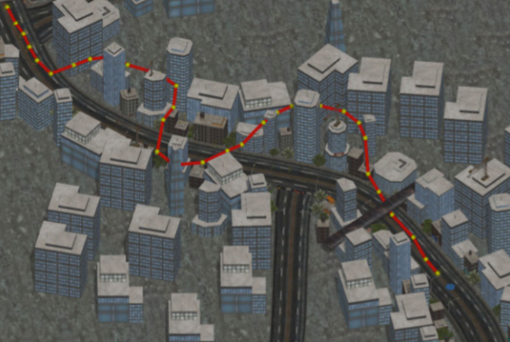
VRocketBoots
Flight simulation game
Follow a given trajectory (350 m, 34 rings)
Increase altitude by standing on toes
NOTE: (non-continuous thrust !!!)
Decrease altitude on normal pose
EMG vs Controller
Why ?
Implicit control
Playful large environment traversal
Nacke et al’s guidelines:
Direct physio. input -> virtual world action
11

Slide 12


Participants
Composition
University recruitment
20 in total (14 m, 6 f)
Average age: 26.3 years
Standard deviation: 2.9 years
Experience
3D apps - 75%
VR - 40%
No previous study participation
12

Slide 13

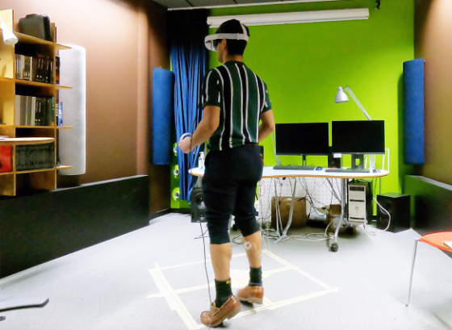
Procedure
Setup
Electrodes attached only on one leg on the calves (gastrocnemius muscle)
EMG Calibrated by performing take-off gesture
Time to familiarize
Two flight ring practice course
Experiment
Perform flight
Short break
Switch to other condition (EMG or Controller)
13

Slide 14

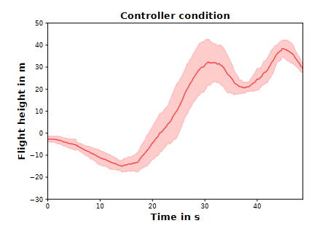
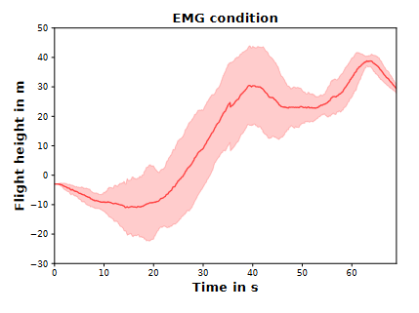
Results
Completion Time (average)
Controller: 52.8 s
EMG: 85.5 s
Flight Path Precision
Red line - Mean
Red corridor - Standard Deviation
14

Slide 15
Results - Interviews
Preference
70% of participants preferred EMG
Challenging and immersive nature
“It was more challenging and immersive. A very different way of using controls, which made it more fun.” (P3, m, 28y)
Immersion
Reported EMG as more immersive
Challenging nature augmented fun
“It felt more like a workout. It activates more parts of my body. But it became a bit tiresome in the end.” (P9, m, 23y)
15

Slide 16



Results - Interviews
Control
Imprecision
Break in the VR Illusion
“It felt quite natural to fly upwards, but when going in different directions it broke the illusion a bit.” (P20, m, 28y)
User insight
Continuous movement suggestion
“If it was possible to make it into a continuous movement, then it would feel like real life.” (P19, m, 25)
16

Slide 17







Discussion
Imprecise but Fun
Bad for accuracy and completion time (RQ1)
Challenging, playful interaction through difficult muscle control (RQ2)
EMG as a Game Element
Large muscle usage
Direct mapping to game elements
Use fatigue with great care
Limitations
Fatigue
Habituation
Best muscle groups remain an open question
17

Slide 18


Conclusion
EMG’s Imprecision
Challenging and engaging game experiences
Suggestions for EMG-based game design
Target large muscles and coarse movements
Limit design to coarse movements
Otherwise, unintended EMG input may break immersion
18

Slide 19
Bibliography & Credits
Bibliography
M.A. Cavalcanti Garcia and T.M. M. Vieira, Surface electromyography: Why, when and how to use it, Rev Andal Med Deporte. 2011;4(1):17-28
Slide template provided by Slidesgo
Icons provided by Google Slides Add-On Flaticon
18

