Slide 1

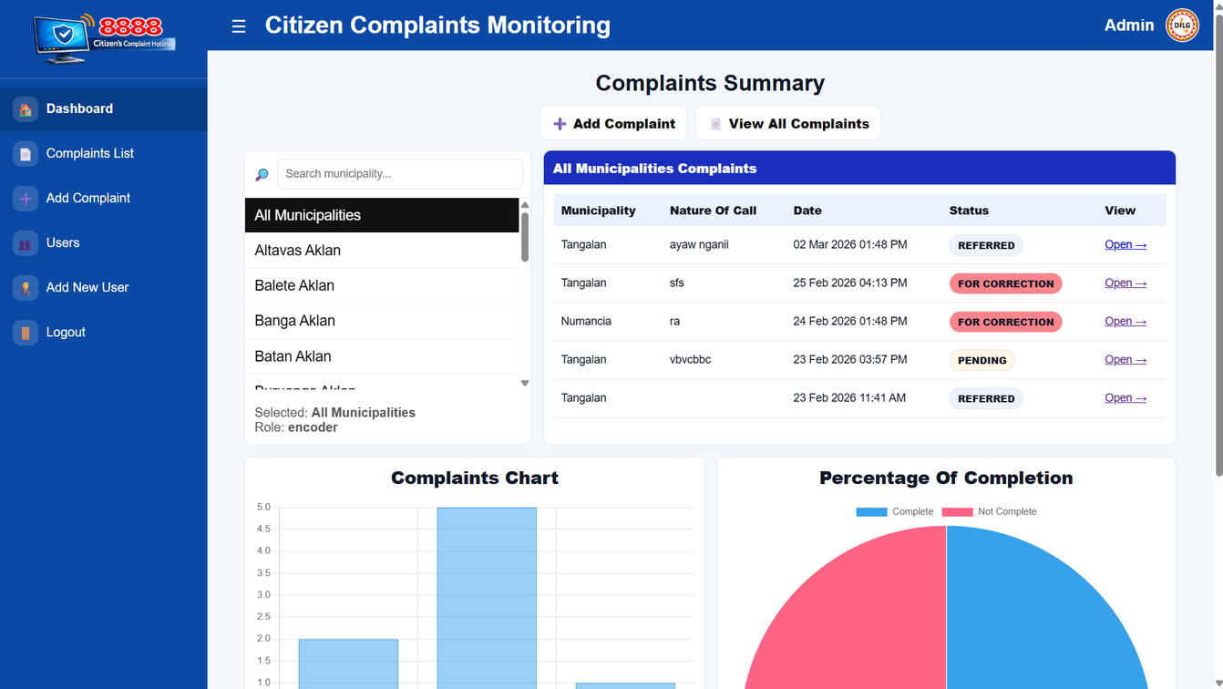
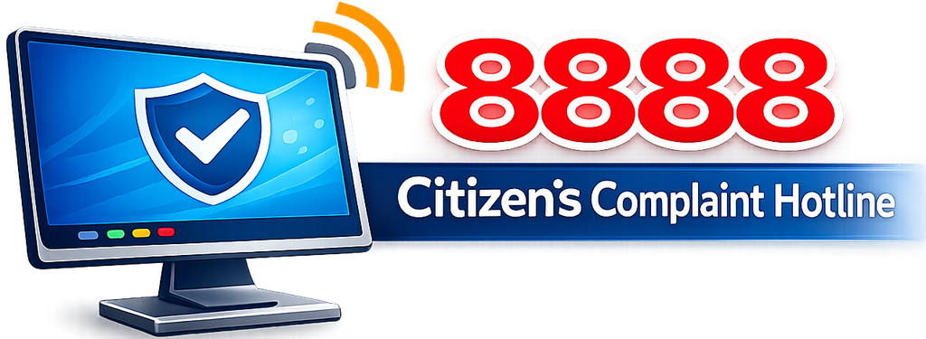
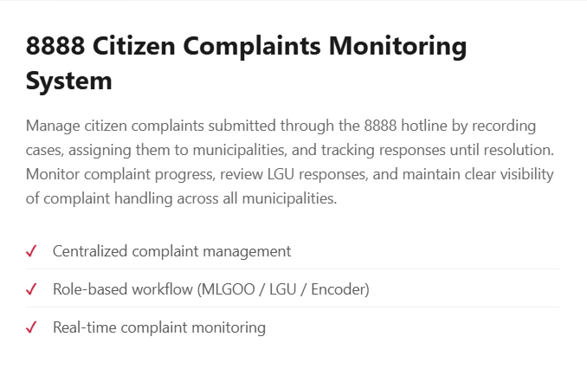
8888 Citizen Complaints Monitoring System
Presented by:
Gabriel B. Tosco &
Mark I. Rellin

Slide 2
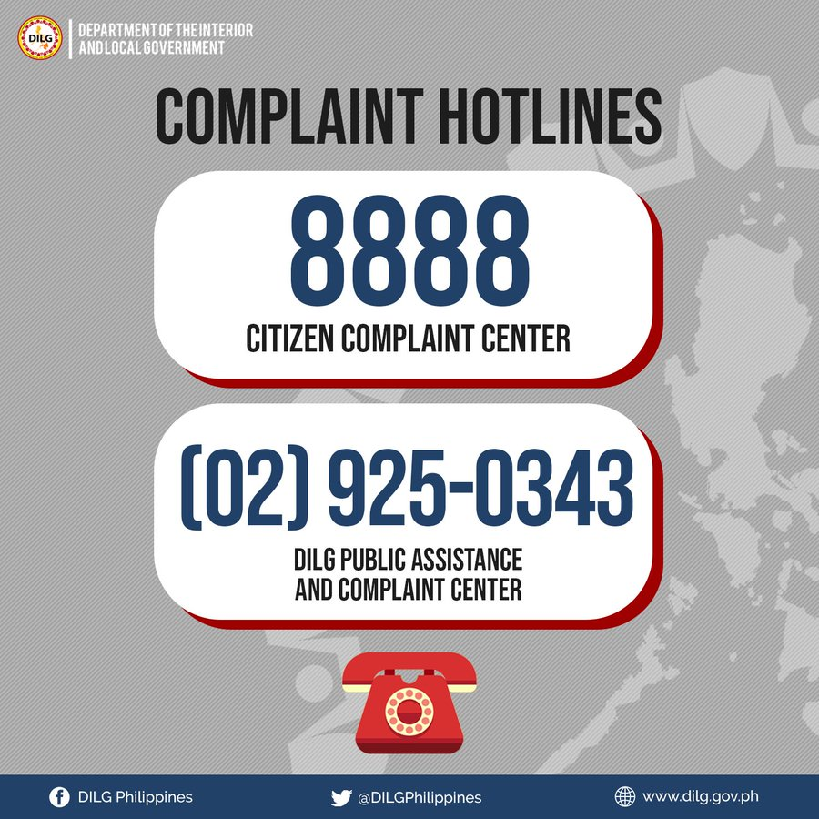
Introduction
The Philippine government established the Citizens' Complaint Hotline 8888 to enable citizens to report grievances directly. This initiative fosters transparency and accountability within government operations, ensuring that complaints are addressed efficiently by the Department of the Interior and Local Government (DILG).

Slide 3

Background
The DILG 8888 system effectively gathers citizens' complaints; however, managing the numerous documents and responses can be challenging for offices. Proper and efficient organization of records is crucial for timely resolution and accurate documentation of citizen complaints.

Slide 4

Problem Statement
Challenges in Current Management
Currently, complaints from the 8888 Citizens’ Complaint Hotline are processed through a chain of email communications—from the central, regional, to field office and then forwarded to the respective Local Government Units (LGUs).
Because this process relies mainly on email and document forwarding, it can lead to delays, and difficulty in monitoring complaint progress. Additionally, without a centralized system, it becomes challenging to clearly determine the current status and updates of each complaint, especially when handling multiple cases.

Slide 5

Project Motivation
To enhance the DILG's operations, my partner and I explored various systems. After thorough discussions and analysis, we identified the need for a streamlined approach to manage complaints effectively, leading us to develop the DILG 8888 Complaint Manager System.

Slide 6
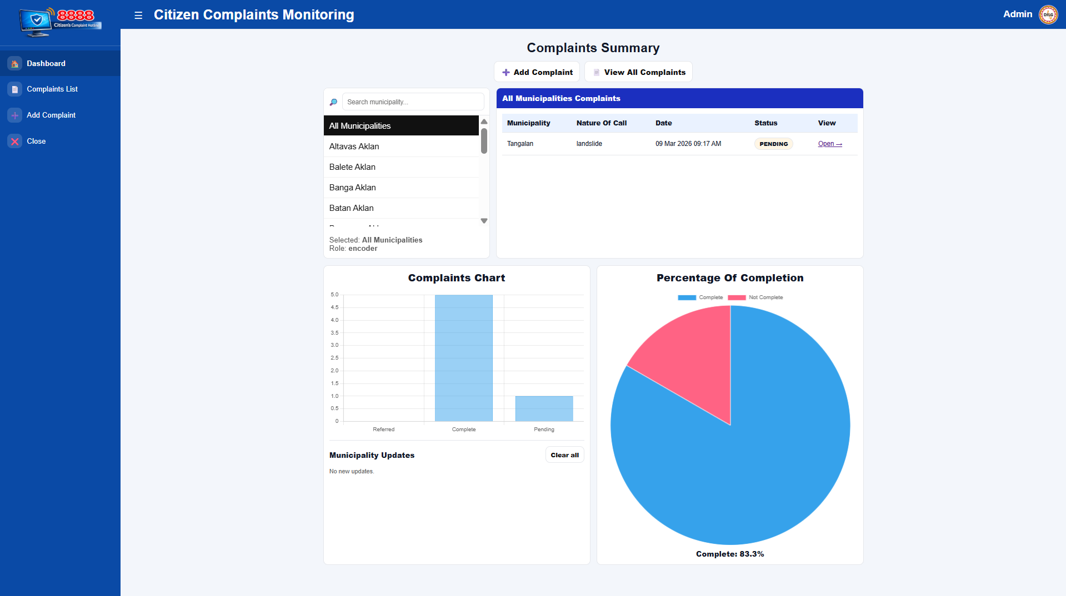
Proposed Solution
We developed a user-friendly, web-based complaint management system tailored for the DILG 8888 complaint process. This platform streamlines complaint organization, tracking, and resolution, enhancing communication between DILG personnel and LGUs for improved public service.

Slide 7

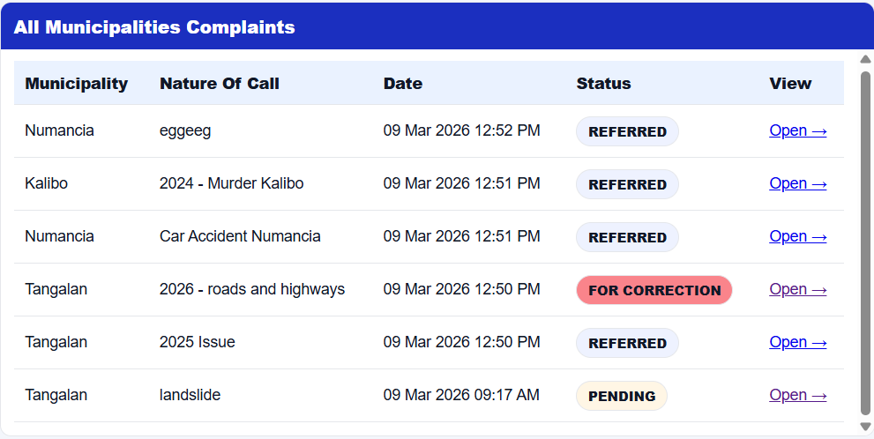
System Benefits
Enhancing efficiency and organization
Easier Monitoring
Organized Records
The 8888 Citizen Complaints Monitoring System enables real-time tracking of complaints, allowing personnel to oversee the progress efficiently and address issues promptly to enhance service delivery.
This system provides a centralized database for all complaints, ensuring that records are systematically organized, making it quicker and easier for staff to locate and manage documentation.

Slide 8
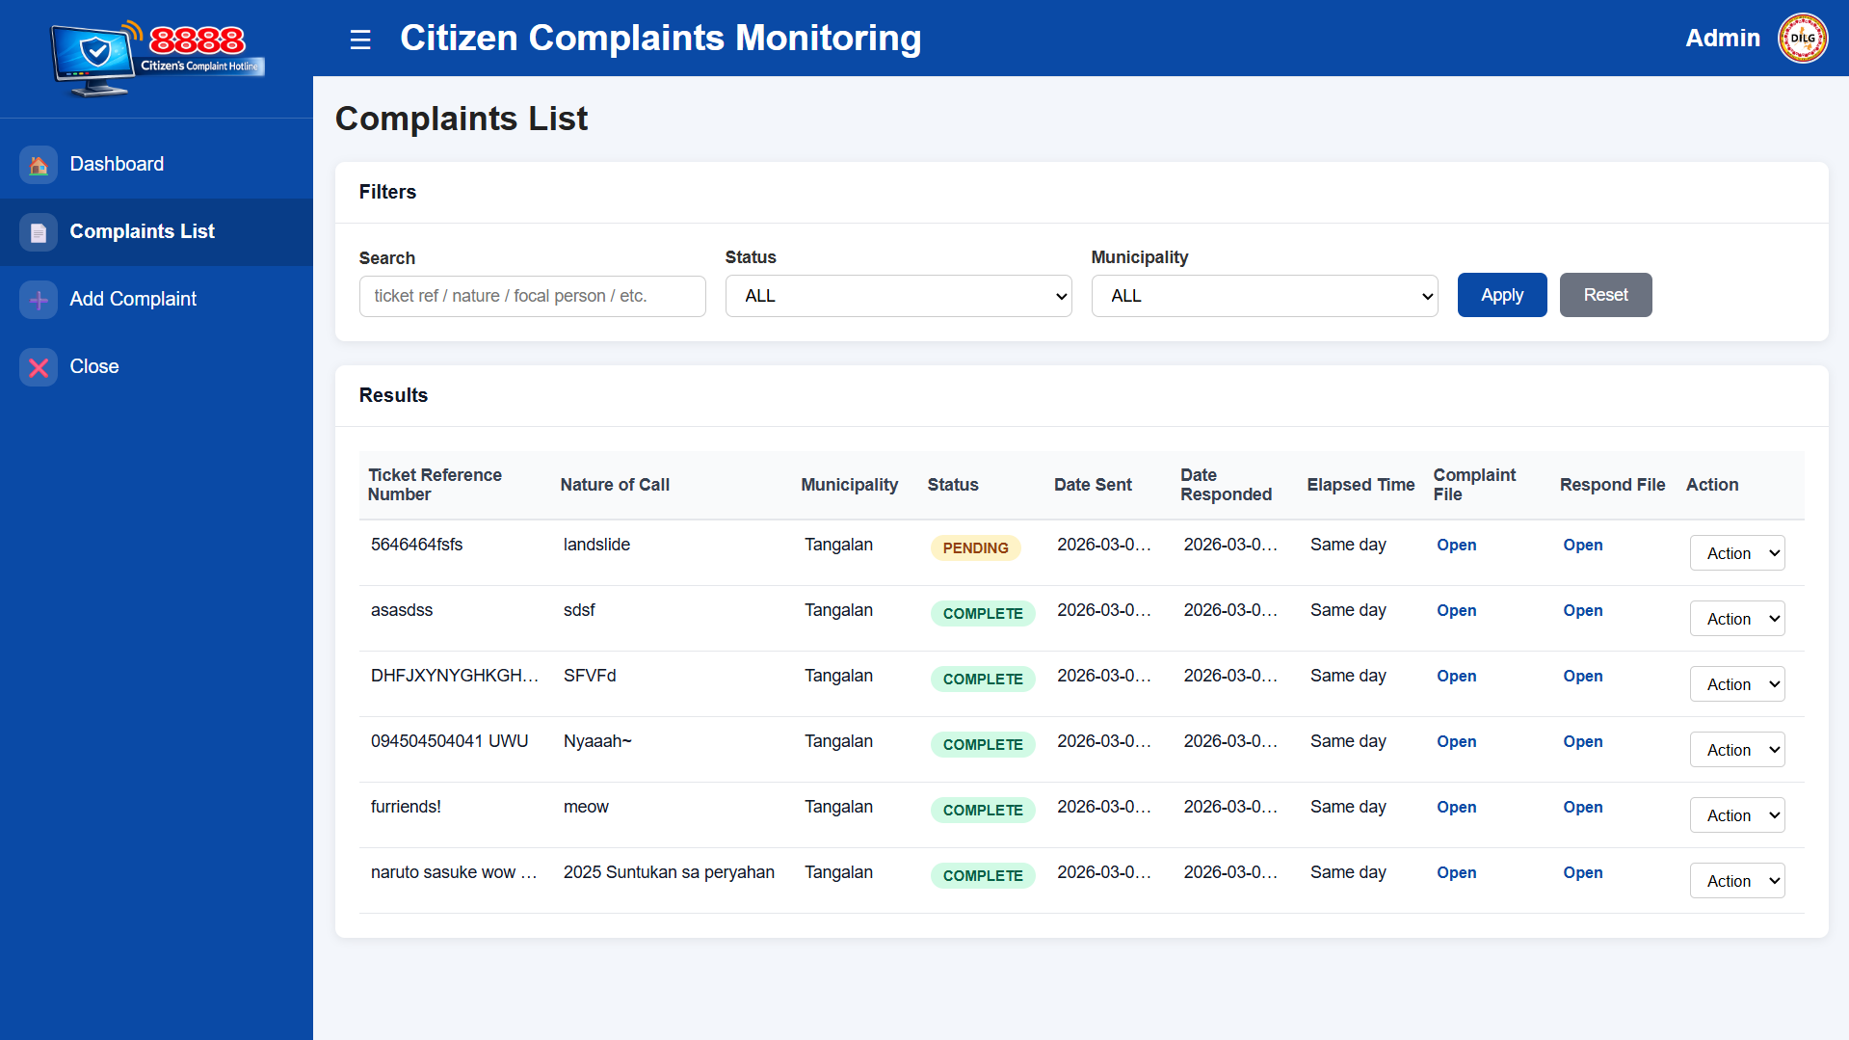
System Overview
The Citizen Complaints Monitoring System is a secure web-based platform enabling users to efficiently manage complaints. With features for logging in, viewing details, uploading documents, and monitoring progress, it streamlines the entire complaint management process for enhanced efficiency.

Slide 9
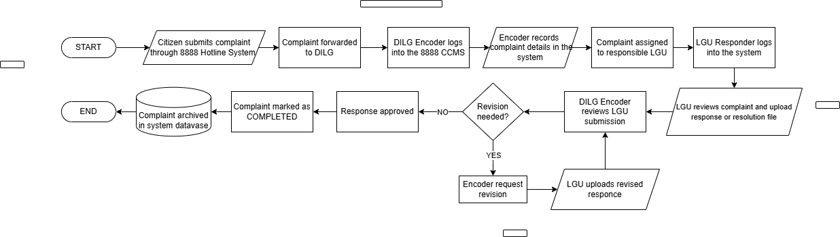
8888 Citizen Complaints Monitoring
Flowchart

Slide 10
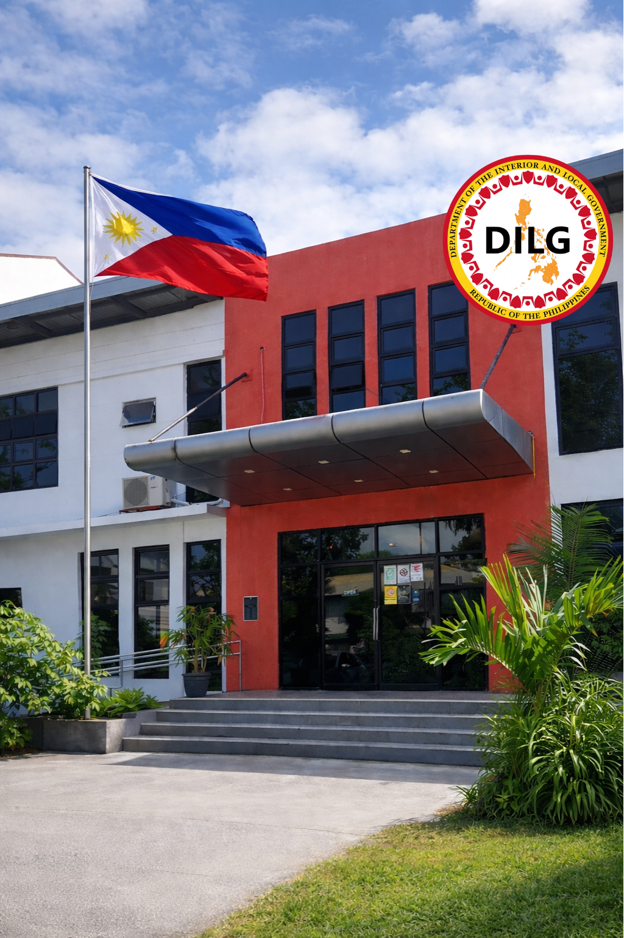
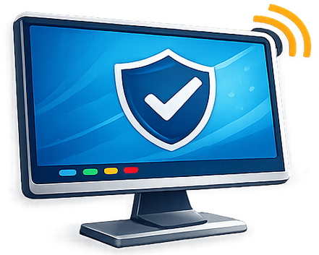
Conclusion
The Citizen Complaints Monitoring System enhances the efficiency of managing citizen complaints, ensuring better communication and accountability. By offering a centralized platform, this system supports improved governance and responsiveness in addressing public concerns across the Philippines.

