Slide 1
Inflation
Dr. Asha Thomas

Slide 2
Inflation refers to a general progressive increase in the prices of goods and services in an economy. When the general price level rises, each unit of currency buys fewer goods and services; consequently, inflation corresponds to a reduction in the purchasing power of money.
Some degree of inflation is natural, but excessive inflation can hurt consumers and other participants in the aggregate economy.
https://youtu.be/kU6NaDs-7ww

Slide 3
Inflation Rate
Inflation means the average level of prices is rising.
Inflation is a general, sustained upward movement of prices for goods and services in an economy. Prices have tended to rise over time, which means that the inflation rate (the percentage increase in the average price level of goods over a period of time) has been positive and as prices rise, the purchasing power of each dollar diminishes.
Example- A 2 per cent inflation rate means that (on average) a dollar buys 2 per cent fewer goods and services than it did last year.
To calculate inflation we must calculate the value of goods and services in the market basket

Slide 4
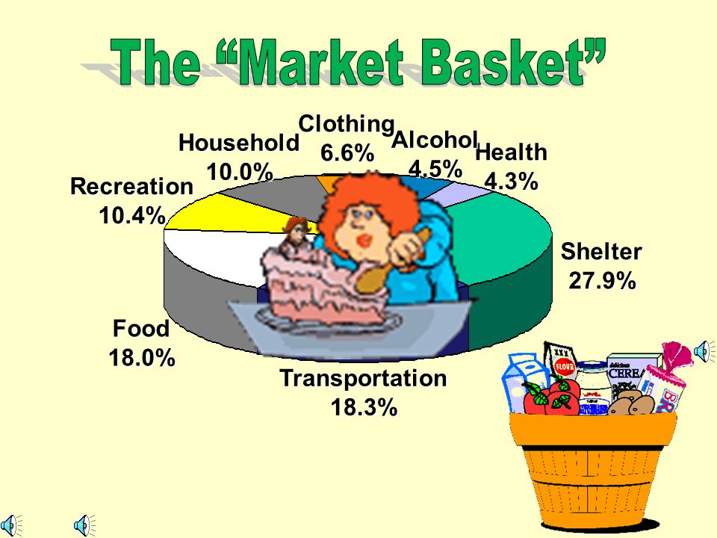
Market basket
The market basket is a sampling of the most commonly purchased goods and services in the aggregate economy year to year.

Slide 5
The market basket is a representative sample of the consumer goods and services that are most frequently purchased in the aggregate economy year after year.
It typically includes goods purchased on a regular basis by consumers to determine their value.
To determine the current year's market basket of consumer goods and services, the prices of each good in the market basket are added together.

Slide 6
Poland market basket
Poland market basket for 2019 | Juice | Bread | Onions
Price (PLN) | 4 | 3 | 3
Quantity | 1 | 1 | 1
Total | 4 | 3 | 3
Poland market basket for 2020 | Juice | Bread | Onions
Price (PLN) | 4 | 4 | 4
Quantity | 1 | 1 | 1
Total | 4 | 4 | 4

Slide 7
The inflation rate is calculated by taking the difference in the same market basket sample between two years and dividing it by the sum of the market basket in the base year of comparison.
So, in 2020 we can conclude the price increase in Poland by 20% (2/10*100) between 2019 and 2020.
Inflation rate shows the percentage increase or decrease in prices of goods and services in the aggregate economy in a given year.

Slide 8
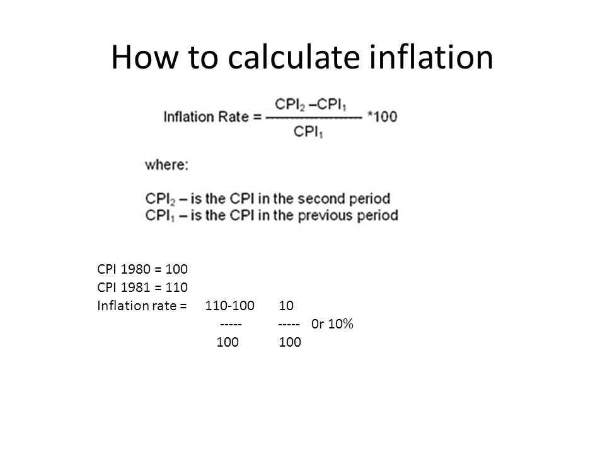
Consumer price index

Slide 9
In Disney land, there are only 3 goods: popcorn, theatre shows, and coke drinks. The following table shows the prices and quantities produced of these goods in 1980, 1990, and 1991
Q1) A "market bundle" for a typical family is deemed to be 5 popcorn, 3 movie shows, and 3 diet drinks. Compute the consumer price index (CPI) for each of the three years, using 1980 as the base year.
 | 1980 |  | 1990 |  | 1991
 | P | Q | P | Q | P | Q
Popcorn | 1.00 | 500 | 1.00 | 600 | 1.05 | 590
Theatre Show | 5.00 | 300 | 10.00 | 200 | 10.50 | 210
Coke Drink | 0.70 | 300 | 0.80 | 400 | 0.75 | 420

Slide 10
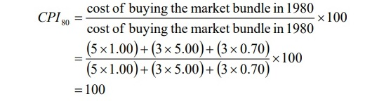

Slide 11
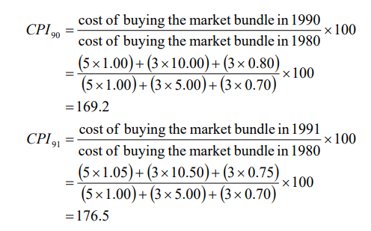

Slide 12
Q2- What was the rate of inflation from 1990 to 1991, using the CPI you calculated in (Q1)?

Slide 13
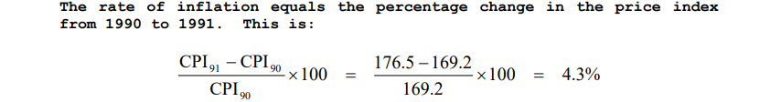

Slide 14
Deflation
When the overall price level decreases so that the inflation rate becomes negative, it is called deflation. It is the opposite of the often-encountered inflation.
General decrease in prices is a good thing because it gives consumers greater purchasing power.
Consumers are able to buy more with every dollar of disposable income.
Maximize consumer utility

Slide 15
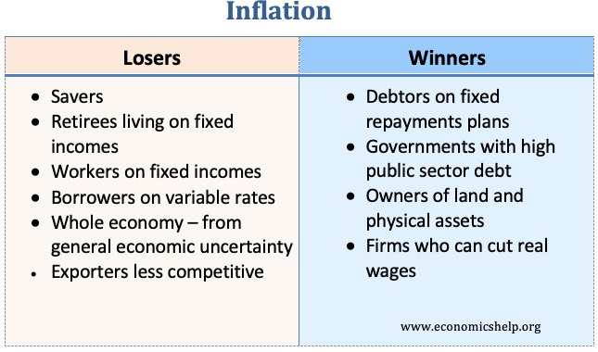
https://www.economicshelp.org/blog/145181/inflation/who-are-the-winners-and-losers-from-inflation/

Slide 16
Causes of inflation
The quantity theory of money inflation
A standard approach to analyse inflation is to use the famous “Quantity Theory of Money” shown below. it is originally formulated by Polish mathematician Nicolaus Copernicus in 1517 and later popularized by economists Milton Friedman and Anna Schwartz.
The quantity theory of money states that money supply and price level in an economy are in direct proportion to one another. When there is a change in the supply of money, there is a proportional change in the price level and vice-versa. It is supported and calculated by using the Fisher Equation on Quantity Theory of Money. M*V= P*Y where, M = Money supply V = Velocity of money P = Price level Y = volume of the transactions (real output/GDP)

Slide 17
P= MV/Y
That means, if prices are changing there are 3 possible causes
Y- Real GDP
V- velocity of money – the average number of times that the dollar is used to purchase final goods and services in a year.
So of V and Y are relatively stable, that implies the only thing that cause an increase is _____
When money chases the same amount of goods and services , prices must _____

Slide 18
Hyperinflation
Hyperinflation is inflation that exceeds 50 percent per month.
The quantity theory can easily lead to a type of runaway inflation called hyperinflation.
Hyperinflation occurs in some countries because the government prints too much money to pay for its spending.
https://www.youtube.com/watch?v=qYHOCbEekR0

Slide 19
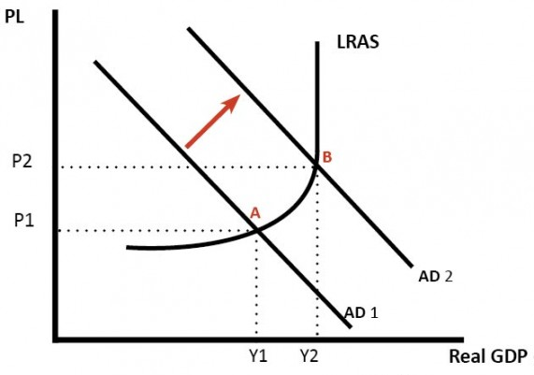
Demand pull inflation

Slide 20
Demand pull inflation is defined as a situation where the total monetary demand persistently exceeds the total supply of goods and services so that prices are pulled upwards by the continuous upward shift of the AD function.
It arises as a result of an excessive aggregate effective demand over an aggregate supply of goods and services in a slowly growing economy.
It occurs when the aggregate demand for a good or service outstrips aggregate supply, and it starts with an increase in consumer demand. Sellers try to meet the higher demand with more supply. If they can't, then they raise their prices.
Supply of goods and services will not match with rising demand.
When AD shifts to the right there is greater pressure on existing factors of production to produce more output.
Prices go up – wages, price of capital, price of land goes up and that will increase the cost of production.
Thus, firms will then pass on that higher cost via higher prices of goods and services.

Slide 21
Causes Of Demand-Pull Inflation: Demand-pull inflation is typically caused by consumer demand out-pacing total available supply. The demand of consumers may be caused by a number of things, including:
1. Rising Inflation Rate
When the inflation rate rises then demand for goods and services usually rises as well because people want to protect their money by buying goods while they are still affordable. For example, the costs of homes are driven greatly by demand in any given market. When demand increases faster than houses are being built, home prices grow.
2. Overall Economic Growth
When the economy is doing well, demand for goods and services usually goes up because people have more money to spend. This is a result of more people being employed or a competitive job market that has driven salaries up for many. Consumers also tend to spend more money when they aren't worried about the status of their job. A growing economy gives consumers peace of mind.
3. Technological Innovations
When new technologies are introduced, demand for the products and services that support them often goes up. For example, when a new iPhone is released there becomes an immediate demand for a case that will protect that phone. When iPhones were fairly new, the number of suppliers making these cases was few, which meant the demand often outweighed the supply and people paid more than they might be willing to pay today.
While these are the main three causes of demand-pull inflation, they can also be triggered by things like government spending, an increase in printing money, or asset inflation when a currency is undervalued.

Slide 22
Cost-push inflation
It refers to a situation where prices rise on account of the increasing cost of production.
Example
Demand for higher wages by the labour class.
Fixing up of higher profit margins by the manufacturers
Introduction of new taxes and raising the level of old taxes.
Increase in the prices of different inputs in the market.

Slide 23
