Slide 1


Departamento de Física
PET - Física UFRN
Universidade Federal do
Rio Grande do Norte
Introduction to
Data Science
General Overview
Fundamental Concepts
Gabriel Wendell Celestino Rocha*
*gabrielwendell@fisica.ufrn.br

Slide 2
What is Data Science?
Data Science is a field that attempts to find patterns and draw insights from data
1.

Slide 3
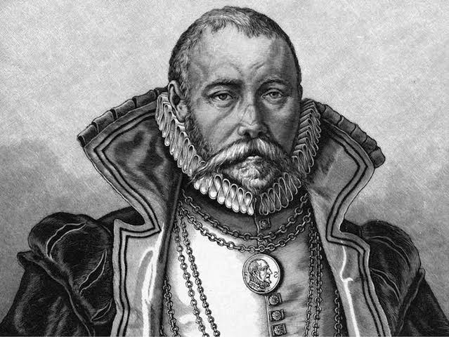
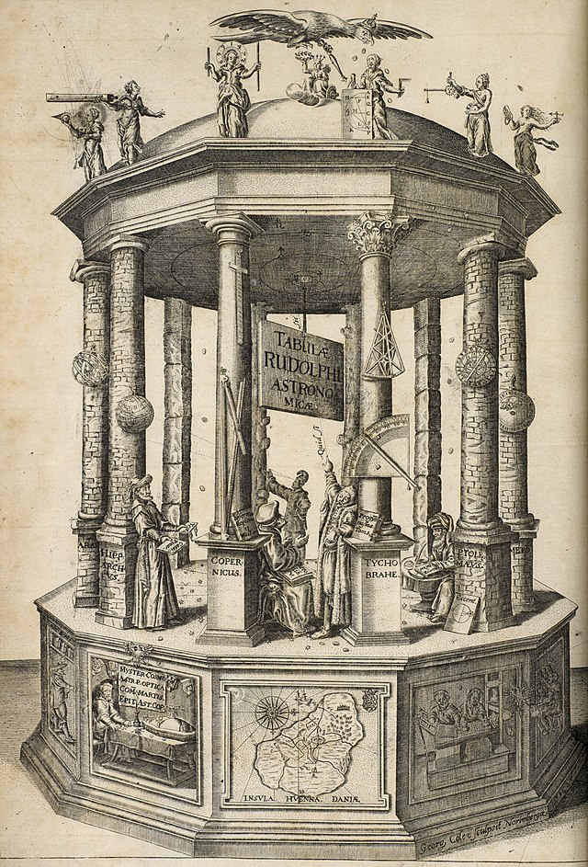

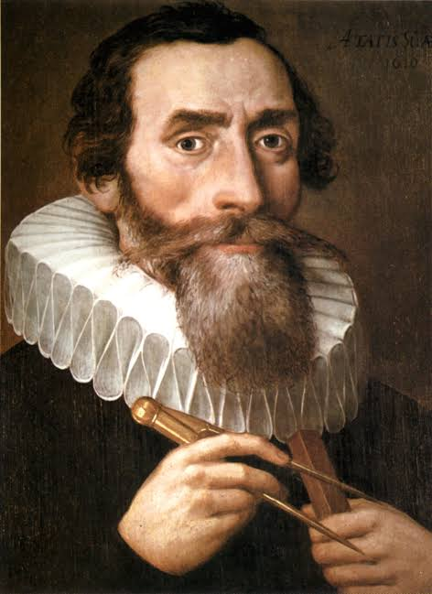
Historical Context
The Rudolphine Tables
A star catalogue and planetary tables published by Johannes Kepler in 1627, using observational data collected by Tycho Brahe.
Tycho Brahe (1546 – 1601)
Johannes Kepler (1571 – 1630)
2.

Slide 4
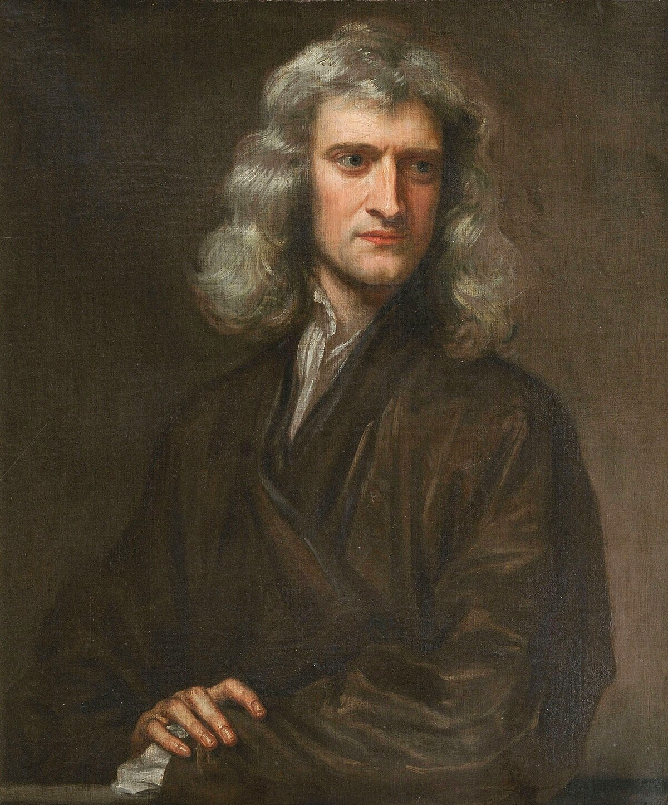
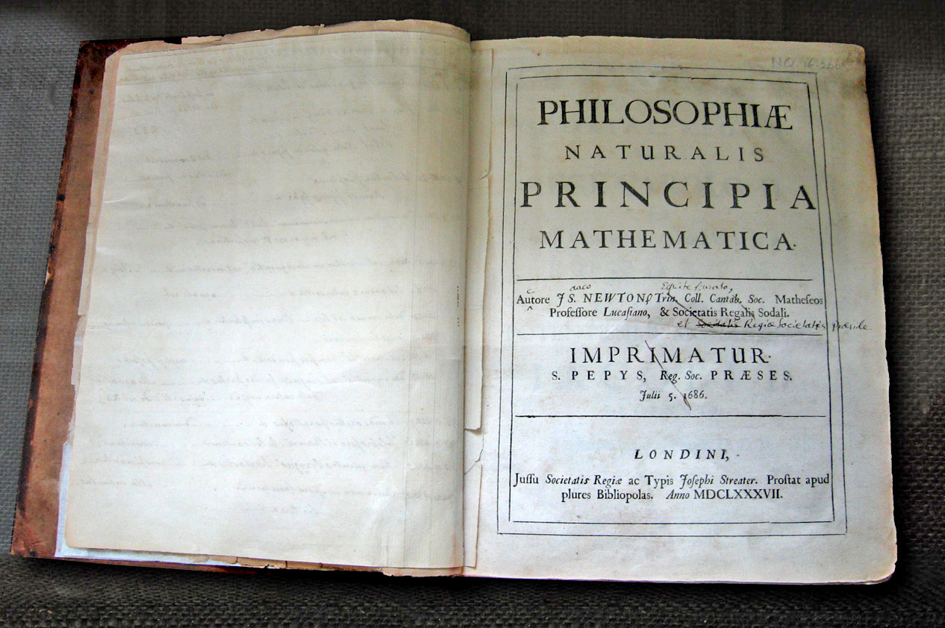
Historical Context
The Philosophiae Naturalis Principia Mathematica
A three-volume work considered one of the most important fundamental works carried out in mechanics in the 17th century.
Sir Isaac Newton (1642 – 1727)
3.

Slide 5
What is Data Science?
Identify the
correct data
Identify the
correct data
Questions
Team of experts
Reproductibility
Answered by data
Generate
new questions
DATA
1. Collecting
2. Curating
3. Cleaning
1. Visualize (Communication)
2. Analyze (Data Enginnering)
3. Model (Machine Learning)
4.

Slide 6
Answering Questions with Data
Questions
DATA
Does the past represent the future?
What do I want to model?
How will the model be used?
What data do I need?
Do I have the data that I need?
How hard is to get the data?
.
.
.
BIG DATA
Smart Data
5.

Slide 7
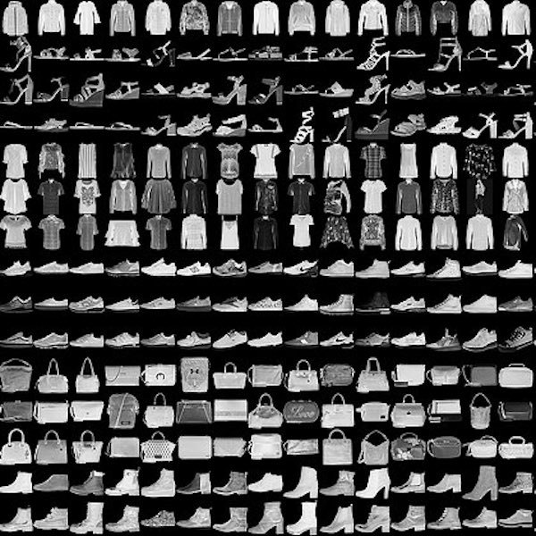
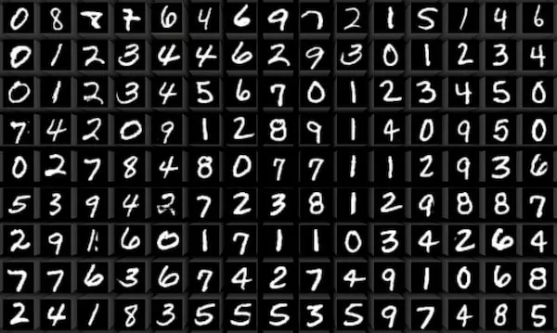
The Nature of Data
Types of Data
Numerical : 0.972, 1.781, -3.931, ...
Categorical : A, B, C, ...
Boolean : True or False
Ordinal : 1, 2, 3, ...
Real-world datasets are a mixture of all!
6.

Slide 8
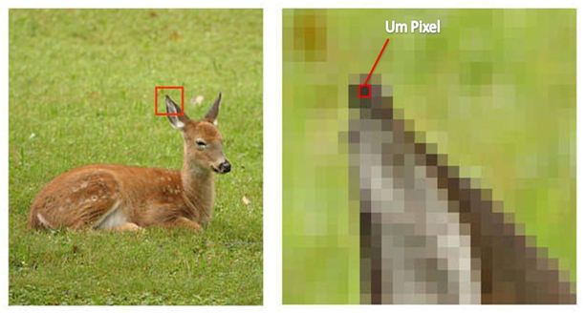
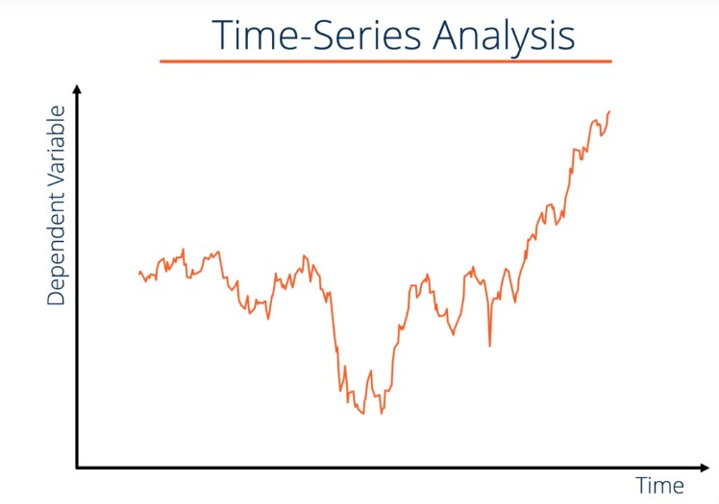
The Nature of Data
Dimensionality
High Dimensional : Megapixels, ...
Low Dimensional : Time-Series, ...
7.

Slide 9
The Nature of Data
Labelled or not?
True
False
Supervised
Learning
Unsupervised
Learning
8.

Slide 10
The Nature of Data
Many examples X Fewer examples
Neural Networks
Machine Learning
Is there Physics involved?
PINNs Models
9.

Slide 11
Summary
Nature of Data
Type?
Dimensionality?
Labelled?
Examples?
Temporal?
Physics?
BIG DATA
Smart Data
Repeat the cycle
Questions
Inputs
Outputs
DATA
10.

