Slide 1
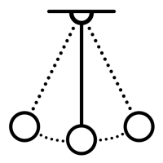

PET Física UFRN, Physics Departament, Universidade Federal do Rio Grande do Norte
Mathematical Foundations
of Machine Learning
Gabriel Wendell Celestino Rocha*
16, July, 2025
*gabrielwendell@fisica.ufrn.br

Slide 2
Motivation
What this course IS
✅ Formal definitions, theorems and mathematical structures ;
✅ Linear Algebra, Probability, Optimization, Statistics and Information Theory ;
✅ Statistical Learning Theory and Generalization Limits ;
✅ Mathematical analysis of ML models from first principles .
What this course is NOT
❌ A programming bootcamp (without a focus on implementation) ;
❌ A course on practical usage of ML libraries (e.g. Scikit-Learn, TensorFlow) ;
❌ A Guide to MLOps or Production Deployment .
2.

Slide 3
Motivation
Why Study Mathematical Foundations of Machine Learning?
Understand why algorithms work — not just how to use them.
Be able to design and improve models analytically.
Connecting ML with Physics, Engineering and Theoretical and/or Experimental Science.
Avoid black-box thinking and introduce rigorous reasoning in ML/DL.
Goal
Develop a deep mathematical understanding of why machine learning works — and when it doesn’t.
2.

Slide 4
Methodology
Part I
(16/06 - Seminar) Introduction to Data Science & Machine Learning ;
(18/06 - Lecture) Foundations on Linear Algebra & Matrix Analysis ;
(25/06 - Lecture) Foundations on Probability & Statistics ;
(30/06 - Lecture) Foundations on Multivariate Calculus & Topology ;
(02/07 - Lecture) Foundations on Information Theory .
Part II
(07/07 - Lecture) Statistical Lea rning Theory ;
(09/07 - Lecture) Linear Regression for Regression and Classification Problems ;
(14/07 - Lecture) Bias & Variance ;
(16/07 - Lecture) Neural Networks ;
(21/07 - Lecture/Seminar) Unsupervised Learning & Manifold Hypothesis ;
(23/07 - Seminar) Advanced Topics & Wrap-Up .
3.

Slide 5

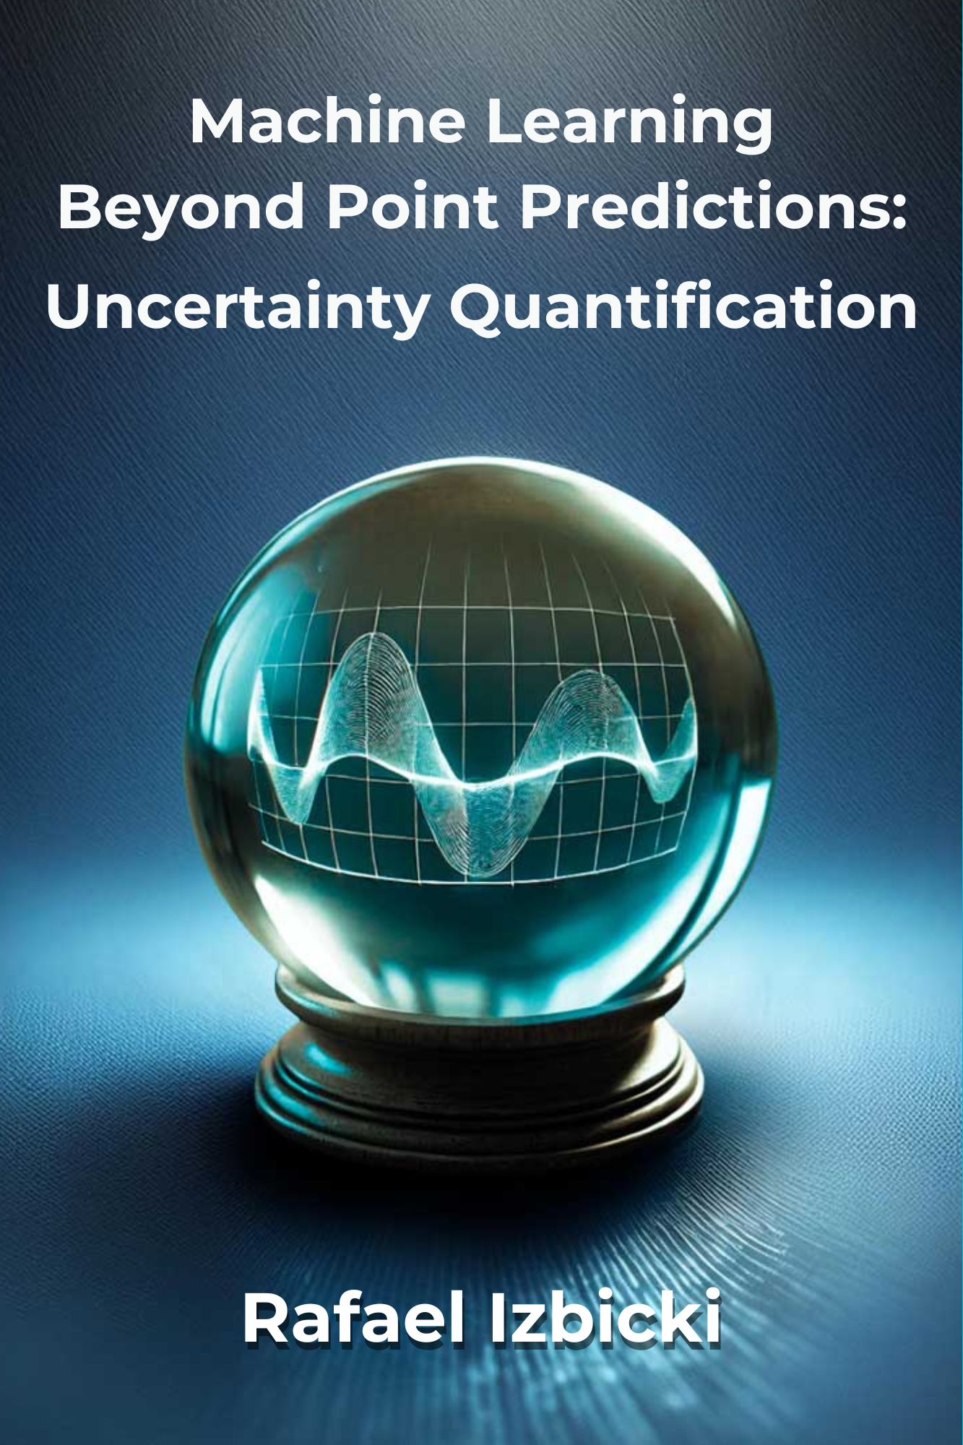
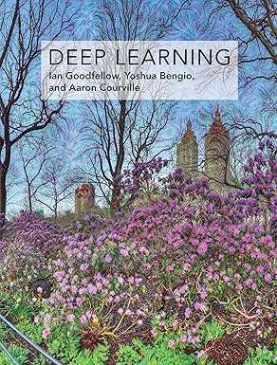
Some References
Deep Learning
Ian Goodfellow & Yoshua Bengio
Aprendizado de Máquina : Uma Abordagem Estatística
Machine Learning Beyond Point Predictions
Rafael Izbicki
4.

Slide 6
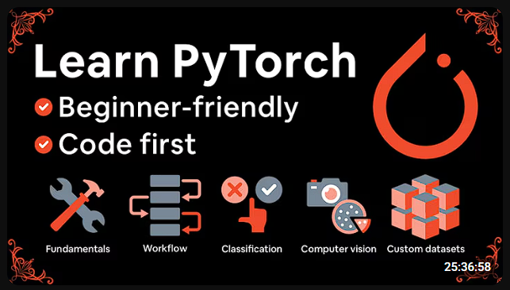
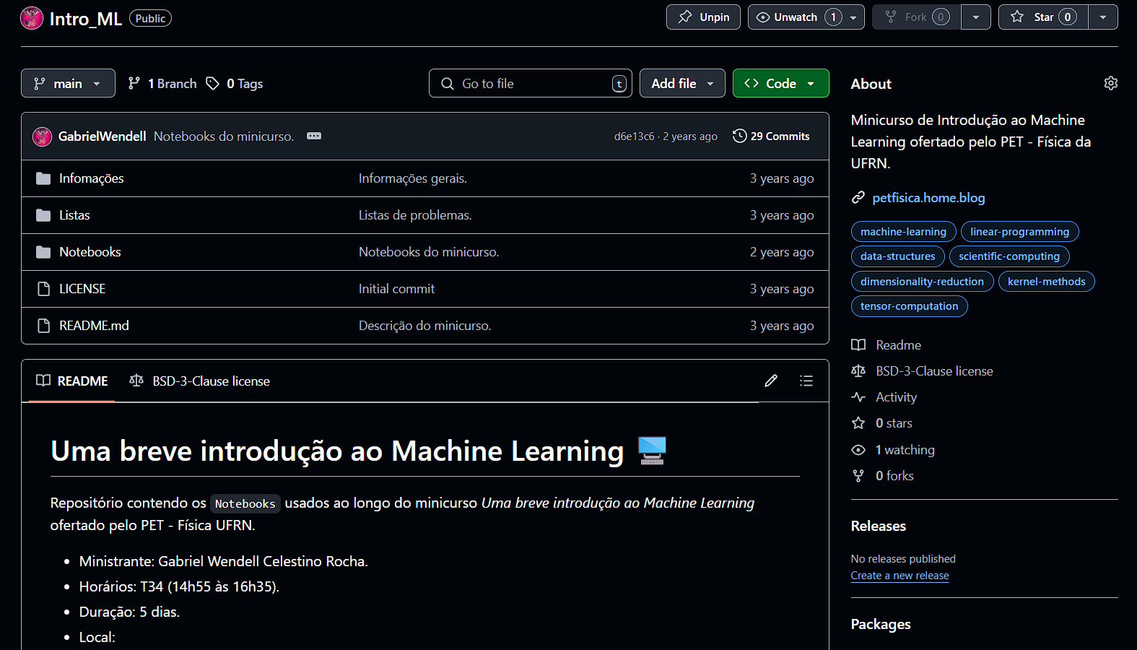
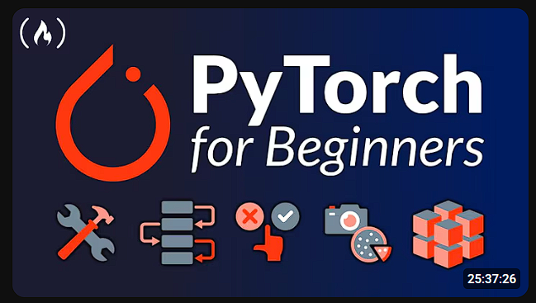
Some (Computational) References
Uma breve introdução ao Machine Learning
Gabriel Wendell (PET - Física)
24-hour PyTorch for Deep Learning Courses
Daniel Bourke
Free Code Camp
"It doesn't take long... if you go straight into Turbo mode on here"
5.

Slide 7
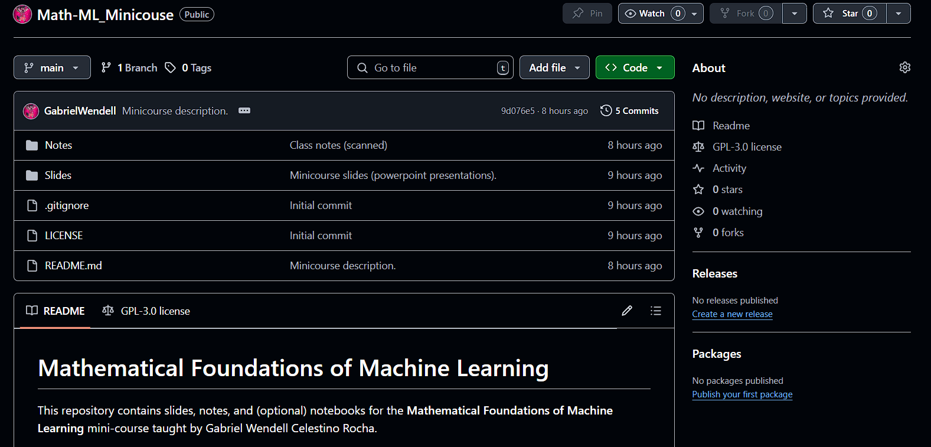

Material Available on GitHub
6.

