Slide 1

SPC: Subspace Predictive Control
Presentation for the course Adaptive Learning, Estimation and Supervision of dynamical systems (ALES)
Computer science engineering
Students
Mazzoleni Gabriele - 1079514
Comandatore Gaetano- 1090952
A.Y. 2025/2026

Slide 2
Selected paper
The following presentation as an analysis and implementation of the contents of “SPC: Subspace Prediction Control”, by Wouter Favoreel, Bart De Moor and Michel Gevers
This paper aims to “combine Subspace Identification and Model Predictive Control methods in a very elegant way to form a numerically robust and easily implementable control/identification algorithm”.

Slide 3
The References
MPC
SUBSPACE STATE IDENTIFICATION
Richalet, J., A. R,ault, J.L·. Testud and J. Papon. Model predictive heuristic control: Applications to industrial processes.
Cutler, C.R. and B.L. Ramaker.
Dynamic matrix control - a computer control algorithm.
1978
1979
Moonen, M., B. De Moor, L. Vandenberghe and J. Vandewalle.
On and off-line identification of linear state space models
1989
Verhaegen, M. and P. Dewilde. Subspace identification, part I: The output-error state space model identification class of algorithms.
1992
Van Overschee P. and B. De Moor. Subspace identification for linear systems: theory, implementation, applications.
Garcia, C.E., D.M. Prett and M. Morari.
Model predictive control: Theory and practice - a survey.
1996
Viberg, M., B. Wahlberg and B. Ottersten .Analysis of state space system identification methods based on instrumental variables and subspace fitting
1997
De Moor, B., P. Van Overschee and W. Favoreel. Numerical algorithms for subspace state space system identification – An overview.
1998
Favoreel, W., B. De Moor and P. Van Overschee .
Subspace state system identification for industrial processes.
1999

Slide 4
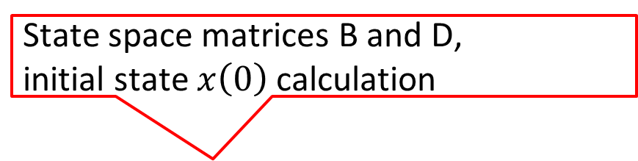
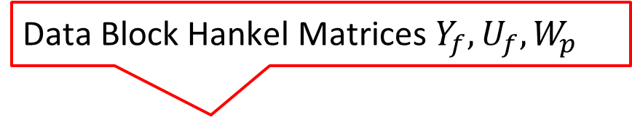
The Idea: from two separated frameworks…
SSI
MPC
Data Block Hankel Matrices $Y_{f}, U_{f}, W_{p}$
QR and SV decomposition
LS problem and Model calculation
State space matrices A and C calculation
Predictor from the model and online preferred input calculation
State space matrices B and D,
initial state $x\left(0\right)$ calculation
Online system control

Slide 5

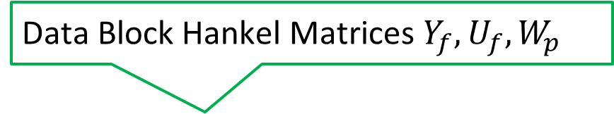
The Idea: … to a unified framework
SSI + MPC = SPC
Data Block Hankel Matrices $Y_{f}, U_{f}, W_{p}$
QR and SV decomposition
Matrices $L_{w}, L_{u}$
Predictor from the model and online preferred input calculation
Online system control

Slide 6
Problem setting – context of application
Subspace System Identification and Model Predictive Control are two widely studied and applied methods to solve two problems that are usually considered separate: these problems being system identification and system control.
The SPC method aims to replace the system identification step and the calculation of the controller parameters with a QR decomposition followed by an SVD decomposition of a matrix that is constructed using known inputs and outputs only, combining the two solution to two problems into an elegant solution for one big problem.

Slide 7
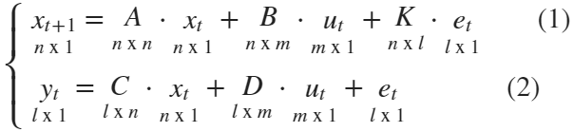




Proposed solution –
System setting
The paper considers a LTI system of the form:
Where:
are the system inputs is the noise sequence
are the system outputs
are the system states only yt and ut are known

Slide 8
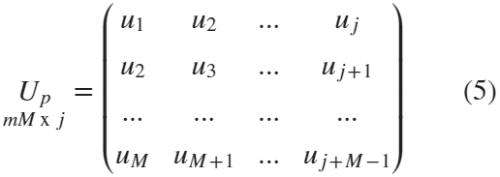
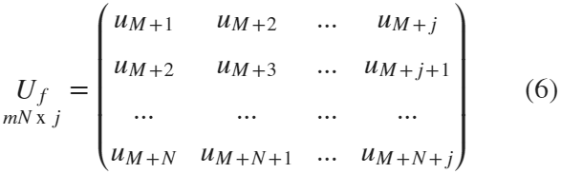

Proposed solution –
Block Hankel matrices definition
The SPC algorithm starts by defining the block Hankel matrices for inputs, outputs and noise, assuming k= N+M+j total samples for all three signals:
We define the matrices in the same way.
p represents “past” matrices, with M being the number of “past” data points
f represents “future” matrices, with N being the number of “future” data points

Slide 9

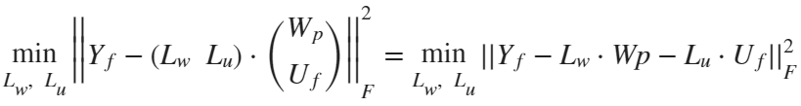
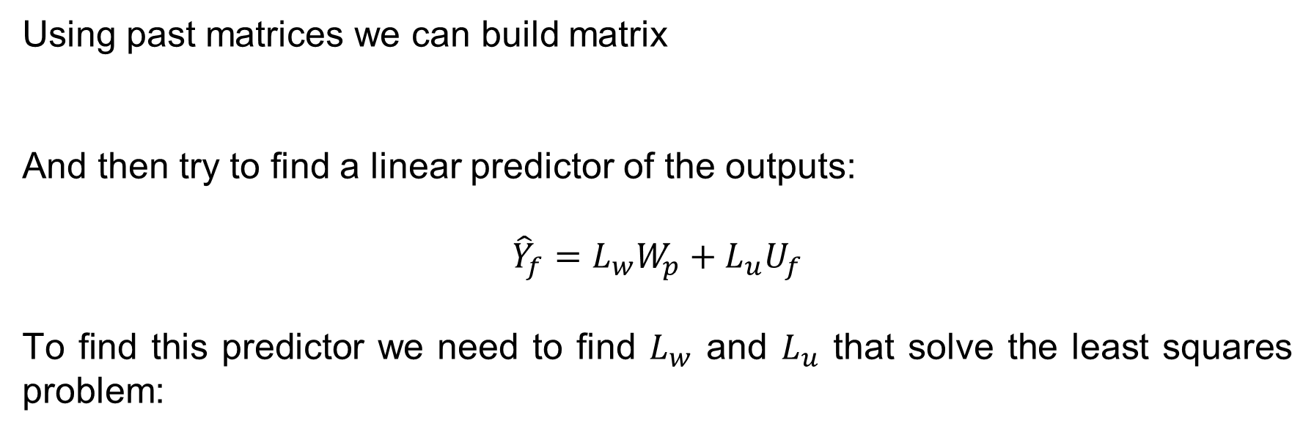
Proposed solution –
Defining the predictor and LS problem
Using past matrices we can build matrix
And then try to find a linear predictor of the outputs:
$${\hat{Y}}_{f}=L_{w}W_{p}+L_{u}U_{f}$$
To find this predictor we need to find $L_{w}$ and $L_{u}$ that solve the least squares problem:

Slide 10
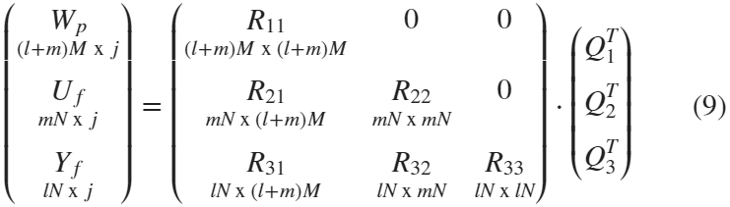



Proposed solution – Subspace Step 1
We can solve the Least Squares problem using QR decomposition like so
And then computing the matrix
and thus:

Slide 11
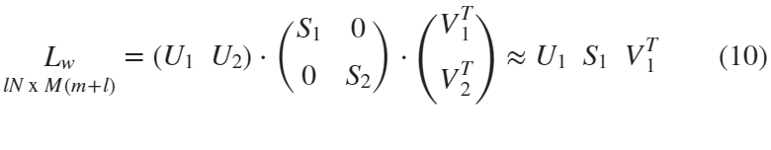




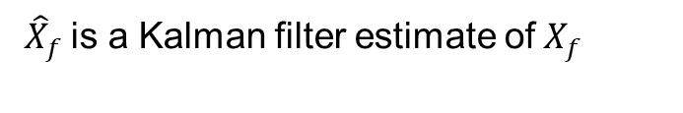
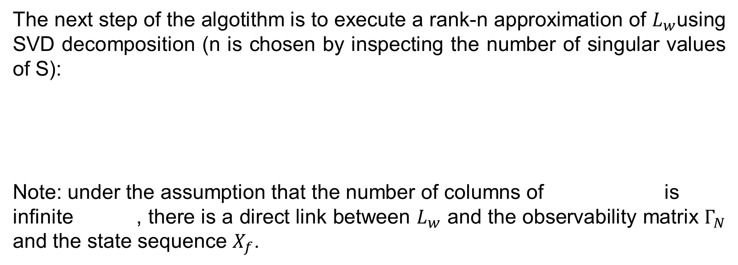
Proposed solution – Subspace Step 2
The next step of the algotithm is to execute a rank-n approximation of $L_{w}$using SVD decomposition (n is chosen by inspecting the number of singular values of S):
Note: under the assumption that the number of columns of is infinite , there is a direct link between $L_{w}$ and the observability matrix $Γ_{N}$ and the state sequence $X_{f}$.
${\hat{X}}_{f}$is a Kalman filter estimate of$X_{f}$

Slide 12
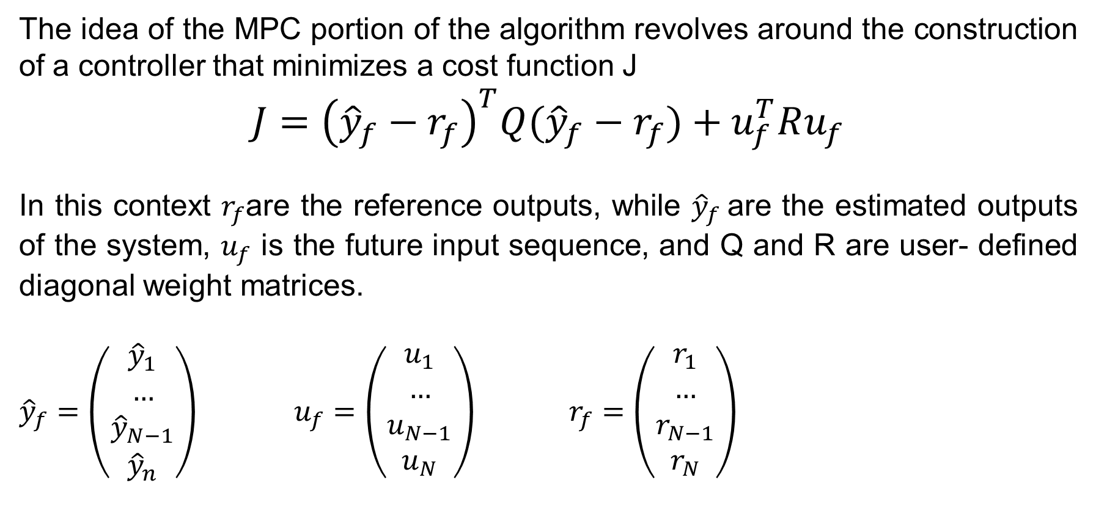
Proposed solution – MPC problem
The idea of the MPC portion of the algorithm revolves around the construction of a controller that minimizes a cost function J
$$J={\left({\hat{y}}_{f}−r_{f}\right)}^{T}Q({\hat{y}}_{f}−r_{f})+u_{f}^{T}Ru_{f}$$
In this context $r_{f}$are the reference outputs, while ${\hat{y}}_{f}$are the estimated outputs of the system, $u_{f}$ is the future input sequence, and Q and R are user- defined diagonal weight matrices.
${\hat{y}}_{f}=\left(\begin{aligned}{\hat{y}}_{1} \\ … \\ {\hat{y}}_{N−1} \\ {\hat{y}}_{n}\end{aligned}\right)$ $u_{f}=\left(\begin{aligned}u_{1} \\ … \\ u_{N−1} \\ u_{N}\end{aligned}\right)$ $r_{f}=\left(\begin{aligned}r_{1} \\ … \\ r_{N−1} \\ r_{N}\end{aligned}\right)$

Slide 13
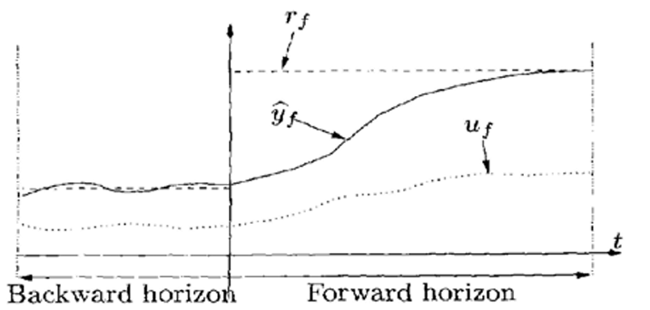
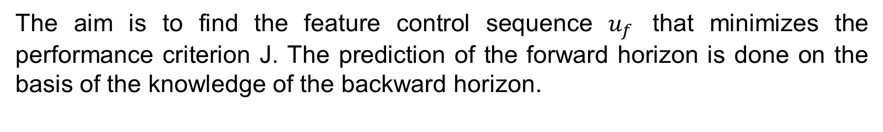
Proposed solution – Principle of MPC
The aim is to find the feature control sequence $u_{f}$ that minimizes the performance criterion J. The prediction of the forward horizon is done on the basis of the knowledge of the backward horizon.

Slide 14
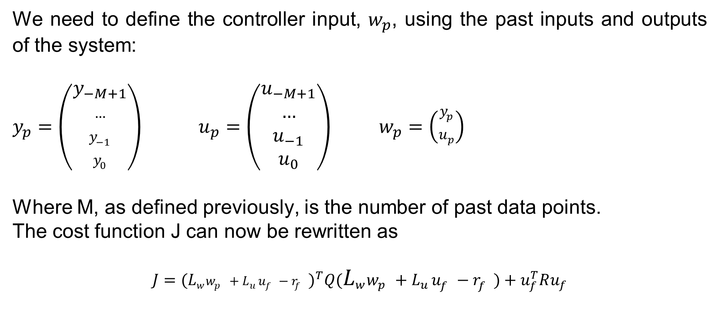
Proposed solution – Control step 1
We need to define the controller input, $w_{p}$, using the past inputs and outputs of the system:
$y_{p}=\left(\begin{aligned}y_{−M+1} \\ … \\ y_{−1} \\ y_{0}\end{aligned}\right)$ $u_{p}=\left(\begin{aligned}u_{−M+1} \\ … \\ u_{−1} \\ u_{0}\end{aligned}\right)$ $w_{p}=\left(\begin{aligned}y_{p} \\ u_{p}\end{aligned}\right)$
Where M, as defined previously, is the number of past data points.
The cost function J can now be rewritten as
$$J={(L_{w}^{}w_{p}^{}+L_{u}^{}u_{f}^{}−r_{f}^{})}^{T}Q(L_{w}^{}w_{p}^{}+L_{u}^{}u_{f}^{}−r_{f}^{})+u_{f}^{T}Ru_{f}$$

Slide 15
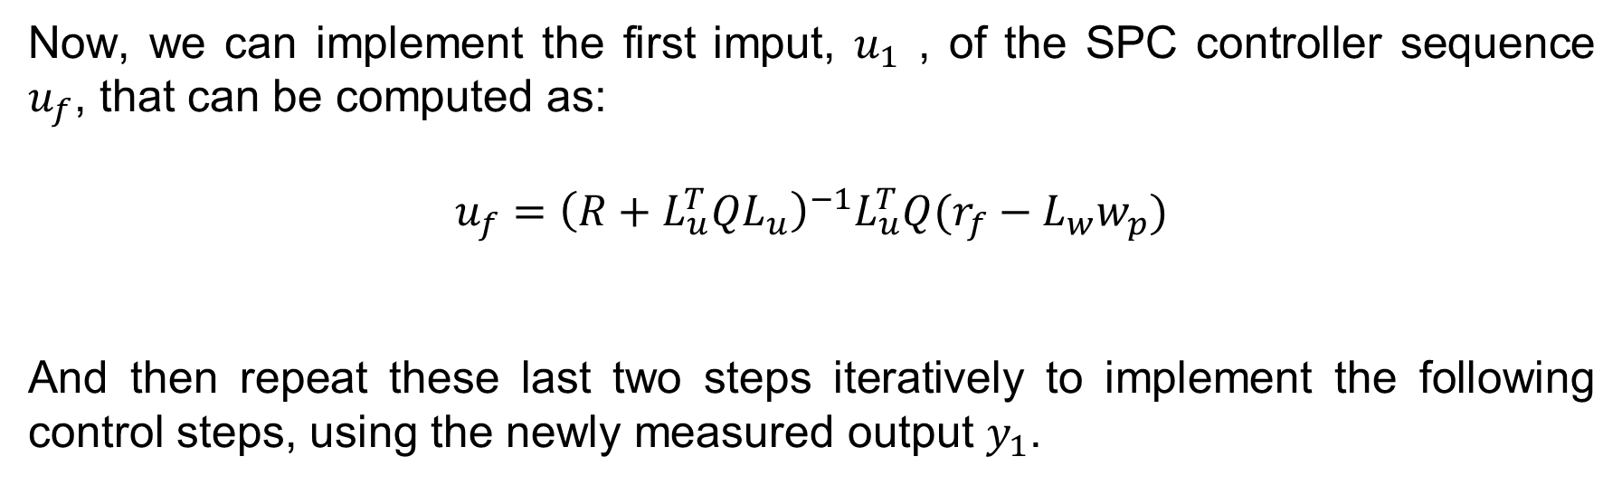
Proposed solution – Control step 2
Now, we can implement the first imput, $u_{1}$ , of the SPC controller sequence $u_{f}$, that can be computed as:
$$u_{f}={\left(R+L_{u}^{T}QL_{u}\right)}^{−1}L_{u}^{T}Q(r_{f}−L_{w}w_{p})$$
And then repeat these last two steps iteratively to implement the following control steps, using the newly measured output $y_{1}$.

Slide 16
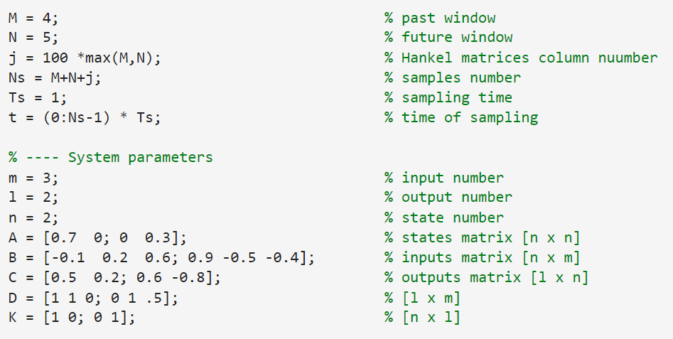
Practical implementation –
System setting
The implementation of the algorithm began by defining the LTI MIMO system to be utilized; we decided to use the following parameters and matrices:
The input signals chosen were two PRBS, to ensure persistent excitation

Slide 17
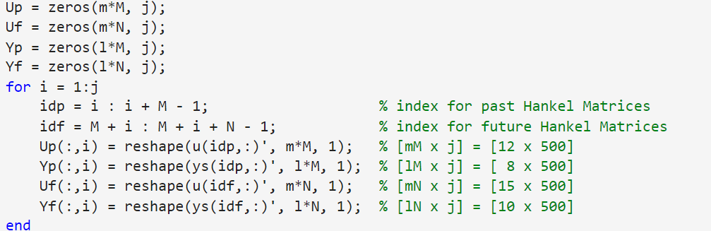
Practical implementation –
Hankel Block matrices
Afterwards, we constructed the past and future Hankel block matrices for input and output signals, as explained in the algorithm.

Slide 18
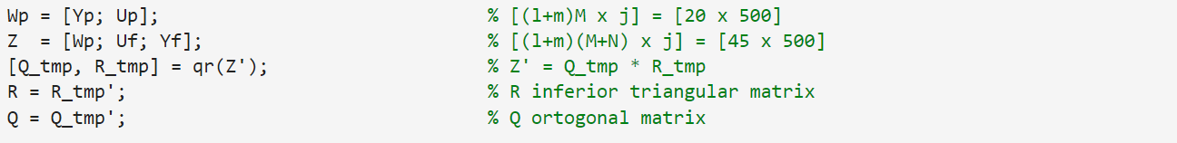
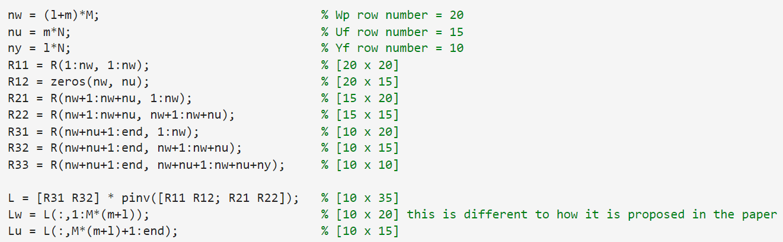
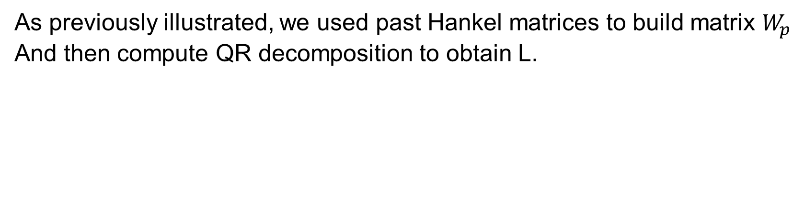
Practical implementation –
SSI step 1
As previously illustrated, we used past Hankel matrices to build matrix $W_{p}$
And then compute QR decomposition to obtain L.

Slide 19
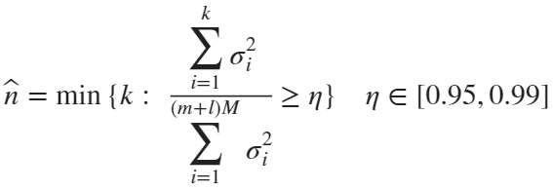
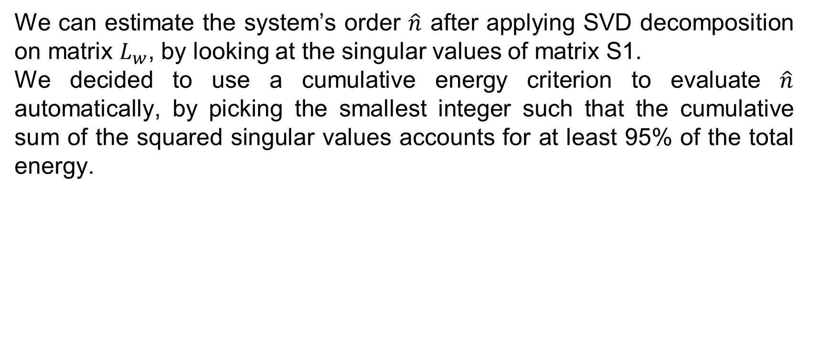
Practical implementation –
Estimation of system order
We can estimate the system’s order $\hat{n}$ after applying SVD decomposition on matrix $L_{w}$, by looking at the singular values of matrix S1.
We decided to use a cumulative energy criterion to evaluate $\hat{n}$ automatically, by picking the smallest integer such that the cumulative sum of the squared singular values accounts for at least 95% of the total energy.

Slide 20

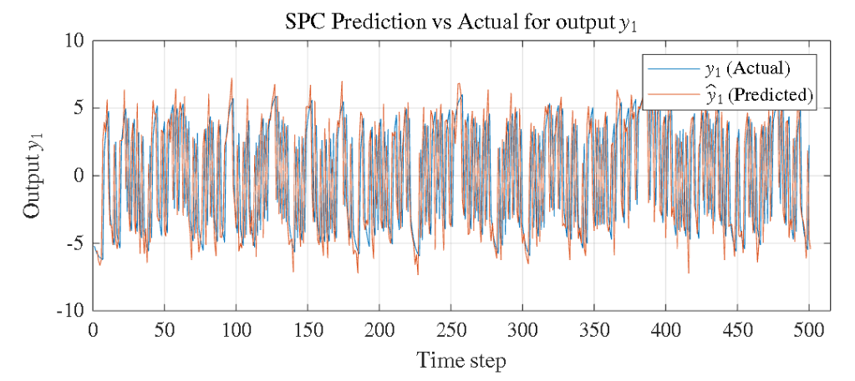
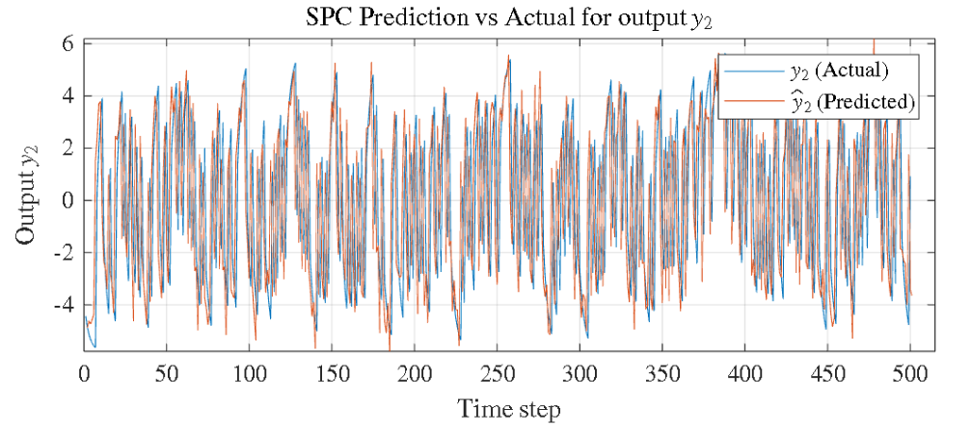
Practical implementation –
Plotting the prediction performance
The predicted output can be calculated as:
We compared it to the output generated by the actual system.

Slide 21
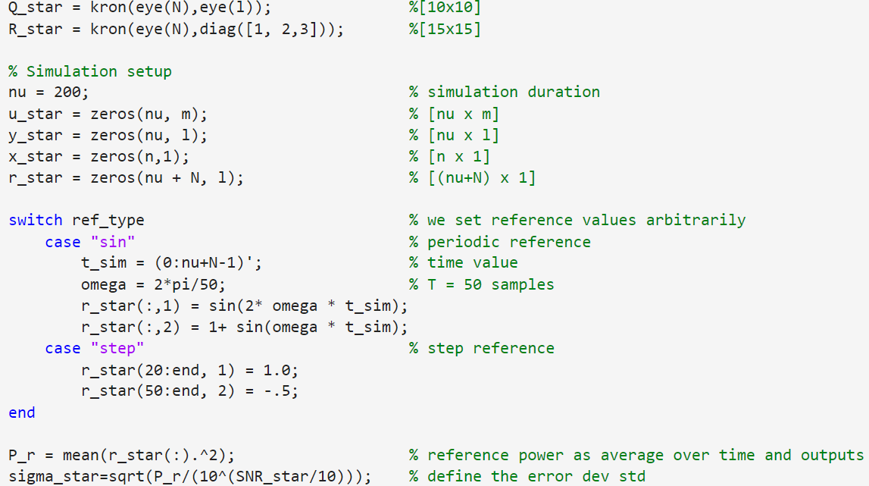
Practical implementation –
MPC implementation
The second half of the algorithm, the one executing control on the system, had to be done on a running simulation instead of “offline” like with SSI.

Slide 22
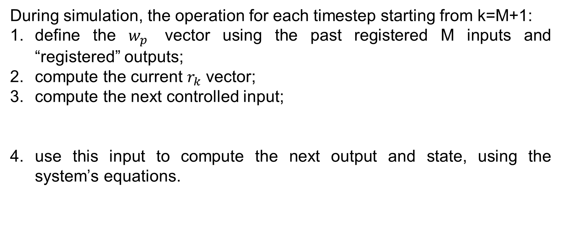
Practical implementation –
Recursive step
During simulation, the operation for each timestep starting from k=M+1:
define the $w_{p}$ vector using the past registered M inputs and “registered” outputs;
compute the current $r_{k}$ vector;
compute the next controlled input;
use this input to compute the next output and state, using the system’s equations.

Slide 23
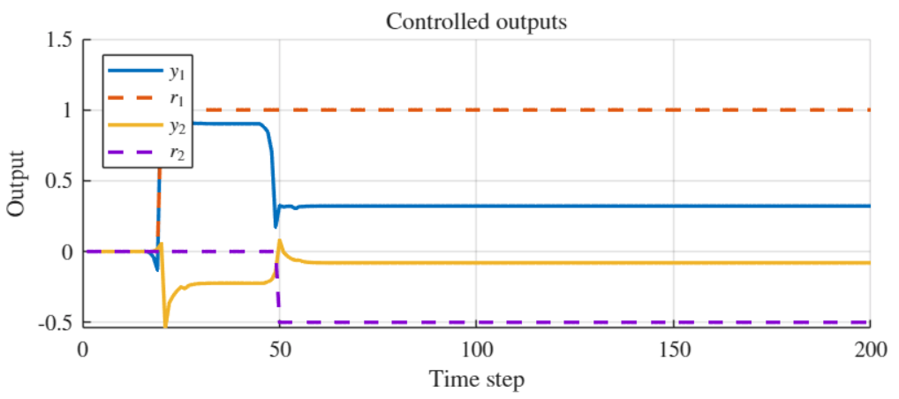
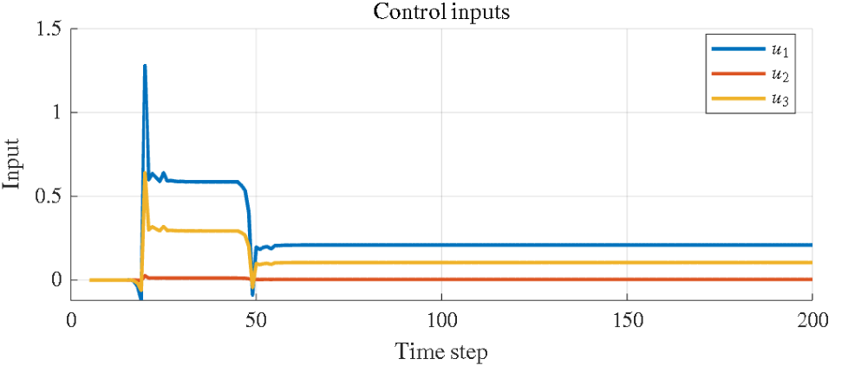
Practical implementation – basic SPC control results
Using a step reference signal:
We can see that the tracking is not very accurate…

Slide 24
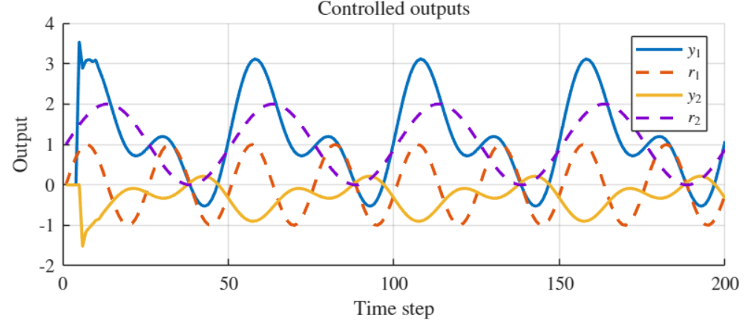
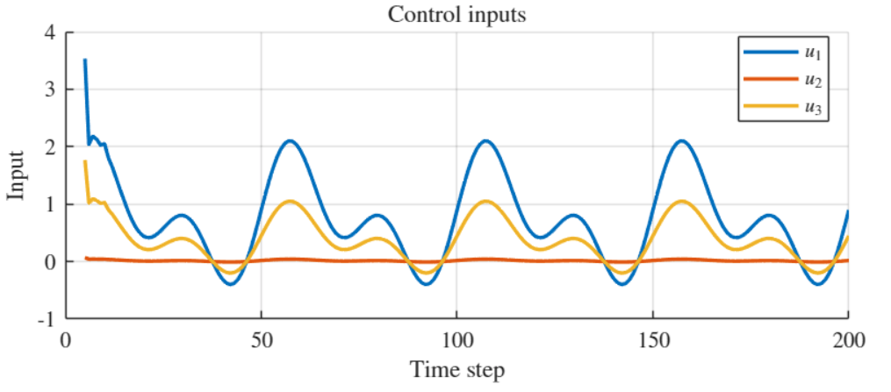
Practical implementation – basic SPC control results
Using a sine reference signal:
We can see that the tracking is not very accurate…

Slide 25
Practical implementation – improving on the proposed solution
Appartently, the SPC algorithm as presented in the paper does not result in a precise tracking of the selected reference signal.
We set out to solve this issue and found a more recent paper, “Offset-Free MPC explained: novelties,subtleties,and applications” by Pannocchia,Gabiccini and Artoni (2015); this paper proposes an approach for MPC that removes offset.
It does so by introducing a feedforward term, allowing exact reference tracking without altering the underlying predictive structure.

Slide 26


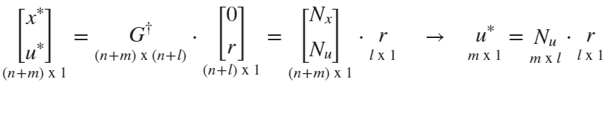

Practical implementation – implementation of offset- free MPC
We can rewrite the steady-state equations (where x(t+1)=x(t)) as:
Where
$N_{u}$ and $N_{r}$ are steady-state mappings.

Slide 27
Practical implementation – implementation of offset- free MPC
In addition to the steady-state feedforward correction, our implementation also includes an optional integral correction of the tracking error.
This mechanism accumulates the output–reference mismatch over time and injects the resulting integral term into the predictive error vector.
The integral correction can be enabled or disabled without modifying the core SPC structure, allowing a direct comparison between purely predictive and enhanced tracking configurations.

Slide 28
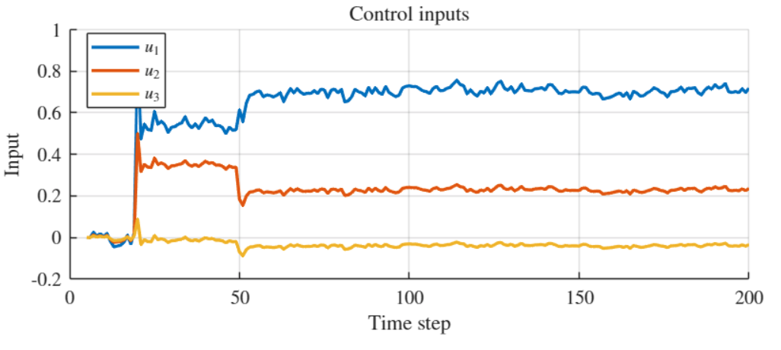
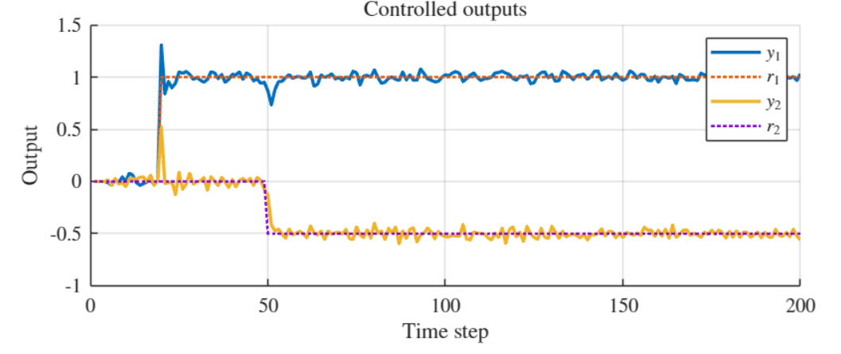
Practical implementation – improved SPC control results
Using a step reference signal:
The tracking is almost perfect, only disturbed by stochastic noise.

Slide 29
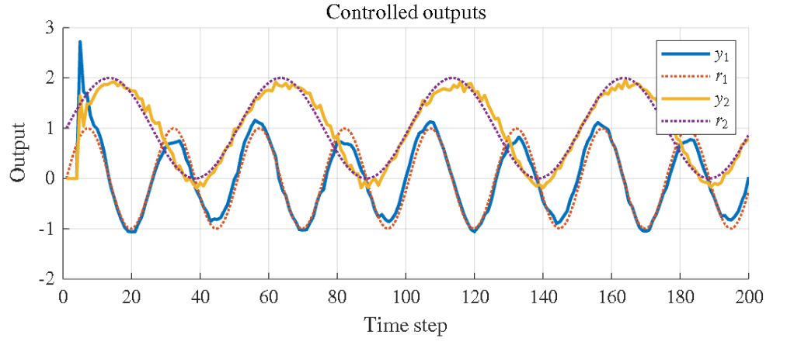
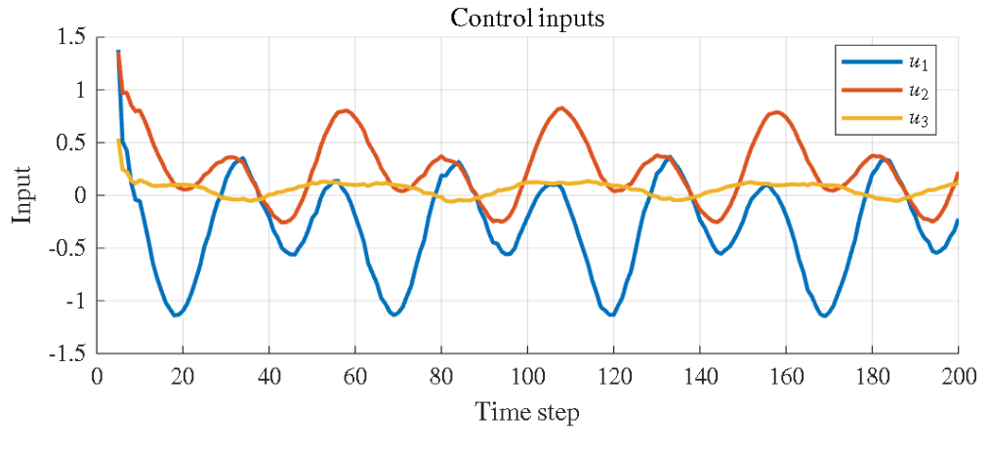
Practical implementation – improved SPC control results
Using a sine reference signal:
The tracking is almost perfect, only disturbed by stochastic noise.

Slide 30
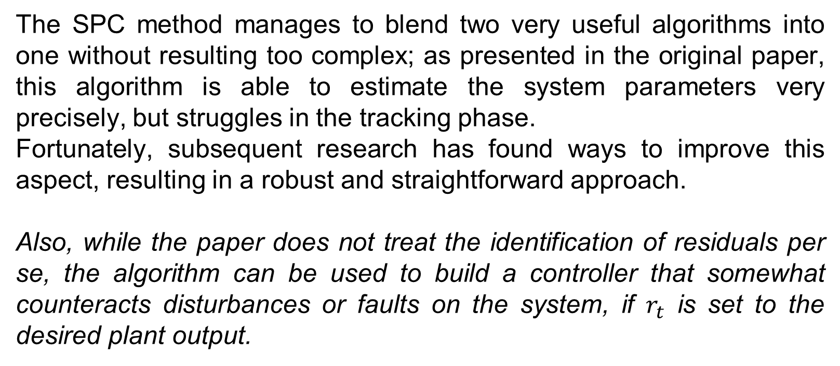
Final considerations
The SPC method manages to blend two very useful algorithms into one without resulting too complex; as presented in the original paper, this algorithm is able to estimate the system parameters very precisely, but struggles in the tracking phase.
Fortunately, subsequent research has found ways to improve this aspect, resulting in a robust and straightforward approach.
Also, while the paper does not treat the identification of residuals per se, the algorithm can be used to build a controller that somewhat counteracts disturbances or faults on the system, if $r_{t}$ is set to the desired plant output.

