Slide 1
Laboratorio IoT
Prof. Paolo Napoletano
a.a. 2020/2021
Home Monitoring
Team
Gabriele Ferrario 817518

Slide 2
Materials
Description of the ingredients employed
1x NodeMCU 1.0 (ESP8266)
1x 16x2 characters LCD display + PCF8574 I2C converter
1x DHT11 temperature and humidity sensor
1x Photoresistor
1x SW-520D roll ball tilt sensor
2x LED
2x 10kΩ resistor
2x 200Ω resistor

Slide 3



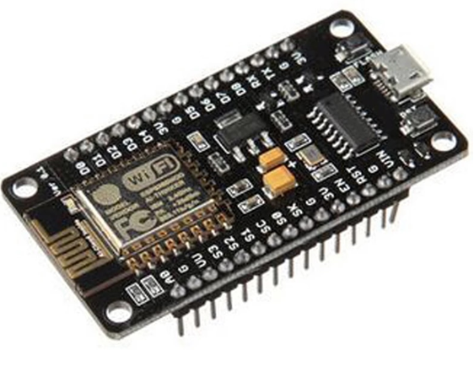
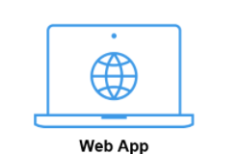
Method – Workflow
Description system: choices, parameters, use cases
Home monitoring
system

Slide 4



Method – Event detection
Description system: choices, parameters, use cases
High/Low Temperature
High/Low Light
Tilt
Low WiFi strength
Alerting events are collected and reported by:
Led
Alert icon in the web page
InfluxDB dashboard

Slide 5
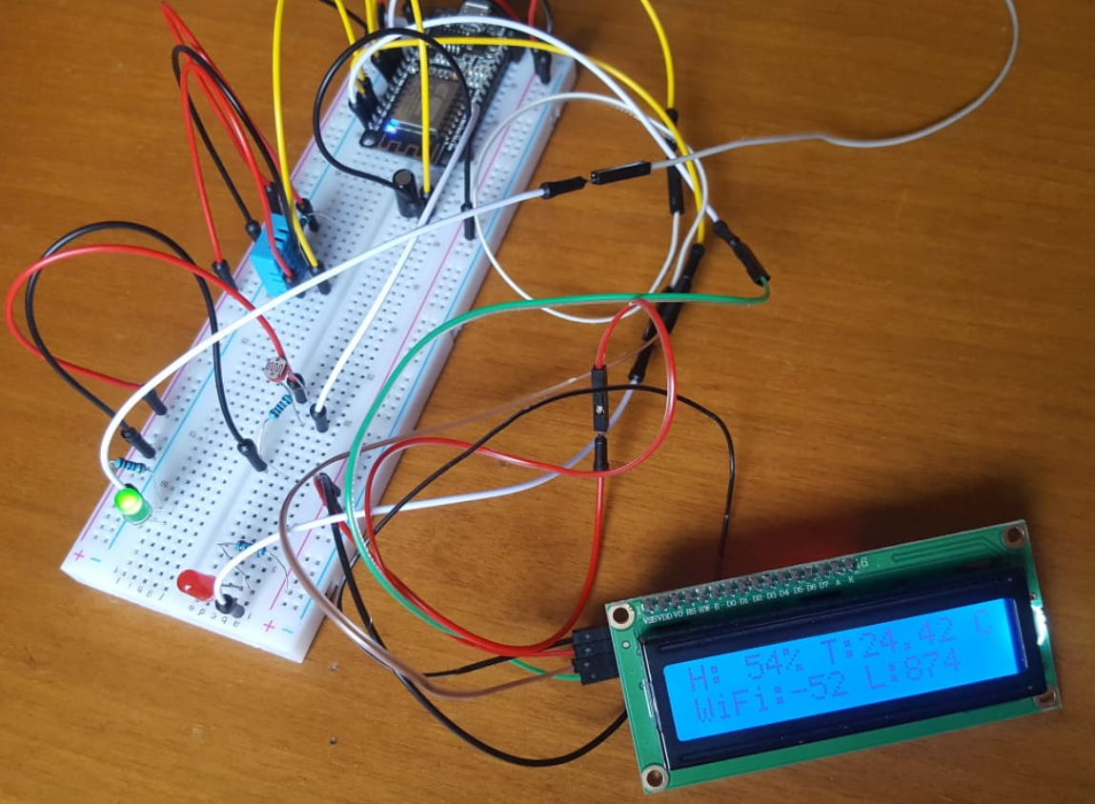
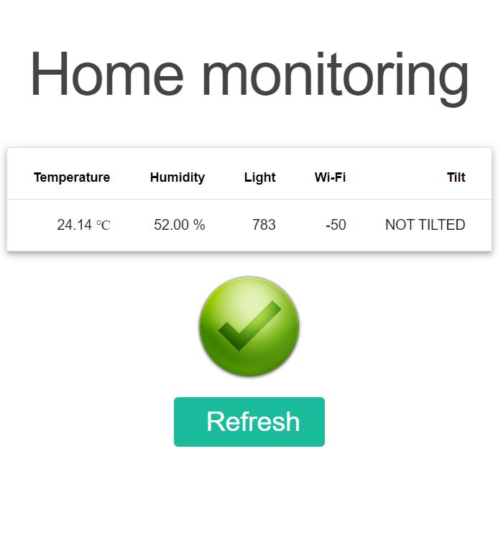
Method – System
Description system: choices, parameters, use cases

Slide 6
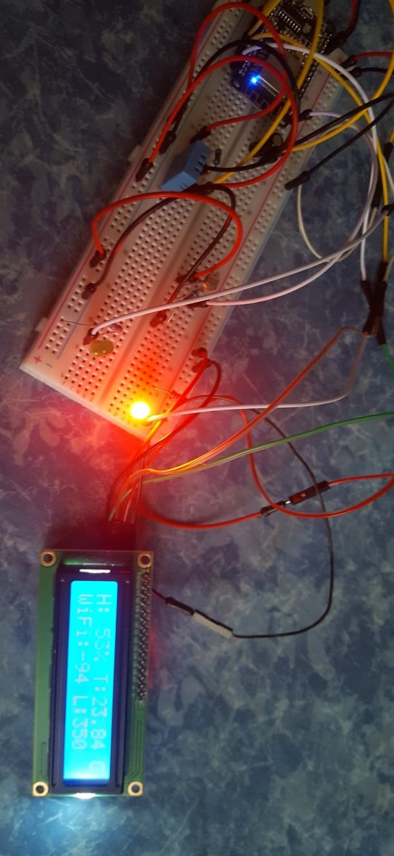
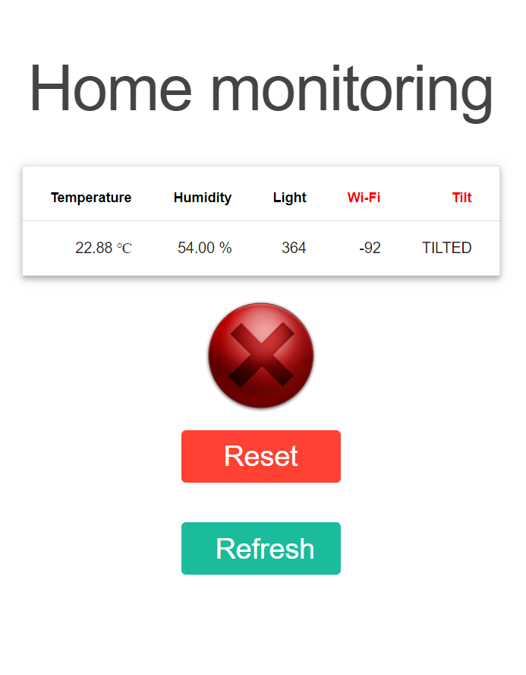
Method – System
Description system: choices, parameters, use cases

Slide 7
Final remarks
Results, Discussion, conclusion
The system allows to:
monitor temperature, humidity, light, WiFi and tilt in the house
alert relevant events
Future works:
insert new sensor, such as sound sensor or flame sensor
real time communication

