Slide 1
Laboratorio IoT
Prof. Paolo Napoletano
a.a. 2020/2021
Smart Monitoring
Team
Gabriele Ferrario 817518

Slide 2





Materials
Description of the ingredients employed
Components:
1x NodeMCU 1.0 (ESP8266)
1x 16x2 characters LCD display + PCF8574 I2C converter
1x DHT11 temperature and humidity sensor
1x Photoresistor
1x SW-520D roll ball tilt sensor
2x LED
2x 10kΩ resistor
2x 200Ω resistor
Technologies:
MQTT
Flask
Telegram
MySQL
InfluxDB
Other:
Machine Learning
Low power consumption

Slide 3
Recap
Description of the previous system
Assignment 1:
Home monitoring system
Detection of alert events
Web Server on NodeMCU
Constaint logging on InfluxDB
InfluxDB Dashboard
Assignment 2:
Virtualization of several NodeMCU
MQTT
Weather Monitoring
Web Server with Flask
MySQL for monitoring NodeMCUs
Dynamic thresholds

Slide 4




Method
Description system: choices, parameters, use cases
MQTT
Home
Master
WeatherStation

Slide 5
Method - Telegram
Description system: choices, parameters, use cases
General:
/registerMe - registers the user to the monitoring system
/removeMe - removes user registration from the monitoring system
/setup sleepTime executionTime - updates the sleep time and the execution time of the ESP8266
Home Monitoring:
/home - activates home monitoring
/stopHome - deactivates home monitoring
/setAlert sensor lowerBound upperBound - sets the thresholds for the indicated sensor
Weather Station:
/weather - activates weather monitoring
/stopWeather - deactivates the weather monitoring
/forecasting city - weather forecasting for the indicated city
Possible value for setAlert:
light lowerBound upperBound
temperature lowerBound upperBound
wifi lowerBound

Slide 6
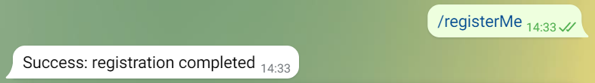
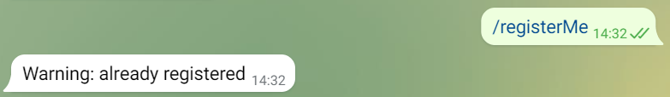
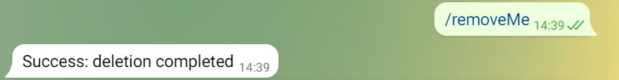
Method - Telegram
Description system: choices, parameters, use cases
General:
/registerMe - registers the user to the monitoring system
/removeMe - removes user registration from the monitoring system
/setup sleepTime executionTime - updates the sleep time and the execution time of the ESP8266
Home Monitoring:
/home - activates home monitoring
/stopHome - deactivates home monitoring
/setAlert sensor lowerBound upperBound - sets the thresholds for the indicated sensor
Weather Station:
/weather - activates weather monitoring
/stopWeather - deactivates the weather monitoring
/forecasting city - weather forecasting for the indicated city
Possible value for setAlert:
light lowerBound upperBound
temperature lowerBound upperBound
wifi lowerBound

Slide 7
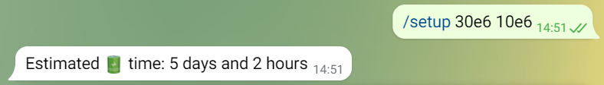
Method – Deep Sleep
Description system: choices, parameters, use cases
Temporaized Deep Sleep that varies according to measured values

Slide 8
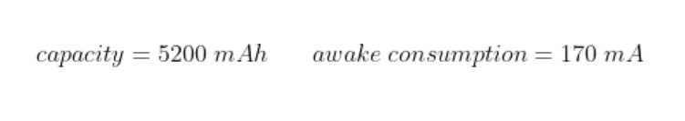
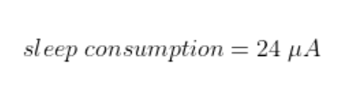
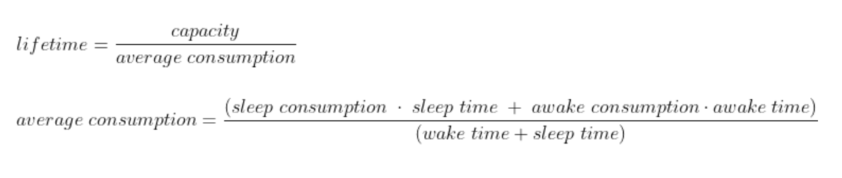
Method – Deep Sleep
Description system: choices, parameters, use cases
Temporaized Deep Sleep that varies according to measured values

Slide 9
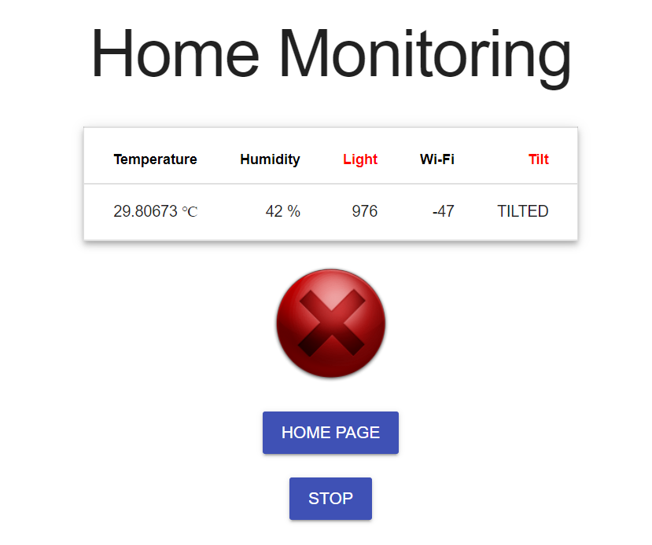
Method – Home Monitoring
Description system: choices, parameters, use cases
Web App

Slide 10
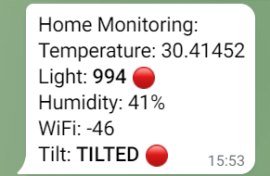
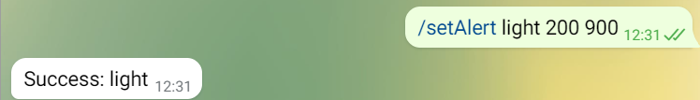
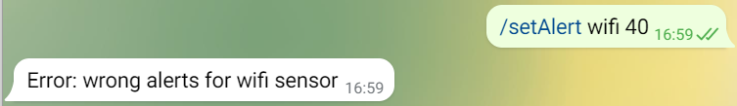
Method – Home Monitoring
Description system: choices, parameters, use cases
Web App
Telegram Bot

Slide 11


Method – Weather Station
Description system: choices, parameters, use cases
HTTP GET
WeatherStation
Predict

Slide 12

Method – Weather Station
Description system: choices, parameters, use cases
Machine Learning:
Weather prediction (sun, cloudy, rain)
Unbalanced Dataset
Oversampling (SMOTE)
SVM (temperature, humdity, wind, pressure)
Hyperparameter optimization (Grid Search)
Accuracy $≈$ 0.82
Conversion to Optimized C code (MicroML)
HTTP GET
WeatherStation
Predict
https://github.com/eloquentarduino/micromlgen

Slide 13
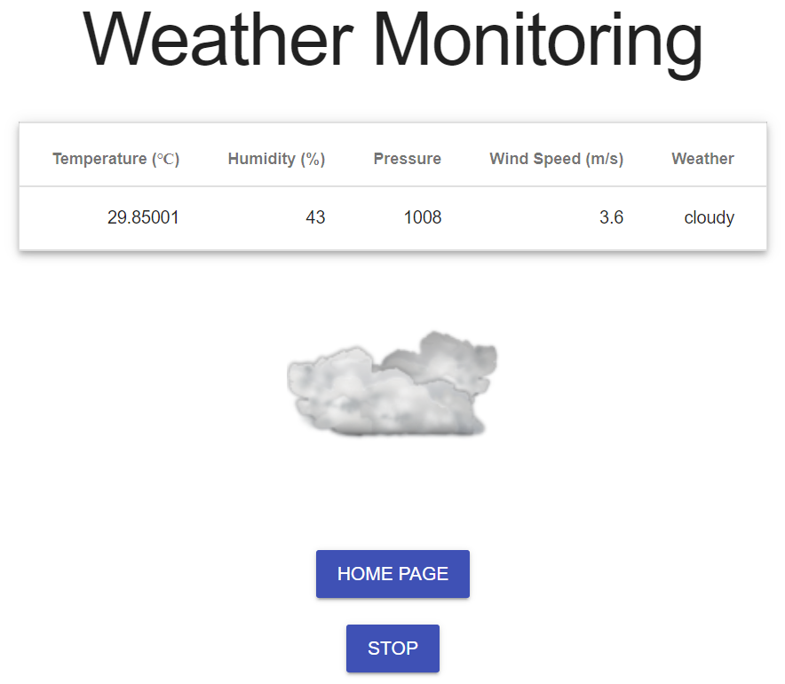
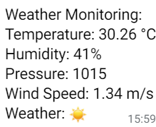
Method – Weather Station
Description system: choices, parameters, use cases
Web App
Telegram Bot

Slide 14
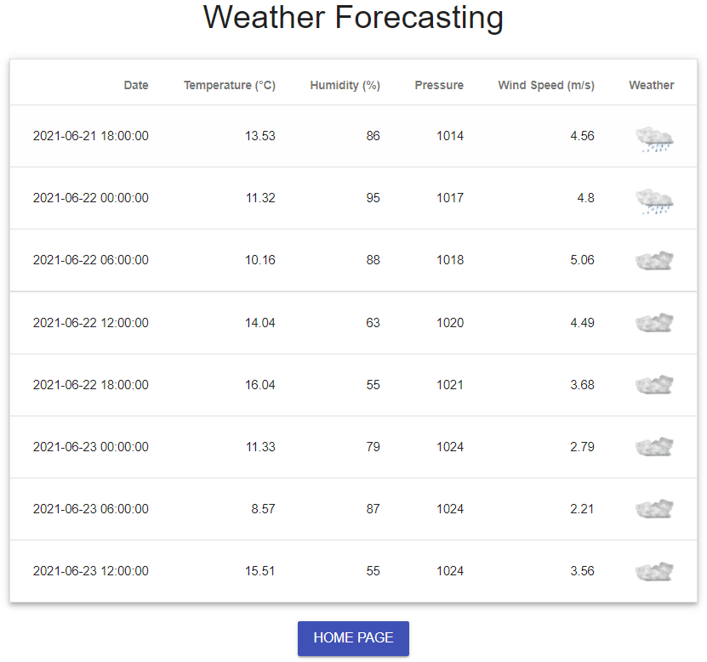
Method – Weather Station
Description system: choices, parameters, use cases
Web App
Telegram Bot

Slide 15
Final remarks
Results, Discussion, conclusion
The system allows to:
monitor the house and notify the users in real time
set different alarms
monitor the weather in real time via a Weather Station
weather forecasting
Observation:
simultaneous running of home monitoring and weather station can cause RAM problems
Future works:
insert new sensor for house monitoring and replace Openweather with sensors
predict more weather conditions
weather forecasting via Machine Learning

