Slide 1
Meal_Voucher
File created on: 2/5/2026 9:55:40 AM

Slide 2
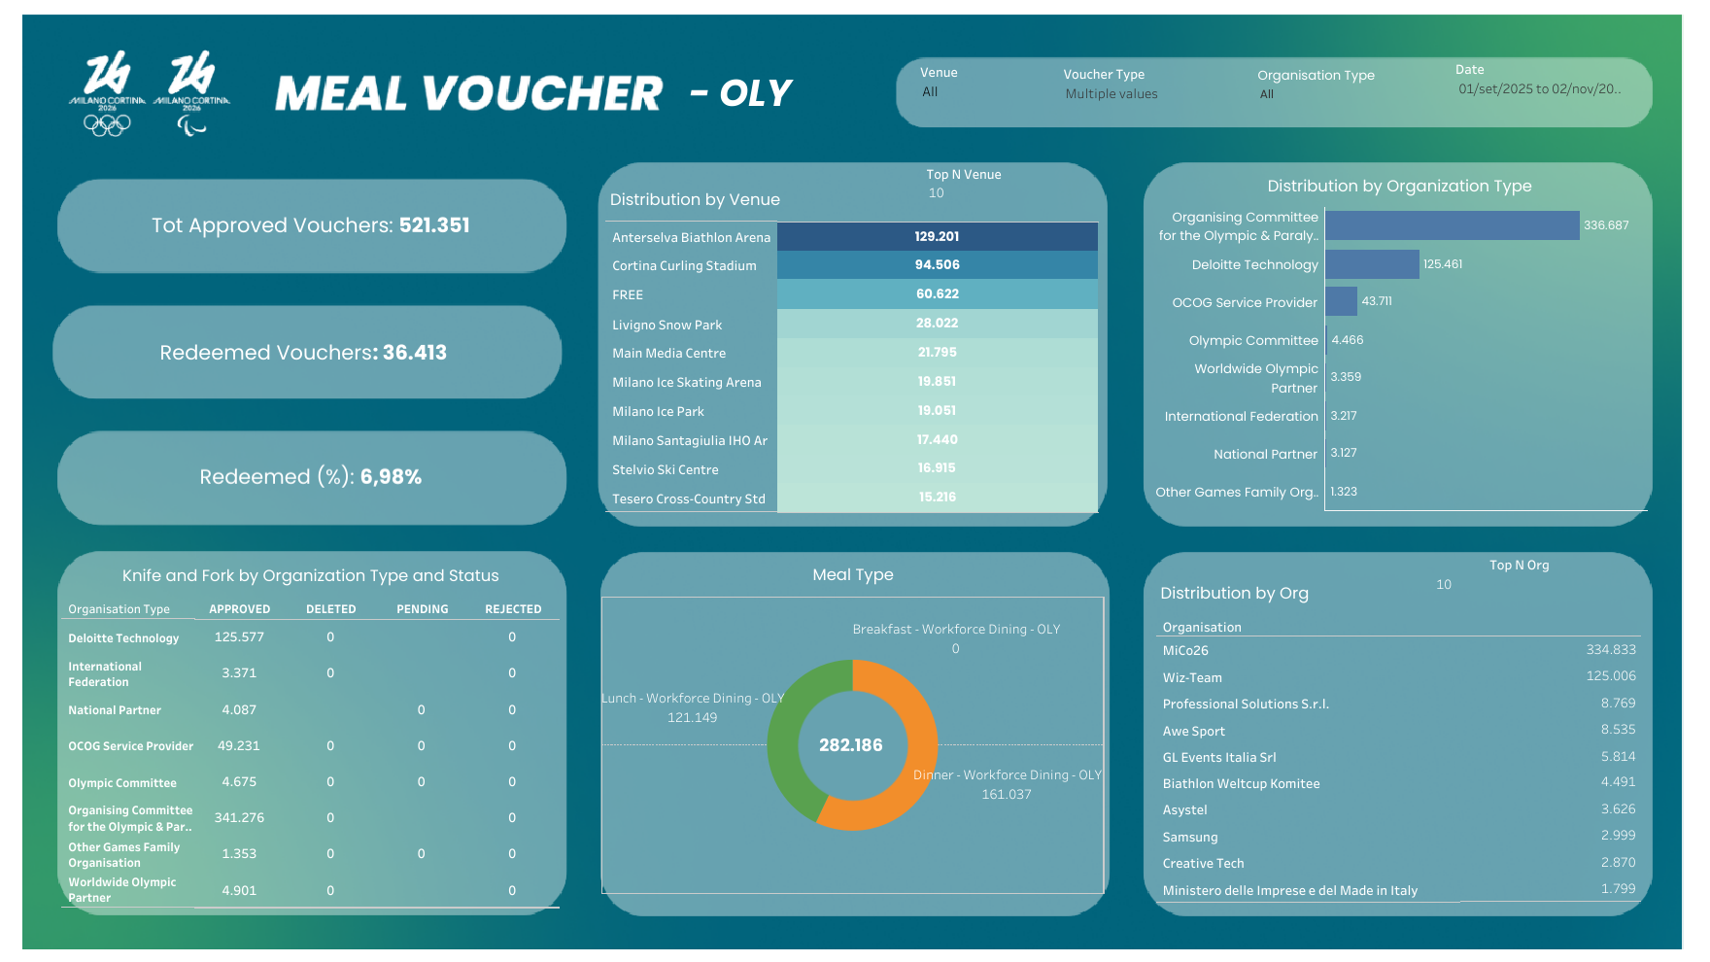

Slide 3
