Slide 1
WorkForce Applications v07
File created on: 2/5/2026 10:01:02 AM

Slide 2
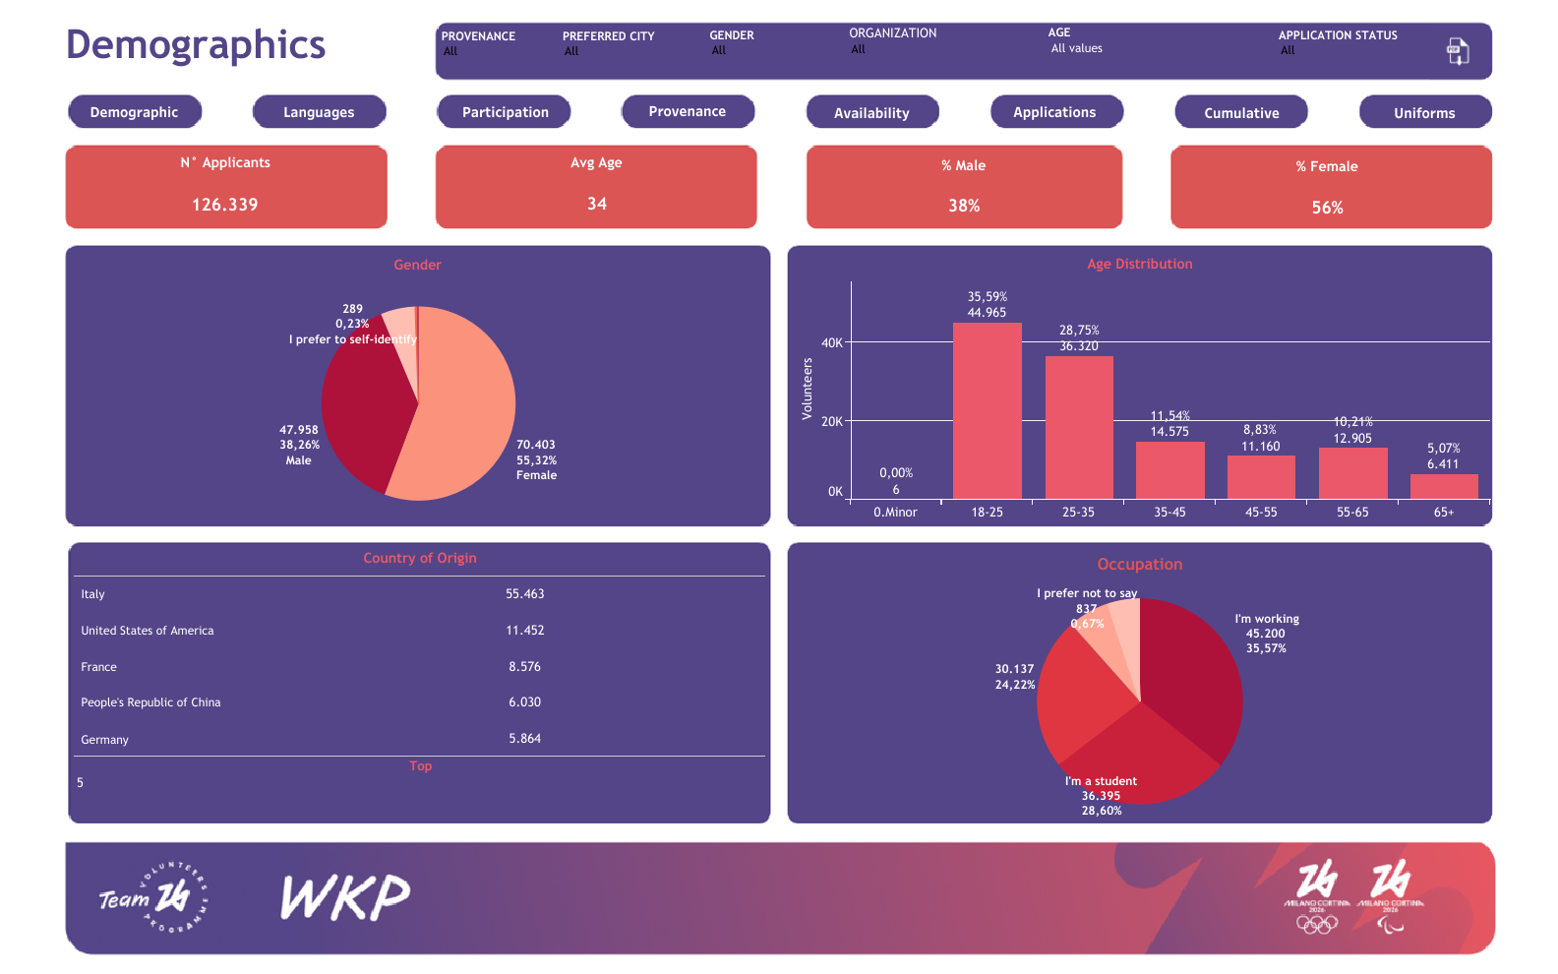

Slide 3
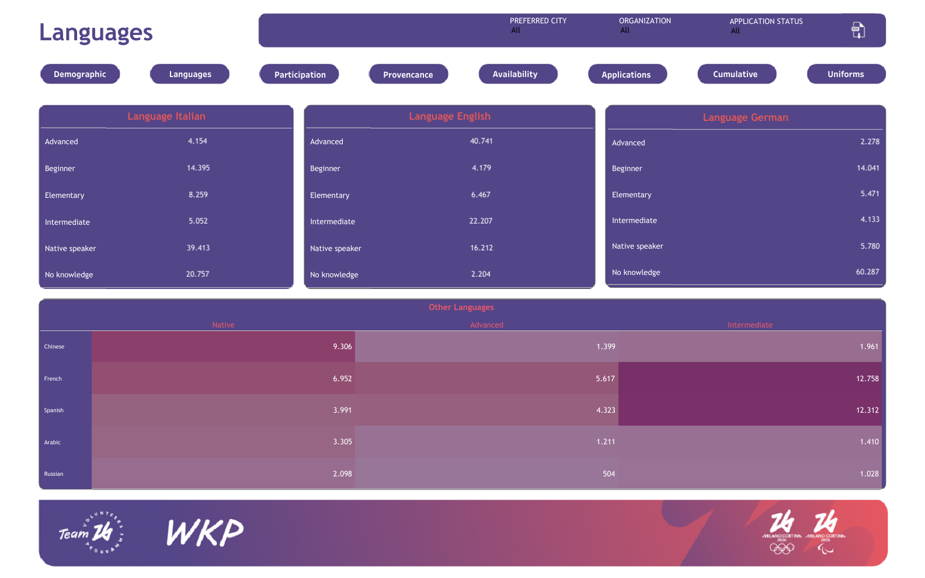

Slide 4
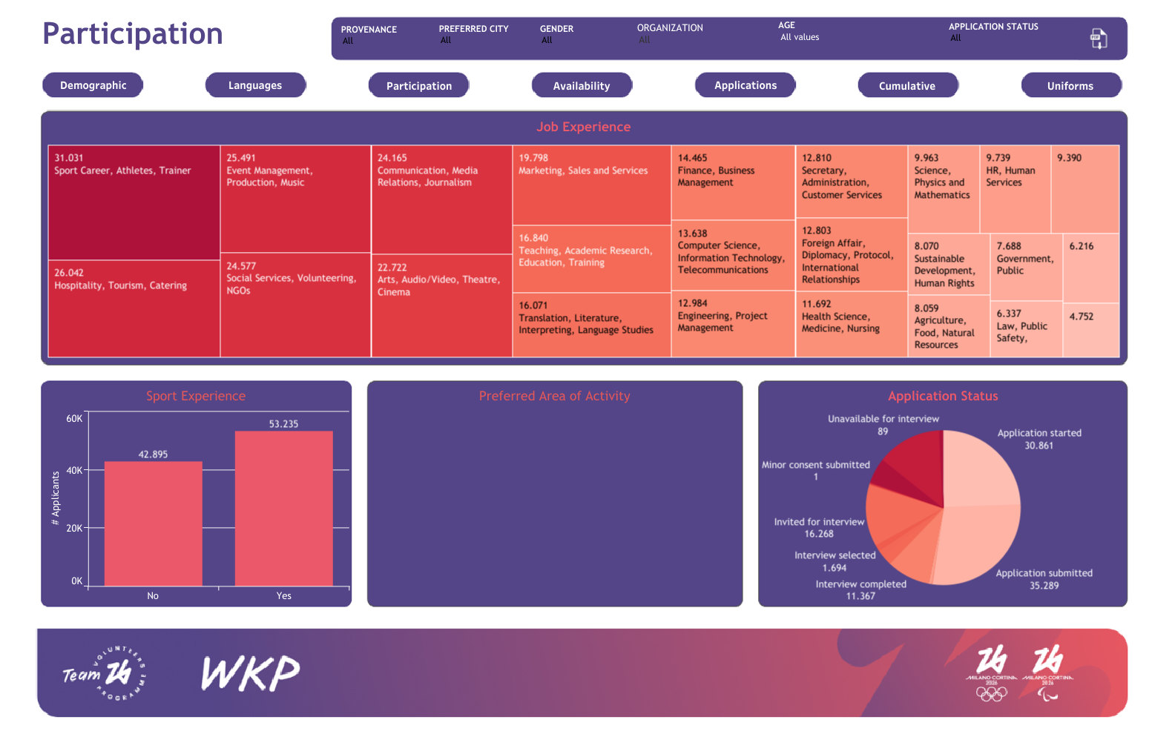

Slide 5
