Slide 1
Byzantine Reliable Broadcast Project
Outline:
Description of the BRB-protocols
Implementation
General problems encountered and proposed solutions
Simulation settings
Simulation Results
Conclusions

Slide 2
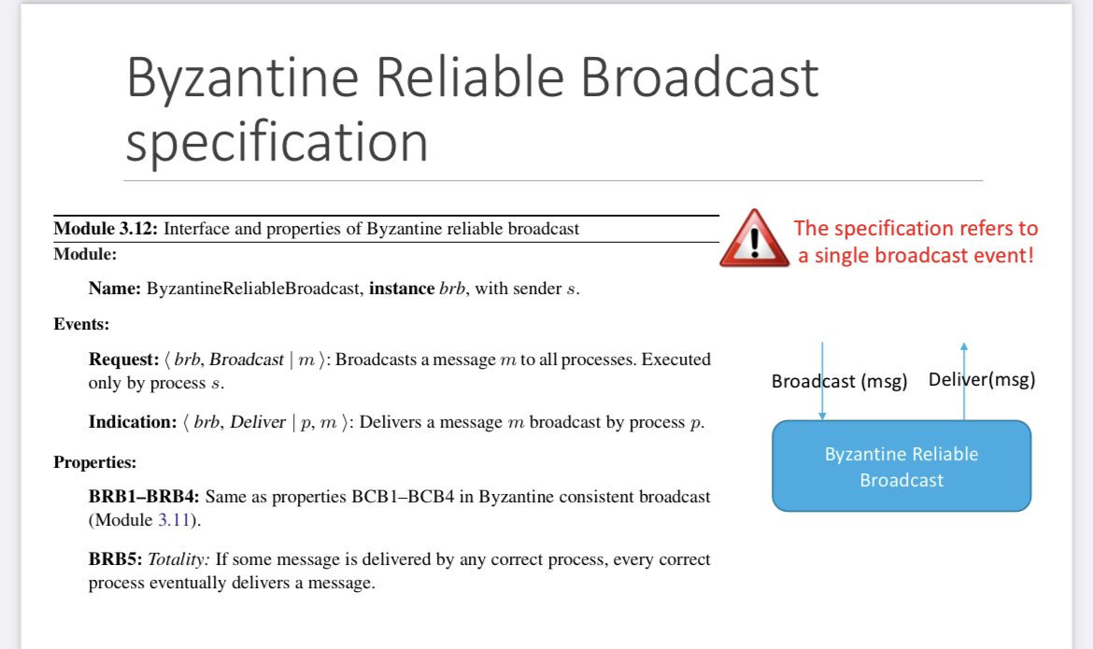
1.Description of the protocols
Properties of BCB:
BCB1: Validity: If a correct process p broadcasts a message m, then every correct process eventually delivers m.
BCB2: No duplication: Every correct process delivers at most one message.
BCB3: Integrity: If some correct process delivers a message m with sender p and process p is correct, then m was previously broadcast by p.
BCB4: Consistency: If some correct process delivers a message m and another correct process delivers a message m then m = m

Slide 3
Assumptions
-the server(s) address(es) is(are) known to every process in the network
-every process knows the ID of the broadcaster that is settled to one in our implementation;
-the broadcaster sends a message only to processes whose ids have been already received by itself before the broadcast primitive so eventually subsequent receivers that connect to the service after it has broadcasted the message will not receive it;
-the network is fully connected;
-every array that contains messages of a specific type is checked according to an interval of time(e.g every .001 s);
-the message is considered delivered when in the terminal is prompted the "- - - - -Message Delivered - - - - -" string;
-in all the algorithm is used the sha256 cryptographic hash function;
-in the Authenticated Messages code algorithm the RSA API interface has been chosen for making the digital signatures;
-in the erasure code algorithm the pyeclib API interface has been chosen for making the shares;
-we have modeled a faulty process like a process that discard every message that it receives after the time it fails;
-in the erasure code algorithm, we have considered the "source" field of a message instead of the "from" message field for finality and soundness reasons.
-we have modeled the byzantine process with specific python modules.

Slide 4
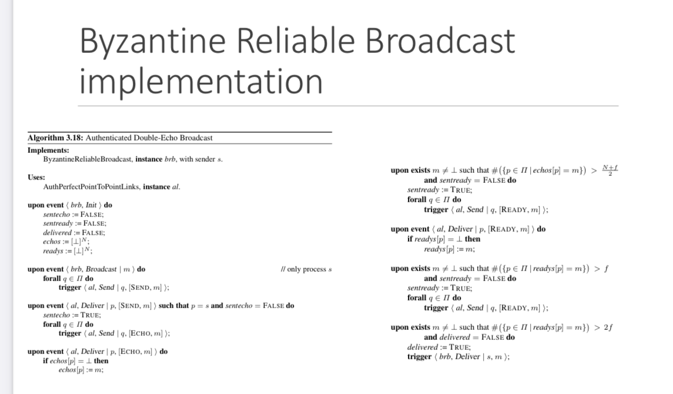
BRB-double-echo pseudocode
Modules:
Authenticated Link
BRB Process
Server(s)

Slide 5
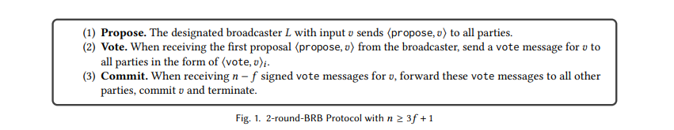
Authenticated Messages Pseudocode
Modules:
Link → used for the vote message phase
Authenticated Link → used for the propose message phase
BRB Process → module that characterizes the protocol implementation
Server(s) → server for process identification

Slide 6
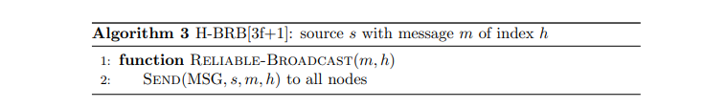
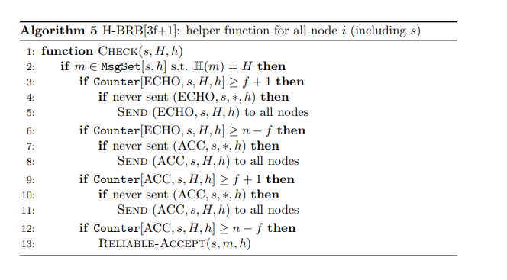
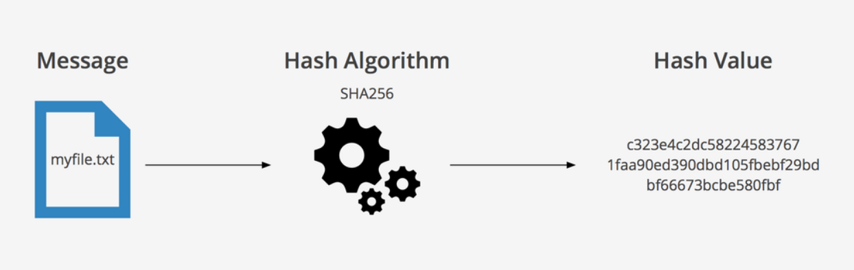
Hash Based Pseudocode
Modules:
BRB Process
Server
Authenticated link
Hashing used → SHA256

Slide 7
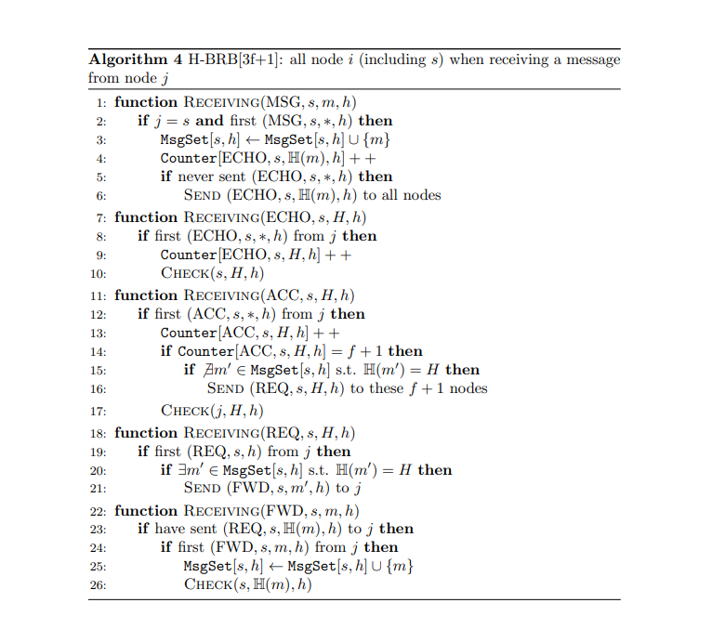
Hash Based Pseudocode 2
For each message flag a different receiving functions
Message identified by (source,SN) tuple
For each message flag a different counter
Counter indexed on the key (flag,source,Hash(m),SN)
Check function to verify if some type of counter exceed a bounded threshold to take the required actions

Slide 8
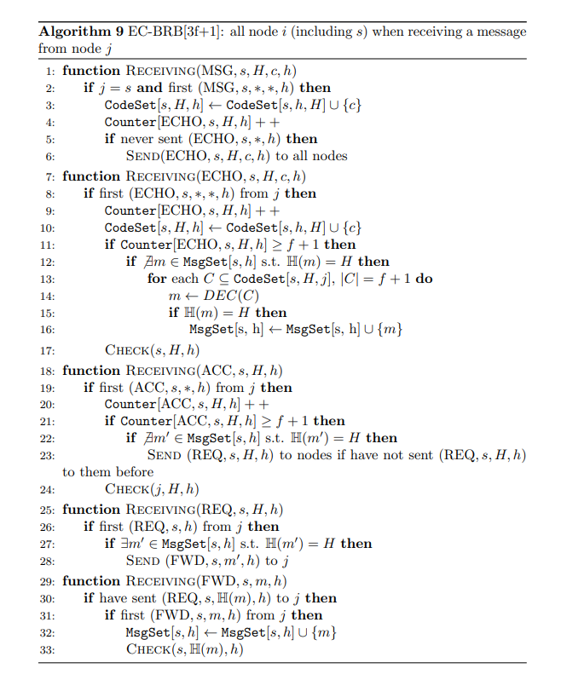
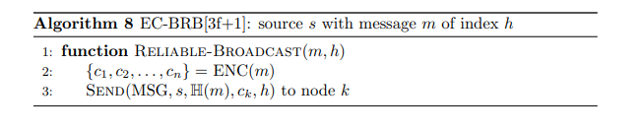
Erasure coding pseudocode
Similar to the others specifications we have the reliable broadcast primitive
The message is divided into fragments
Different receiving functions for each flag
Check function similar to the HB one
Counter structures similar to the HB ones
Codeset indexed on tuple (source,H(m),SN)

Slide 9
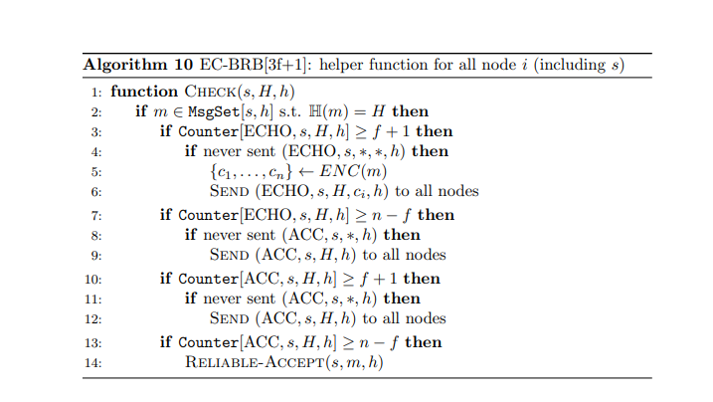
Erasure coding pseudocode 2

Slide 10
2.Implementation
#TODO Carlo se hai delle idee da mettere qui o come strutturare la sezione

Slide 11
3.General problems encountered and solutions
Not very familiar to the simulation tools
Few documentation for the encryption functions
Difficult to find the suitable encryption python libraries
Difficult to decide between robustness of the protocol and efficiency
Difficult to manage the links module implementation and API’s
Difficult to code from scratch the suitable links module implementation
Not always clear stated some features and steps of the protocols pseudocode
Function specification difficult to implement
Difficult to set up a basic benchmarking to debug
Limit to the SW/HW resources

Slide 12
4.Simulation settings
#TODO Gabriele

Slide 13
5.Simulation results

Slide 14
6.Conclusions

Slide 15
Byzantine Reliable Broadcast Project
● Number of group members: 3
● Members: Gianmarco Bordin, Carlo Giralda, Gabriele Lerani
● Student IDS: 2081387,...,...

