Slide 1

Planning and reasoning project
PDDL modeling and heuristic search using Fast-Downward
Gabriele Lerani

Slide 2

Outline
Domain specification
PDDL modeling
Problems definition
Heuristics and analysis
Results and conclusion
References

Slide 3
Domain: high level requirements
Truck can move like a car: turn left, turn right, reverse, lateral reverse and one step forward.
If the machine makes two consecutive turns, it jams, but it can be repaired and resume movement but with a very high repair cost.
Truck can carry blocks and climb on them to build bridges.
In some cells there are pits, truck can move on top of them using bridges.
Truck consumes more energy moving on the ground than when walking on bridges.
The goal is to reach an exit cell, the truck needs to navigate through the grid avoiding pits and building bridges if needed.

Slide 4
Outline
Domain specification
PDDL modeling
Problems definition
Heuristics and analysis
Results and conclusion
References

Slide 5
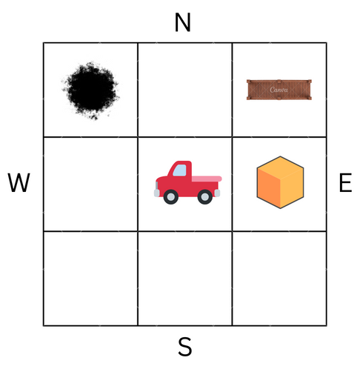
PDDL Modeling: actions
Turn
Move forward
Move backward
Lateral reverse
Repair
Load
Unload
Build
Climb
Get off

Slide 6
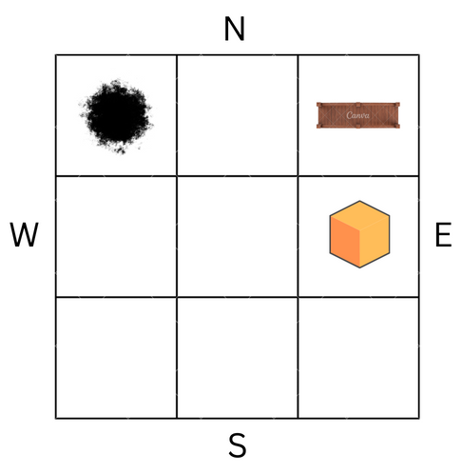
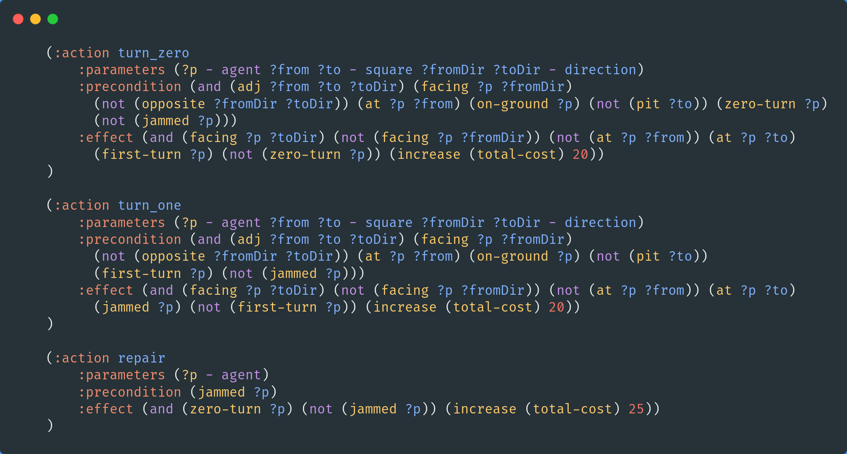
Turn left and right
How model the car direction?
How to get the car jammed after two consecutive turns?
How to get the car repaired?
CAR
CAR

Slide 7
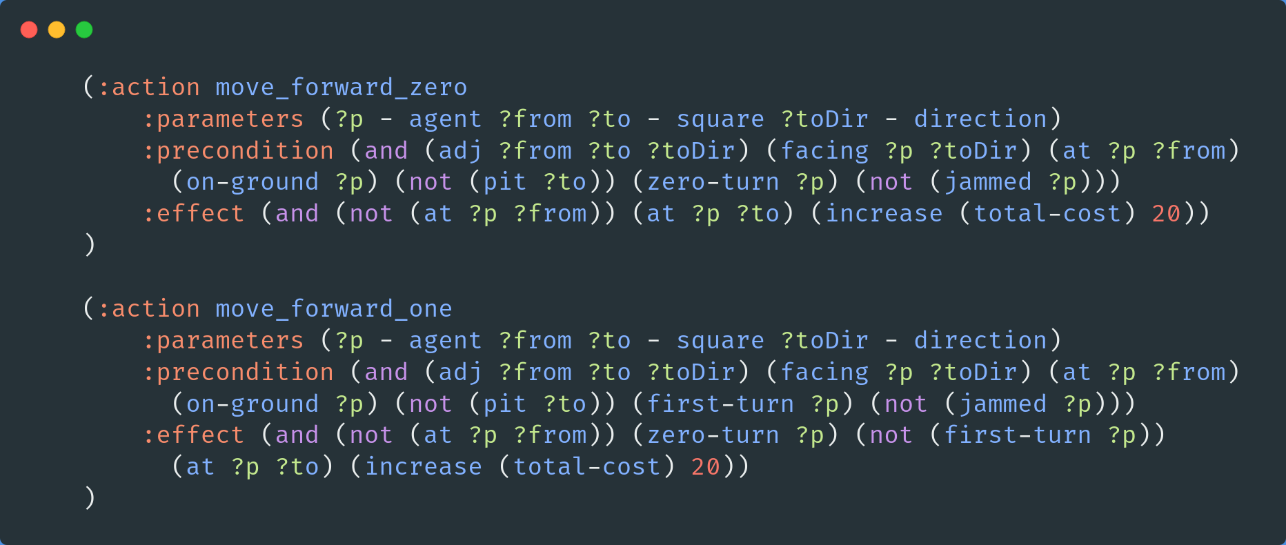
Move forward
How model the car direction?
How to reset the count of turns when car move one step forward?
CAR
CAR

Slide 8
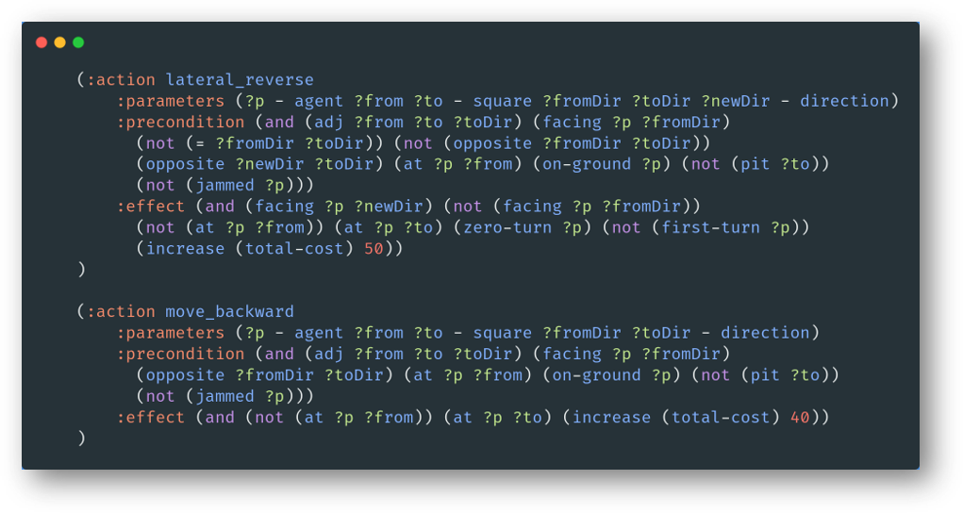
Move backward and lateral reverse
How to change the direction when car makes a lateral reverse?
CAR
CAR

Slide 9
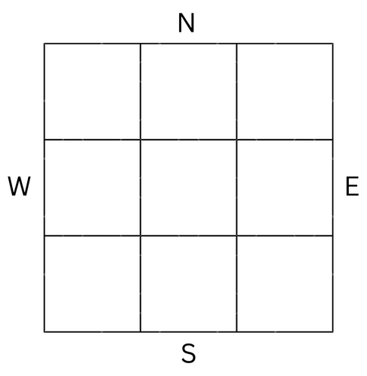
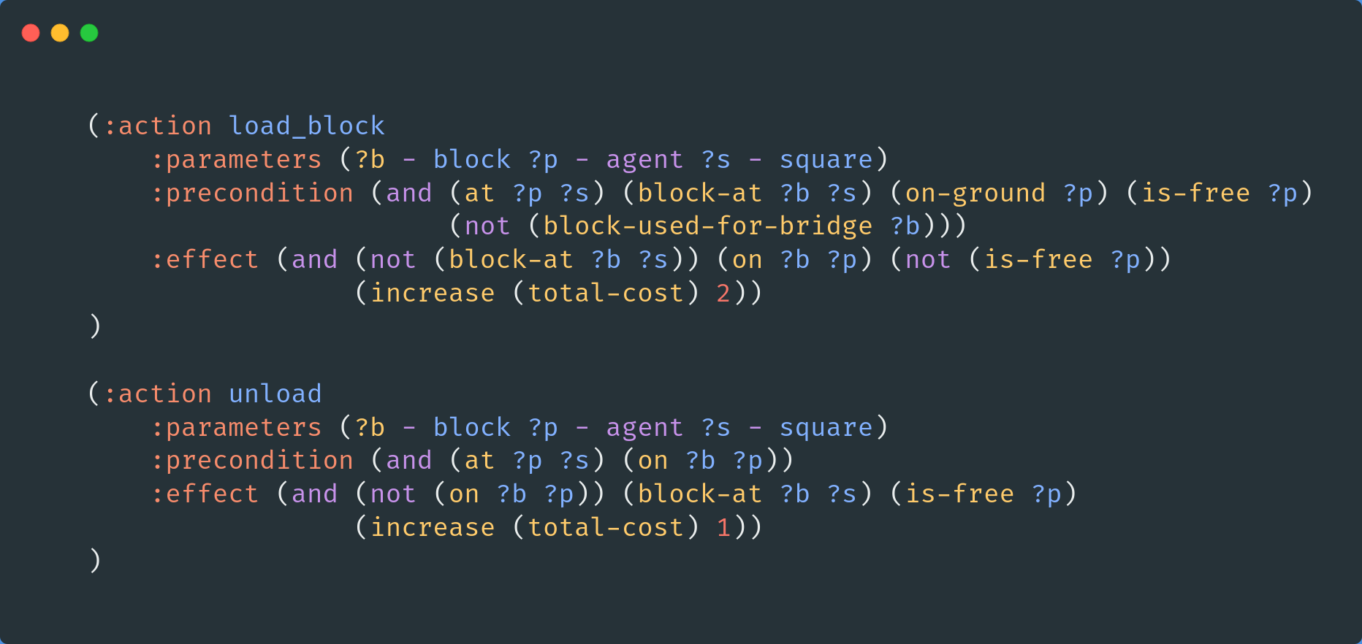
Load block and unload
How to distinguish blocks used for bridges versus normal ones?
B3
B1
B2

Slide 10
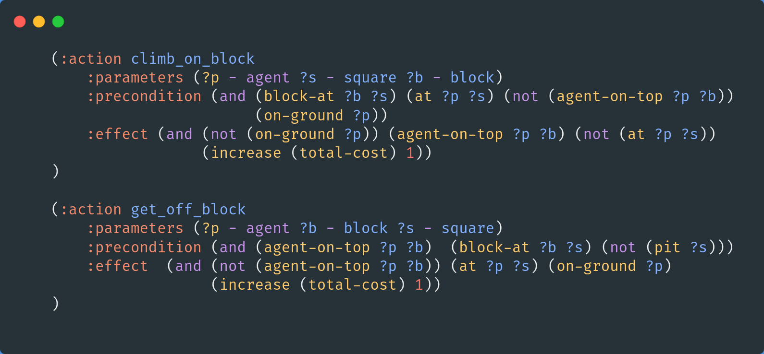
Climb, get off
How to distinguish when agent is on ground or on top of a block?
PIT
B1
CAR
CAR
PIT

Slide 11
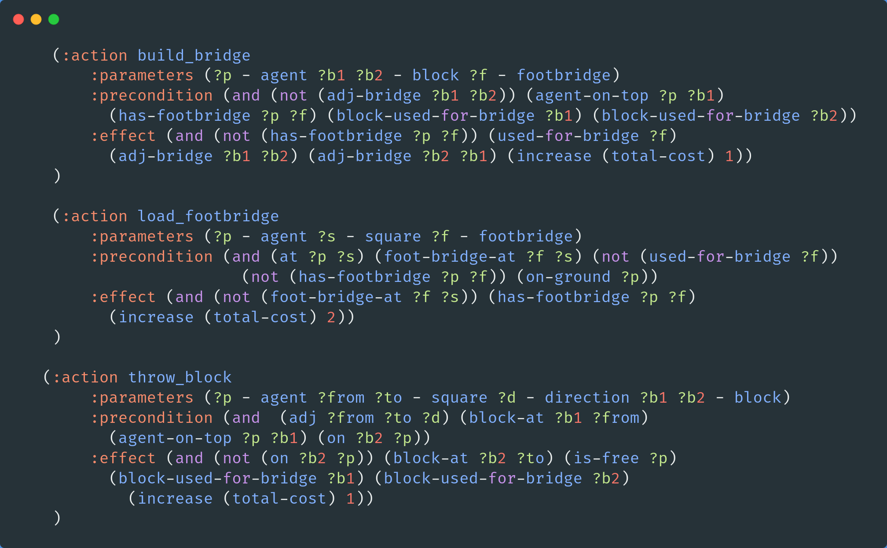
Build, load footbridge, throw block
How to make two block connected for a bridge?
PIT
F1
CAR
PIT
B1
B2
F1
B1
CAR
PIT

Slide 12
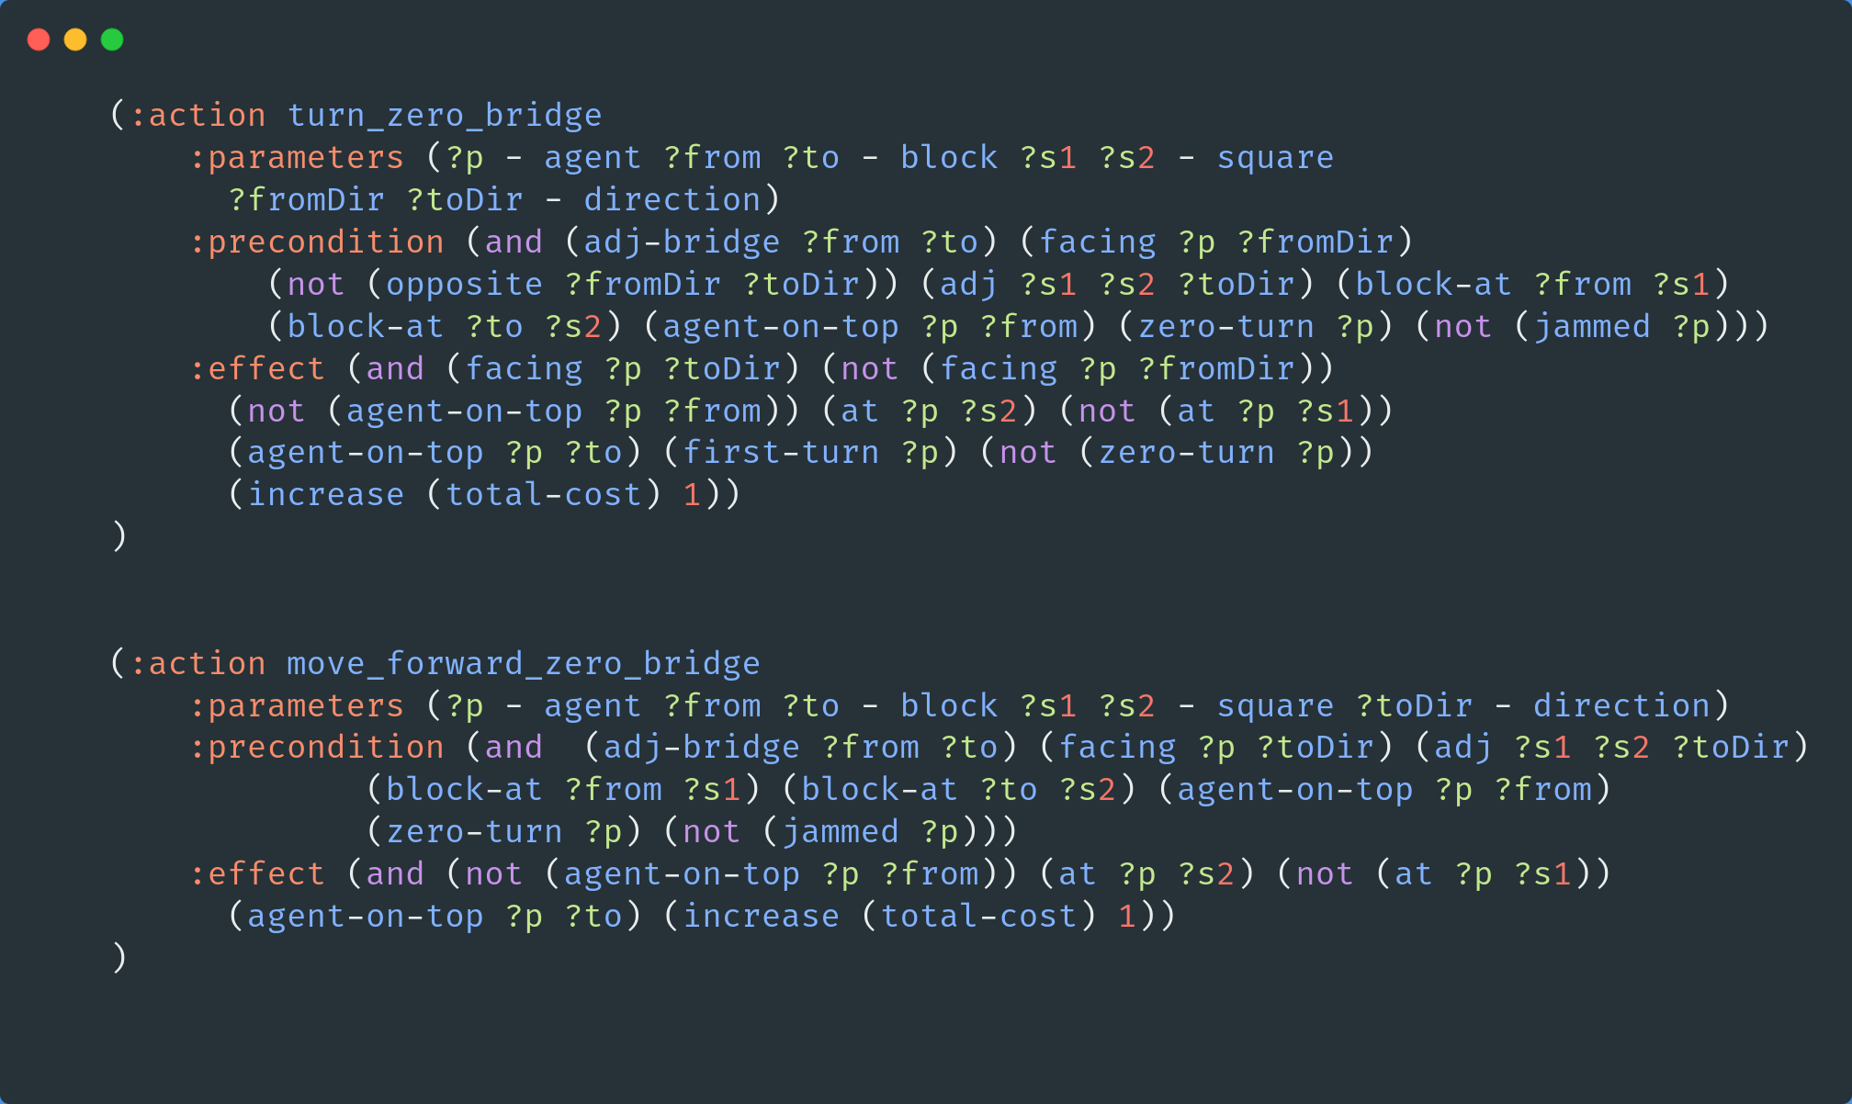
Move on top of a bridge
How to move on blocks?
PIT
PIT
B1
PIT
CAR
B2
CAR
PIT

Slide 13
Outline
Domain specification
PDDL modeling
Problems definition
Heuristics and analysis
Results and conclusion
References

Slide 14
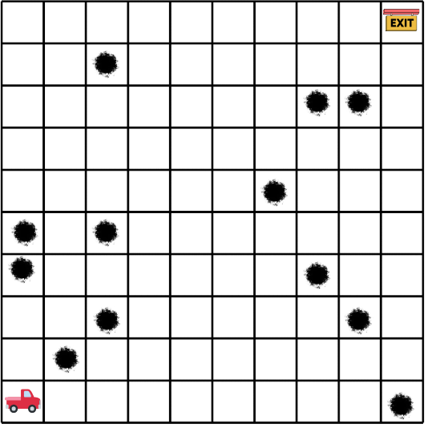
Problem 1
Test basic navigation with a straightforward path from the initial position to the exit

Slide 15
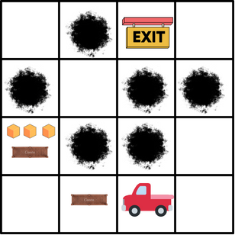
Problem 2
Test building ability with pits strategically located so to that the only possible path can be reached with a bridge

Slide 16
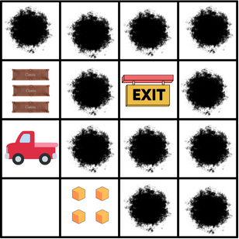
Problem 3
Test more than one bridges construction with a lot of pits on the grid, the truck is encouraged to build a long bridge towards the exit

Slide 17
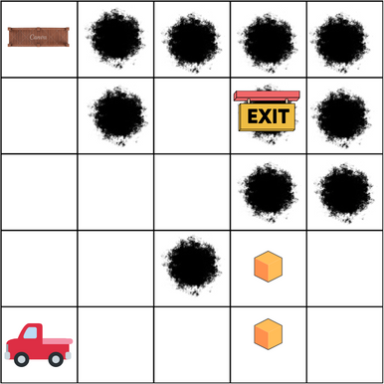
Problem 4
Few blocks are placed on the grid so that the truck is forced to use them strategically to find the optimal path

Slide 18
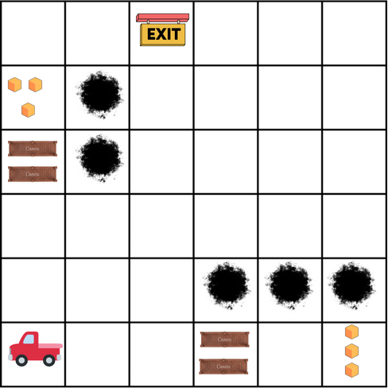
Problem 5
Increase the size of the grid with many possible paths towards the exit cell

Slide 19
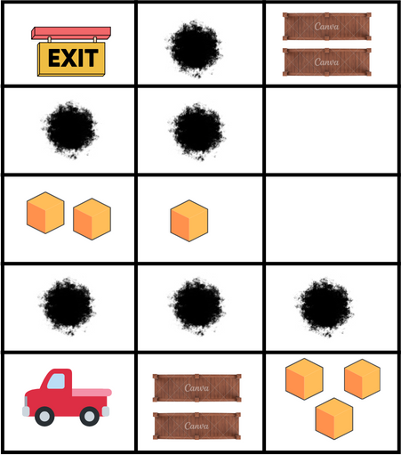
Problem 6 (Extra 1)
Test the ability to overcome multiple obstacles and build discontinuous bridges

Slide 20
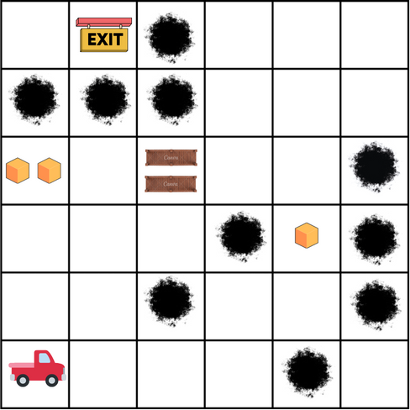
Problem 7 (Extra 2)
Force the car to get repaired to load the block

Slide 21
Outline
Domain specification
PDDL modeling
Problems definition
Heuristics and analysis
Results and conclusion
References

Slide 22

Heuristics and performance analysis
OS and hardware: Ubuntu 23.04, 8GB RAM, Intel i5-8250U
Planner: Fast-Downward
IPC planner: BJOLP (Big Joint Optimal Landmarks Planner)
Algorithm: A*
Heuristics: blind, hmax, hadd, hff
Metrics: search time, memory peak, number of nodes

Slide 23
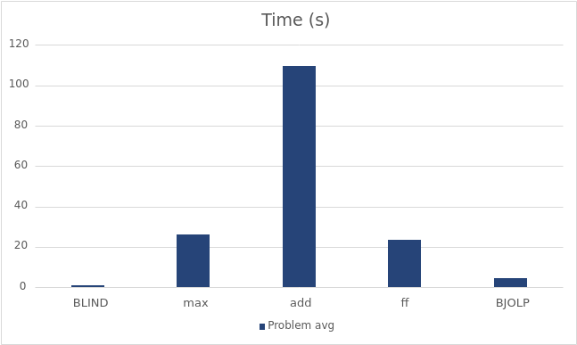
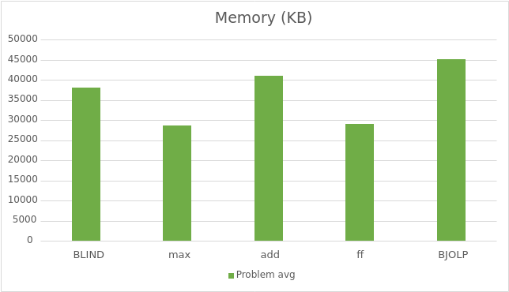
Time and memory

Slide 24
Time per block

Slide 25
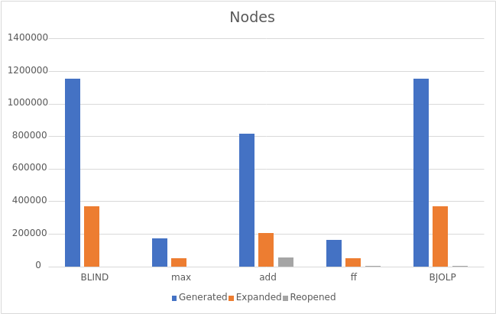
Search nodes

Slide 26
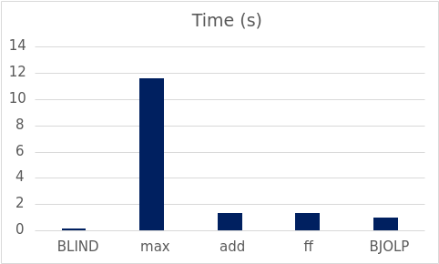
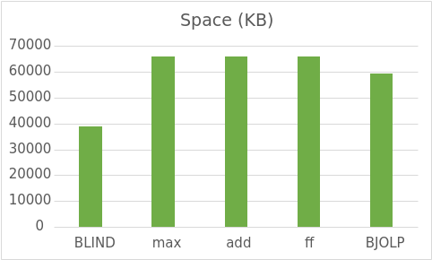
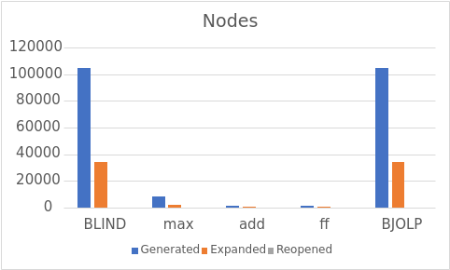
Analysis of problem 5 (1)
Algorithm | Plan cost
BLIND | 118
max | 118
add | 140
ff | 140
BJOLP | 118
26

Slide 27
Analysis of problem 5 (2)

Slide 28
Outline
Domain specification
PDDL modeling
Problems definition
Heuristics and analysis
Results and conclusion
References

Slide 29
Results and findings
BLIND is very fast but not memory efficient.
h^{max}, h^{ff}, h^{add} are on average fast but computing them can be very expensive.
In some cases when h^{ff} and h^{add} find a non-optimal plan they are faster than the other heuristics.
BJOLP planner uses landmarks to derive admissible heuristic combined with A*. Performances similar to A* + BLIND.
The number of parameters per action greatly influences search times.

Slide 30
Conclusion
Model a PDDL domain using STRIPS
Use Fast-downward for solving a planning task
Use VAL to validate a plan
Compare different problem for the same domain
Compare different heuristics using A*

Slide 31
Outline
Domain specification
PDDL modeling
Problems definition
Heuristics and analysis
Results and conclusion
References

Slide 32
References
https://www.fast-downward.org/
https://github.com/KCL-Planning/VAL
https://planning.wiki/ref/planners/bjolp
https://planning.wiki/ref/pddl21/domain
https://editor.planning.domains/

