Slide 1
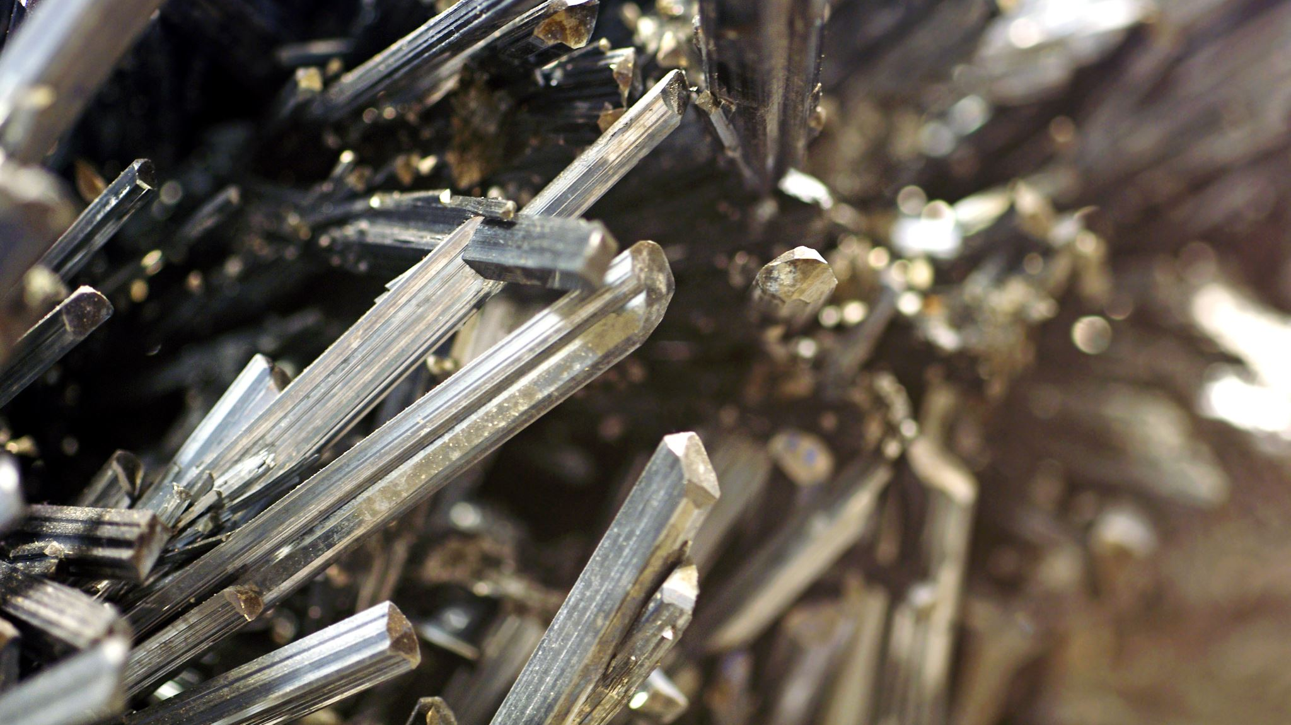
Studying Niobium Crystals used to build Superconducting Qubits using LT-STM in UHV
Tannishtha Nandi

Slide 2

Overview
Quantum Computation
What are superconducting qubits
Superconductors
Why do we need superconducting qubits
Why do we choose Niobium
Experimental Setup: What is an LT-STM
Experimental Setup: What is UHV
Experimental Results
Conclusions

Slide 3
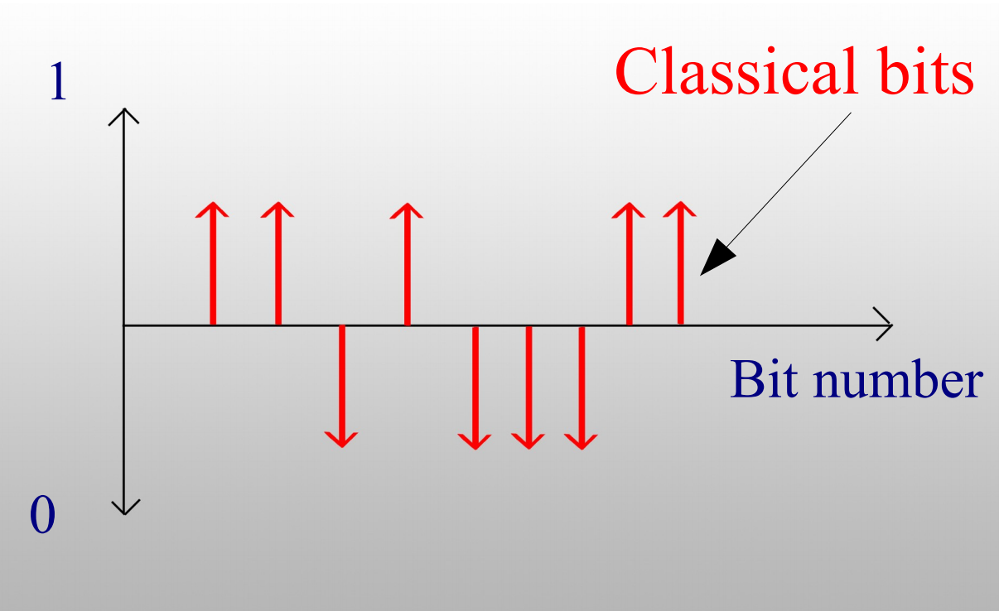
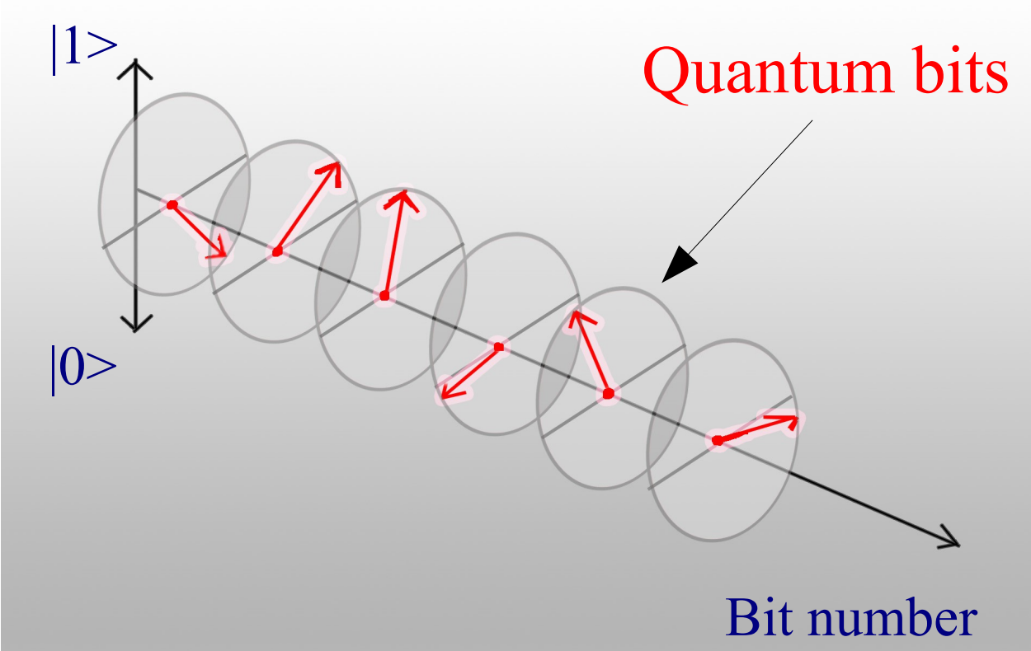
Quantum Computation
Classical Computation
Quantum Computation
Classical Computation:
Classical logic bit: “0” and “1”
Quantum Computation:
Quantum bit, “Qubit”, can be manipulated using the rules of quantum physics
Orthogonal quantum states |0> , |1> and their superposition |Ψ> = c₀|0> + c₁|1>
A quantum computer can perform operations in seconds while for a classical computer it would take thousand of years.

Slide 4
What are SuperConducting Qubits
Any quantum mechanically coherent system could be used as qubit.
Different platforms include:
single photons
nuclear spins
trapped ions
superconductors
Superconducting devices using materials
The minimum levels of de-coherence among solid state implementations.
A promising implementation of qubit. It is widely believed that the only way to realize large scale integration of qubits will be with solid state technologies.
Advantage of solid-state implementations
Possibility of a scalable implementation of the qubits

Slide 5
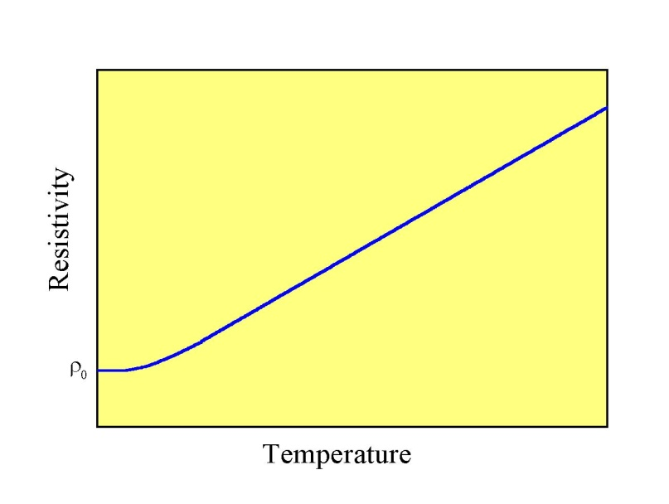
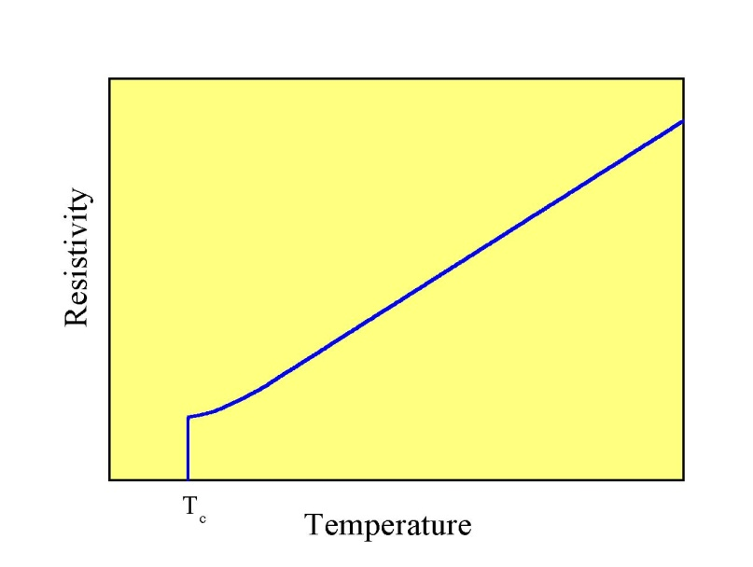
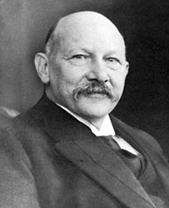
Superconductors
I
Normal metal
Superconductor
S
l
Θ_{D}
1911 H. K. Onnes
(Nobel: 1913)

Slide 6
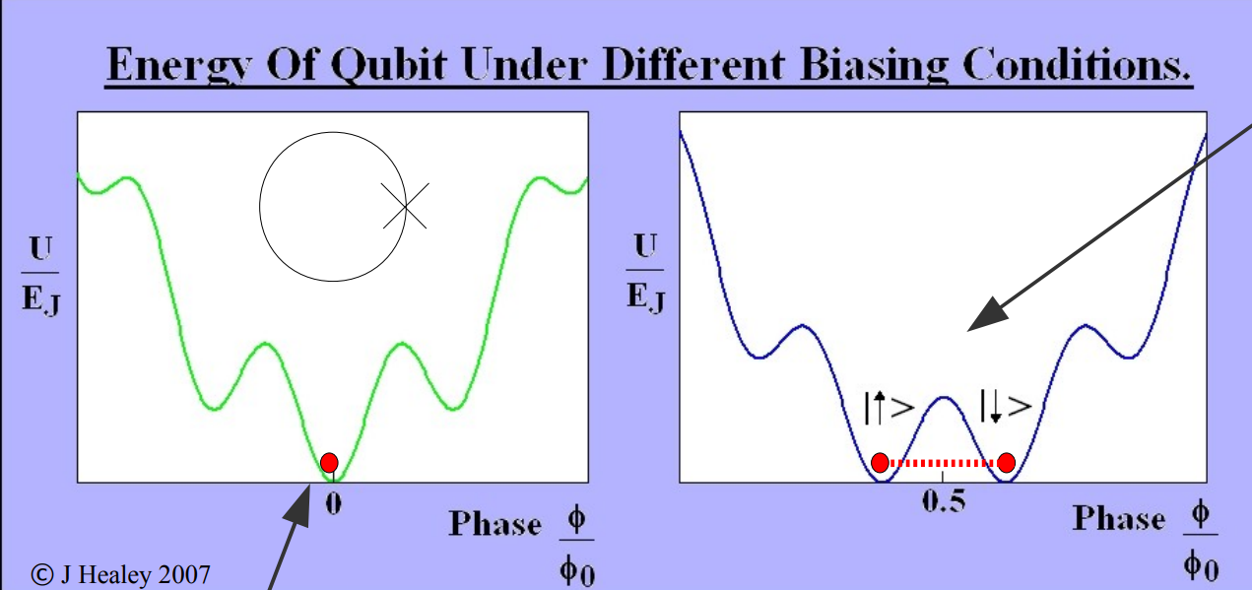
Superconducting Qubit
The building block of the superconducting qubit is a Josephson junction.
A Josephson junction consists of 2 superconductors separated by a barrier (usually an insulator)
An example of superconducting qubit is a ring of one or more Josephson junctions
The energy diagram of a ring with a junction is given by:
Apply a magnetic field. Current will start to flow around the loop. The current can flow in both directions.
Ground state of the system-no currents flow.

Slide 7
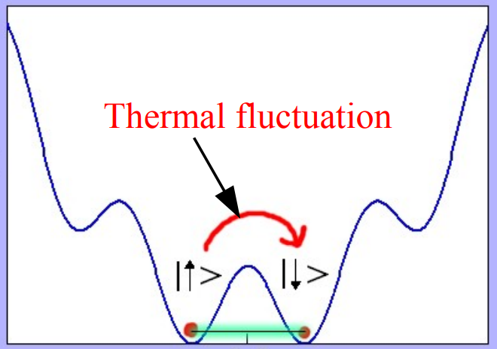
Measuring Qubits
Superconducting Qubits operate in the superconducting regime, i.e. low/cryogenic temperatures.
They need to be cold enough that thermal fluctuations are not important, so that the energy of the system is not sufficient to cause excitation in the system accidentally over the barrier.
All kind of noise is important. The main issue is : “reading a qubit without disturbing it!”
Even if we had a room temperature superconductor, qubit will still need to work at very low temperatures!

Slide 8
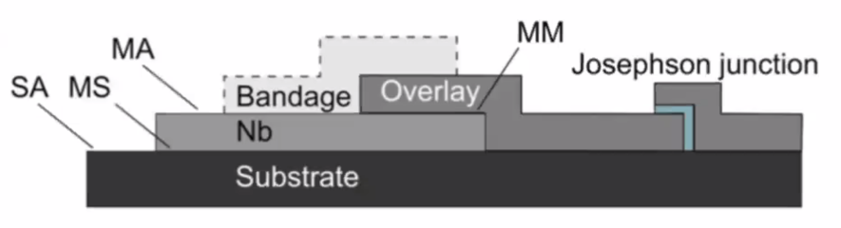
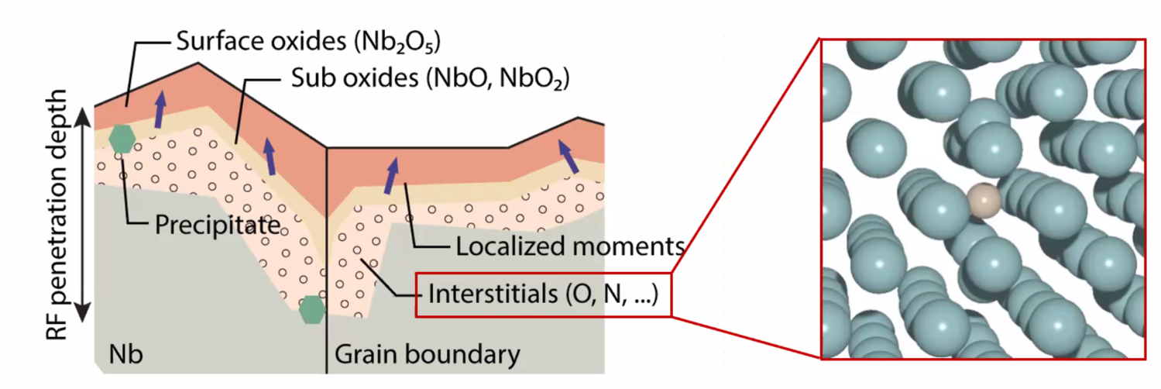
Primary Goals:
- Understand the physics and materials of coherence limiting factors
- Characterize different parts of the devices by low temperature scanning tunneling microscopy and spectroscopy
-Find mitigation strategies from the materials perspective
Niobium and Niobium oxides
Diverse set of possible interfaces:
- Nb-air native oxides
-Nb-substrate with possible interfacial oxides, silicides
-Metal-metal interfaces including interfacial oxides, alloying, residues

Slide 9
Limitations of Niobium
Niobium is used to develop Quantum Computers.
Niobium tends to form oxides and hydrides very easily due to its high affinity for oxygen and hydrogen. The presence of Niobium oxides and hydrides is assumed to reduce the coherence time in a Quantum Mechanical system (Qubits).
Studying Niobium crystals provides a pathway to understand sources of de-coherence in Qubits.
The surfaces of Niobium single crystals were cleaned by annealing them at extremely high temperatures, close to 2200℃ in Ultra High Vacuum in order to remove Niobium oxides and hydrides. (Experiment)

Slide 10
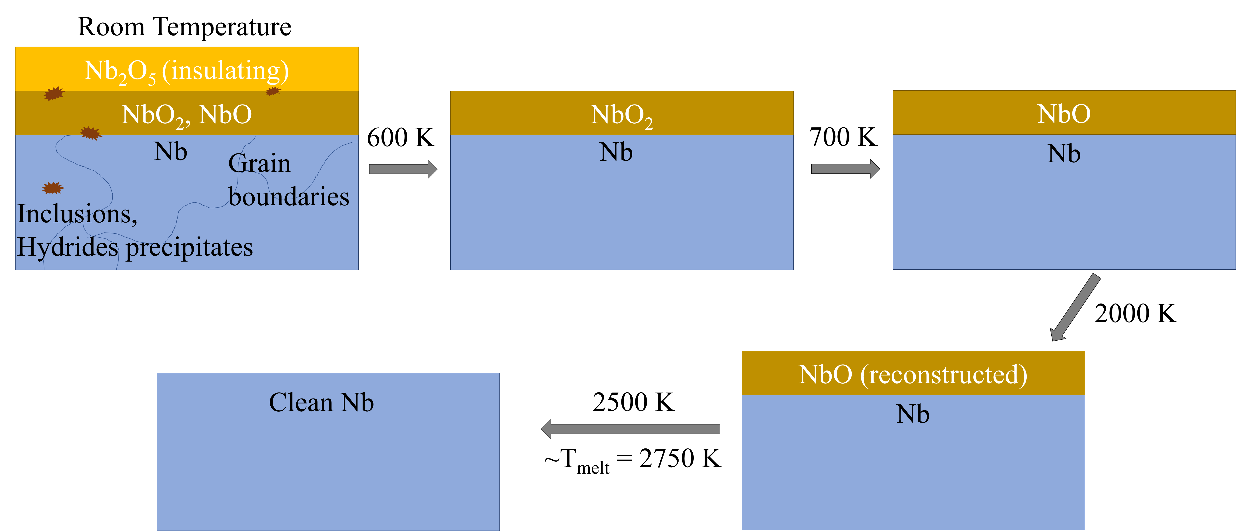
Niobium is a key material in superconducting qubits. Interfaces and defects are believed to contribute to the problem of de-coherence.
It has a high critical temperature (~9K), large superconducting gap, needs less cooling

Slide 11
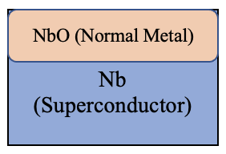
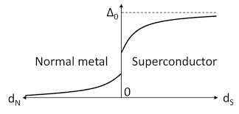
Proximity effect
After annealing the top metallic oxide (NbO) becomes superconductor by proximity to the Nb. Tunneling spectroscopy allows to get information on the underlying superconductor.

Slide 12



LT- STm Low Temperature Scanning Tunneling Microscope
Surface Topography
Tunneling current decreases about one order of magnitude with every 1 Å increase in z.
$$ψ(z)=ψ\left(0\right)e^{−κz }$$
$κ= \frac{\sqrt{m \text{(}\text{φ}\text{tip}\text{ + }\text{φ}\text{sample}\text{)}}}{ћ}$
$$I \left(d\right)∝ |ψ\left(d\right)|^{2}∝e^{−2κd }$$
Feedback ON
Constant I
Measure z
I(z)
Energy
E_{F Tip}
eV
Piezo Crystal
E_{F Sample}
Tip
Sample
X,Y,Z
V
d
Feed-back Loop
z

Slide 13
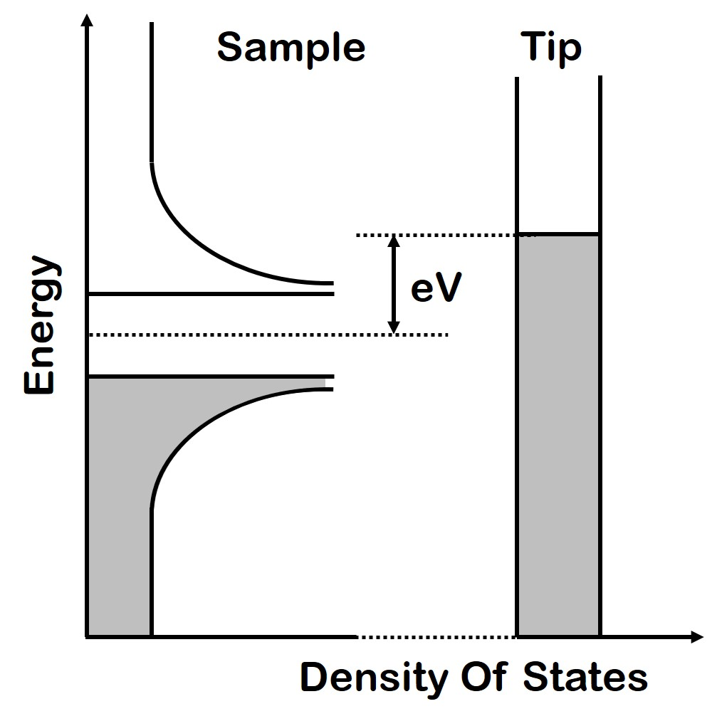

When the density of states of the tip is approximately flat close to the Fermi energy, by measuring the conductance we get access to electronic density of states of the sample:

Slide 14
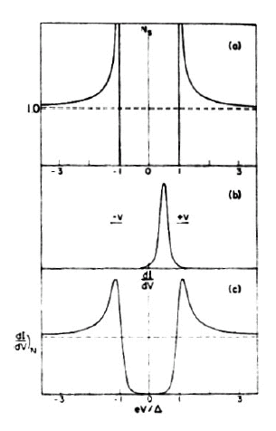
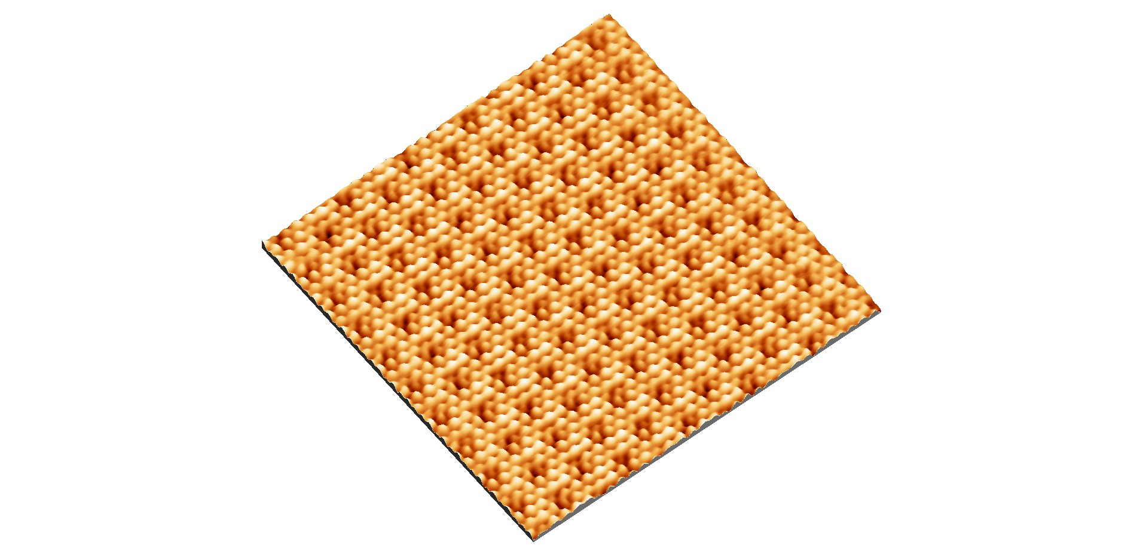

Slide 15
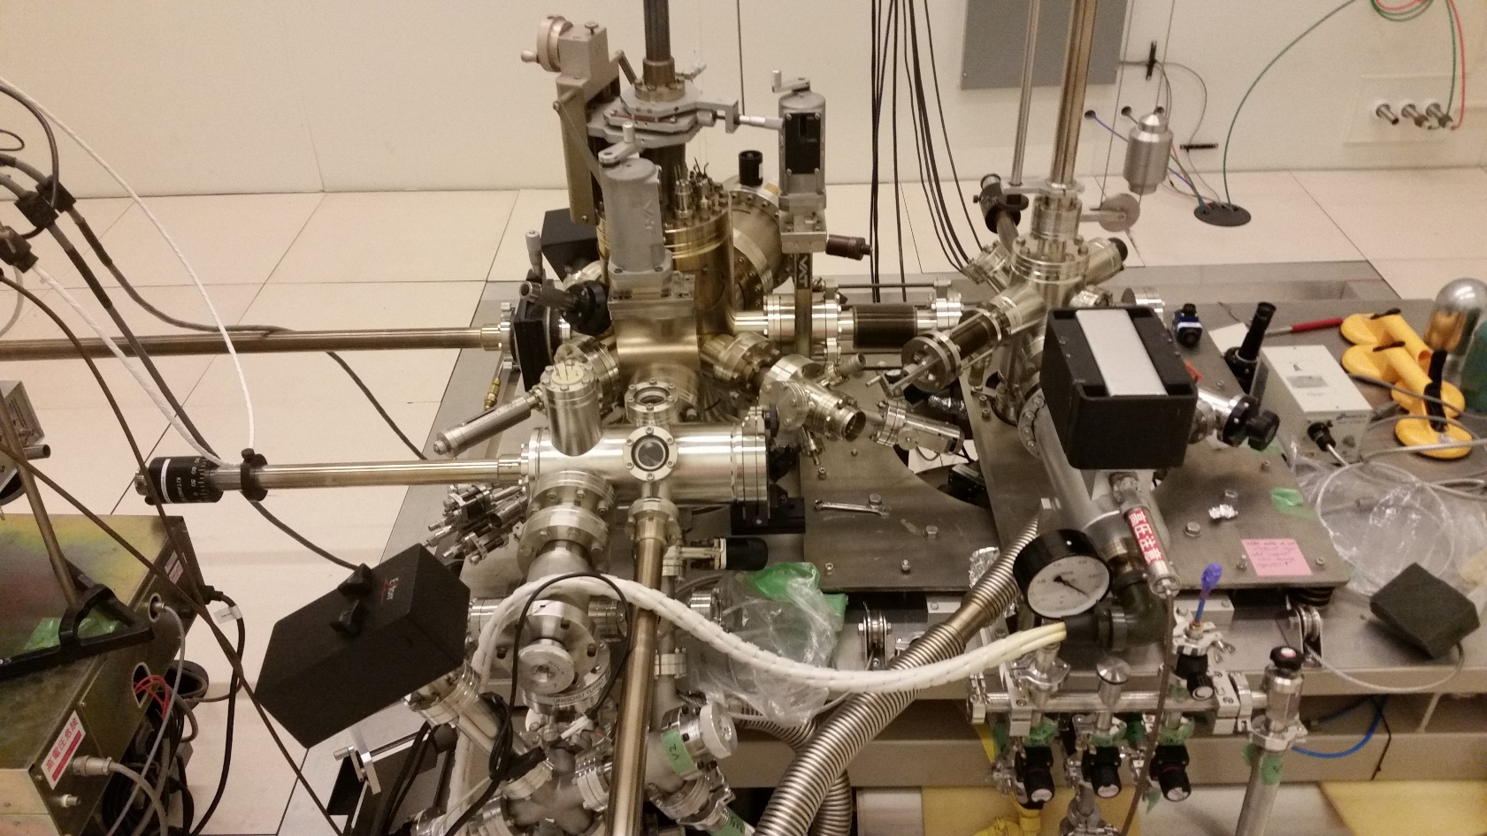
Experimental Setup
Unisoku UHV-LT ³He Scanning Tunneling Microscope
RF/Acoustic shielding room
Passive vibration isolation
UHV 10⁻¹¹ Torr
Minimum temp: 300 mK
Magnetic field up to 9 T
Cold cleavage stage
Tip prep. in-situ (e-beam)
LEED-Auger
E-beam evaporator
Substrate e-beam heater 1500ºC
Substrate cooling stage -130ºC

Slide 16
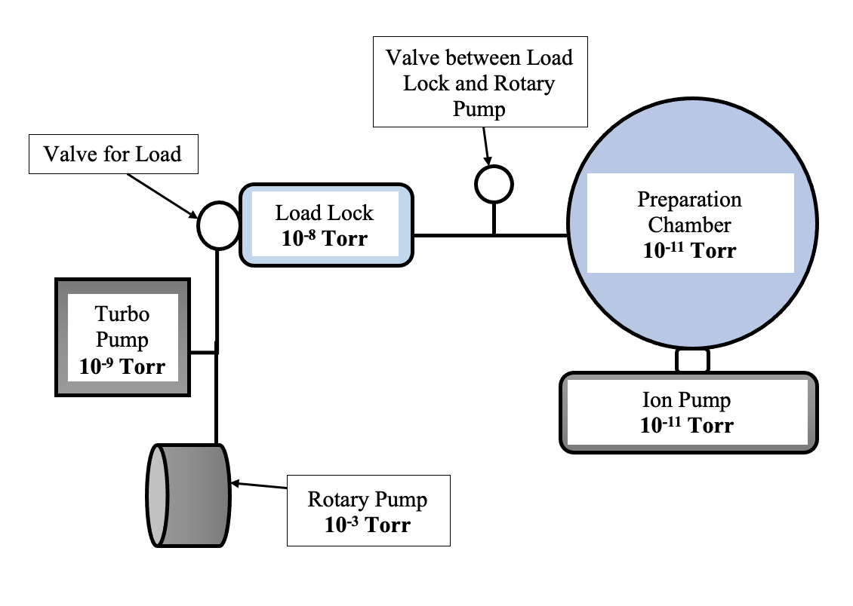
Ultra High Vacuum

Slide 17
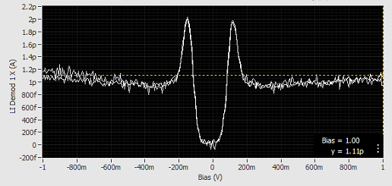

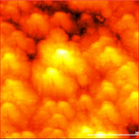
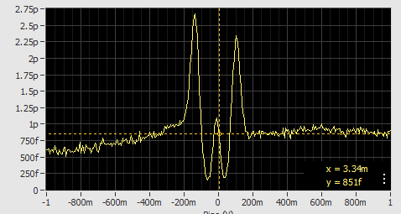
Experiments:
- Nb films grown on Si (001)
- Nb films grown on Si (111)
The Nb Thin Film 155 nm on New Moly Sample Holder
Topography
Area is 500 nm x 500 nm.
Roughness is 2 nm

Slide 18
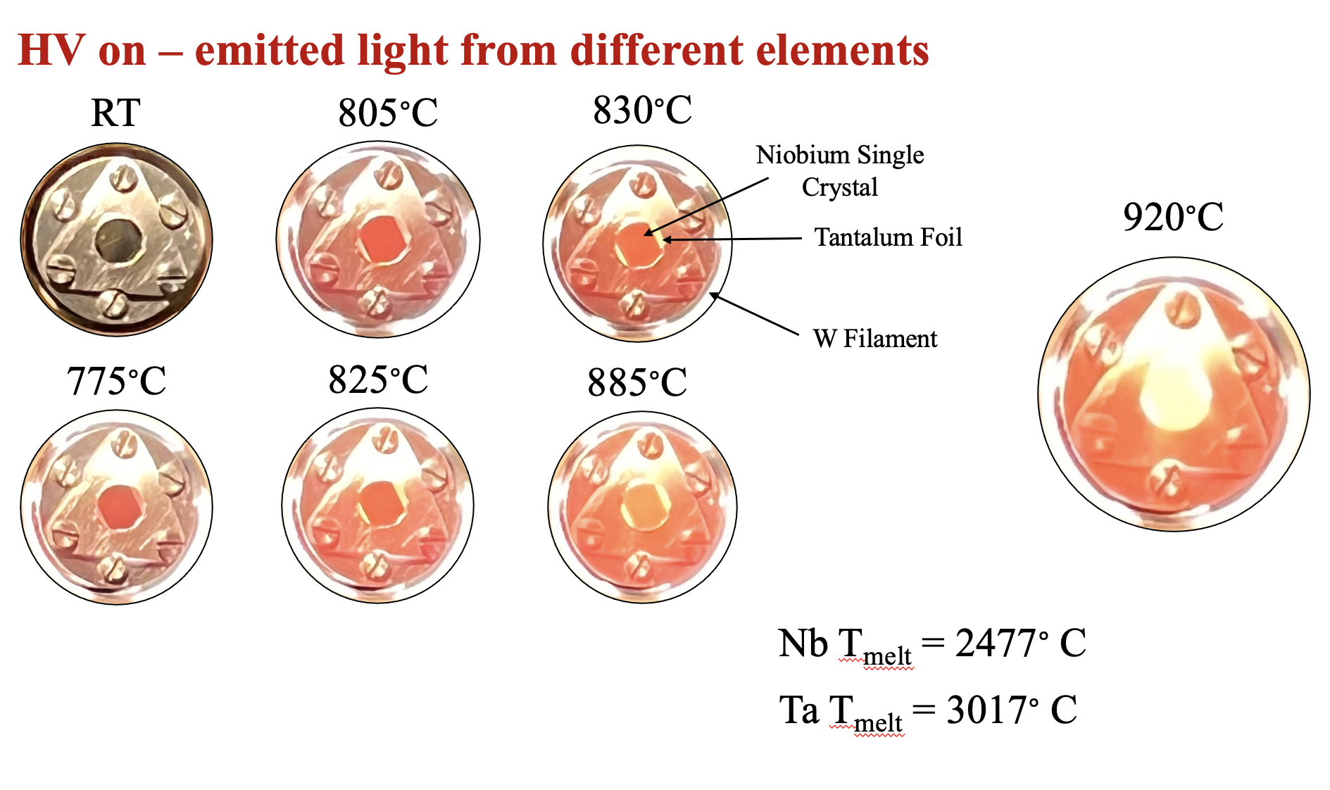
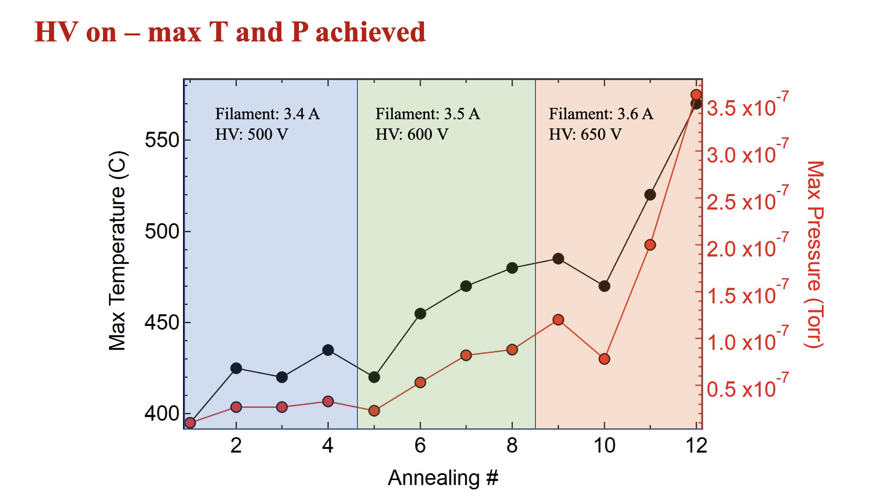
Annealing
Filament current of 3.7 A and 2.6 V and an external high voltage of 1200 V to heat the sample to 2200 C.

Slide 19
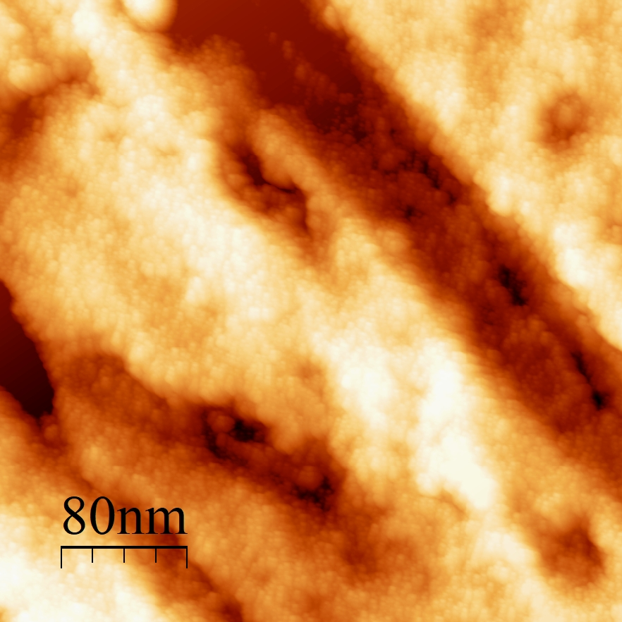
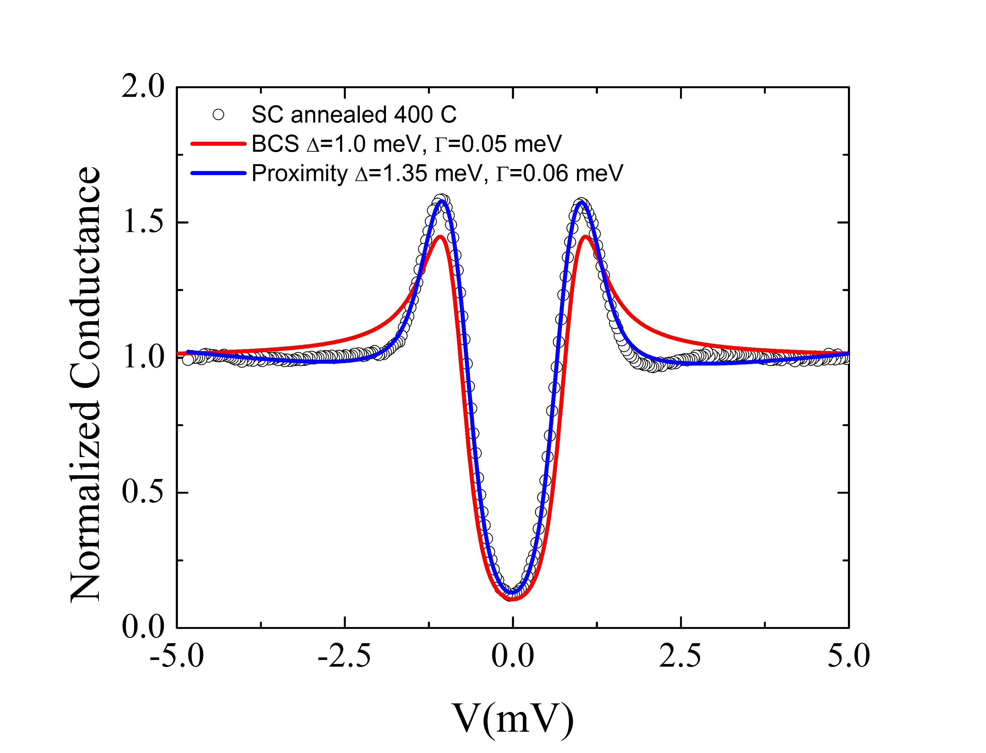
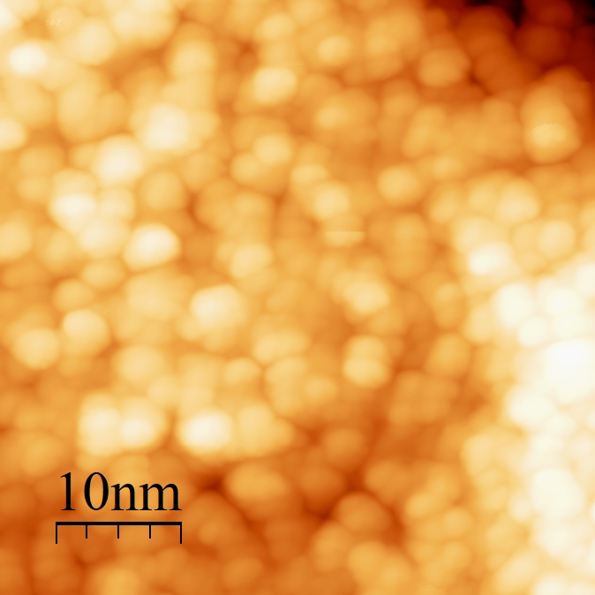
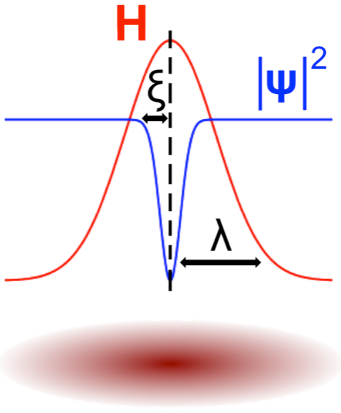
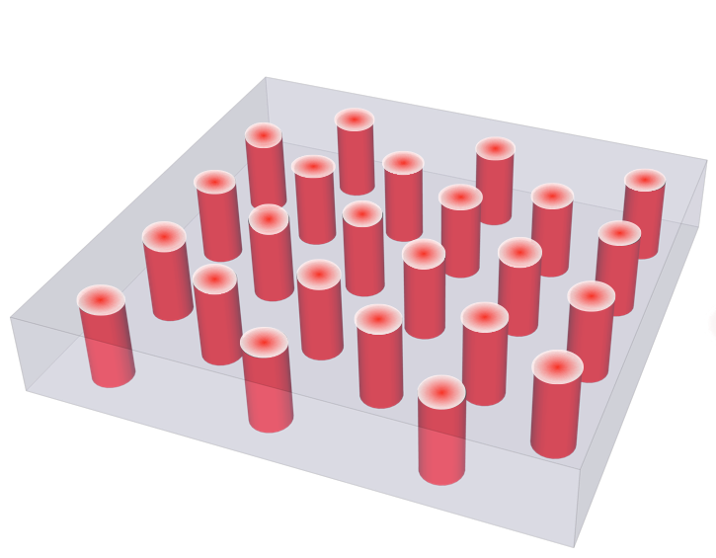
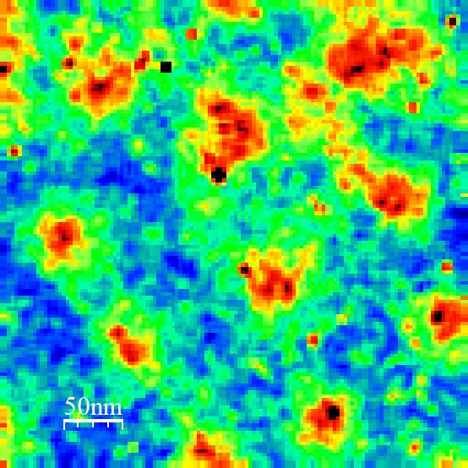
Topography
Spectroscopy
Spectroscopic Mapping and Vortices
Proximity feature
ξ=21 nm
Nb single crystal after annealing at 400 ℃ (Presence of NbO on the top)
Surface roughness higher than 1 nm.
Superconducting gap at the interface suppressed to 1meV.
Superconducting coherence length suppressed to 21 nm from the bulk value of 40 nm.

Slide 20
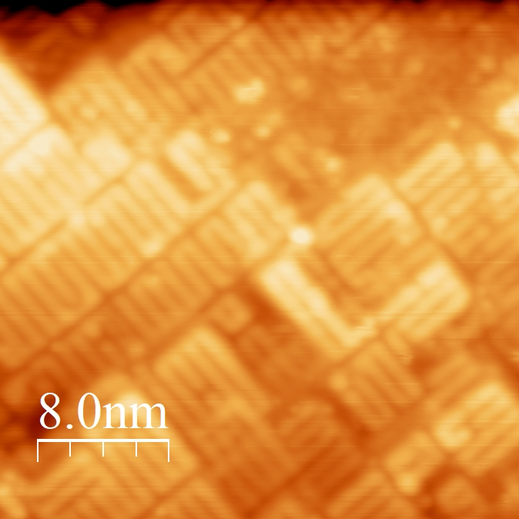
Topography
Magnetic field dependence
Spectroscopy
BCS Fit
Δ=1.55 meV
Γ=0.018 meV
Nb single crystal after annealing at 1700 ℃
Surface atomically flat.
Superconducting gap of bulk Nb 1.55 meV.
Superconducting coherence length suppressed to 30 nm from the bulk value of 40 nm.

Slide 21
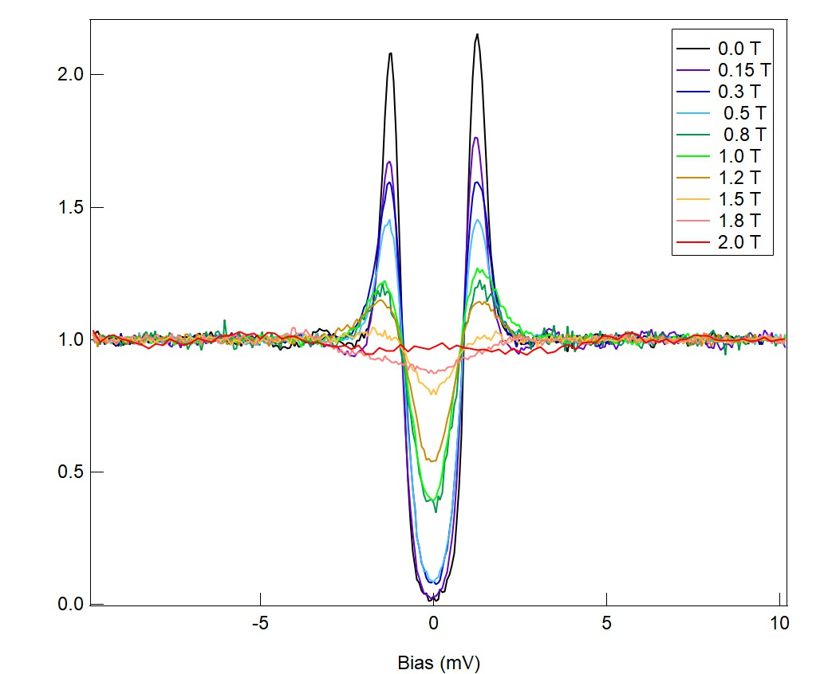
Magnetic Field Dependance
We performed another analysis on the Nb Film Si (001), i.e. the Magnetic Field Dependance
Superconductivity of a material is also determined by the amount of Magnetic Field present in the material.
Every material has a characteristic Hc2 value. Feature of a type II Superconductor.
Hc2 is the specific value of magnetic field at which a superconducting material transitions into its normal state.
Destruction of Superconductivity is related to the Coherence length of the material/ system.
Small coherence length corresponds to high dirty limit. Hence, finding the Hc2 value of a material helps us gain information about its coherence length.
The Hc2 value for Nb Film on Si (001) is about 2.0 T
Made using Igor Pro

Slide 22
Conclusion
After a UHV annealing at 400 ℃ the Nb pentoxide is completely reduced to an amorphous NbO.
After a UHV annealing at 400 ℃ , the reduced superconducting gap at the interface between the bulk Nb and the top NbO together with a reduced superconducting coherence length suggest diffusion of oxygen at the top surface of bulk Nb.
Further UHV annealing at 1700 ℃ a (3x1) oxygen reconstruction is observed in topography and a bulk superconducting gap is measured in topography. Magnetic field measurement suggest an increased coherence length and a clean interface.
Complete removal of oxygen requires annealing close to the melting point of Nb.
The HC2 value for Nb on Si substrates was ~ 2T
Quantum Computation can outperform current technology based on semiconductor chips.

Slide 23
Thank you

