Slide 1
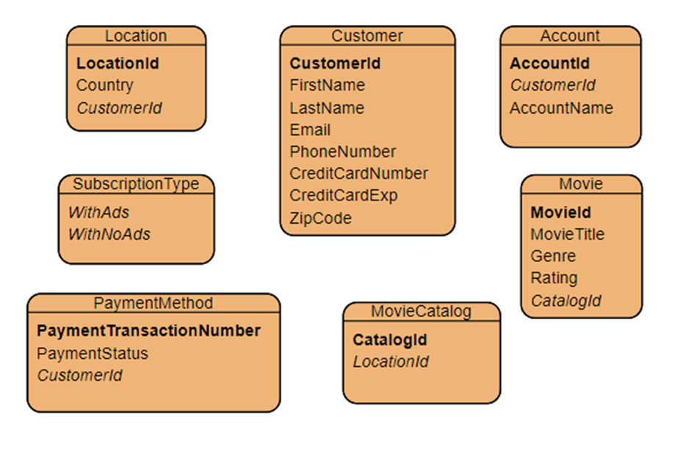
We take the assessment we made of our new eMovie Streaming Platform and go through the steps of creating a Conceptual, Logical, and Physical Data Model.
eMovie Streaming Platform
Business Object | Definition
Customer | Person who signed up to the eMovie platform.
Subscription Type | Subscription with ads or no ads.
Payment Methods | Digital payment information.
Customer Invoice | Receipt of payment made by customer.
Movie Catalog | Extensive catalog of all movies available by location.
Location | Location of customer to determine movie catalog.
Account | Multiple accounts can be made under the same customer but limited to 3 simultaneous usages.
Movie | A movie from the movie catalog.

Slide 2
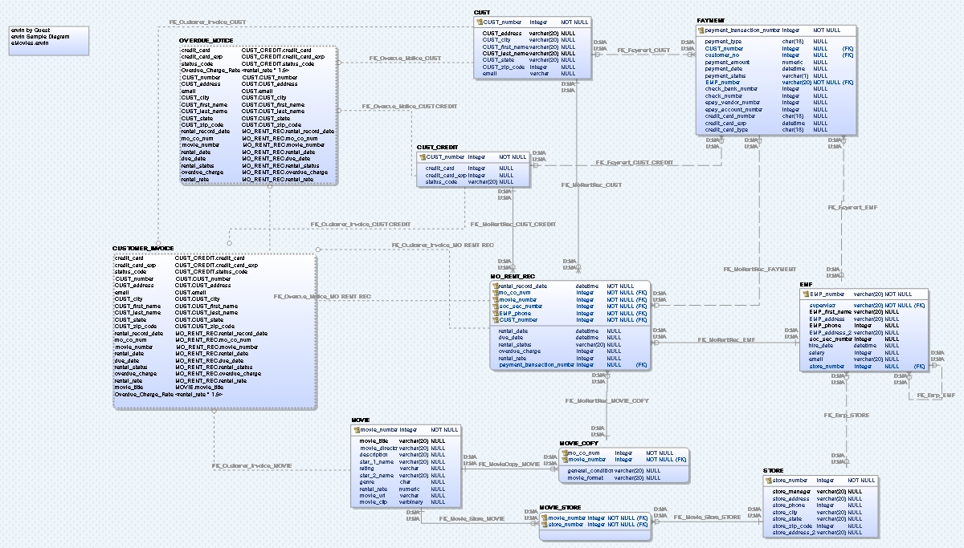
We take the eMovie model and modernize it, by using different tools such as the bulk editor in Erwin, Microsoft Excel and Notepad++, we can make the transformation of eMovie to our eMovie Streaming Platform faster and efficient.

Slide 3
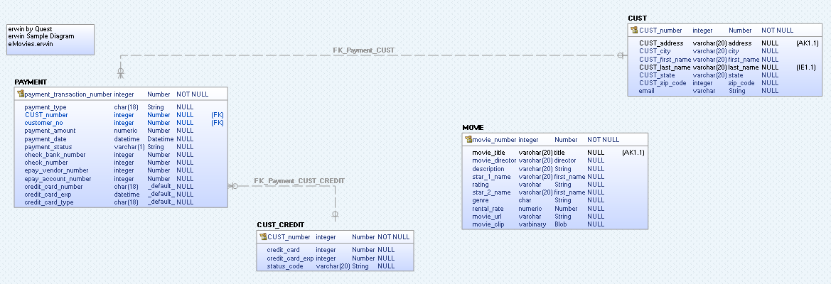
We removed tables that we have no use for anymore and leave the four tables shown above. Our next step is to edit these tables using bulk editor to correct the name convention of our table names and columns before we start adding our new tables.

Slide 4
After exporting the tables from Erwin’s bulk editor, we utilize notepad++ to make the name transformation to Proper Case and paste the changes in the csv file in Microsoft Excel.
ERwin Property Ids | 1075850516::User Formatted Name [read only] | 0::Object Type [read only] | 1073742126::Name | 1075849176::Physical Name | 1073742125::Definition | 1075849148::Comments
1075838979::141 | MOVIE | Table | MOVIE | MOVIE | A MOVIE is any video that can be rented” for the entity “MOVIE | A MOVIE is any video that can be rented” for the entity “MOVIE
1075838979::242 | CUSTOMER | Table | CUSTOMER | CUST | A CUSTOMER is a person or organization who has rented a movie within the past year. | A CUSTOMER is a person or organization who has rented a movie within the past year.
1075838979::262 | CUSTOMER CREDIT | Table | CUSTOMER CREDIT | CUST_CREDIT | CUSTOMER CREDIT is the status of available credit for a CUSTOMER | CUSTOMER CREDIT is the status of available credit for a CUSTOMER
1075838979::338 | PAYMENT | Table | PAYMENT | PAYMENT | A PAYMENT is received when a customer rents a movie | A PAYMENT is received when a customer rents a movie
ERwin Property Ids | 1075850516::User Formatted Name [read only] | 0::Object Type [read only] | 1073742126::Name | 1075849176::Physical Name | 1073742125::Definition | 1075849148::Comments
1075838979::141 | Movie | Table | Movie | Movie | A movie from the movie catalog | A movie from the movie catalog
1075838979::242 | Customer | Table | Customer | Customer | Person who signed up to the eMovie Streaming Platform | Person who signed up to the eMovie Streaming Platform
1075838979::262 | Payment Method | Table | Payment Method | Payment Method | Payment information | Payment information
1075838979::338 | Customer Invoice | Table | Customer Invoice | Payment | Receipt of payment made by customer. | Receipt of payment made by customer.

Slide 5
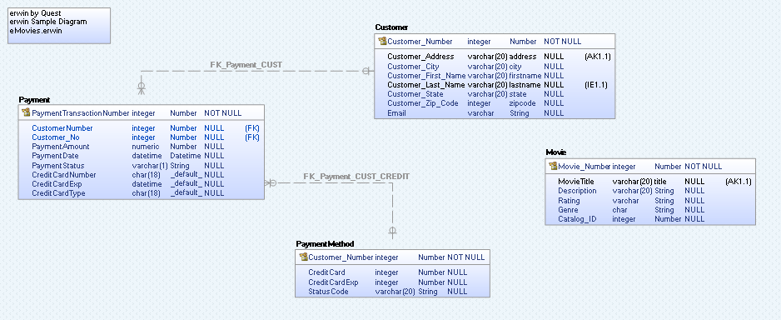
We proceed with also editing the column names and removing columns that are not part of our new model. We add new columns such as CatalogId to the Movie table that will serve as a foreign key to the Movie Catalog table we will create next.

Slide 6
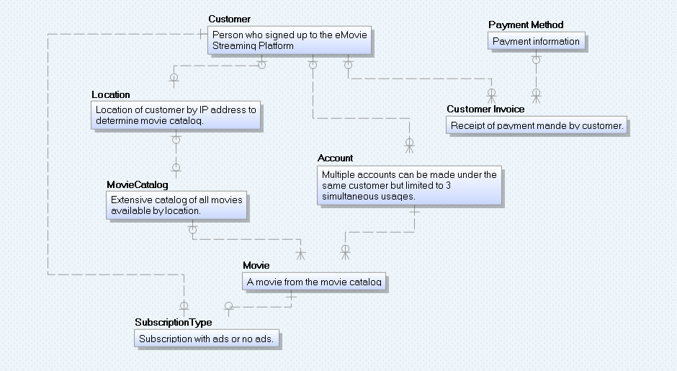
Below is the Conceptual Data Model that displays the definitions of each object. We have now created the new tables Location, MovieCatalog, SubscriptionType, and Account.

Slide 7
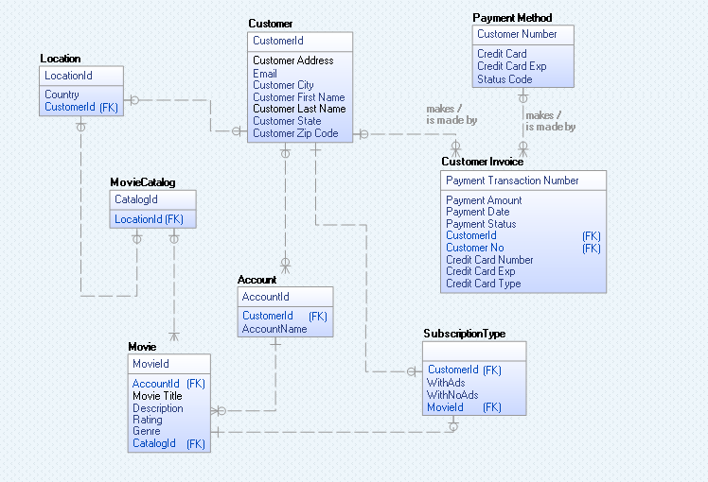
Below is the Logical Data Model, displaying the attributes of each table and their relationships.

Slide 8
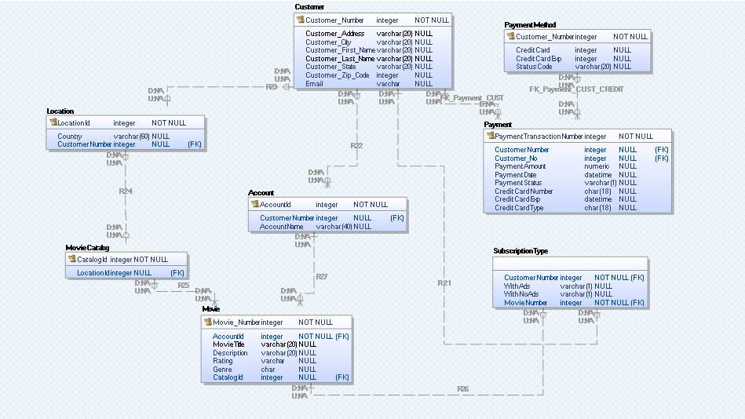
Below is the Physical Data Model, displaying the data types used for each attribute.

