Slide 1

Production Flask Prediction API — Project Overview
Goal: single POST /api/predict that accepts 11 farm data fields and returns a recommendation (Low/Medium/High), per-class probabilities, confidence score, water amount, best irrigation time, and an optional warning. Model artifacts (RandomForest + scaler + encoders + feature list + mapping) are provided as pickles in model_artifacts/. Tech stack: Python, Flask, Flask‑CORS, scikit‑learn, pandas, numpy, joblib, python‑dotenv.

Slide 2

Phase 1 — Project Setup
Repository
Environment
model_artifacts/, logs/, .env, .gitignore, requirements.txt, app.py, README.md
Virtualenv, pinned dependencies, tests to verify import and env loading
Configuration
Env vars: MODEL_PATH, FLASK_ENV, CORS_ORIGINS, CONF_THRESHOLD, LOG_LEVEL
Verified environment loading with a lightweight test script that imports artifacts and prints model meta.

Slide 3
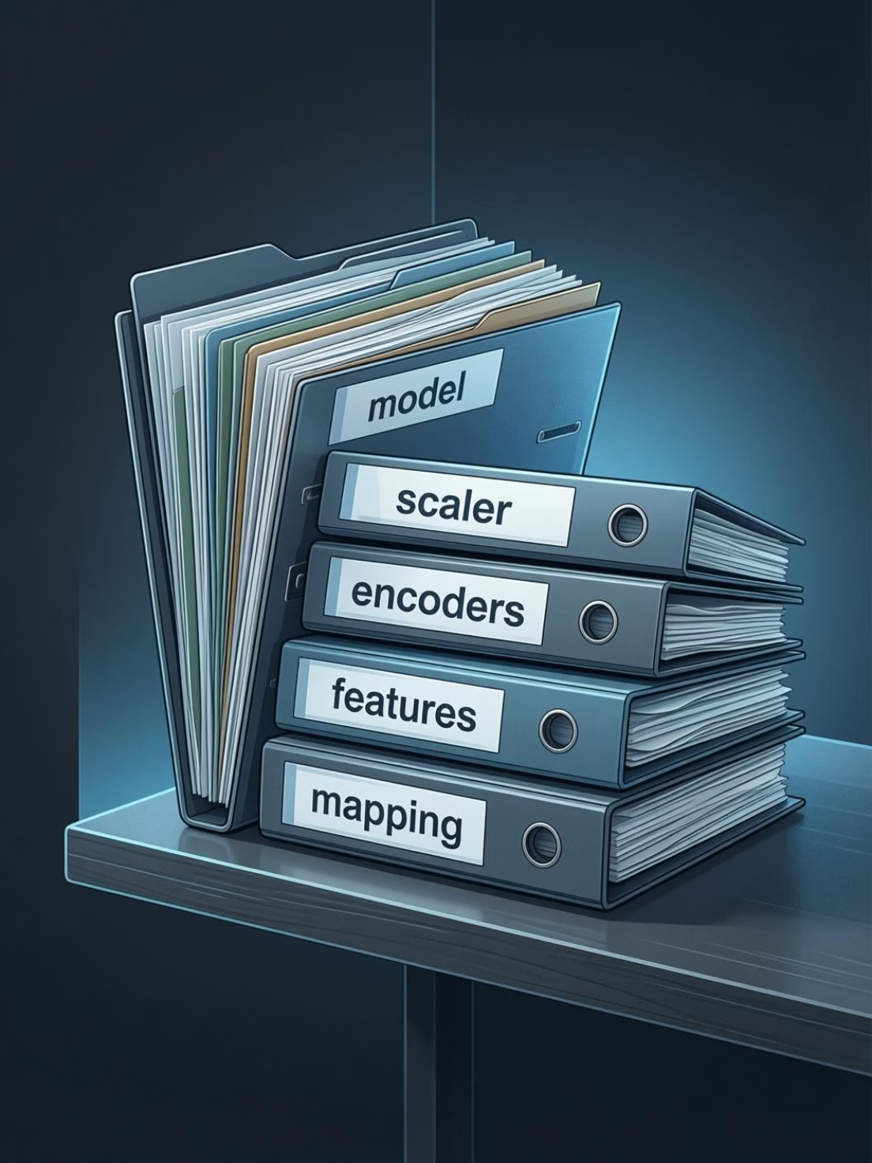

Phase 2 — Model Artifacts
Loaded five pickles: model, scaler, label_encoders, feature_cols, target_mapping
Confirmed model type RandomForestClassifier and feature count = 20
Noted scikit‑learn version warnings (documented but non‑blocking)
Ensure artifact integrity checks (hash/mtime) before service start to avoid silent mismatches.

Slide 4

Phase 3 — Basic Flask App
Implemented /api/health returning model status and feature count. Enabled CORS for http://localhost:5173. Added placeholder /api/predict that echoes input for early frontend integration tests. Verified server lifecycle and health responses.
Dev ergonomics
Auto‑reload, structured logging, clear error responses

Slide 5

Phase 4 — Input Validation
Defined 11 required fields with explicit bounds and categorical sets per frontend spec. Implemented validate_input() to verify presence, type, numeric ranges, and allowed categories. Returns structured 400 JSON: { field, message } to aid rapid debugging.
Edge cases handled
Testing
Missing fields, out‑of‑range numbers, wrong types, invalid categories
curl/PowerShell checks for each error case — responses validated

Slide 6


Phase 5 — Feature Engineering
Implemented required formulas exactly: Water_Stress_Index, ET_Proxy, Effective_Moisture, Irrigation_Deficit. Added five derived features expected by scaler/model and three categorical buckets: Rainfall_Category, Soil_Moisture_Category, Temp_Category. Included NaN/∞ guards on numeric columns.
Numeric guards
Categorical buckets
Clip ranges, replace inf with large sentinel, explicit NaN checks before scaling
Discrete labels to improve model generalisation and align with encoders

Slide 7
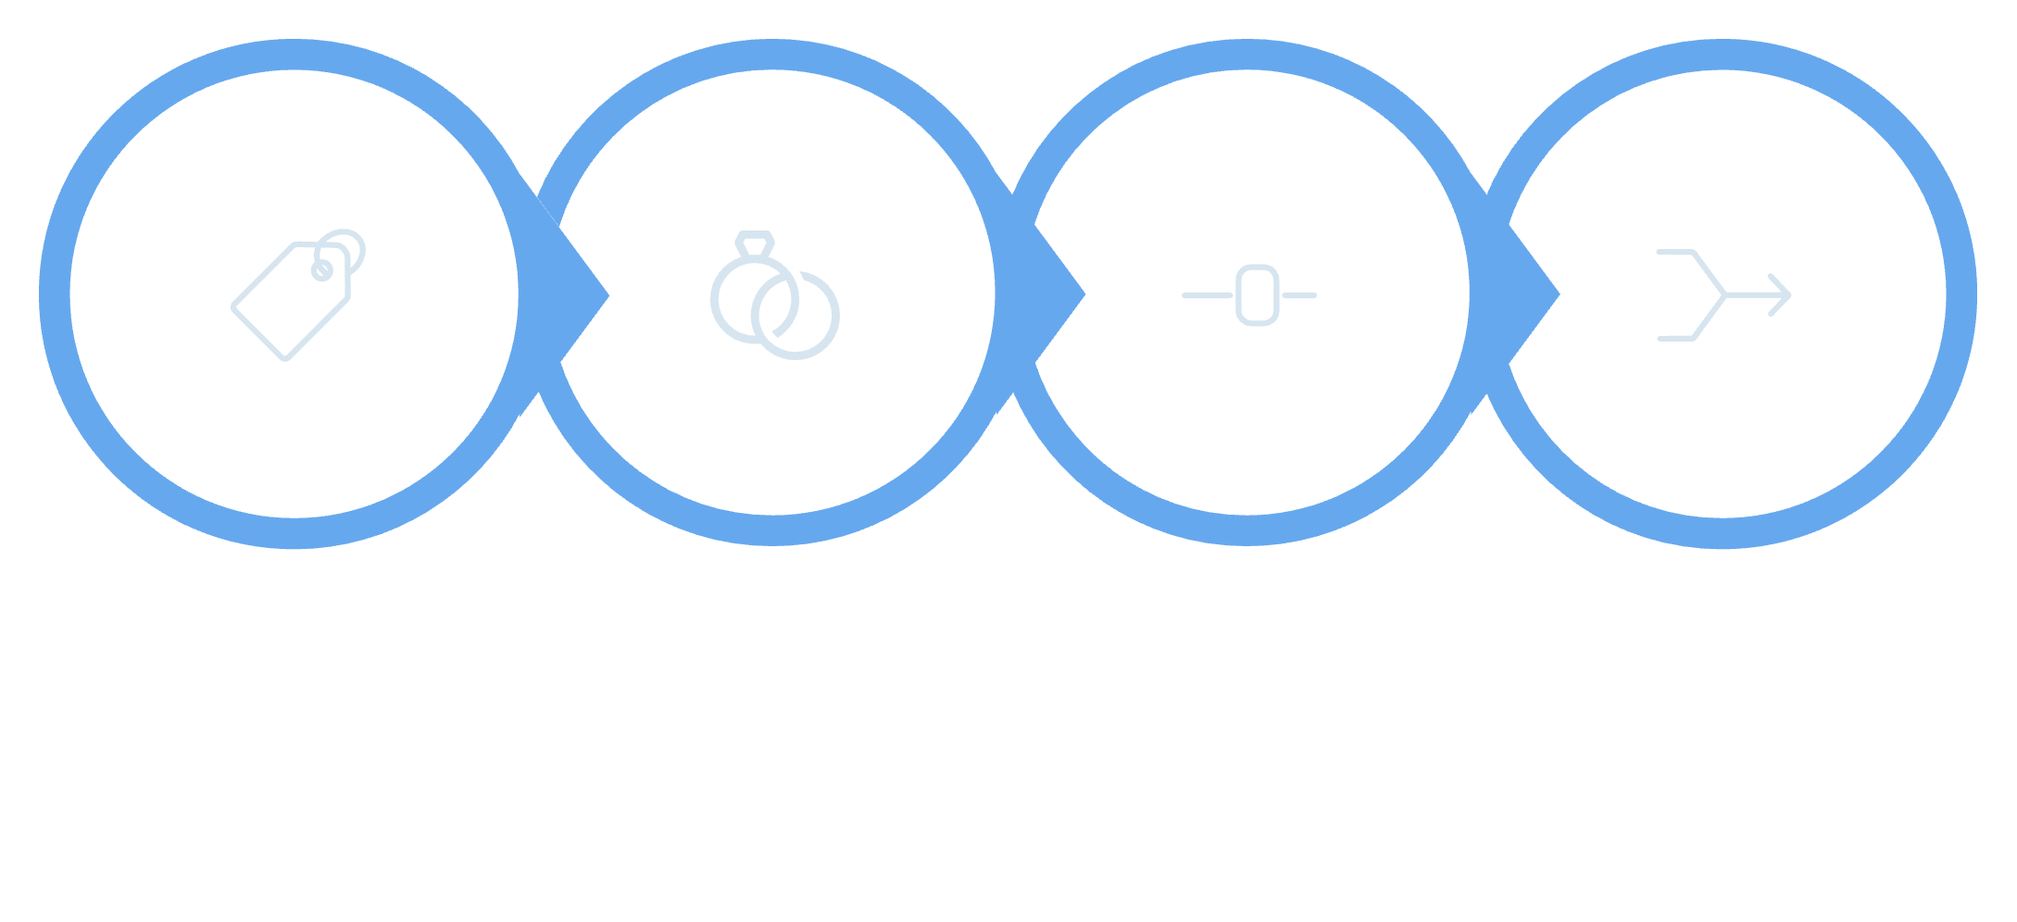

Phase 6 — Prediction Pipeline
Label-encoded categorical columns using saved encoders; unseen labels fallback to 0. Aligned DataFrame to feature_cols: added missing as zeros, dropped extras, reordered to exact expected sequence. Scaler expects 12 numeric features — constructed subframe, scaled, then merged back. Categorical features remain unscaled.
Label Encode
Align Features
Scale 12 Features
Reintegrate Vector
Maintain a scaler_features_compl ete.txt and feature_cols.pkl in sync; add CI check to fail build on mismatch.

Slide 8


Phase 7 — Response Formatting
Mapped numeric output to label via target_mapping with safe fallback. Computed confidence as max probability and normalised probabilities to sum to 1.0 (float safety). Added warning when confidence < 0.70. Looked up water_amount and best_time by label and logged each prediction (timestamp, inputs, result, confidence).
Robust mapping
Low confidence
Fallbacks ensure API never returns raw numeric codes
Include warning and suggest manual review or sensor recheck

Slide 9

Phase 8 — Testing & Debugging
Fixed NaN/∞ checks by restricting to numeric dtypes only.
Resolved scaler feature mismatch by reading scaler.feature_names_in_ and building scaling subframe.
Maintained full 20-feature input to model: scaled 12 numeric, keep encoded categoricals.
Converted numpy types to native Python for JSON serialisation (np.int64 → int).
After fixes, end‑to‑end tests produced stable predictions, consistent confidences and clean logs.

Slide 10

Phase 9 — Deployment Readiness
Code is production-ready: env-driven config, structured logs, and health checks. Recommend Render or Railway. Deployment checklist: push to GitHub, add gunicorn to requirements, set env vars on platform, deploy, update CORS to production origin. Share live URL with frontend team to switch from mock to real API.
1. Git
Push main and tag release
2. Runtime
Use gunicorn, set workers based on CPU
3. Secrets
Set env vars, restrict CORS, enable logging retention

