Slide 1
Boolean, if-else & Switch
by annemarie caballero
I.T. Girls august 13-17

Slide 2
Boolean
One of the primitive data types
Two values: true and false
Can be used in conditionals

Slide 3
Conditionals
Have a test statement (which must evaluate to true or false)
Often used to allows programs to respond to the user
There are two types
If-Else statements
Switch statements
(mostly used when there are multiple possibilities)
Example:
Executing code in a guessing game, when the user enters the right guess
condition
evaluated
true
false
statement

Slide 4
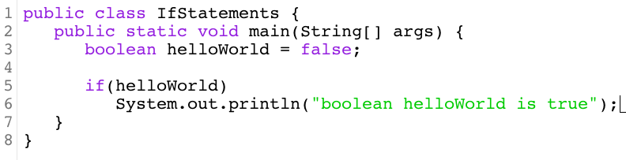
If Syntax

Slide 5
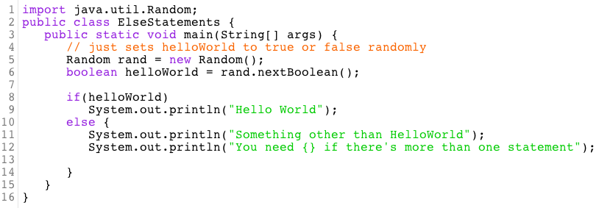
If-Else Syntax

Slide 6
operators
Syntax: | Means:
< | Less than
> | Greater than
<= | Less than or equal to
>= | Greater than or equal to
== | Equals (diff for String)
!= | Not equals
= means assignment
== means comparison
Syntax: | Means:
&& | AND
|| | OR
! | NOT

Slide 7
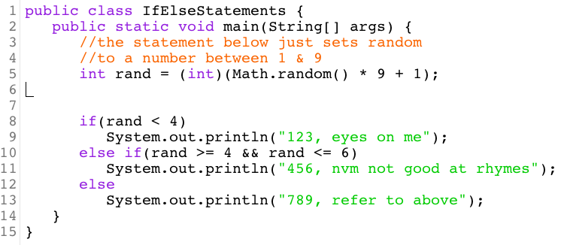
But what about multiple possible values for the test condition?

Slide 8
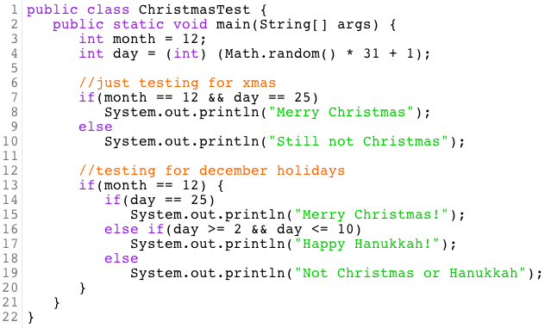
Nested ifs – putting ifs in other ifs

Slide 9
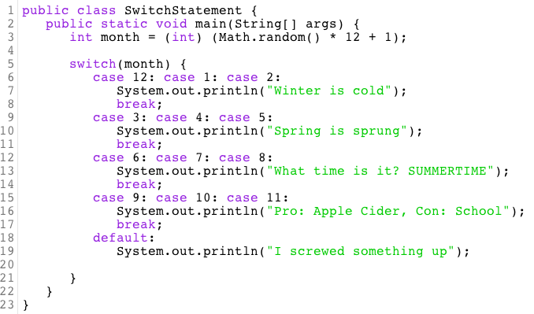
Switch statements
Easier (cleaner) option for testing multiple values
Checks a variable for multiple possible options (does not use a single boolean)
Case statements will continue until they hit break or return a value

