Slide 1
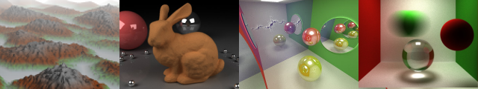
Project 1 Ray Tracer Demonstration
Qiong Wang
University of Pennsylvania
CIS 565 - Fall 2013

Slide 2
Features Implemented
Basic Features
Raycasting from a camera into a scene through a pixel grid
Phong lighting for one point light source
Diffuse lambertian surfaces
Raytraced shadows
Cube intersection testing
Sphere surface point sampling
Optional Features
Specular reflection (optional)
Soft shadows and area lights (optional)

Slide 3
Ray Tracing Algorithm
for each pixel
{
Construct ray from camera through pixel
Find first primitive hit by ray
Determine color at intersection point
Draw color
}
Psedo codes from: http://cse.csusb.edu/tong/courses/cs621/notes/ray.php

Slide 4
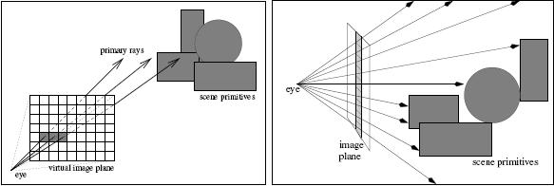
Ray Tracing Algorithm
Image from: http://cse.csusb.edu/tong/courses/cs621/notes/ray.php

Slide 5
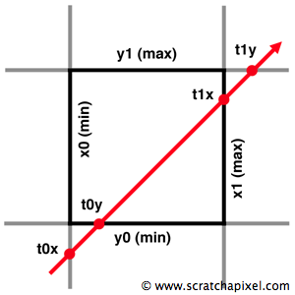
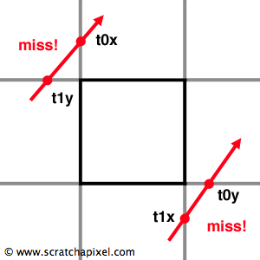
Box Intersection
Images from: http://www.scratchapixel.com/lessons/3d-basic-lessons/lesson-7-intersecting-simple-shapes/ray-box-intersection/

Slide 6
Bidirectional Reflectance Distribution Functions (BRDFs)
Define how lights is reflected at a given opaque surface
Reflectance models
Ideal Specular(mirrors)
Ideal Diffuse
Slide from: Liam's lecture – http://cis565-fall-2013.github.io/lectures/09-18-Raytracing.pptx

Slide 7
HARD TRIP STARTED!

Slide 8
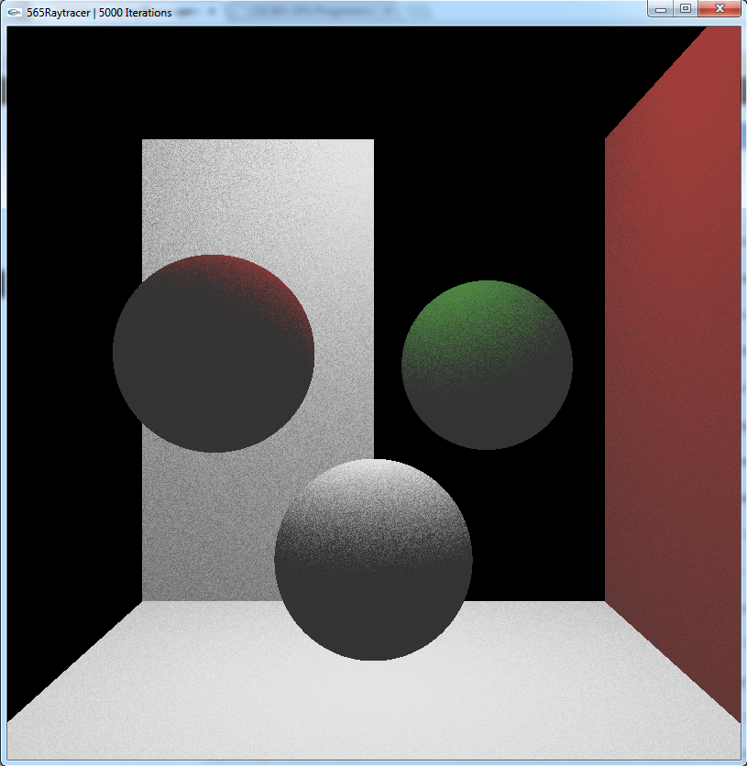
Result with wrong box intersect--ion

Slide 9
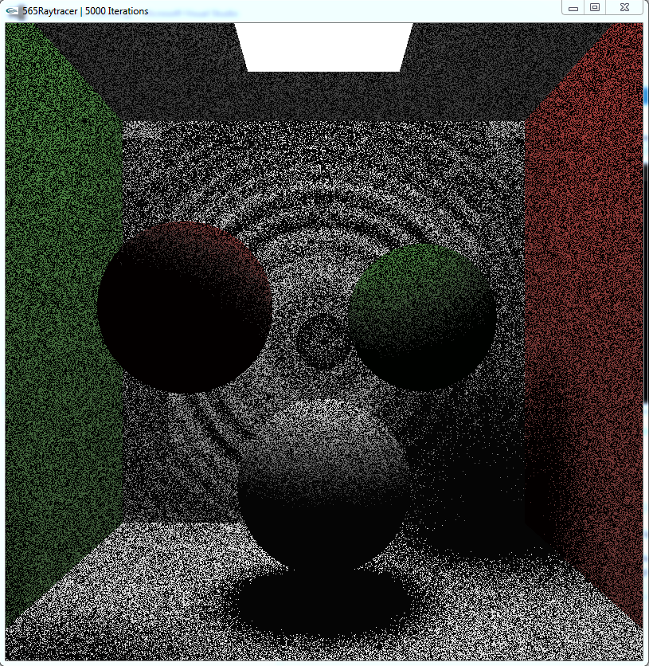
Result with right box intersect- -ion and apparent artifects

Slide 10
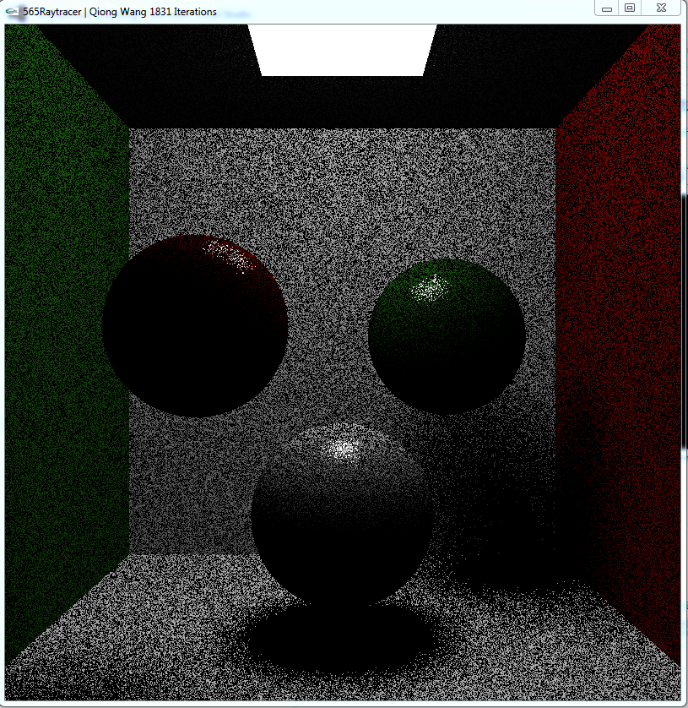
Result with noise

Slide 11
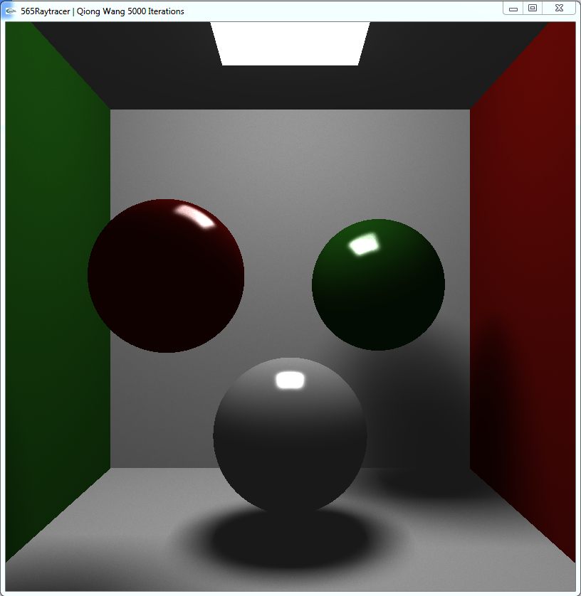
Final Result

Slide 12
Performance Evaluation
The processing rate changes when using different tileSize

Slide 13
References
Ray Tracing Algorithm:
http://cse.csusb.edu/tong/courses/cs621/notes/ray.php
Ray Tracing Pseudo-Codes
http://www.cs.unc.edu/~rademach/xroads-RT/RTarticle.html
Box Intersection
http://www.scratchapixel.com/lessons/3d-basic-lessons/lesson-7-intersecting-simple-shapes/ray-sphere-intersection/
Cosine-weighted Distribution
http://web.cs.wpi.edu/~emmanuel/courses/cs563/S07/talks/emmanuel_agu_mc_wk10_p2.pdf
Sphere Geometry
http://en.wikipedia.org/wiki/Sphere
Lambertian Surface
http://en.wikipedia.org/wiki/Lambertian
Blinn Phong Lighting
http://en.wikipedia.org/wiki/Blinn%E2%80%93Phong_shading_model
Ambient Light
http://en.wikipedia.org/wiki/Phong_shading

