Slide 1
关于UiControl和Uimenu中回调函数的说明

Slide 2
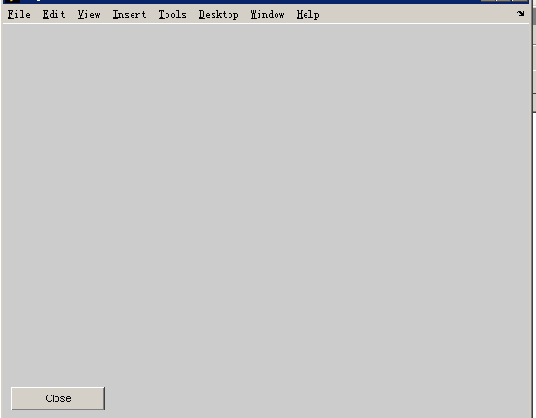
h_fig=figure
Hc_close=uicontrol(h_fig,'Style','push','Position',[10,10,100,25],'String','Close','CallBack','close');
上述语句中控件类型是按钮，位置在[10,10,100,25]，按钮上的字符为'Close'，点击按钮后执行的动作是'close'
‘Callback’, ‘回调函数‘(响应事件函数)

Slide 3
回调函数几种调用方式
1.直接语句调用
h_fig=figure;
hr1=uicontrol(gcf,'style','radio','string','正体','position',[70,60,50,20],'value',1);
Hc_close=uicontrol(h_fig,'Style','push','Position',[10,10,100,25],'String','Test','Callback','set(hr1,''value'',~get(hr1,''value''));’);
注意( a )语句用’ ‘将其括起来, 错误 set(hr1,'value',1)
( b ) 字符串必须用’’ ‘’括起来,错误 1.‘ ‘ 2.” “
2.直接语句组调用
c1=['subplot(1,3,2);line([1 2],[1 3])'];
uimenu(m,'Label','line','Callback',c1);

Slide 4
3.函数调用
回调函数设置 | 回调函数定义
set(h, 'StartFcn', 'myfile') | function myfile
set(h, 'StartFcn', @myfile) | function myfile(obj, event)
set(h, 'StartFcn', {'myfile', var1, var2, ...}) | function myfile(obj, event, arg1, arg2, ...)
set(h, 'StartFcn', {@myfile, var1, var2, ...}) | function myfile(obj, event, arg1, arg2, ...)

Slide 5
h_fig=figure;
hr1=uicontrol(gcf,'style','radio','string','正体','position',[70,60,50,20],'value',1);
%Hc_close=uicontrol(h_fig,'Style','push','Position',[10,10,100,25],'String','Test','Callback',{'test',hr1});
Hc_close=uicontrol(h_fig,'Style','push','Position',[100,10,100,25],'String','Close','CallBack','close');
function test(obj,event,hand)
x=get(hand,'value');
disp(nargin);
if x==1
set(hand,'value',0);
else
set(hand,'value',1);
end
end

