Slide 1
Transcribing Handwritten Text
Gabrielle Chavez, Jackson Shapiro, Mehmet Emre Tiryaki

Slide 2
Problem
Texts are used as data for various applications:
NLP : summarizing, sentiment analysis
Storage: easier and more robust.
However, some data is handwritten on paper, which the models described above cannot use.
Some examples
doctor’s charts
old manuscripts
handwritten notes etc.
To fix this problem we need a method to convert handwritten text images into digital text.

Slide 3
Project Description
We built various Machine Learning models that include different neural networks to transcribe handwritten characters.
We compare the results of each model and discuss the advantages and disadvantages of each.
Non-Neural Network Models | Neural Network Architectures
Random Forest | Feed-Forward
XGBoost (Extreme Gradient Boosting) | CNN (Convolutional Neural Network)
KNN (K-Nearest Neighbors) | Transformer With Convolutional Neural Network Features

Slide 4
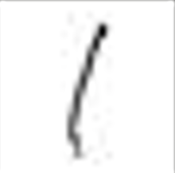
Data
Image Examples:
We used the AlphaNum Dataset
108,781 grayscale images
~24x24 pixels
Training, Testing, & Validation dataset
Preprocessing
Not all images were the same pixel size
We padded each image to be 28x28
Mapping (elaborate in NN)
Padding

Slide 5
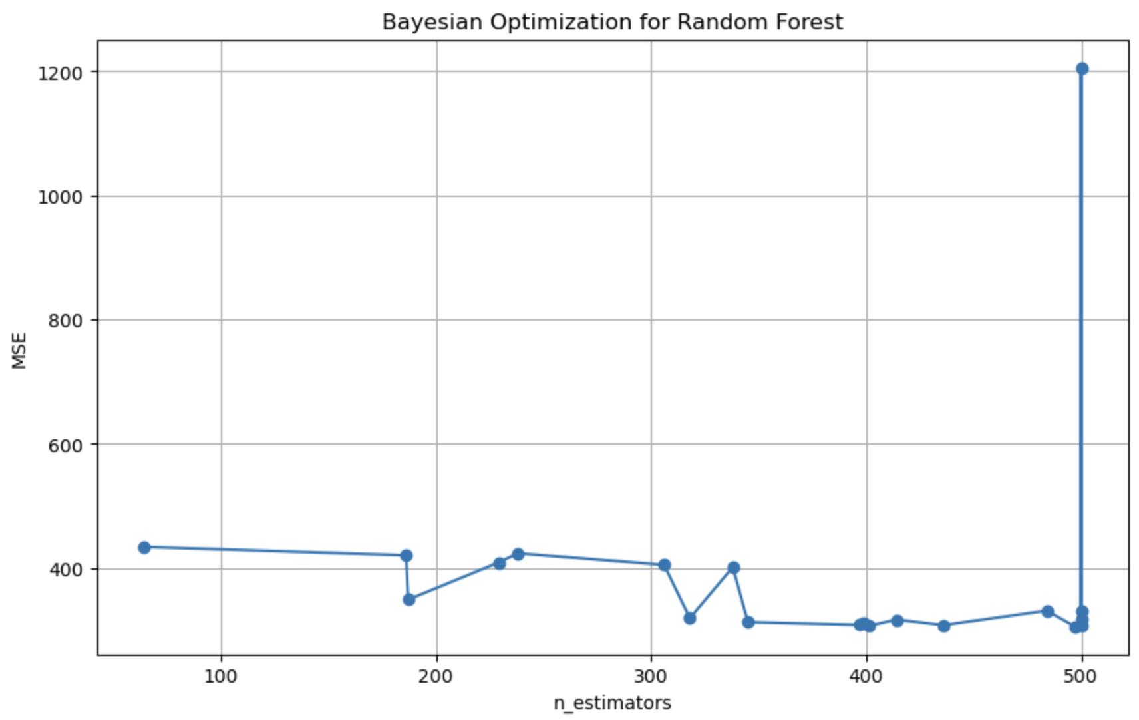
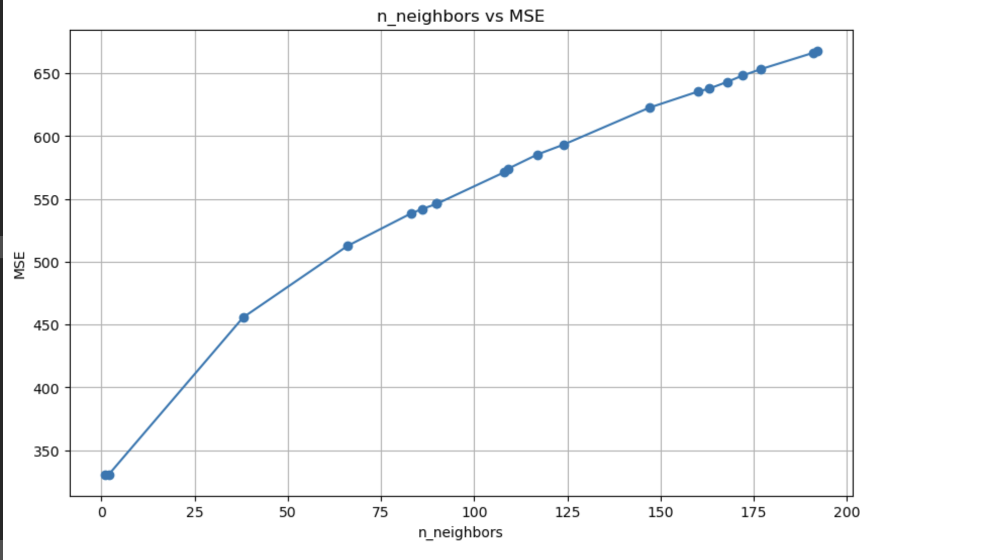
Bayesian Optimization
Optimization method for justified hyperparameter tuning
Iteratively converge towards best hyperparameters that minimize the given loss function (MSE)
K-Folds validation to prevent overfitting

Slide 6
Training Loop
Cross-Entropy Loss
Validation
Early Stopping
Patience
Reduce on Plateau Scheduler based on validation loss

Slide 7
Feed Forward NN
Output
Logits
&
Classification
28x28
784 x 1
3 Hidden Layers
Each Hidden layer used ReLu activation function & Linear transformation
We decreased the layer size by ½ each time
We use a linear Transformation as the final layer before classifying the output
Notes:
https://afit-r.github.io/feedforward_DNN
https://www.geeksforgeeks.org/feedforward-neural-network/
https://deepai.org/machine-learning-glossary-and-terms/feed-forward-neural-network#:~:text=Architecture%20of%20Feedforward%20Neural%20Networks,layers%20are%20interconnected%20by%20weights.

Slide 8


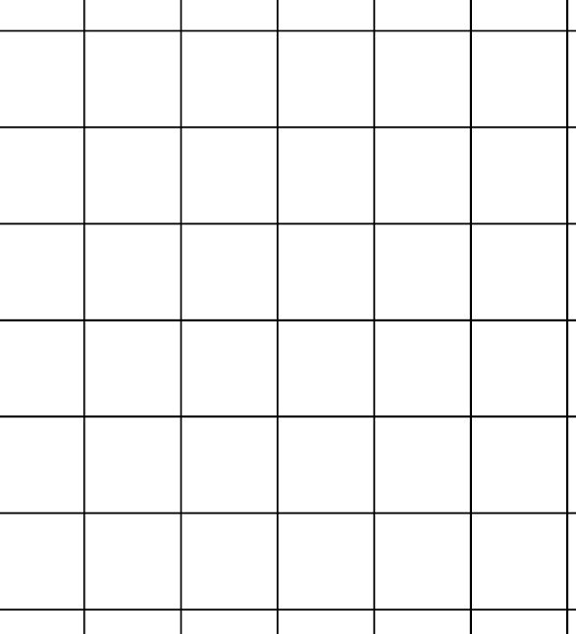
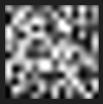
Convolutional NN
2 Hidden Layers
Final ReLu Func
Input
Output
Logits
&
Classification
28x28
14x14
7x7
Flatten
Kernel Size = 2 , reduced dimension by 2
2 Hidden Layers: Convolution → ReLu Activation Function → Pooling
After flattening we use another ReLu Activation Function to get Logits & then Classify the largest logit

Slide 9
Transformer With CNN Features
TRANSFORMER
Input
Output
DECODER
DECODER
DECODER
DECODER
Logits
&
Classification
CNN
ENCODER
DECODER
Spatial Feature
FULLY CONNECTED LAYER
28x28
The transformer has 8 attention heads per encoder and decoder
attention head: calculates the “importance” of each feature

Slide 10
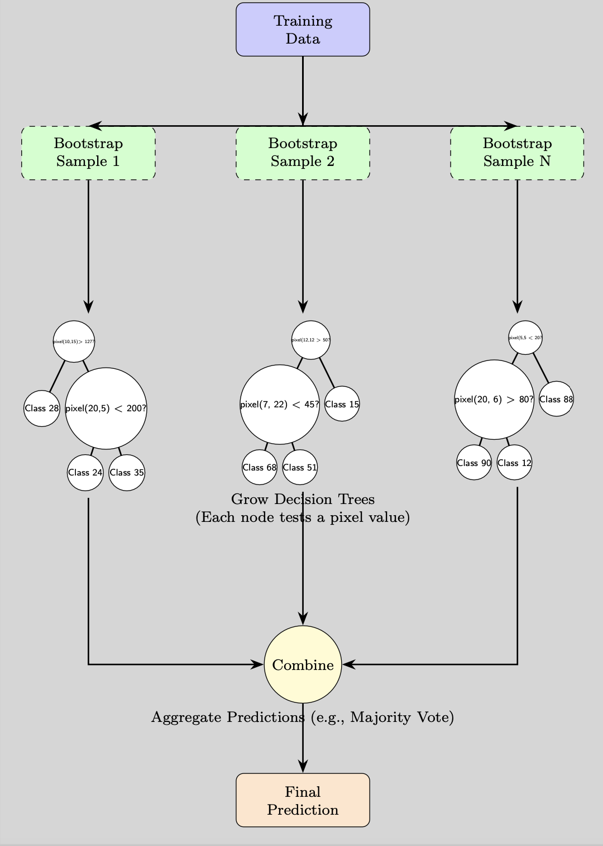
Random Forest
Uses CART (Classification and Regression Trees) Algorithm to build decision trees with binary separations
Calculates information gain using the log-loss and chooses the decision with highest information gain per layer
Bootstrap to get a subset of the data and build an ensemble of trees.
The final classification is the majority vote of the constructed trees.
Our random forest was made up by 184 trees, which were trained to optimize log-loss, using a max depth of 41
explain criterion
Converged on this set of parameters through Bayesian Optimization

Slide 11
XGBoost
Builds trees iteratively, attempting to improve loss at each iteration through the process of gradient boosting
Each tree is created to achieve the negative gradient of previous iteration
The predictions of each new tree are added to overall model’s predictions, scaled by a learning rate
Our XGBoost model creates 140 consecutive trees, which were trained to optimize objective function using a max depth of 8
Objective function combines cross-entropy loss with L2 regularization to prevent overfitting
Uses the softmax function to select class with highest probability

Slide 12
K-Nearest Neighbors
Classifies images by using train and test datasets.
Converts Image to a Feature Vector
Uses Euclidean distance to find distance between vectors
Uses voting process to classify images
In our model we used Bayesian Optimization to find the best value for the number of neighbors:
best value: 3

Slide 13
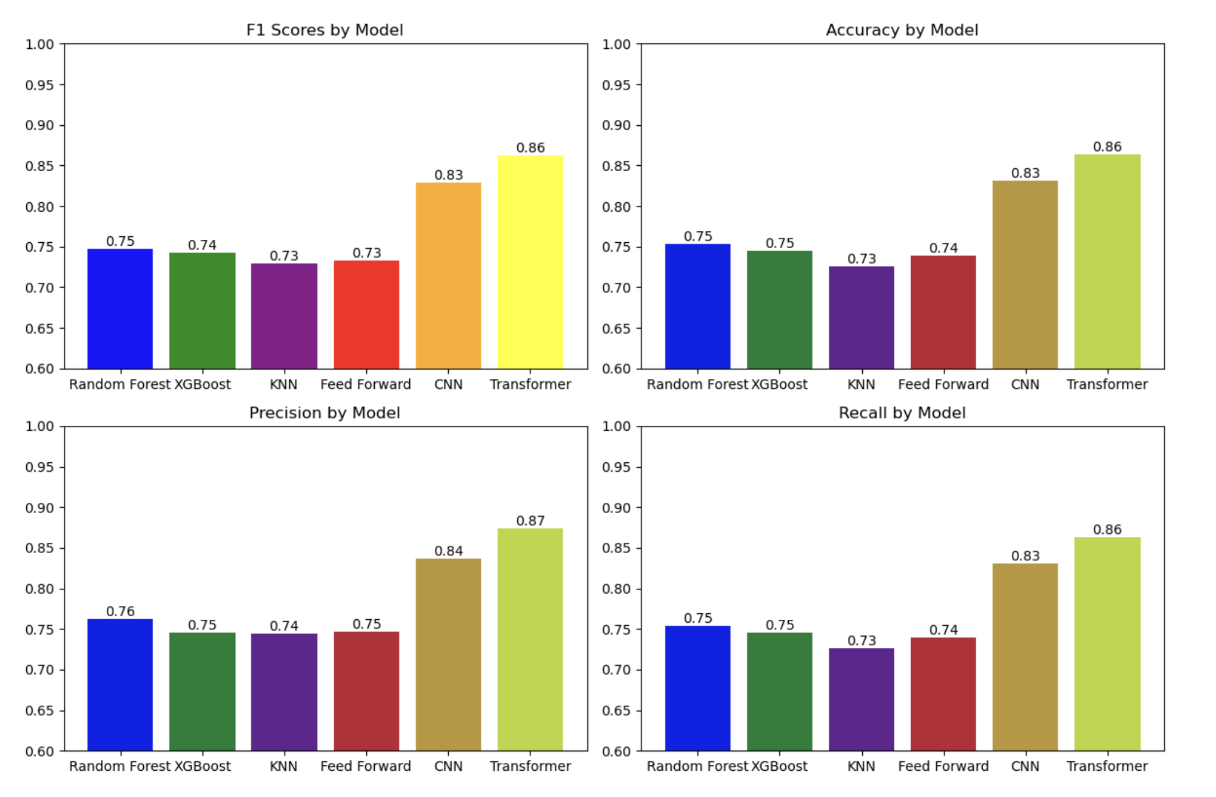
Results
Weighted average for
F1 score: Avg of Precision & Accuracy
Precision: measures correct positive predictions
Recall: measures correct positive predictions out of all positive predictions

Slide 14
Discussion
Accuracy of Various Models
Transformer outperforms other models
Feed-Forward Neural Network in-line with more traditional models
Traditional models perform relatively well
Training Time of Models
Time vs. accuracy trade-off using Transformer
CNN has closer training time with other models while keeping higher accuracy

Slide 15
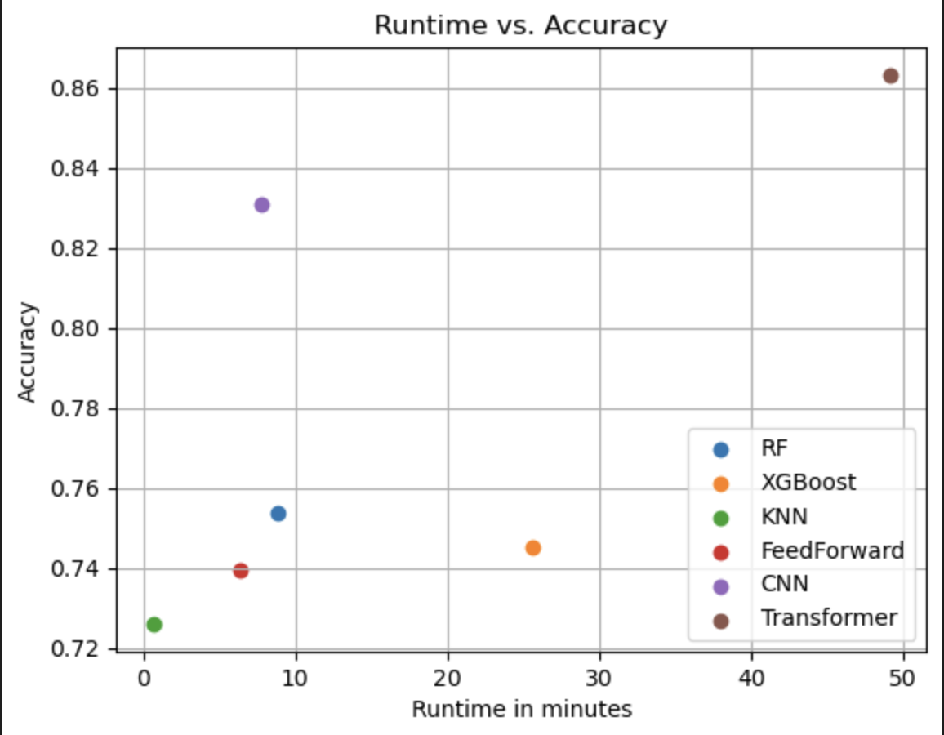
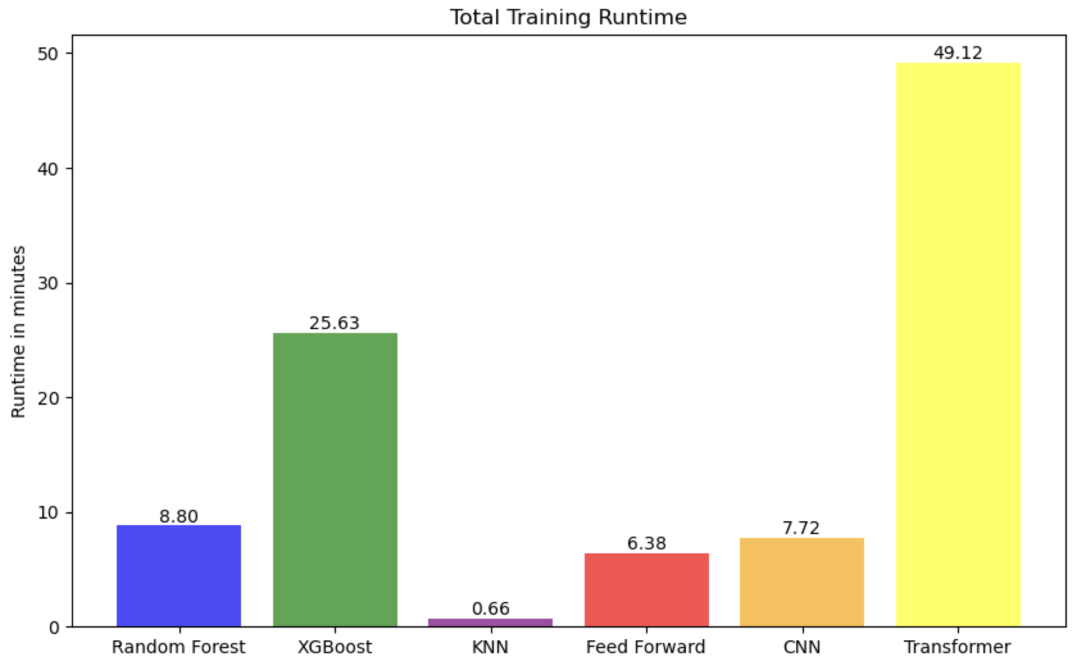
Challenges
Data
Inconsistent image sizes
Incompatible class labels
Training
Only had access to CPUs
All models took a while to train using Bayesian Optimization
Hyperparameter Tuning
Bayesian Optimization too computationally intensive

Slide 16
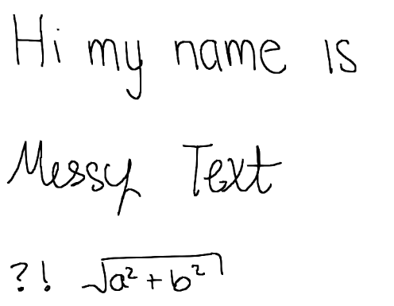
Implications & Extensions
Future Ideas:
We can transcribe:
Sentences
Messy or Cursive Text
Mathematical Expressions
Can be used to:
transcribe historical documents

Slide 17
THANK YOU!
Questions?

