Slide 1
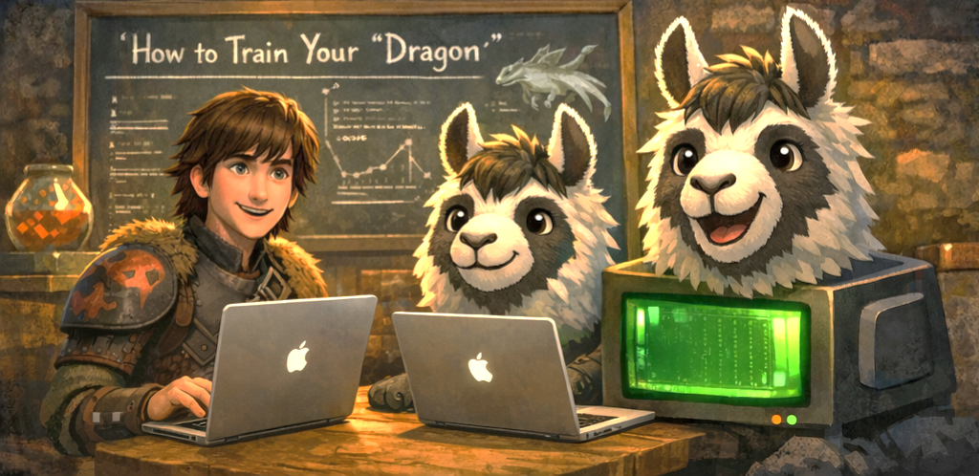
Using Ollama as a Framework
Spring Summit 2026
Tristan Roberts & Gabrielle Maxey

Slide 2
Things We Will Cover
Make a Model Yours
How to ‘Train’ vs Tune
Working With A Lora Adapter
Questions
Expected throughout

Slide 3
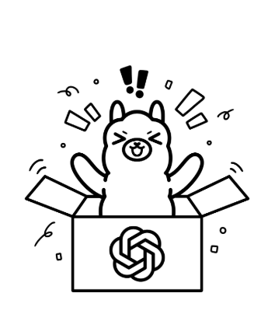
What is Ollama
a lightweight, extensible framework for building and running language models on a local machine.
Supports many popular models such as OpenAI, gemma, mistral, and llama
Allows personalization of input data, interpretations, and response.
Now Includes the ability to run cloud models, eliminating the need for individuals to have massive GPUs.
Notes:
You can think of Ollama as the interface that allows you to interact with a LM on your machine.
The models are quantized so they are smaller
Available across multiple platforms
With Ollama you can ‘personalize’ a model to fit your specific needs

Slide 4

Model Types Available for Use With Ollama
Chain of thought prompting
Structured output
Reliable
Thinking
Multimodal
Visual-language fusion
Works with both image + text
Vision
Text -> vectors
Semantic search + clustering
RAG over docs
Embedding
Execute code, browse, query
Connect APIs
Add external capabilities
Tools
Ollama lets you run models locally and extend them with vision, embedding and tool use.
Notes:
Thinking – Text only
Vision – Text and image interpretation
Embedding – Basically chunking and sorting words into like/similar segments

Slide 5
Train Your Dragon:
Ways to Make it Work for You
Lora Adapters
Lightweight fine-tuning adapter
Tool / Internal APIs
Allowed list lookups
RAG (Retrieve + Augment)
Top-K chunks + citations
More capability
More engineering
Local-only by default
Redact before indexing/prompting
Allow-list source & file types
Keep citations to show provenance
Data Control
Few- Shot Examples
1-3 examples: input -> ideal output
Task Prompt / Output Contract
Summary , Findings, Actions, Verify
System Prompt (Modelfile)
Role, tone, rules,
Notes:
Are you REALLY training the model or are you ‘tuning or optimizing’ what’s the difference?
What it really means to train – building and refining a base model– like llama or Claude.
To train a model you need loads of GPUs. the larger the model created the more GPUs.
Start with prompts: system prompt sets behavior; tasks prompt set structure
Few-shot improves consistency without ‘training’
RAG adds grounding by retrieving internal context with citations
Tools/API add real-time truth safely via an allow-list
Lora is the step where we adapt behavior permanently with an adapter.
Training a lora adapter requires a large amount of GGUF. Again, the larger the adapter the more GGUFs.

Slide 6
Type | How is it Tuned | What Changes / What Doesn’t | Pros / Cons | Best For
Prompt | Instructions & examples No learning, memory, or persistence | Tone Output format Role Reasoning style ------------ Model knowledge & instincts Long-term behavior | No infrastructure Fast iteration Safe & reversible ------------ Brittle Can require verbose prompts Can be inconsistent | Prototyping Demos One-off analysis
RAG Retrieval–Augmented Generation | Inject external data at runtime Docs, API response, DB queries etc. Model reasons over supplied data | Available knowledge ------------ Model behavior, reasoning, instincts | No ‘training’ required Data stays external to the model Good for internal systems Auditable & Controllable ------------ Context window limits Latency Still needs good prompting | Internal APIs Knowledge bases Live system interpretation Air-gapped enterprise use
Adapter Based Lora | Small trained parameter layers added to a base model Base model remains frozen Permanently biases behavior | How the model interprets Domain instincts Output consistency Generalization within domain ------------ Base model weights Core language ability | Persistent Short prompts Consistent outputs Cheaper than full training ------------ Requires training pipeline Harder to iterate than prompts Needs curated datasets | Stable domain logic Structured outputs Compliance workflows Repeatable automation

Slide 7

CHECK HERE FIRST!
Before you download a model, be sure to check the company’s AI Governance Page
Only use approved models
Ensure the model and your application isn’t performing any prohibited actions, like sending Lumen data outside our network.
If you are unsure, stop and ask your friendly AI Ambassador or contact the Ambassador team at the email below.
AI-Governance@lumen.com.
This Photo by Unknown Author is licensed under CC BY
Notes:
Before you go on a downloading spree, you want to make sure that you are going to the company’s AI Governance site.
Check to see if the model is on the approved list and not performing prohibited actions. If you have questions or are unsure, reach out to the AI Governance DL.
The point of today and presenting Ollama to you, is, if you haven’t already is to see and think about what is possible.

Slide 8

Jupyter Notebooks
Notebook_prompting:
  promptEngineering_example.ipynb:
    Modelfile Manipulation
    Environment setup/verification
    Chat interaction using sample data
    Adding interpretation instructions and using files
    Image analysis (vision)
Notebook_rag:
  rag_example.ipynb:
    Introducing an embedding model
    Add vectors via chunking
    Build vector index
    Retrieval of relevant chunks
    Generating a response
  rag_w_redaction_ex.ipynb:
    Add redaction to output and input

Slide 9
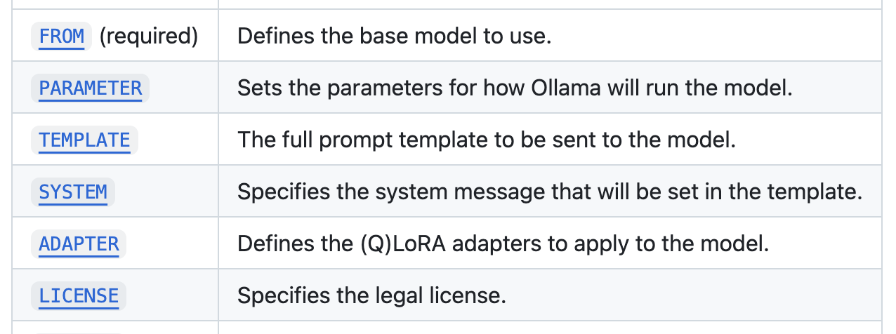
What variables make a model yours

Slide 10
Frequently used Ollama API Endpoints
api/generate
api/create
1
POST – single-turn completion (Prompt->return)
When to use: When you don’t need role/history
4
POST – builds from a Modelfile
When to use: When you want pinned params/templates.
api/chat
api/tags
2
POST – role based messages
When to use: Conversation, retrieval and reasoning, built in history
5
GET – list local models
When to use: When you want a list of models on your machine
api/embed
api/show
3
6
POST – vector embedding, chunks text into numeric vectors for search/RAG.
When to use: Searching documentation
POST – model metadata
When to Use: To see detailed parameters
https://github.com/ollama/ollama/blob/main/docs/api.md#create-a-model

Slide 11
Links
Site | Address
Lumen AI Governance | https://centurylink.sharepoint.com/sites/ILLegalCorpAdmin/SitePages/AI-Governance.aspx email: DL-AI-Governance <DL-AI-Governance@lumen.com>
Ollama Website | https://ollama.com/
Ollama GitHub | https://github.com/ollama/ollama
Ollama Documentation | https://ollama.readthedocs.io/en/
Ollama Model Documentation | https://github.com/ollama/ollama/blob/main/docs/modelfile.md
JavaScript Library | https://github.com/ollama/ollama-js
Python Library | https://github.com/ollama/ollama-python
LangChan | https://python.langchain.com/docs/integrations/chat/ollama/
LangChan Embeding | https://python.langchain.com/docs/integrations/text_embedding/ollama/

Slide 12
Links
Site | Address
Link to Jupyter Notebooks | SpringSummit26
Fine Tuned Model Used in Demo | https://github.com/molbal/llm-text-completion-finetune?tab=readme-ov-file
Learn about llama.cpp | https://en.wikipedia.org/wiki/Llama.cpp
Llama.cpp github | https://github.com/ggml-org/llama.cpp?tab=readme-ov-file - llamacpp
Meta explanation of updated Tokenization using Tiktoken | https://www.youtube.com/watch?v=Tmdk_H2WDj4
Walk thru & explanation of quantization. | https://www.youtube.com/playlist?list=PLcp6ZnH4WYlZOXUK-6V2iaZ6SeoxhC8Dg
Chunking Strategies | https://www.youtube.com/watch?v=ZTOtxiWb2bE
What is a vector db? | https://www.youtube.com/watch?v=Yhv19le0sBw

Slide 13
Links
Site | Address
Podman (container) | https://podman.io/
Visual Studio Code | https://code.visualstudio.com/Download
VS Code Jupyter Extension | https://marketplace.visualstudio.com/items?itemName=ms-toolsai.jupyter
Jupyter | https://docs.jupyter.org/en/latest/
Python | https://www.python.org/
Hugging Face | https://huggingface.co/

Slide 14
Recording Highlights
Site | Address
Prerequisites | 00:00 - 08:00
What is Ollama | 8:00 -15:45
Downloading & Exploring Models | 15:46 - 30:46
AI Governance | 30:46 - 36:00
What’s in the Notebooks, some definitions, and links | 36:00 - 40:22

Slide 15
Recording Highlights
Site | Address
Demo 1st Notebook promptEngineering_example | 40:22-01:07 Prompt comparisons: 40:22 - 47:15 API call – tags: 51:10 - 52:15 API call – chat: 52:15 – 54:45 Interpretation Instructions w/ sample logs: 54:45 – 01:01 Working with an image: 01:01 – 01:04 Few-Shot example: 01:04 – 01:07
Demo 2nd Notebook rag_example | 01:07-01:19 Adding the embedding model and Chunking: 01:07 – 01:08 Vector Indexing: 01:09 – 01:10 Redacting: 01:12 – 01:19

Slide 16


