Slide 1
INTERNAL TOOL REVIEW
Task Manager
One local workspace for Jira-heavy work — daily queries, notes, metrics, and the status updates written from them.
Purpose
Use
Value
Notes:
Task Manager is a local desktop and browser app for Jira-heavy work. Built for one person's daily workflow, now ready to hand to the team.

Slide 2
The Swivel-Chair Day
The same question — what am I working on, and is it on track — gets answered in four different places.
01
02
03
04
Jira views and filters
Spreadsheet trackers
Private notes on each issue
Status updates retyped by hand into each place
Every move between them is re-reading context the last tool already had.
Notes:
The cost today is not any single tool. It is the shuffle between them, repeated every day. Spreadsheet trackers and per-issue notes both mean retyping the same information by hand — and that manual re-entry is where the status update comes from too.

Slide 3
One Local Workspace
A desktop or browser app that talks to your Jira project through a local proxy. Six tabs cover the whole loop.
Task Manager
Task Management
Metrics
Project Managers
Past Reports
Chat
Task Management
Metrics
Project Managers
Up to five saved JQL queries, inline edits, notes, priority, create issue.
Project and contributor health across saved epic and JQL presets.
Capacity view built from Contributor Metrics entries.
Past Reports
Chat
Settings
Local archive of every generated report, plan, and saved Chat reply.
Natural-language Jira questions, scoped by your presets and session data.
Connection check, presets, field mappings, contributor entries.
Notes:
Six tabs, one app. Task Management is the daily driver; Metrics is the project view; Project Managers is capacity. Jira credentials stay in a local .env read only by the local proxy.

Slide 4
The Daily Loop
One pass through Task Management, start to finish, without leaving the page.
1
2
3
4
Run JQL
Triage the table
Update in place
Note, then push
Up to five saved queries load fresh from Jira.
Filter by key, status, or assignee. Sort by your priority.
Status and assignee changes go straight to Jira from the row.
Notes and files save locally, then post as a Jira comment.
Refreshes, reports, and week plans keep running if you switch tabs — a status pill in the nav shows what is in progress.
Notes:
This is the flow to remember. Run JQL loads fresh results, you edit status and assignee in place, notes and priority save to the local database, checked notes push to Jira as comments, and the report is generated from the work already loaded. Long-running steps continue if you switch tabs.

Slide 5
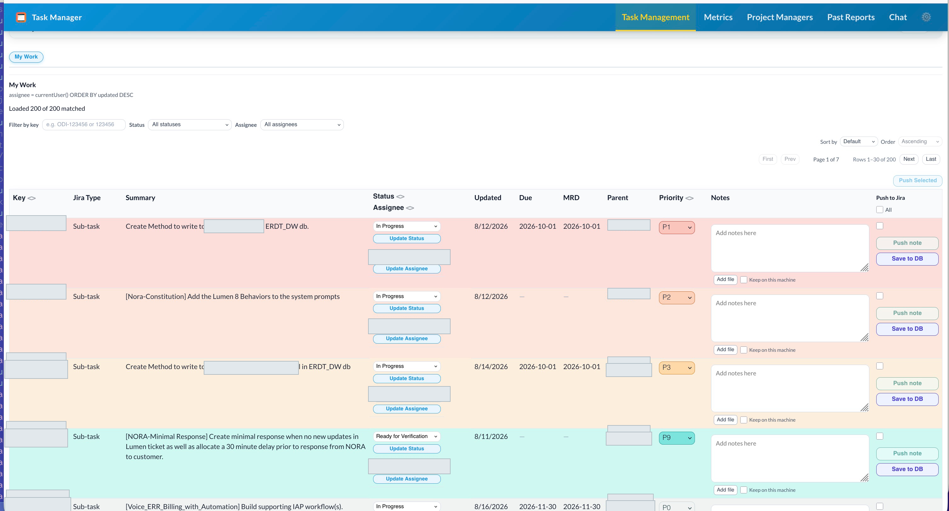
Task Management
The daily driver. Everything for one issue lives in one row.
Per-query count chips — total, open, overdue, in progress
Loaded X of Y matched, with Load remaining for the rest
Status and assignee dropdowns that write back to Jira
P1–P20 personal priority, warmer row colors for P1–P3
Notes with up to five attachments per note
Closed and resolved issues are read-only
Screens redacted: project and contributor names
Notes:
Real screen, project and contributor names redacted. Note the per-query metrics header, the load status line, and the per-row controls.

Slide 6
Notes, Priority, Push to Jira
The working layer that sits on top of Jira, and the one action that puts it back in front of the team.
P1–P20
5 files
Push
Your own ranking, saved in the local database. A Jira badge marks a priority read from the latest comment on Run JQL.
Per note, 5 MB each — images plus TXT, PDF, DOC/DOCX, XLSX, CSV. Paste, drag, or Add file.
Check the rows, click Push note. Text and attachments post as a Jira comment, visible to everyone with access.
Notes and priorities stay on your machine until you push. Nothing reaches Jira by accident.
Notes:
This is the layer Jira does not give you: a private working note per issue, your own ranking independent of Jira priority, and a one-click path from that note to a Jira comment so the team sees it.

Slide 7
Shared Priority Without a Spreadsheet
Teams that kept a shared Excel tracker so everyone saw the same ranking can set that ranking in the app instead.
SHARED-PROGRAM SLOT
BOOTSTRAP FROM THE SHEET
Link a Task Management slot to a shared program. Priority saves to the team store immediately, and rows show a Team badge.
Export the existing tracker as CSV — Priority, ODI, Developer, Jira Status, notes — and import it in Settings.
Matching issue keys overwrite priority for the chosen target. Re-import when rankings change.
Run JQL on that slot loads priorities from the shared store. Personal slots stay local.
One central place to set project priorities — and the ranking sits next to the work it applies to.
TODO
Shared-program store is a demo today (Atlas) — the production database and API for team-wide priority still needs to be decided and built.
Notes:
This is the spreadsheet replacement. Teams that kept a shared Excel ranking can link a Task Management slot to a shared program, so priority reads and writes the team store and rows show a Team badge. PMs who still keep the NORA sheet can import it as CSV.

Slide 8
Create Issue with AI Draft
New Stories, Tasks, and Bugs without leaving the app — with the parent chain already correct.
PARENT RULES
WHAT AI DRAFT WRITES
Story
requires
Epic
Story
Job Story format — when, I want, so I can — plus 2–5 suggested sub-tasks as editable checkboxes.
Bug
requires
Epic only
Task
requires
Story
Bug
What is broken, steps, expected vs actual, environment, workaround, and a suggested priority.
Start from an epic preset, a saved query, or a typed issue key — the app validates it before unlocking the form.
New Epics still need to be created directly in Jira — Create Issue covers Story, Bug, and Task.
Task
A plain description, drafted from the ask and why it matters.
Notes:
Create Issue keeps ODI structure correct: Story and Bug hang off an Epic, Task off a Story. AI Draft writes the description and, for Stories, suggests two to five sub-tasks as editable checkboxes. Everything stays editable before Create.

Slide 9
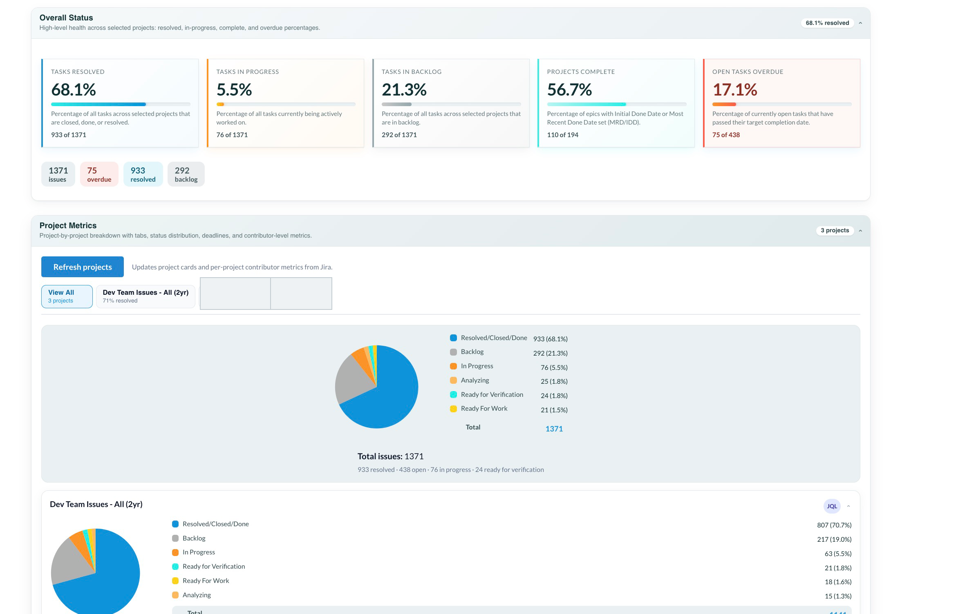
Metrics
How a project is tracking, not how one issue is doing.
Resolved, in progress, backlog, epics complete, open past due
Tabs per project preset, each with its own status breakdown chart
Upcoming and past-due lists, grouped by project and person
Contributor workload and overdue counts per person
Snapshot stored locally — the page loads even when Jira is slow
Click any issue key or name to open Task Management already filtered to it.
Notes:
Metrics is the project-level view. Select epic and JQL presets, refresh, and the snapshot is stored locally so the page still loads when Jira is slow. Every issue key and assignee name links back into Task Management with filters applied.

Slide 10
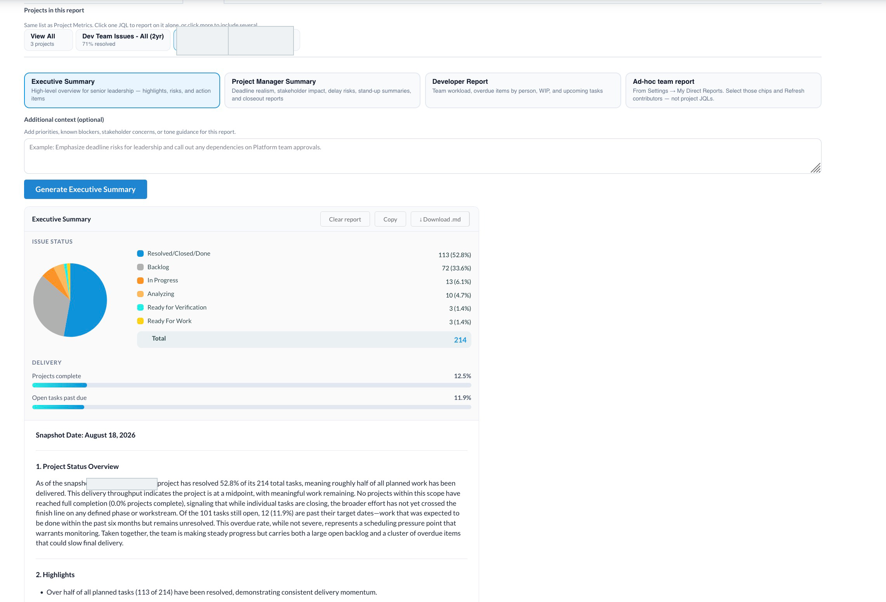
Reports by Audience
Written from the data already loaded, for the person who has to read it.
FROM METRICS
FROM TASK MANAGEMENT
GENERATING A REPORT
Executive Summary
Highlights, risks, action items
Status Report
How your work is tracking, what needs attention, next steps
Product Owner Report
Feature delivery, backlog health, blockers
1:1 Prep
Workload, completion rate, blockers, what to discuss now
Developer Report
Team workload, overdue by person, WIP
PWB Review
First-person self-assessment prose for the review period
Weekly digest
Snapshot-based stand-up brief, no LLM required
Week plan
Monday–Friday, built from your real issue keys
All three Task Management report types flag top-priority Backlog items that have recent comments — work happening under a stale status.
Notes:
The status update stops being a writing task. Pick one project tab or View All, then an audience — Executive Summary, Project Manager Summary, Developer Report, or Ad-hoc team report — on Metrics; three report types on Task Management; and a weekly digest that needs no LLM at all. Every generated report is archived automatically.

Slide 11
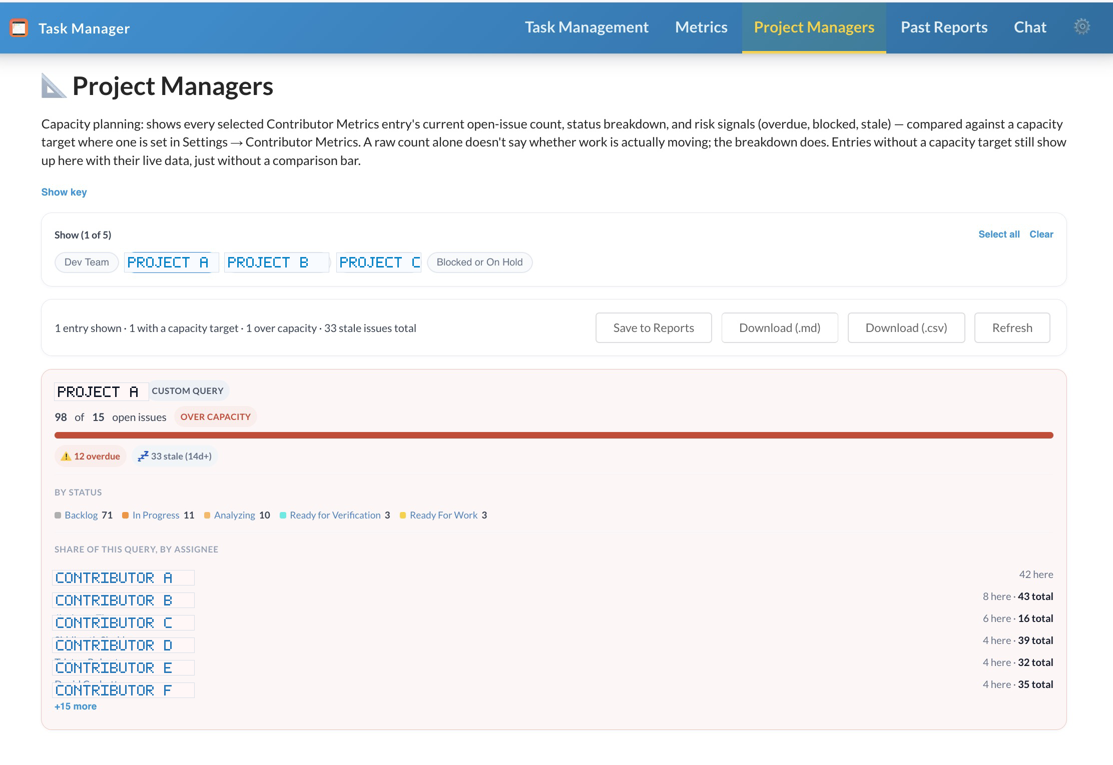
Project Managers
Who is over capacity, and whether their work is actually moving.
Open issue count against an optional capacity target
Risk signals — overdue, blocked, stale at 14 days or more
Status and assignee breakdown per tracked entry
People, reporter watches, saved presets, or custom JQL groups
Download as .md or .csv, or Save to Reports
A raw count does not say whether work is moving. The breakdown does.
Notes:
Capacity planning. Each tracked entry shows open count against an optional capacity target, plus overdue, blocked, and stale signals. Export as .md or .csv, or save the view to Past Reports.

Slide 12
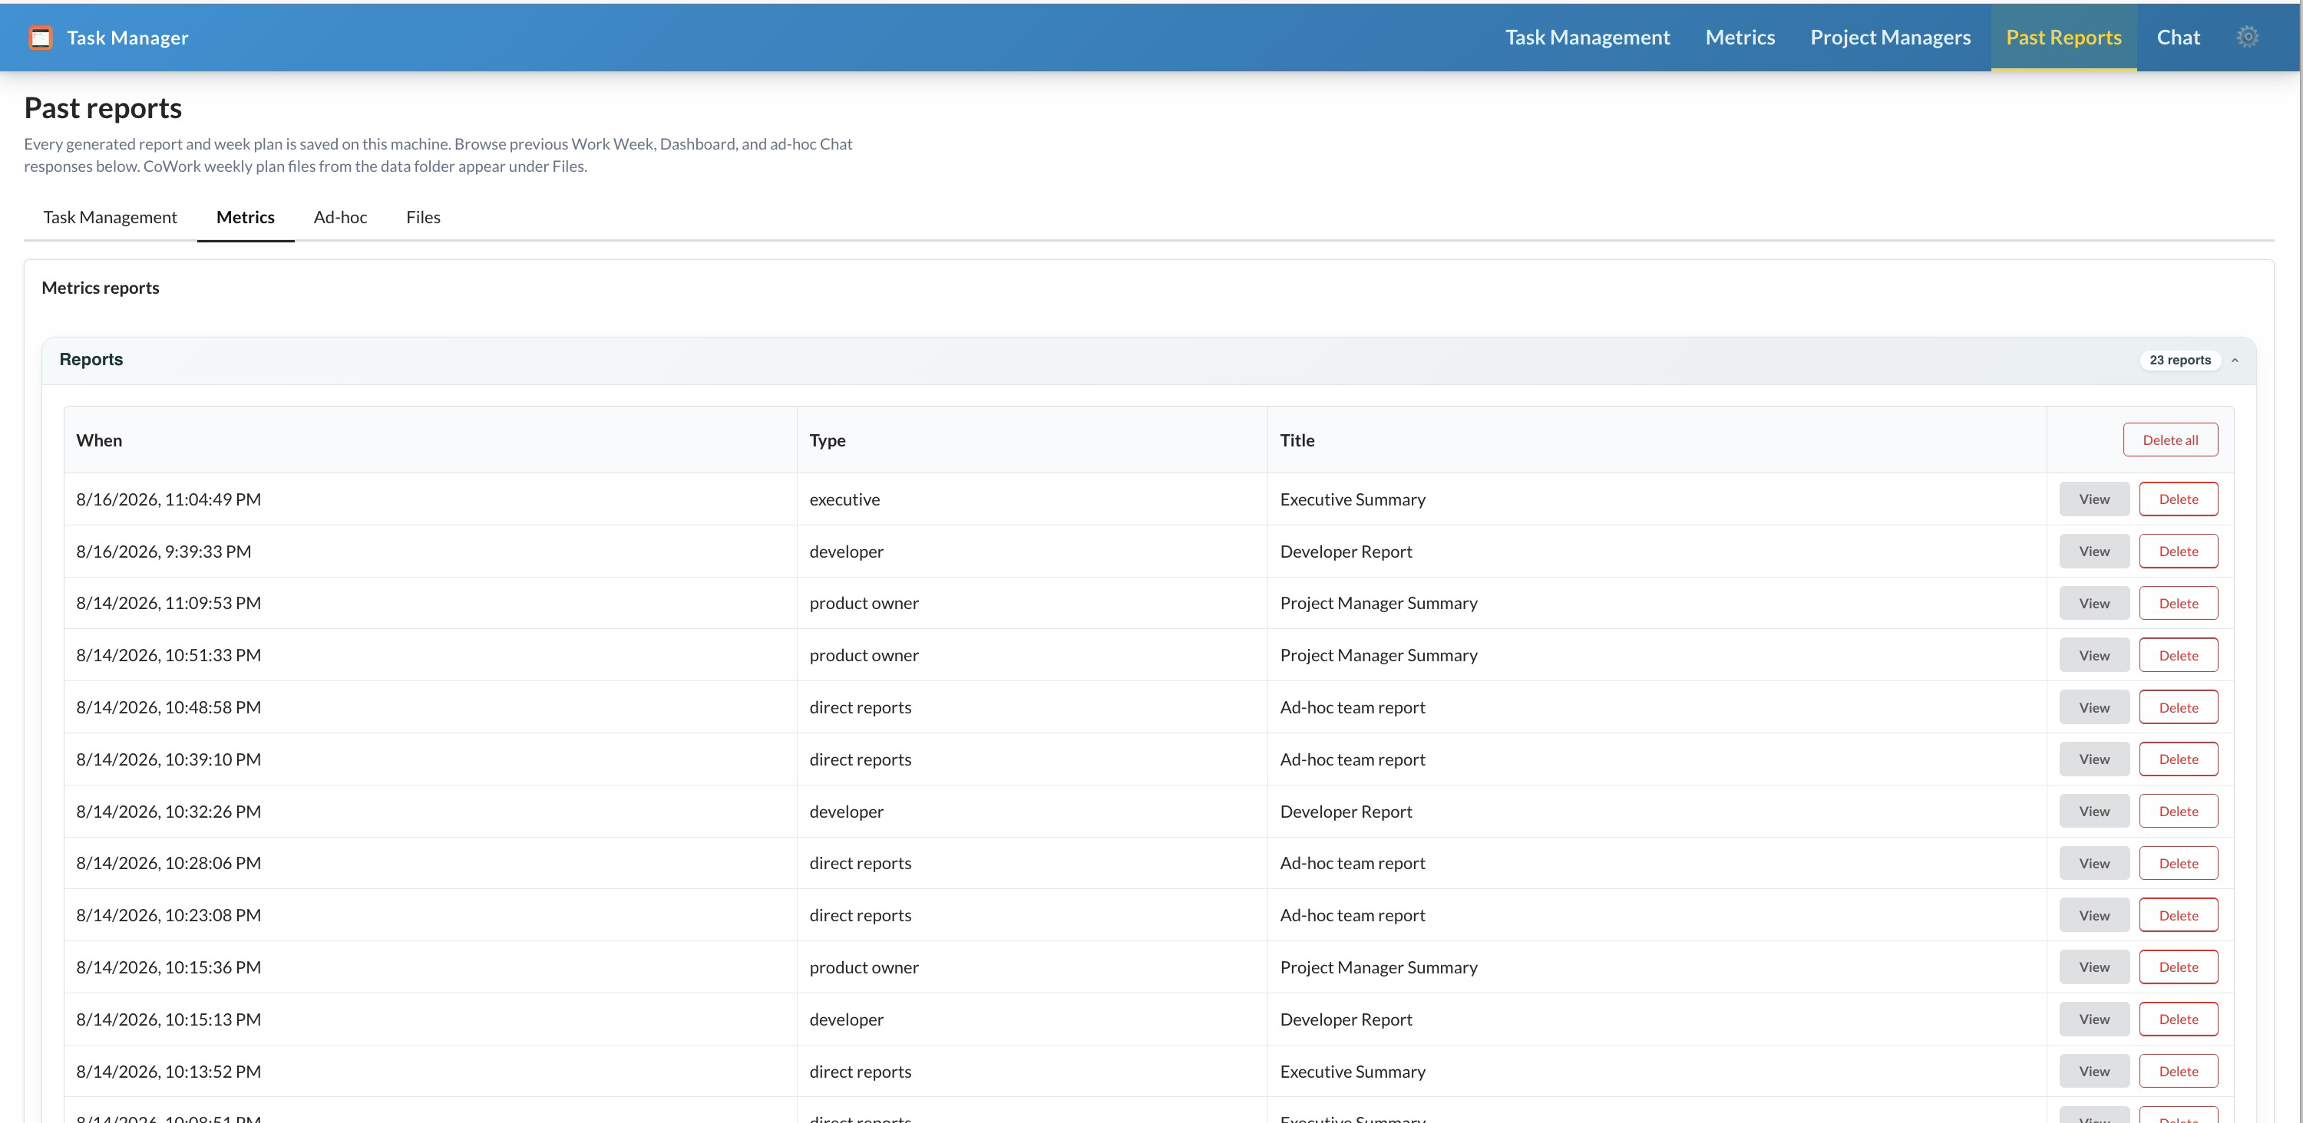
Past Reports and Chat
Everything generated is kept, and can be asked about in plain language.
Past Reports
Chat
Project reports and week plans, audience reports, saved Chat replies, and CoWork weekly-plan files — archived on this machine as they are generated.
Questions answered from your preset selection, the last JQL run, the latest Metrics snapshot, and the reports already in the session.
“Which epics are past due?”
“Who has the most overdue tasks in my My Work query?”
“What did my week plan say about Tuesday?”
Outside that context it searches Jira directly, and says when it has no data rather than guessing.
View, copy, download, or delete. Clearing a report from a page never deletes the archived copy.
Notes:
Two supporting tabs. Past Reports is the local archive — Work Week, Dashboard, Ad-hoc, and CoWork files. Chat answers Jira questions using the presets, the last JQL run, the latest snapshot, and the reports already generated in the session.

Slide 13
Where the Time Goes
The same four jobs, with the moving between tools taken out.
JOB
BEFORE
IN TASK MANAGER
See my open work
Several Jira filters, opened one at a time
Five saved queries in one table, one keystroke
Rank the work
Shared spreadsheet, kept in sync by hand
P1–P20 on the row, shared across the team
Keep the team updated
Open each issue in Jira, retype the note
Write in the row, push selected notes as comments
Write the status update
Read everything again, then write from memory
Generated from the work already loaded
Notes:
This is the value slide. Same four jobs, before and after. The point is not that any one step is faster — it is that they all happen in one place, from data already loaded.

Slide 14
Setup and Access
Runs on macOS and Windows, as a desktop app or as an installed browser window.
NOTE
Some corporate laptops block the Electron desktop app. No problem — install the web UI as its own standalone app window in Chrome or Edge, same six tabs.
01
02
03
04
Install
Add credentials
Test connection
Import a team pack
Run the desktop app, or run the browser UI and install it as its own standalone window.
Jira base URL, email, and API token in the local .env file.
Settings → Test Jira Connection. A check mark means everything else works.
One JSON file of epic and JQL presets, merged or replaced. Nobody starts from scratch.
Credentials, notes, priorities, snapshots, and the report archive stay in local files on your machine — only status changes and pushed comments go to Jira.
Prefer Chrome or Edge for Install as app — the dialog shows the Task Manager name and icon, not localhost.
Notes:
Setup is short: install or run, put credentials in the local .env, Test Jira Connection, then add epic and JQL presets. One person can export a team pack so nobody else builds presets from scratch. Credentials and local data never leave the machine.

Slide 15
Rollout
The app is in daily use by one person. The ask is approval to hand it to the team — and your read on what is missing.
Pilot users
Canonical presets
Shared priority
Who installs it first, and which project they run it against.
The epic and JQL list everyone should start from, shipped as one team pack.
Runs on an Atlas demo today. A production database and API for team-wide priority still need to be decided and built before this scales past the pilot.
Feedback welcome on anything in this deck
Notes:
The ask: approve rollout to the wider team, and tell us what is missing. Named pilot users, a canonical preset pack, and the shared-priority target are the three open decisions.

