Slide 1

Nirmala College of Engineering Technology and Management
Department of Computer Science and Engineering
Project Phase 1
FIRST INTERIM PRESENTATION
Illegal Garbage Dump Detection & Waste Management System
Group Members:
NIE22CS019 | ATHUL BABU K
NIE22CS023 | GABRIEL M S
NIE22CS028 | JAYDEV JOSHY
Guided by Mrs Sisira K I Date: 24.09.2025

Slide 2
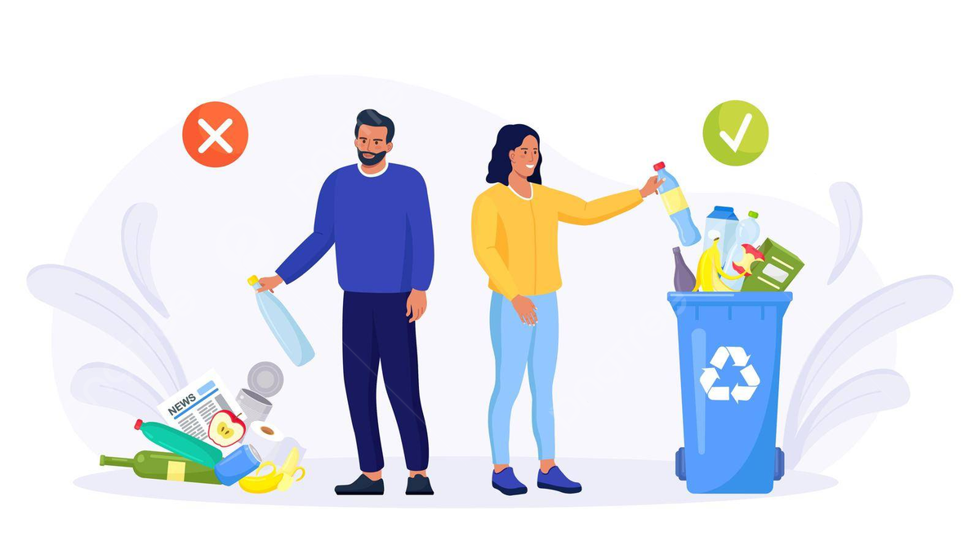
CONTENTS
Structure:
Abstract
Key features
Problem Statement
Literature Review
Methodology
System Design
Current Progress

Slide 3
INTRODUCTION
Abstract:
A system to combat illegal dumping and to bring awareness about proper waste management made using computer vision (YOLOv8), geolocation (Google Maps API), and public engagement tools.
Key Features:
Detection: Real-time illegal dump identification via CCTV.
Reporting: Automated alerts to authorities with GPS coordinates and snapshots.
Map Provision: Provide maps which show legal dumping areas and frequently dumped places.
Public Support: A waste management guide which helps understand the ways of proper waste disposal.

Slide 4
PROBLEM STATEMENT
Illegal Waste Dumping is a Major Issue in India
Limited public access to legal disposal sites.
Lack of offender accountability.
Waste often accumulates in unauthorized/random places.
Health/environmental risks from uncontrolled waste.
Manual monitoring is inefficient and unscalable.

Slide 5
LITERATURE REVIEW
Paper 1 – Deep Learning-Based Garbage Detection (Lakshmi et al., 2022)
Focus: Automated garbage detection in street images for smart cities
Method: YOLOv3 object detection
Dataset: 100 images (50 train, 50 test)
Key Findings:
Detected garbage in all test images
Missed some instances (low recall)
Image size impacted performance

Slide 6
LITERATURE REVIEW
Paper 2 – OCR Techniques Review (Srivastava et al., 2022)
Focus: OCR pipeline and challenges with Indian scripts
Relevance: License plate recognition for violator ID
Key Findings:
High accuracy (>95%) for printed text
Indian scripts pose challenges (e.g., shirorekha, matras)
Pre-processing is critical for real-world images

Slide 7
LITERATURE REVIEW
Paper 3 – CNN Survey (Li et al., 2021)
Focus: Comprehensive review of CNN architectures and components
Key Findings:
Leaky ReLU and Adam optimizer recommended
Lightweight models (e.g., MobileNet) suitable for real-time use
Deformable convolutions handle object variability.

Slide 8
LITERATURE REVIEW
Paper 4 – Waste Management Concept (Amasuomo & Baird, 2021)
Focus: Definition, classification, and management of waste
Key Findings:
Waste is subjective and context-dependent
Detailed classification of solid waste (MSW, industrial, etc.)
Management hierarchy: recycle > landfill

Slide 9
LITERATURE REVIEW
Paper 5 – Clustering Algorithms Survey (Wong, 2020)
Focus: Overview of clustering methods for hotspot detection
Relevance: Identify illegal dumping hotspots using GPS data
Recommendation: Density-based algorithms like DBSCAN
Key Findings:
DBSCAN is suitable for spatial clustering of dumping events.
Handles arbitrary shapes and noise
No need to predefine cluster count

Slide 10
METHODOLOGY OVERVIEW
Input → Process → Output
Input: Live CCTV footage from multiple locations
Process:
  YOLOv5/YOLOv8 detects illegal garbage dumping
  CNN model attempts offender recognition (vehicle number plate)
  GMaps API logs location & updates frequency map
  Clustering algorithm identifies dumping hotspots
  Waste module suggests legal disposal sites via GMaps
  Chatbot assists users with queries and education
Output: Automated report to authorities + interactive web/app dashboard

Slide 11
METHODOLOGY – Core AI & Detection Process
Real-Time Monitoring & Recognition
YOLO-based detection for immediate dump identification
CNN model for violator recognition (if visible)
GPS tagging and frequency mapping using Google Maps API
DBSCAN clustering to detect high-frequency violation zones

Slide 12
METHODOLOGY – Output & User Interaction
Reporting & Public Interface
Automated alert to authorities with evidence (image/video, time, location, offender data if available)
Interactive dashboard for officials and public
Chatbot support for disposal guidelines and FAQs
Hotspot visualization and suggested legal disposal sites

Slide 13
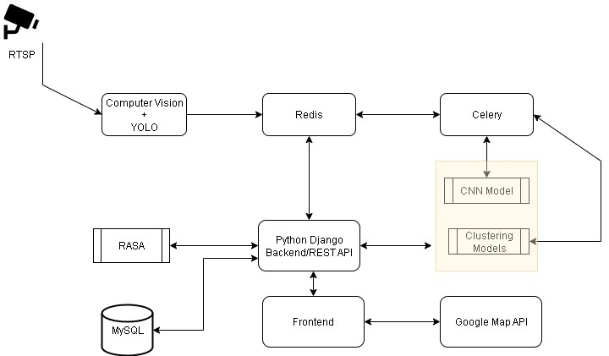
SYSTEM DESIGN

Slide 14
CURRENT PROGRESS
Completed Tasks:
Literature Review Completed
  Reviewed 5 key papers covering AI detection, OCR, CNNs, waste management, and clustering
  Identified best practices and potential pitfalls
System Design Finalized
  Modular architecture defined (Detection, ID, Geo, Hotspot, Chatbot, etc.)
  Tech stack selected (YOLOv8, Django, React, Google Maps API, DBSCAN, etc.)

Slide 15
REFERENCES
[1] D. Yu et al., "Detection of Illegal Dumping Using YOLO,“ in IEEE AVSS, 2024.
[2] E. Amasuomo and J. Baird, "The Concept of Waste and Waste Management," Journal of Management and Sustainability, vol. 6, no. 4, pp. 88–96, 2021.
[3] K.-C. Wong, A Short Survey on Data Clustering Algorithms, Nov. 2020.
[4] Z. Li, F. Liu, W. Yang, S. Peng, and J. Zhou, "A Survey of Convolutional Neural Networks: Analysis, Applications, and Prospects," IEEE Transactions on Neural Networks and Learning Systems, vol. 33, no. 6, pp. 1–21, Jun. 2021.
[5] S. Srivastava, A. Verma, and S. Sharma, "Optical Character Recognition Techniques: A Review," in 2022 IEEE International Students' Conference on Electrical, Electronics and Computer Science (SCEECS), pp. 1–6, 2022.

Slide 16
THANK YOU

