Slide 1
PROJECT UPDATE · AUGUST 2026
PROJECT UPDATE
AI Companion for Elderly Care
A modular sensing and conversation system designed to turn live observations into gentle, safe support.
Notes:
Timing: 0:45
Open with the human problem: an older adult living alone may need a timely check-in before a situation becomes an emergency.
Frame the system as a screening and support companion—not a diagnostic medical device.
[Sources]
- README.md
- docs/RESEARCH.md

Slide 2
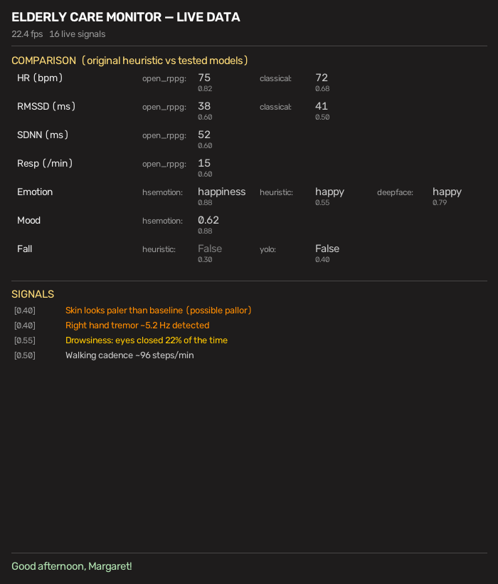
OVERVIEW
The project turns camera and audio signals into understandable support
PROJECT OVERVIEW Sense Camera, depth and optional audio create a live context. Reason Independent modules estimate safety, health and emotional signals with confidence and quality gates. Respond A dashboard, voice agent and deterministic alerts turn evidence into appropriate action.
Notes:
Timing: 2:00
Walk left-to-right through sense, reason, respond.
Use the dashboard screenshot to make the project tangible: the user sees readable signals, not raw model output.
[Sources]
- README.md
- docs/ARCHITECTURE.md
- docs/dashboard_preview.png

Slide 3
MY ROLE
My role spans the full path from model idea to safe user experience
ROLE
Developer and systems integrator—owning architecture, implementation, validation and the experience that connects them.
BUILD THE CORE
MAKE IT TRUSTWORTHY
• Modular pipeline + scheduler
• Vision, vitals and conversation
• Dashboard and developer tooling
• Confidence and quality gates
• Privacy-safe context
• Tests, diagnostics and fallbacks
3
Notes:
Timing: 1:30
Describe the role as end-to-end ownership, not just feature coding.
Connect technical work to the outcome: maintainable modules, credible measurements, and safe interactions.
All 39 repository commits are attributed to Gabriel in the current git history.
[Sources]
- git shortlog and git rev-list, repository state on 2026-08-06
- docs/ARCHITECTURE.md

Slide 4
AGENDA
The agenda is organized around one end objective
01 · WHY
The problem, the user and the boundaries of a screening companion.
02 · WHAT
Architecture, major capabilities and the working experience.
03 · LEARNINGS
Progress, constraints and the strategies used to manage risk.
END OBJECTIVE
A reliable pilot that notices meaningful change, explains uncertainty and escalates safely.
4
Notes:
Timing: 1:30
Set expectations for the next 15 minutes.
Emphasize the end objective: pilot readiness is defined by reliability and safe escalation, not the number of detections.
[Sources]
- README.md
- docs/ARCHITECTURE.md

Slide 5
HOW IT WORKS
A simple three-stage loop keeps a complex system understandable
01
02
03
SENSE
Camera, face, pose, motion, depth and optional audio build a bounded FrameContext.
INTERPRET
A scheduler runs hot-swappable detectors; results are aggregated with freshness and confidence.
SUPPORT
Advice, conversation, dashboard and deterministic alerts act from the same current snapshot.
5
Notes:
Timing: 2:00
Explain that modules do not directly control the user experience; the aggregator creates a shared truth layer.
Call out the separation between conversational assistance and deterministic emergency/caregiver alerting.
[Sources]
- docs/ARCHITECTURE.md lines 13–58
- README.md

Slide 6
PROGRESS
The foundation is broad, modular and heavily exercised
PROGRESS MADE
The repository now covers the complete path from capture to guest-facing output, with optional backends isolated behind clear capability and consent boundaries.
52
521
39
detector and support modules
automated test functions
commits in the current history
6
Notes:
Timing: 2:15
Treat counts as evidence of breadth, not as proof of clinical performance.
Highlight delivered areas: modular sensing, guided assessments, vitals backends, dashboard/console, conversation safeguards, RealSense support and privacy-safe diagnostics.
[Sources]
- modules/*.py count on 2026-08-06
- tests/*test.py scan on 2026-08-06
- git rev-list on 2026-08-06
- README.md

Slide 7
CHALLENGES
The hardest challenges are reliability, real-time performance and safety
NOISY SIGNALS
Lighting, movement, distance and camera quality can turn plausible estimates into misleading ones.
SHARED COMPUTE
Face, pose, rPPG, VLM and UI work must coexist without starving the live capture loop.
HIGH-STAKES UX
A companion must be useful without sounding diagnostic, exposing private data or taking unconfirmed action.
EVIDENCE
SYSTEM
TRUST
7
Notes:
Timing: 2:30
Give one concrete example for each challenge: motion corrupting rPPG; heavy inference reducing analysis FPS; conversational language overstating an uncertain observation.
Mention hardware-bound gaps: blood pressure requires a contact or calibrated sensor; fever confirmation requires thermal/IR; multi-person tracking is not yet supported.
[Sources]
- docs/RESEARCH.md lines 95–121
- docs/ARCHITECTURE.md
- docs/SKIN_DETECTION.md

Slide 8
STRATEGIES
Constraints became explicit engineering strategies
QUALITY BEFORE VALUE
Hide stale, blocked or low-confidence measurements instead of presenting false precision.
BOUND THE WORK
Decouple capture from analysis, cache expensive results and drop old work before it creates latency.
SAFE BY DESIGN
Keep calls for help deterministic; require explicit confirmation for model-proposed assessments.
DEGRADE GRACEFULLY
Make cloud, neural and hardware-specific features optional while preserving a useful local baseline.
8
Notes:
Timing: 2:15
Connect each strategy directly to the challenge on the prior slide.
Emphasize graceful degradation as a product strength: unavailable capabilities are reported clearly rather than silently faked.
[Sources]
- docs/ARCHITECTURE.md
- README.md
- tests/runtime_performance_test.py
- tests/vitals_debug_test.py

Slide 9
WAY FORWARD
The way forward moves from technical breadth to validated usefulness
NEXT 2–4 WEEKS
NEXT 1–2 MONTHS
THEN
VALIDATE
Benchmark critical signals against reference devices across lighting, distance, movement and skin tones.
INTEGRATE
Add calibrated pulse-ox, thermal or other sensors only where they materially improve confidence.
PILOT
Run supervised home-like trials; tune prompts, alert thresholds, accessibility and caregiver workflows.
9
Notes:
Timing: 2:00
Position validation as the primary next investment.
Be explicit that adding more models comes after evidence that the existing loop is stable and useful.
[Sources]
- docs/RESEARCH.md
- docs/REALSENSE_D435I.md
- README.md

Slide 10
NEXT STEPS
Immediate next steps define what ‘pilot-ready’ means
1 · CALIBRATE
Collect paired reference measurements and document acceptable error, failure and abstention behavior.
2 · HARDEN
Complete bounded replay, real-camera soak and privacy checks across target hardware profiles.
3 · PILOT
Test with users and caregivers; measure clarity, false alerts, response time and trust—not feature count.
10
Notes:
Timing: 1:15
Close the presentation portion with three actions and their success criteria.
Invite alignment on target hardware, reference devices, pilot participants and the acceptable alerting threshold.
[Sources]
- docs/RESEARCH.md
- docs/AI_DEVELOPMENT.md
- README.md

Slide 11
DISCUSSION
10-MINUTE Q&A
Questions & next decisions
Target pilot environment
Validation hardware and metrics
Safety and caregiver workflow
Notes:
Timing: 10:00 Q&A
Use the three prompts on the slide to structure discussion if questions are slow to start.
Capture decisions on pilot environment, measurement references and escalation ownership.
[Sources]
- No external sources; discussion prompts derived from the project roadmap.

