Slide 1
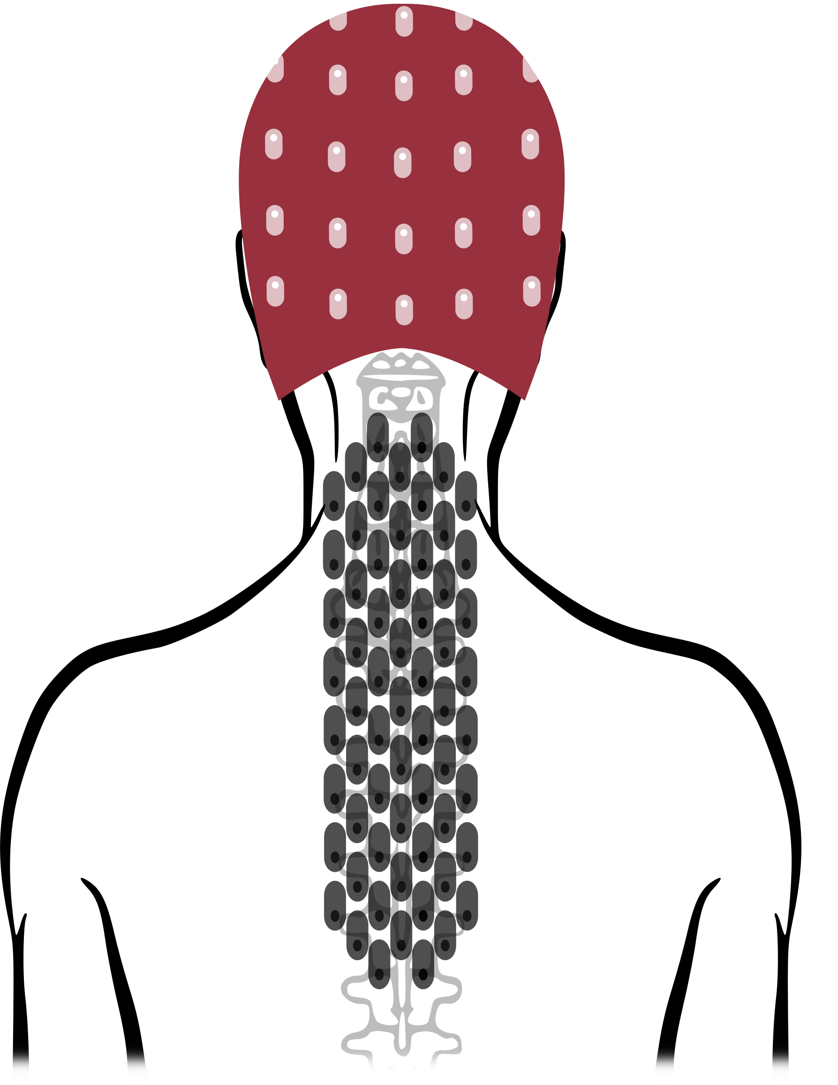
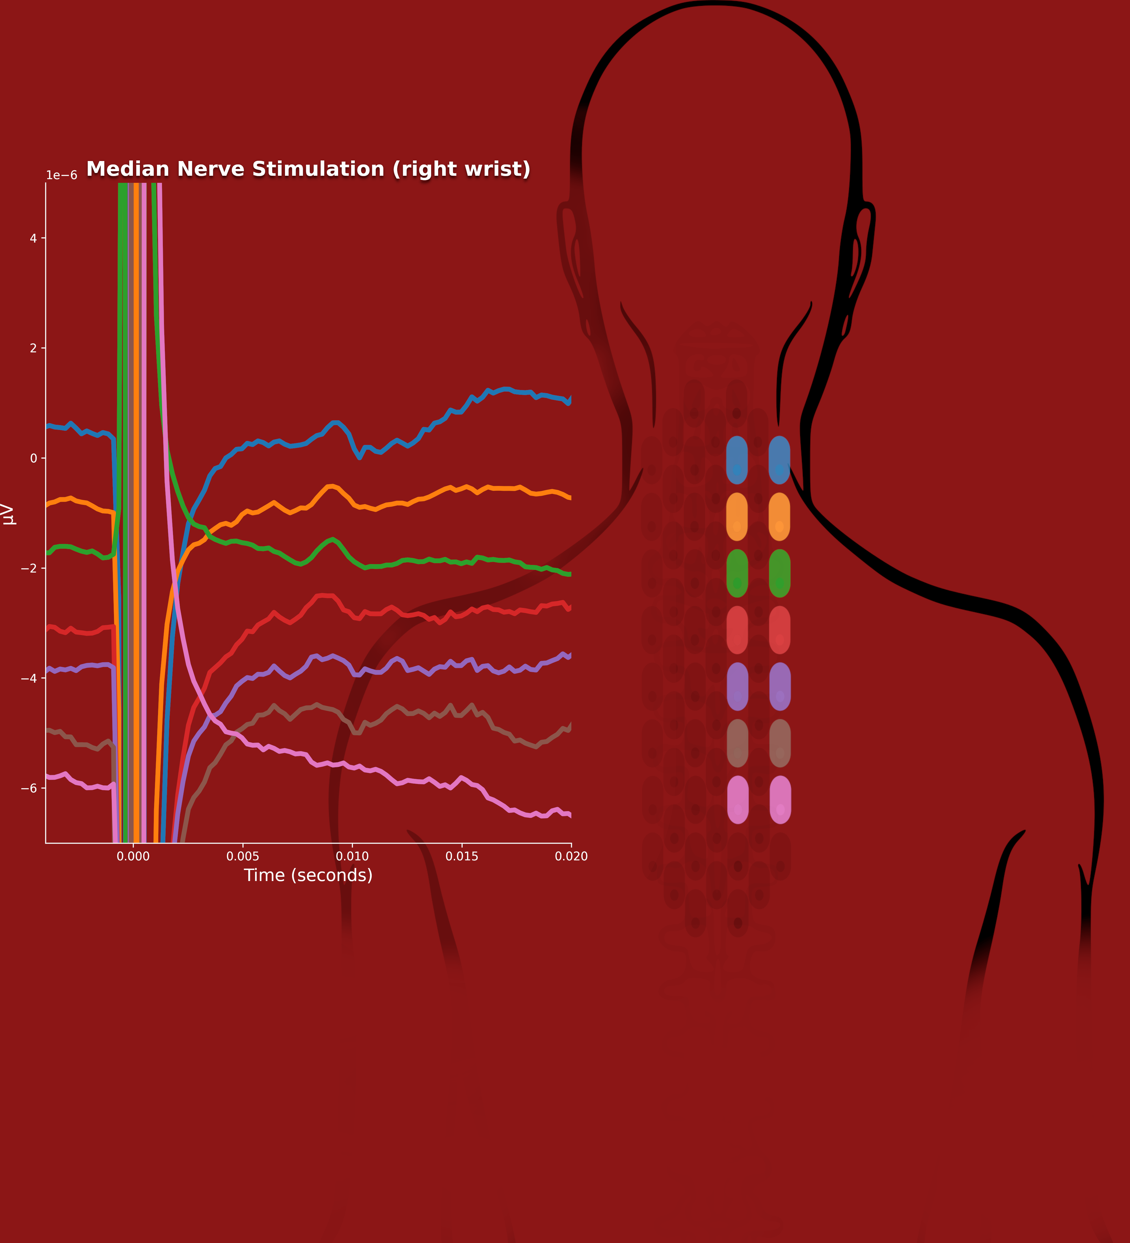
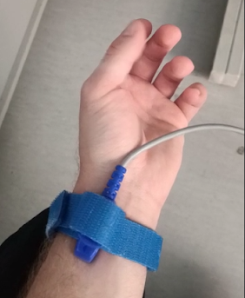
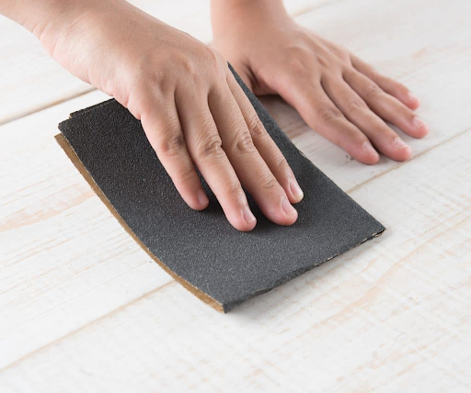




We can record the electrical activity of the spinal cord using non-invasive surface electrodes.
A non-invasive technique for recording the electrical activity of the human spinal cord
SETUP
63 active electrodes for spinal recording
32 channels EEG setup
2 lead ECG
Flat surface electrodes on the neck, ear lobes, and Erb’s points.
PRELIMINARY RESULTS
Preliminary results confirmed the possibility of obtaining artifact-free evoked electrical potentials reflecting the electrical activity of the cord following the different types of tasks employed.
Giulio Gabrieli, Cedric Lenoir, Rory J. Bufacchi, Andre Mouraux, Giandomenico Iannetti
AIM OF THE PROJECT
This work aims to develop a non-invasive technique to record the electrical activity of the spinal cord by means of active surface electrodes
METHODS
We collected electrical activity of the spinal cord by mean of 64 active electrodes from X healthy participants
Subjects participated in three different tasks: (1) a median nerve stimulation task, a (2) passive discrimination task, and an (3) active discrimination task.
1 2 3
Take a picture to discover more about this research
Notes:
Notes:
In Powerpoint, click View > Guides
Keep text within gutter guides.
Author list: Don’t split names onto two lines (e.g., “Jimmy [break] Smith”). If that happens, use a new line, unless you need the space. Bold the first names of anybody who’s presenting in person.
Intro/methods/result: Do not drop below font size 28, but if you have extra space, jack up the font size until the space is full.
Do not use color in the sidebars except in graphs/figures. It’ll pull attention from the center and slow interpretation for passersby.
<number>

