Slide 1
Preparing to Teach Statistics
Thanks to:
American Statistical Association
National Science Foundation

Slide 2
Agenda
8:30 - 9:00 Welcome and Introductions
9:00 - 10:30 Teaching Introductory Statistics and Assessing Learning
10:30 - 10:45 Break
10:45 - 1:45 Teaching focused career opportunities
11:30 - 12:30 Lunch at ARC Restaurant (Fairmont)
Waterfront Cobb Salad, Smoked Brisket, Vegetarian Burger

Slide 3
Agenda (cont)
12:30 - 13:30 Teaching Introductory Data Science and Assessing Learning
13:30 - 13:45 Break
13:45 - 14:30 Preparing to mentor undergraduate researchers
14:30 - 15:15 Opportunities for grants
15:15 - 14:45 Sharing resources and staying connected
15:45 - 16:00 Wrap-Up and Moving forward

Slide 4
Internet
Fairmont_Meetings
JSM2018

Slide 5
Teaching Introductory Statistics and Assessing Student Learning
Allan Rossman – Cal Poly, San Luis Obispo
Ulrike Genschel, Iowa State University

Slide 6
GAISE
Guidelines for Assessment and Instruction in Statistics Education
Recommendations for teaching introductory statistics at college level
Comparable guidelines at PreK-12 level
Developed by American Statistical Association
Originally in 2005, revised in 2016
www.amstat.org/education/gaise

Slide 7
GAISE recommendations
Teach statistical thinking.
Focus on conceptual understanding.
Integrate real data with a context and purpose.
Foster active learning.
Use technology to explore concepts and analyze data.
Use assessments to improve and evaluate student learning.

Slide 8
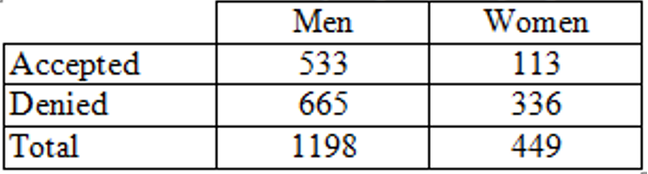
1. Teach statistical thinking
Example: Sex discrimination?
Men: 533/1198 ≈ .445 were accepted
Women: 113/449 ≈ .252 were accepted
Does this provide evidence of discrimination against women applicants?

Slide 9
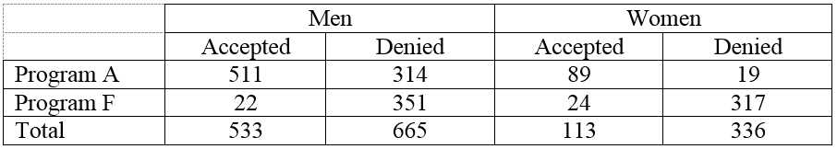
1. Teach statistical thinking
Program A
Men: 511/825 ≈ .619
Women: 89/108 ≈ .824
Program F:
Men: 22/373 ≈ .059
Women: 24/341 ≈ .070

Slide 10
1. Teach statistical thinking
Do the data provide evidence of discrimination against women applicants?
How do you explain the apparent paradox, using the data provided?

Slide 11
1. Teach statistical thinking
Engage in proportional reasoning
Take sample sizes into account
Consider alternative explanations
Confounding variables

Slide 12
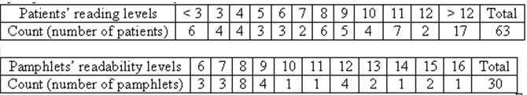
1. Teach statistical thinking
Example: Cancer pamphlets
Researchers investigated whether pamphlets containing information for cancer patients are written at appropriate levels for the patients to comprehend

Slide 13
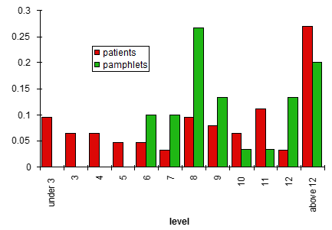
1. Teach statistical thinking
Think in terms of distributions of data
Be sure to address motivating question
Do not underestimate value of simple graphs

Slide 14
2. Focus on conceptual understanding
Example: Variability/SD
Suppose that Abby records the ages of customers at The Avenue (on-campus snack bar) from 11am-2pm today, while Mary records ages of customers at McDonald’s (near freeway).
Who will have the larger standard deviation of customer ages: Abby or Mary? Explain.

Slide 15
2. Focus on conceptual understanding
Example: Measures of center
I sometimes joke that when I moved from Pennsylvania to California, the average IQ dropped in both states!
Is this possible? If so, what would have to be true for this to happen?

Slide 16
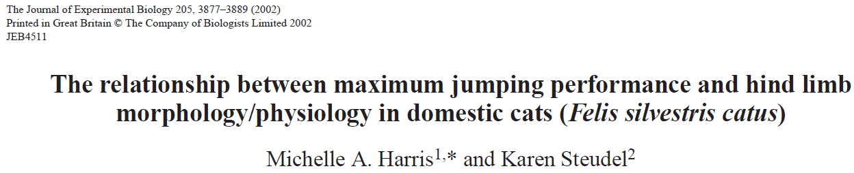
3. Integrate real data

Slide 17
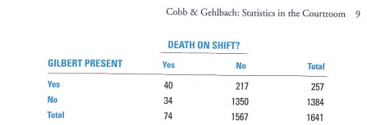
3. Integrate real data

Slide 18
3. Integrate real data
Example: Facial prototyping
Do people tend to associate names with faces? (Lea, Thomas, Lamkin, & Bell, 2007)
Who is on the left: Bob or Tim?

Slide 19
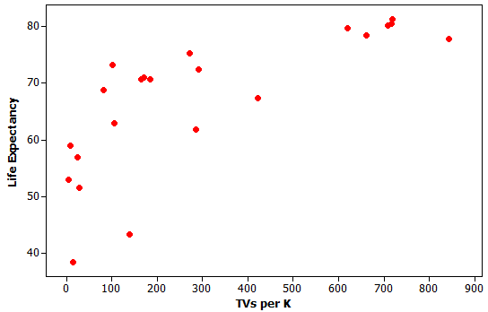
4. Foster active learning
Example: Televisions and life expectancy
Is there an association?
Does association imply causation?
Is the variable useful for prediction?

Slide 20
4. Foster active learning
Example: Gettysburg Address
Select a sample of 10 words from the population of 268 words in the Gettysburg Address. (Just circle 10 words.)
Record the length (# of letters) in each word.
Calculate the average length for your sample.
Produce graph of sample averages.
Is this a reasonable sampling method?

Slide 21
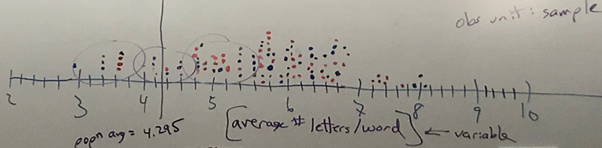
4. Foster active learning
How does this graph indicates sampling bias?
Would closing eyes and pointing be unbiased?

Slide 22
4. Foster active learning
Example: Facial prototyping (cont)
36 of 46 students in class put Tim on the left
What are two possible explanations for observed sample result?
Which explanation can we investigate/model? How?
How often would such an extreme sample result occur by chance alone (if there were no facial prototyping)?
Have students flip coins to investigate

Slide 23
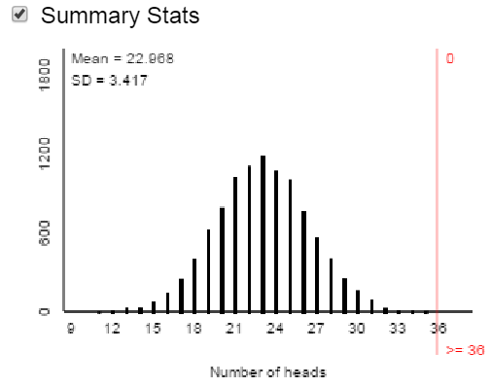
5. Use technology to explore concepts
10,000 simulated samples of 46 students

Slide 24
5. Use technology to explore concepts
Extremely unlikely to obtain 36 or more successes in 46 trials by chance alone
Very strong evidence that people tend to put Tim on the left

Slide 25

Brief digression
What’s the key to being a successful singer?
Sing Good Songs
25

Slide 26
My similarly succinct advice
What’s the key to effective teaching?
Ask Good Questions
26

Slide 27
6. Use assessments to improve learning
Almost every example/assignment
Is this an observational study or an experiment?
What are the observational units in this study?
What are the variables in this study? Which type is which variable? Which variable plays which role?
Did this study make use of random sampling, random assignment, both, or neither?

Slide 28
6. Use assessments to improve learning
Example (adapted from Jay Lehmann):
Which would be larger – the mean weight of 10 randomly selected people or the mean weight of 1000 randomly selected cats? Explain briefly.
Which would be larger – the standard deviation of the weights of 1000 randomly selected people or the standard deviation of the weights of 10 randomly selected cats? Explain briefly.

Slide 29
6. Use assessments to improve learning
Example (easy to grade):
For each of the following, indicate whether it can SOMETIMES or NEVER take a negative value.
Standard deviation
Correlation coefficient
Slope coefficient
Inter-quartile range
p-value

Slide 30
6. Use assessments to improve learning
Example (harder to grade):
The purpose of a confidence interval is to estimate the unknown value of a population parameter based on a statistic calculated from a sample.
Convince me that you understand this by describing an example of a situation (not shown in class or the textbook) in which you might do this. Be sure to clearly identify the variable, population, parameter, sample, and statistic.

Slide 31
New emphases in GAISE revision
Teach statistical thinking
Teach statistics as investigative process of problem-solving and decision-making
Give students experience with multivariable thinking

Slide 32
A. Teach statistics as investigative process of problem-solving and decision-making
Statistics
Is foundation of all scientific inquiry
Leads to data driven, objective decision making
Efficient and effective

Slide 33
A. Teach statistics as investigative process of problem-solving and decision-making
Most real life applications require close collaboration between statistician and scientist with expert subject matter knowledge
Requires ability to identify statistical analysis most appropriate to answer posited research question of interest
Becoming a data detective; able to solve puzzles

Slide 34
Investigative process of problem-solving
Two facets of problem solving:
At the level of a posited research question
At the data level, for example
Data contamination and outliers
Data properties

Slide 35
Investigative process of problem-solving
Example: Scallops, Sampling, and the Law¹
U.S. Fisheries and Wildlife Services confiscated 95% of a ship’s catch (scallops) after a random sample of 18 bags (out of 11,000) resulted in an average scallop weight below the required minimum weight of 0.0278 of a pound.
Ship’s owner filed lawsuit against the federal government.
Who is right?
¹ McClave, J.T., Benson, G.P. and Sincich, T. (2008). Statistics for Business and Economics. Pearson Prentice Hall, Pearson Education Inc., Upper Saddle River, NJ, 10th Edition.

Slide 36
Investigative process of problem-solving
Mean, median, 3rd quartile < 0.0278, in fact 16/18 bags weighed < 0.0278 (about 89%).
Std. deviation is 0.0020962
95% CI for μ: (0.0248298, 0.0269146)

Slide 37
Investigative process of problem-solving
A different way of looking at the data
16/18 bags weighed < 0.0278 (about 89%).
Ship’s owner complains that by confiscating 95%, the government confiscated too much of the catch.

Slide 38
Investigative process of problem-solving
A different way of looking at the data cont’d
Let p denote the proportion of all 11,000 bags weighing less than 0.0278
95% CI for p: (0.743706, 1.000000)
Interpretation:
In favor of the captain or the federal government?
Too small of a sample size?
What can we say about the upper bound of 1?
Adjusted 100(1-⍺)% CI for p by Agresti & Coull (1998)

Slide 39
Investigative process of problem-solving
Example: at the data level To Drop or Not To Drop?!
Discovery of the o-zone hole delayed for years¹
Data collected via NASA satellite
Observations too small (considered outliers) were automatically removed → stable o-zone layer
In person expedition to Antarctic resulted in lower measurements leading to discovery of o-zone hole
¹ https://water.ca.gov/LegacyFiles/environmentalservices/docs/qaqc/outliers_workgroup_06-20-12.pdf

Slide 40
Investigative process of decision-making
Example: Purchasing a SPAM filter¹
Base decision on results of a 30-day free test trial
Software will pay for itself if less than 20% of all messages are SPAM
How many messages should be tested?
Does a reduction to 19% suffice? What about a reduction to 15%?
What about the rate of messages incorrectly labeled as SPAM?
What are the Type I and Type II errors?
¹ Stine, R.A. and Foster, D. (2014). Statistics for Business: decision making and analysis. Pearson Prentice Hall, Pearson Education Inc., Upper Saddle River, NJ, 2nd Edition.

Slide 41
B. Multivariable Thinking
Real-life phenomena rarely explained through one-dimensional measurements
Becomes essential when exploring relations between variables
Helps to identify confounding factors
Leads to increased accuracy (provided signal in the data)

Slide 42
2. Multivariable Thinking
Example: IRIS data¹
5 variables: sepal length, sepal width, petal length, petal width and species (n=150)
¹ D.F. Andrews, D.F. and Herzberg, A.M. (1985). Data. Springer Verlag.

Slide 43
2. Multivariable Thinking
Graphical display
supports results given by
pairwise correlations
But note the clustering
of data points

Slide 44
2. Multivariable Thinking
After accounting for
species, all relation-
ships are positive

Slide 45
2. Multivariable Thinking
Example: What do you consider the ideal height of your spouse?

Slide 46
2. Multivariable Thinking
What about gender?

Slide 47
Goals for introductory students
Become critical consumers.
Be able to apply investigative process.
Produce and interpret results of graphical displays and numerical summaries.
Recognize and explain fundamental role of variability.
Recognize and explain central role of randomness in designing studies and drawing conclusions.

Slide 48
Goals for introductory students (cont)
Gain experience with statistical models, including multivariable ones.
Demonstrate understanding of, and ability to apply, statistical inference in variety of settings.
Interpret and draw conclusions from standard output of statistical software.
Demonstrate awareness of ethical issues associated with sound statistical practice.

Slide 49
GAISE Appendices
Evolution of Introductory Statistics
Multivariable Thinking
Activities, Datasets, and Projects
Examples of Using Technology
Examples of Assessment Items
Learning Environments

Slide 50
Applicability of GAISE?
To all kinds of introductory statistics courses
Statistical literacy vs. methods
All types of student majors
All class sizes
All learning environments: face-to-face, online, hybrid
All institution types: universities, colleges, two-year colleges, high schools
Beyond introductory courses

Slide 51
Thanks very much!
www.amstat.org/education/gaise
arossman@calpoly.edu
ulrike@iastate.edu

