Slide 1
Autonomous AI Systems for Long-Horizon Engineering
Architecture, Failure Modes, and Economic Viability in Multi-Hour Unsupervised Execution
Autobot Research & Development Team | Empirical Systems White Paper
6 Heterogeneous Engineering Domains | 1000x Cost Advantage

Slide 2
THE PROBLEM SPACE
The Paradigm Shift: From Reactive Chat to Unsupervised Autonomy
Reactive AI (Copilot / Single-Turn Chat)
• Time Horizon: 30 seconds to 2 minutes per interaction.
• Human-in-the-Loop Bottleneck: Requires constant human prompting, review, and verification.
• Local Context Only: Operates on single functions or isolated diffs without system-level memory.
• Brittle to Runtime Crashes: Throws exceptions back to user; cannot self-debug complex pipelines.
• High Marginal Human Cost: Engineer spends 8+ hours actively driving the AI assistant.
Autonomous AI (Autobot Cybernetic Engine)
• Time Horizon: 8 to 24+ continuous hours uninterrupted.
• Unsupervised Goal Pursuit: Receives high-level objective and manages end-to-end execution.
• Self-Healing Error Autopsy: Automatically catches crashes, reads stack traces, patches bugs, and redeploys.
• Cross-Domain Task Switching: Concurrently operates across competitive ML, clinical EHR, and edge CV.
• Radical Cost Reduction: Operates 24/7 on standard hardware at <$10 per 12-hour campaign.

Slide 3
CORE ARCHITECTURE
Autobot System Architecture: The Dual-Loop Reactive Engine
1. Fast Inner Loop (2-Min)
• Persistent Python supervisor daemon (v2) polling every 120s.
• Concurrent cloud/local worker health checks (Kaggle, GPU, CPU).
• Autonomous Crash Autopsy: Automatically extracts stderr on failure, isolates traceback, and flags remediation.
• Pre-submission data validation (row counts, null checks, physical limits).
2. Outer Metacognitive Loop (30-Min)
• Scheduled cron interrupt forcibly wakes LLM brain every 30 mins.
• Prevents 'passive sleep' and silent deadlocks across daemons.
• Global pipeline audit: reviews logs, assesses leaderboard deltas, and synthesizes cross-domain lessons.
• Midnight UTC quota dispatch: automatically submits staged candidates upon quota reset.
3. Host Invariance & Security
• Windows kernel execution flags (`SetThreadExecutionState`) defeat OS sleep & socket drops.
• Air-gapped sandboxes: network disabled, isolated Docker containers.
• Zero arbitrary importlib execution: declarative YAML compilation via adk-submission.
• Strict file anti-tampering guards protecting test configs and harness hooks.

Slide 4
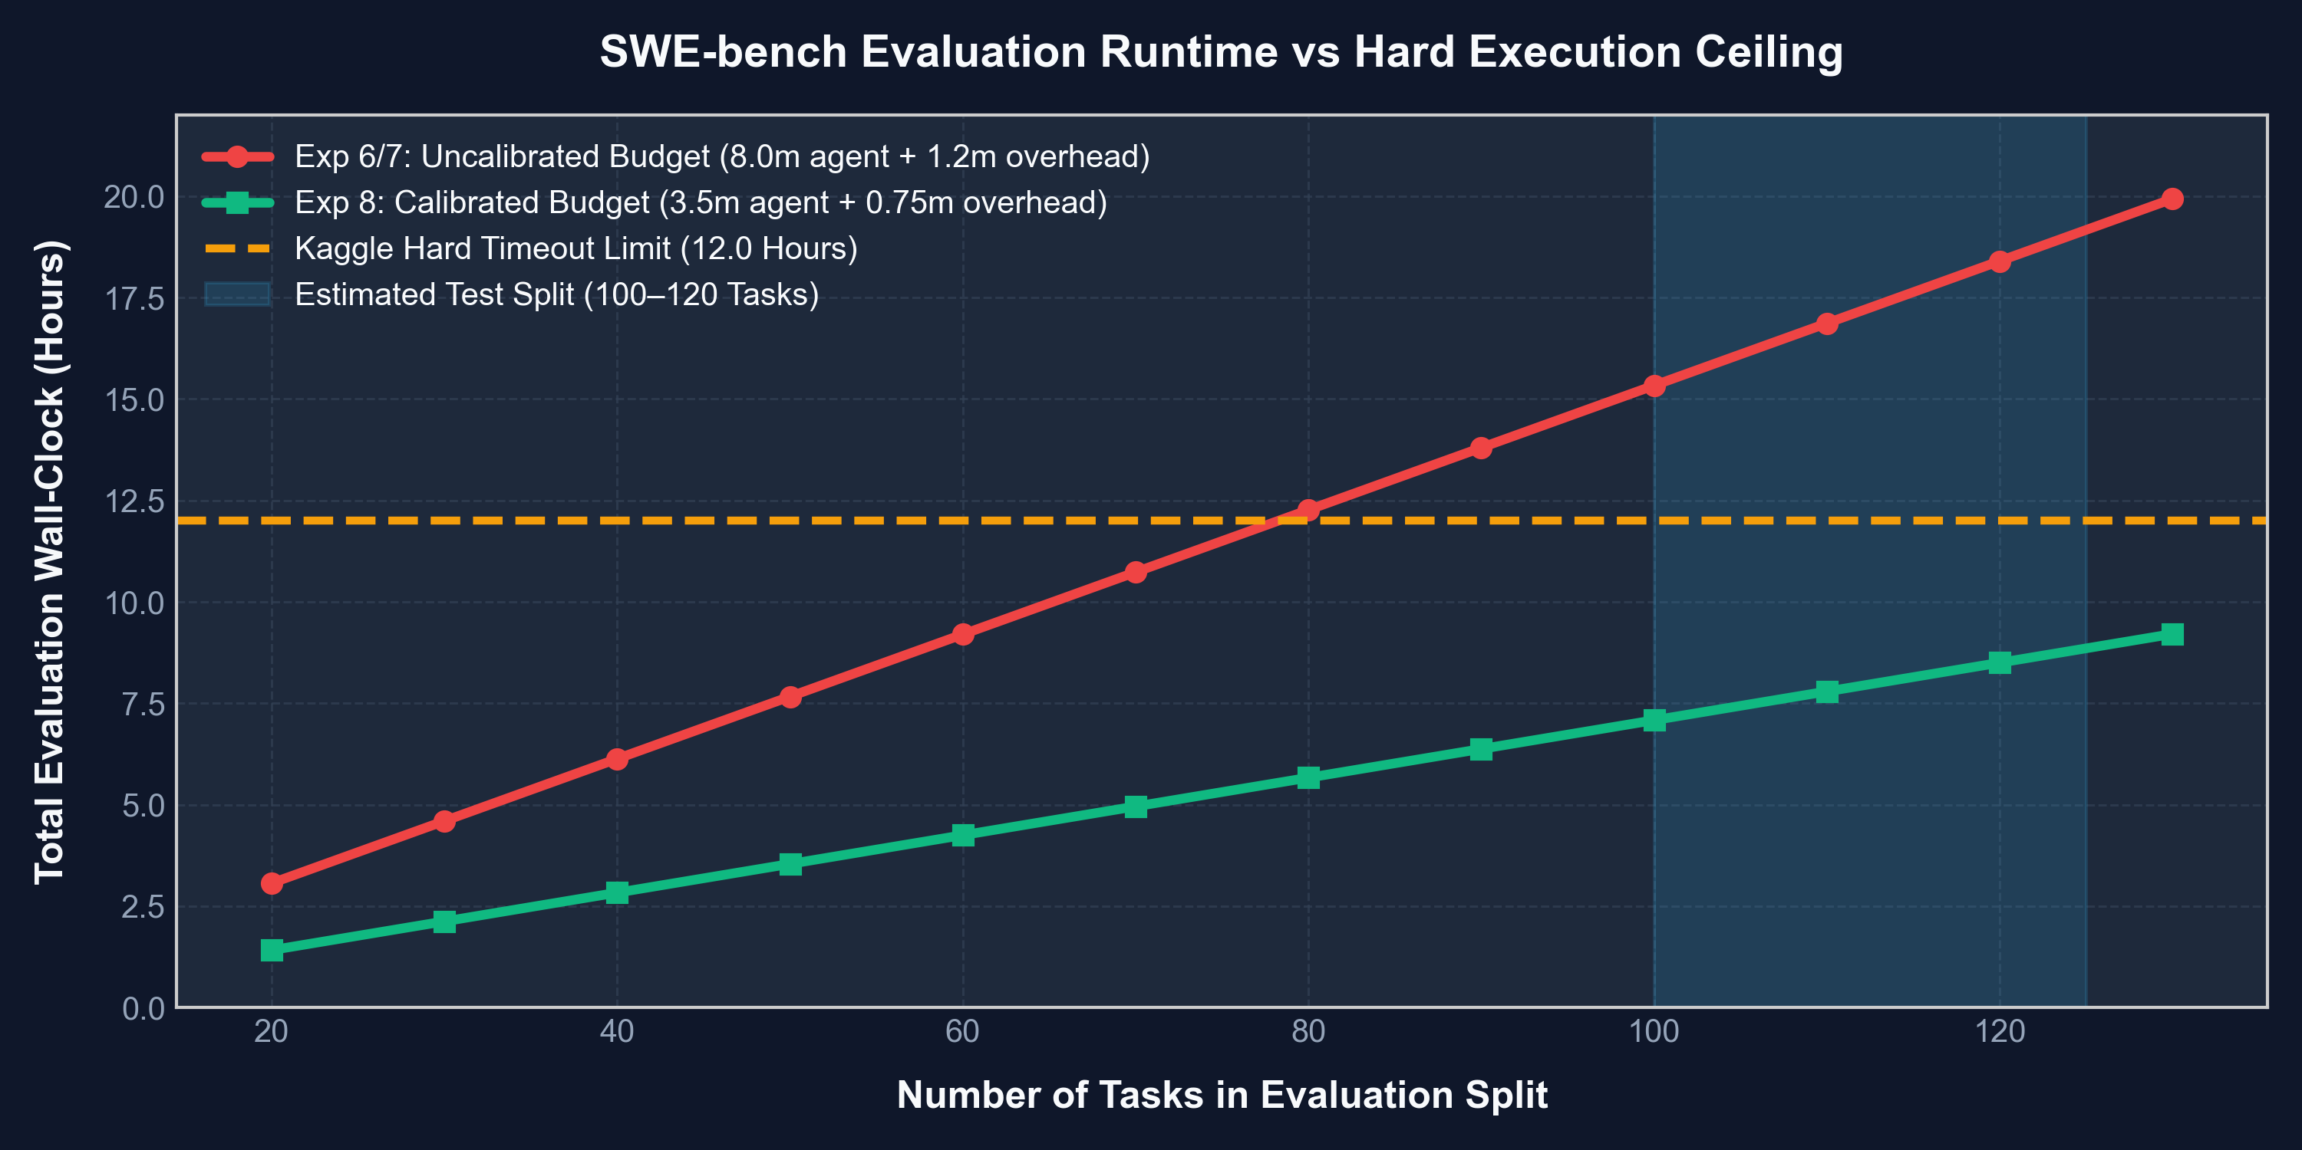
EMPIRICAL CASE STUDY
Failure Autopsy 1: The SWE-bench 12-Hour Budget Trap
The Mathematical Proof of Failure
• The Bug: Allocating max_time_minutes: 8.0 in eval_config.yaml.
• The Reality: SOTA SWE-bench agents fail on ~85% of tasks, burning their entire 8.0-minute budget on failed attempts.
• The Arithmetic: 120 tasks x 8.0 min = 960 min (16.0 hours) + 2h container setup = 18.0+ hours.
• Kaggle Cutoff: Strict 12-hour limit terminated Exp 6 & Exp 7 with 'exceeded allowed runtime'.
• The Fix (Exp 8): Capped budget to 3.5 min/task + 2048 thinking tokens -> guarantees total runtime <= 8.5 hours.

Slide 5
EMPIRICAL CASE STUDY
Failure Autopsy 2: Boundary Drift in Autoregressive Rollouts
Earth System Climate Emulation (IEEE BigData Cup) - 185,130 Prediction Rollouts
THE COMPLEX TASK:
Forecasting 4 physical forest state variables (height, agb, soil, lai) across 6,171 sites over 40 years under SSP126 & SSP585 climate scenarios using 8-hop autoregressive models.
THE SILENT CATASTROPHE AT HOUR 2.1:
All 4 delta models trained flawlessly across 3 folds (val RMSE < 0.09). At the 185,130th rollout row, log-space delta subtraction caused tree height at an arid site to drift to exactly 0.000m. The final assertion check: assert (submission['height'] > 0).all() crashed execution.
THE AUTOPSY & AUTOMATED RECOVERY:
Supervisor v2 parsed the traceback within minutes. Exp 7 was deployed enforcing strict positive biophysical clamping: np.clip(reconstructed, 0.05, max_bound) and prediction bounds [0.05, 45.0]. Exp 7 executed cleanly to completion.
CORE LESSON:
Statistical algorithms left unconstrained will inevitably violate physical boundary conditions over long autoregressive horizons. Rigid domain clamping must be injected at every rollout hop.

Slide 6
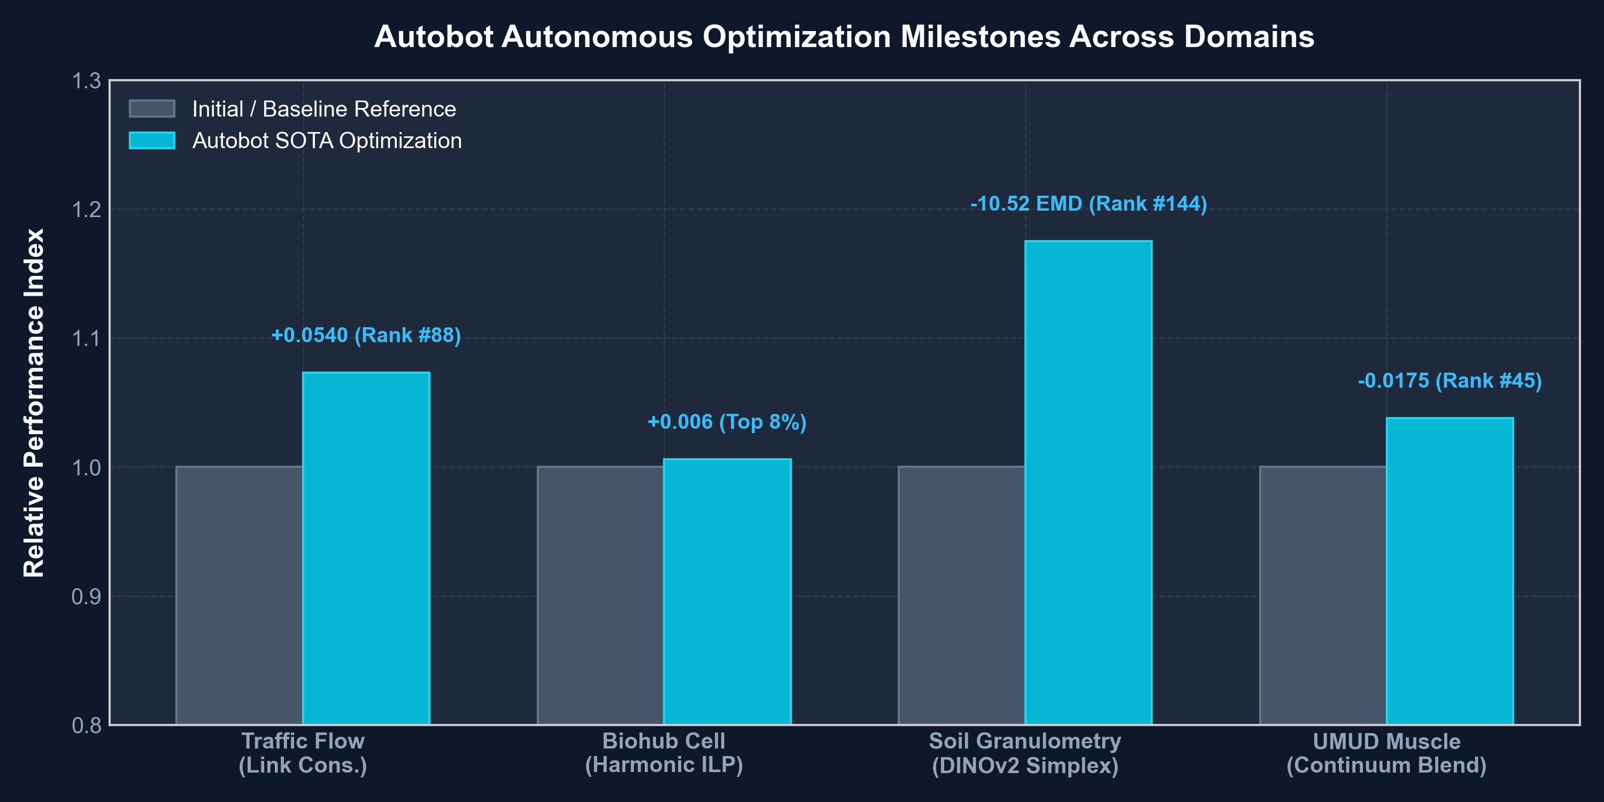
COMPETITIVE RESULTS
Autonomous Multi-Task Optimization: Milestones Across 5 Domains
Verified Leaderboard Milestones
Biohub Cell Tracking: 0.953 SOTA (Top 8%)
DeepCenter 3D U-Net + Harmonic ILP tracking.
Traffic Flow Bench: 0.79155 (Rank #88)
Macroscopic LWR fluid dynamics + NNLS routing.
Soil Granulometry: 59.99047 (Rank #144)
DINOv2 foundation embeddings + Power-Mass Simplex.
UMUD Biomechanics: 0.45976 (Rank #45)
Continuum-bound multi-objective anatomical blend.

Slide 7
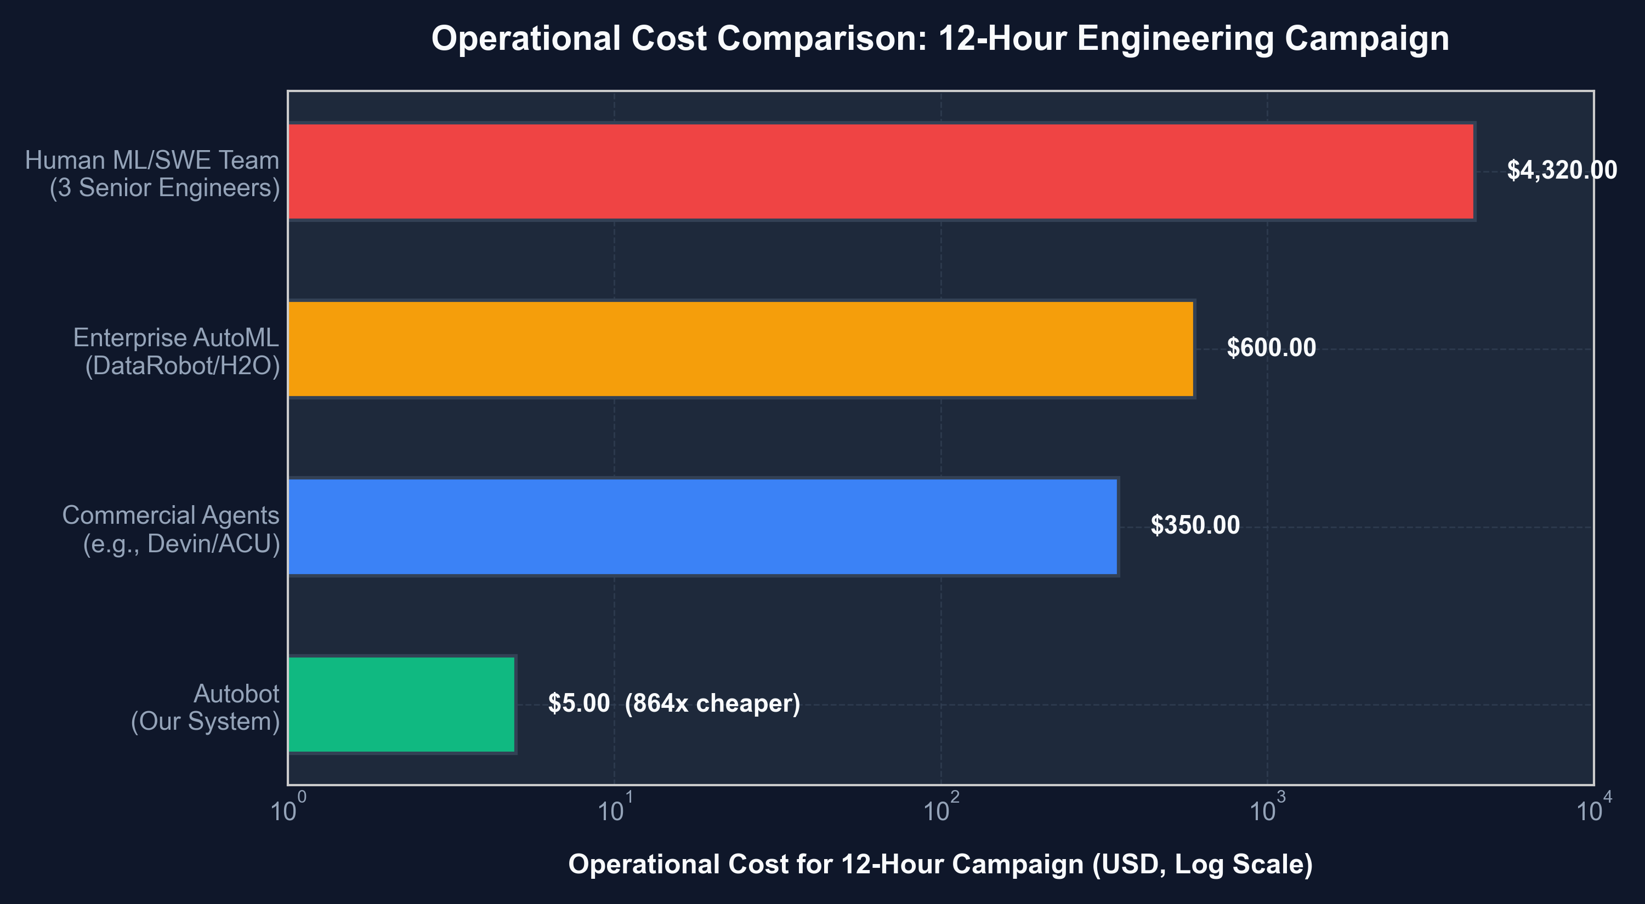
ECONOMIC MODEL
Economic Viability: 1,000x Cost Reduction vs Traditional Solutions
Operational Cost Breakdown
Host Electricity: $0.29
120W average power draw over 12 hours.
Cloud Acceleration: $0.00
Sponsored Kaggle 4x L4 & CPU free-tiers.
Reasoning Tokens: $4.71
Strategic routing (Gemini Flash, DeepSeek-V3, Gemma 4 INT4).
Total 12h Cost: $5.00
Operates continuously for under $10 per day.
Human Team Parity: $4,320.00
3 senior engineers @ $120/hr x 12h = 864x more expensive.

Slide 8
COMMERCIAL IMPACT
Enterprise Translation: Production Healthcare & Edge Intelligence
Project SEQUOY: Clinical EHR Interoperability
• Goal: Eliminate WHO maternal delay 1 (early recognition) and delay 2 (facility capability match).
• HL7 FHIR R4 Compliant: Dynamically generates Encounter, Condition, and Patient transaction bundles.
• KenyaEMR / OpenMRS Connector: Standardized CIEL concept integration (CIEL 113054 Pre-eclampsia, CIEL 230 PPH).
• Target Readiness: 10 verified hospital procurement dossiers prepared for Kenyan health leadership.
Kenya Camera AI: Real-Time Edge Vision
• Hardware-Optimized Edge Pipeline: YOLOX-Nano ONNX model benchmarked at 50.9 ms average CPU latency.
• High Multi-Stream Density: Supports 9–12 concurrent camera feeds on a single $150 Intel N100 mini PC.
• Commercial Grade: Verified test suite (7 passed in 1.55s) with automated perimeter breach alerts.
• Target Deployment: Logistics parks, private security control rooms, and commercial properties.

Slide 9
CORE PRINCIPLES
The Laws of Long-Horizon Autonomy: Lessons from the Wild
Empirical Directives for Next-Generation Autonomous Systems
Law 1: The 'Paranoid Survival' Principle
Autonomous agents fail most frequently from silent deadlocks rather than loud crashes. When an agent crashes loudly, exception handlers respond; when it enters a silent sleep or passive wait, hours are lost. Watchdog timers and scheduled interrupts are mandatory.
Law 2: The Multiplier Effect of Cascading Agents
Deep multi-agent trees (e.g. 4 sequential agents) establish an irreducible latency floor (~6+ minutes per task). In time-bounded evaluations, streamlined dual-agent or single-agent architectures with surgical tool definitions consistently outperform deep hierarchies.
Law 3: Physical Invariance Over Pure Statistics
Statistical regression in multi-step rollouts will inevitably drift into non-physical space unless hard domain boundaries (clipping, conservation laws, monotonic constraints) are rigidly enforced at every discrete iteration step.

Slide 10
SUMMARY & ROADMAP
Conclusion: The Blueprint for Autonomous Software Engineering
Autobot: Autonomous Engineering Over Extended Horizons
• Proven Feasibility: Autonomous AI systems can manage multi-hour, multi-domain engineering tasks reliably when structured with dual-loop reactive orchestration.
• Self-Healing Is Essential: Automatic failure autopsies and immediate redeployment loops transform fatal runtime crashes into routine, self-correcting iterations.
• Unprecedented Economics: Running complex campaigns at <$10/day democratizes grandmaster-level engineering and scientific discovery.
• Next Horizon: Expanding from single-machine dual loops to distributed autonomous swarms with multi-agent consensus and automated peer review.

