Slide 1
AUTOBOT SYSTEMS RESEARCH
Long-Horizon Autonomy
Fails Quietly
12 h
30 m
Architecture · Failure modes · Economics
Dalton Omondi
2 m
Chat
Agent chains
Autobot
12+ h
unattended horizon
6
concurrent domains
$5
marginal cost per run
Notes:
Long-horizon autonomy fails quietly. This talk covers the architecture, the two failure modes that cost us the most, verified results, and the economics of a 12-hour unattended AI engineering agent.

Slide 2
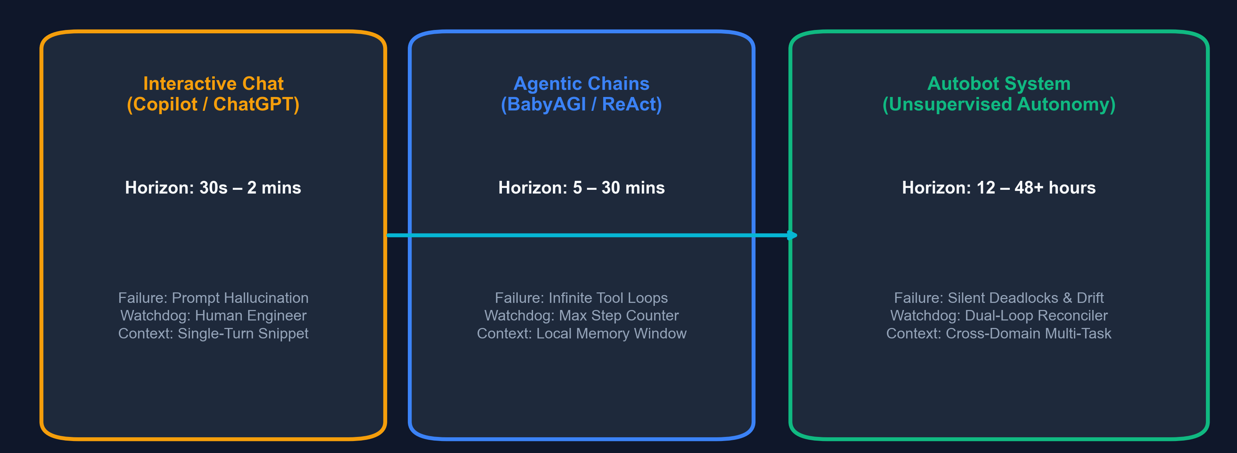
THE PROBLEM
360×
longer than a chat turn
The horizon gap
12–48 h
Autobot horizon
Silent
dominant failure mode
→ Beyond 30 min, operations decide success
Notes:
Short horizons (2 min): model reasoning dominates and a human is the watchdog. Long horizons (12 h+): operations dominate - budgets, liveness, silent sleep and drift. Single-turn benchmarks mask these long-horizon failure modes entirely.

Slide 3
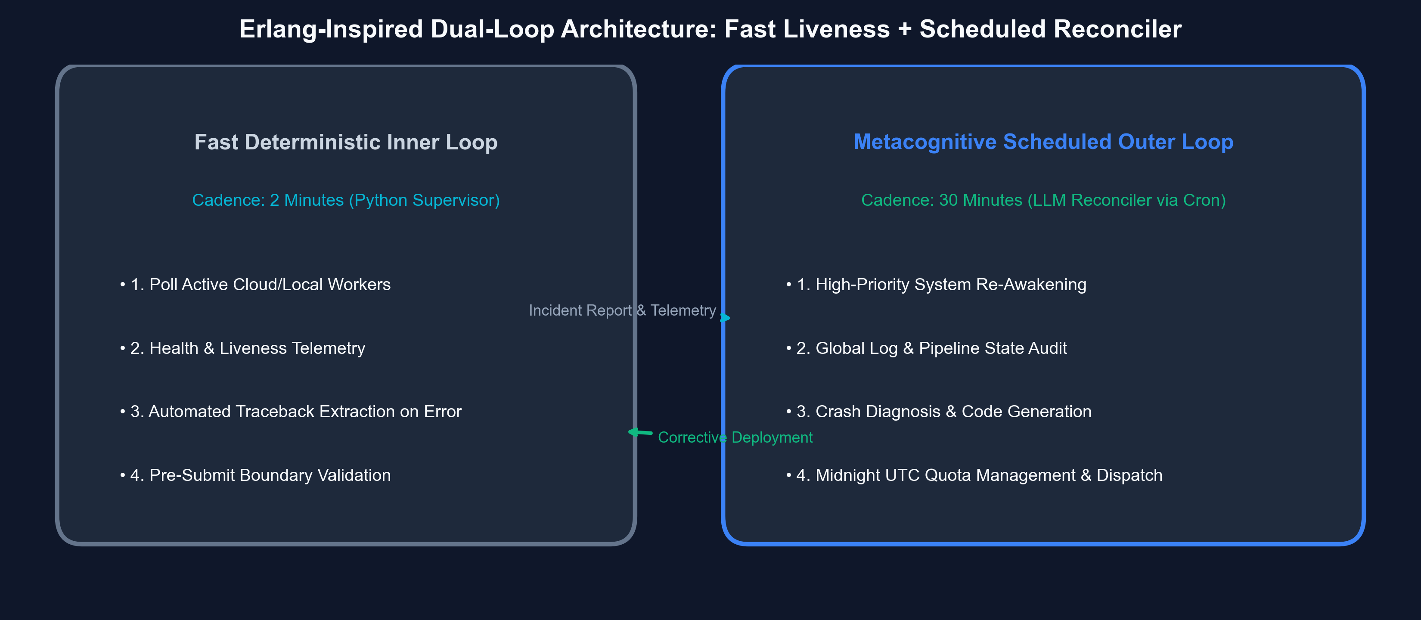
SYSTEM DESIGN
2 m / 30 m
inner / outer cadence
Dual-loop supervision
Python
deterministic inner loop
LLM
scheduled outer reconciler
→ Cheap loop notices. Expensive loop thinks.
Notes:
Erlang / Kubernetes lineage. Fast inner loop (2 min): deterministic Python supervisor that polls workers, checks health and extracts tracebacks. Slow outer loop (30 min): scheduled LLM reconciler that audits state, diagnoses crashes and manages midnight-UTC quotas. Together they stop silent overnight stalls.

Slide 4
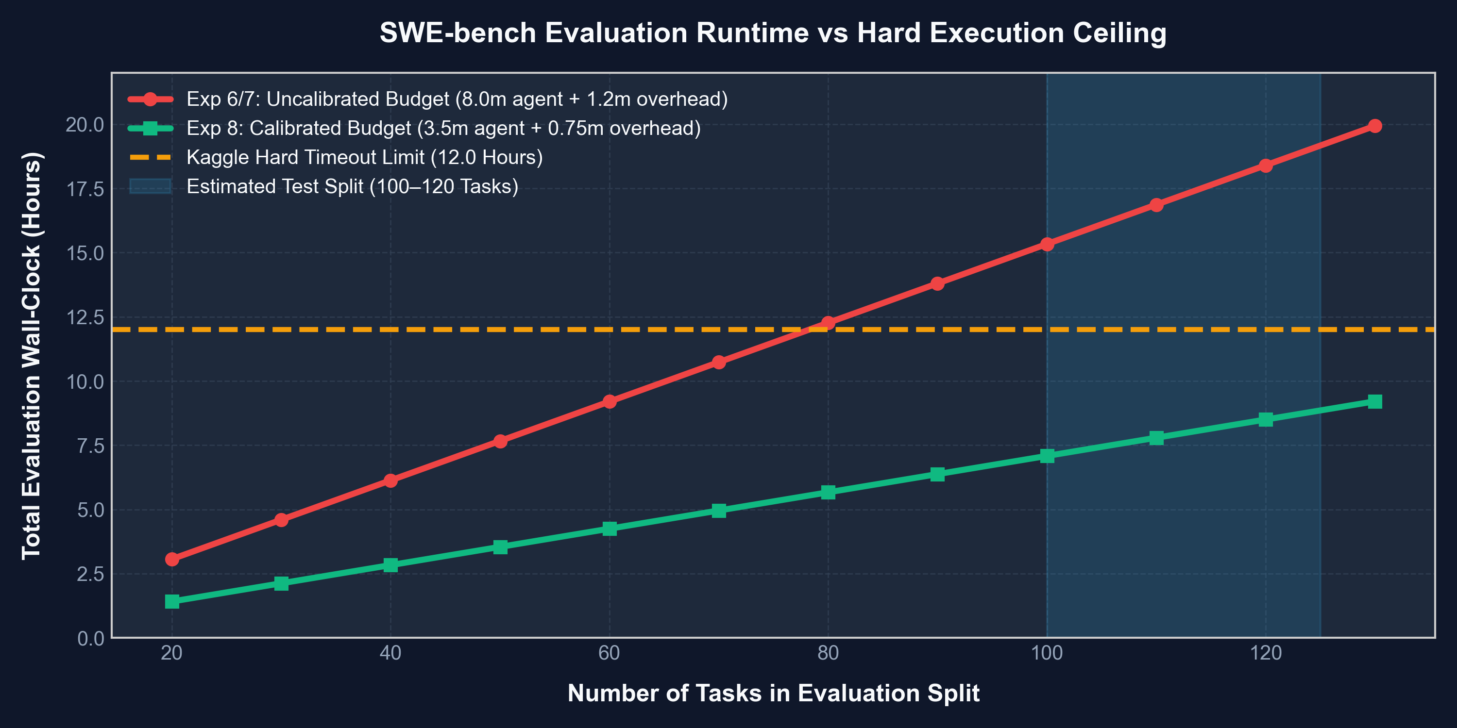
FAILURE AUTOPSY 1 · SWE-BENCH
18.4 h
projected vs 12 h hard kill
Budgets compound multiplicatively
8.0 → 3.5 min
per-task agent cap
≤ 8.5 h
calibrated runtime
→ Prove T_worst ≤ limit before dispatch
Notes:
Exp 6/7: 8.0 min budget x 120 tasks = 16 h, plus 2.4 h overhead = 18.4 h, which hits the 12 h SIGKILL. SWE-bench agents fail on ~85% of tasks and burn the full cap each time. Exp 8: 3.5 min budget with 2048 thinking tokens keeps total runtime <= 8.5 h.

Slide 5
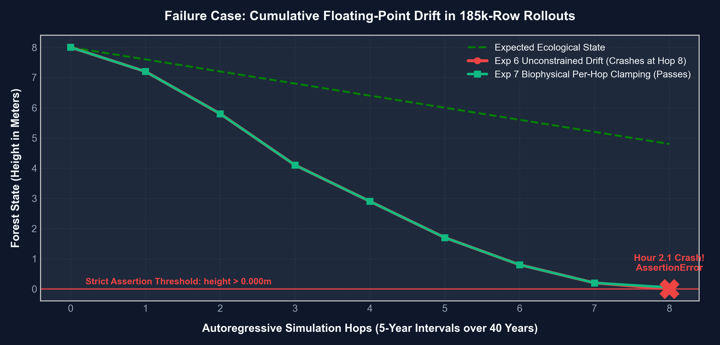
FAILURE AUTOPSY 2 · CLIMATE EMULATION
Hour 2.1
AssertionError at hop 8
Autoregressive boundary drift
185k
rows rolled out
0.000 m
tree height reached
→ Enforce invariants every hop — not at export
Notes:
At hour 2.1 an AssertionError fired: tree height reached 0.000 m at an arid test site. The invariant was only checked at export after 185k rows, wasting two hours of compute. Exp 7 clamps per hop and passes; report clip hit-rates so clamping never hides drift.

Slide 6
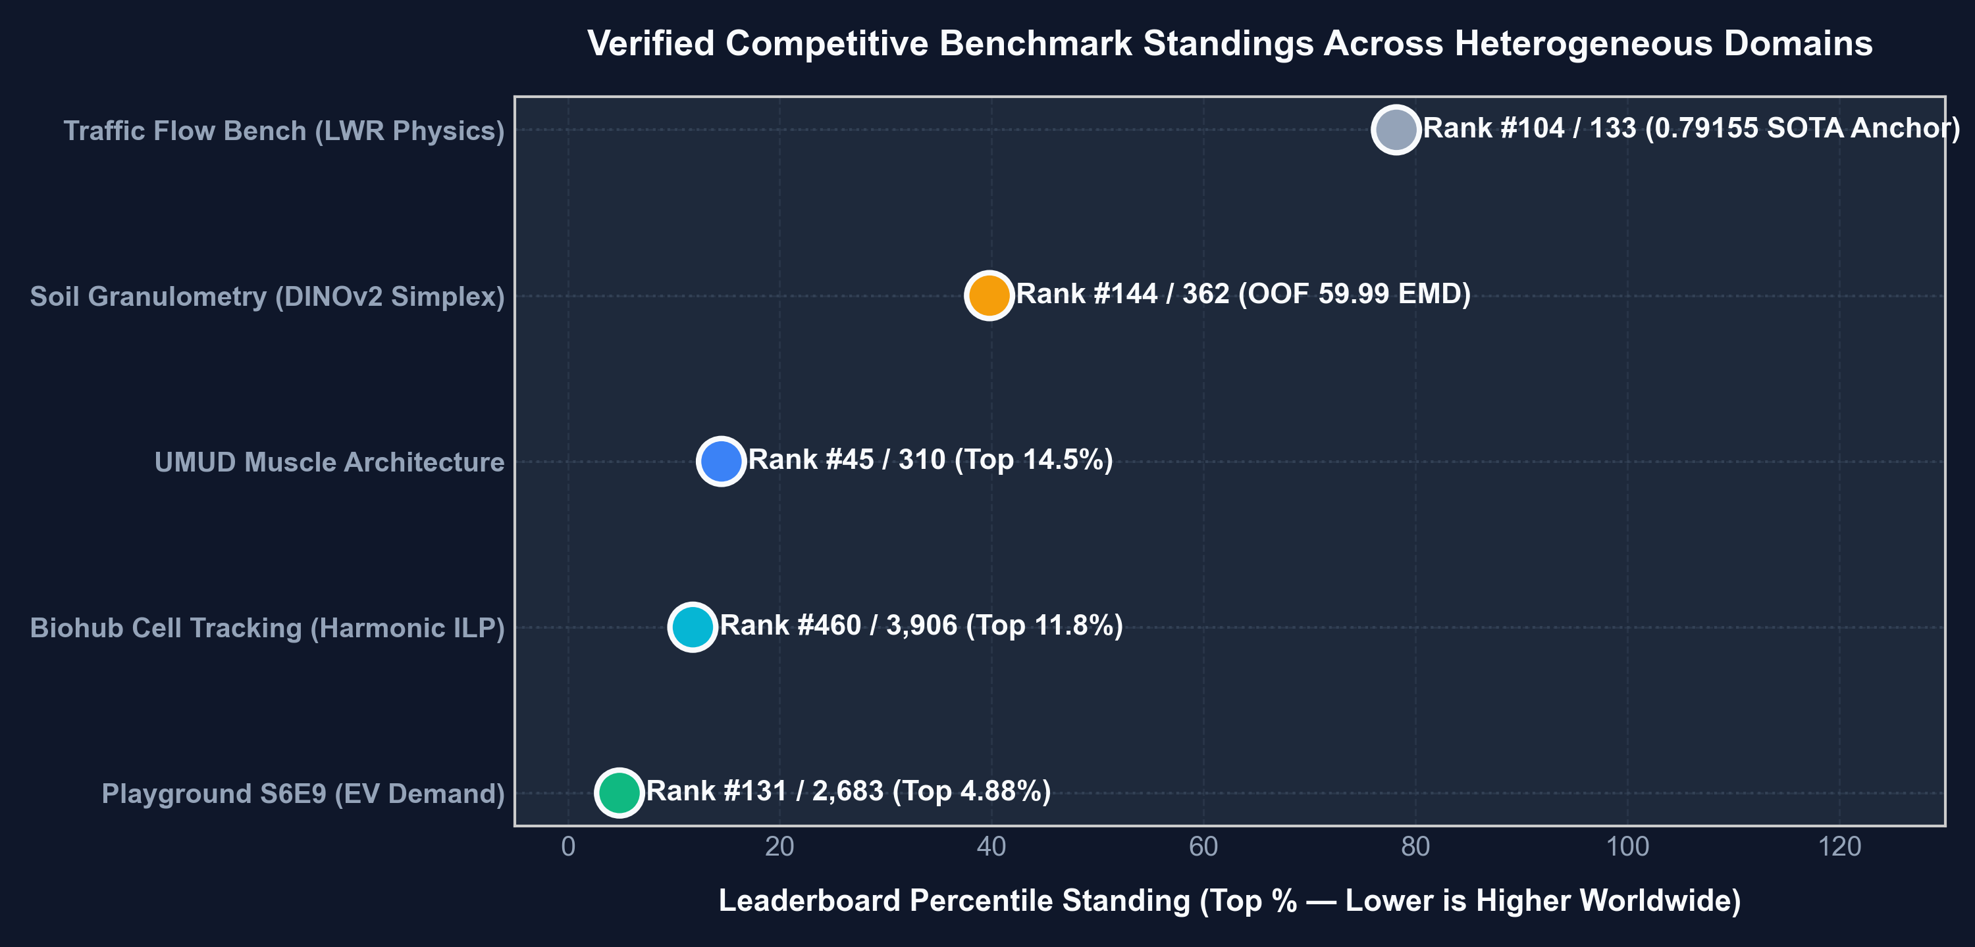
VERIFIED RESULTS
Top 4.88%
S6E9 · #131 / 2,683
One agent, five live leaderboards
Top 11.8%
Biohub · #460 / 3,906
Top 14.5%
UMUD · #45 / 310
→ Five concurrent campaigns under one supervisor
Notes:
Playground S6E9: rank #131 of 2,683 (top 4.88%). Biohub cell tracking: #460 of 3,906 (top 11.8%). UMUD muscle architecture: #45 of 310 (top 14.5%). Soil granulometry and traffic flow were held concurrently by the same unattended agent.

Slide 7
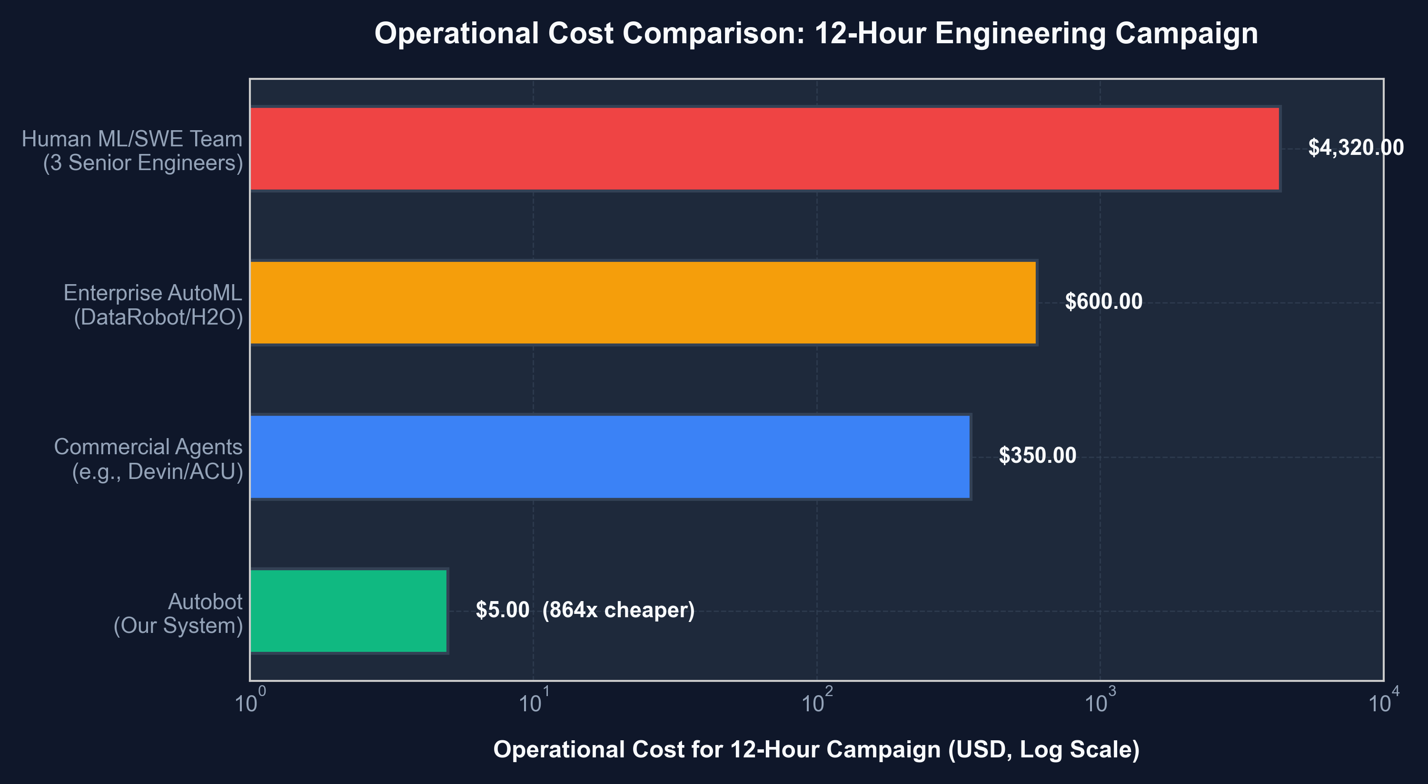
ECONOMICS
864×
cheaper than a 3-engineer team
Cost of a 12-hour campaign
$5.00
marginal cost per run
~$35
fully loaded (4× L4)
→ Engineer-hours become supervision-minutes
Notes:
Marginal cost: $5.00 per 12 h run ($0.29 electricity + $4.71 inference). Fully loaded ~$35 including amortized 4x L4 GPU compute and tooling, versus $4,320 for three senior engineers over the same 12 hours.

Slide 8
REAL-WORLD TRANSLATION
From leaderboards to production
Project SEQUOY
Clinical EHR · Kenya
Kenya Camera AI
Edge vision · CPU only
FHIR R4
transaction bundles
CIEL
KenyaEMR / OpenMRS concepts
10
hospital dossiers
50.9 ms
CPU inference
9–12
feeds per box
$150
Intel N100, no GPU
→ Standards-native from day one
→ 7/7 smoke tests pass in 1.55 s
Notes:
Project SEQUOY: dynamically generated HL7 FHIR R4 transaction bundles (Encounter, Condition, Patient) mapped to KenyaEMR / OpenMRS CIEL concepts (CIEL 113054 pre-eclampsia, CIEL 230 PPH); 10 Kenyan hospital procurement dossiers drafted.
Kenya Camera AI: 50.9 ms average CPU inference with YOLOX-Nano ONNX; 9-12 concurrent camera feeds on a $150 Intel N100 mini PC; 7 smoke tests pass in 1.55 s with no GPU.

Slide 9
PRINCIPLES
Three laws of long-horizon autonomy
1
2
3
5 : 1
silent stalls vs loud crashes
≤ 12 h
worst case, proven pre-launch
Every hop
invariants checked in-loop
Paranoid liveness
Watchdogs + scheduled interrupts
Budget proofs
Prove T_worst ≤ limit, then dispatch
Boundary projections
Clamp per hop; log clip hit-rate
Notes:
Law 1 - Paranoid liveness: silent deadlocks outnumbered loud crashes roughly 5:1, so watchdog timers and scheduled interrupts are mandatory.
Law 2 - Pre-dispatch budget proofs: budgets compound multiplicatively across task splits; prove worst-case runtime <= the hard limit before launching.
Law 3 - Physical boundary projections: statistical models drift into non-physical space; clamp at every hop and monitor clip hit-rates.

Slide 10
ROADMAP
Next: measure, generalize, prove
MEASURE
GENERALIZE
PROVE
MTTD / MTTR ablation
Declarative job registry
Open telemetry logs
Stall-hours avoided
Invariant library
Reproducible snapshots
Clip-rate telemetry
Budget-verifier CLI
Multi-day swarms
Autonomy is an operations problem.
Notes:
Measure: ablate the outer loop to quantify MTTD and MTTR, record stall-hours avoided, and log clip-activation telemetry.
Generalize: replace bespoke scripts with a declarative job registry, a per-hop invariant library, and a pre-dispatch budget verifier CLI.
Prove: publish telemetry logs, reproducible commit snapshots, and run continuous multi-day autonomous swarms.

