Slide 1


Solar tracker
Gattaux Gabriel
Andrei George Claudiu

Slide 2
Summary
Focus on electronics and motorization
Lake of printing
Introduction
Architecture
Electronics parts
Motorization
Algortihm
Improvements and Conclusion

Slide 3
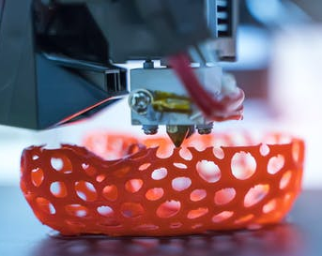
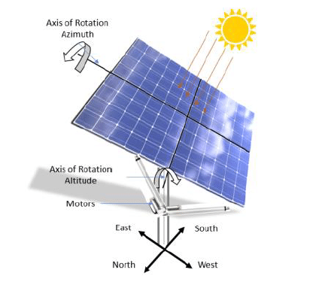
Introduction
Additive manufacturing project :
Goal : To construct a prototype of heliostat in plastic and ceramic
Specifications :
Rotational movement around vertical axis at least 270 degs
Rotational movement around horizontal axis at least 90 degs
Restricted volumic area of 120mm diameter and 150mm height
Restricted width of the mirror, between 5mm and 12mm
Drive system project:
Goal : To motorize our prototype of heliostat → solar panel tracker
Specifications :
Add a motorization system
Bonus : Add sensors

Slide 4
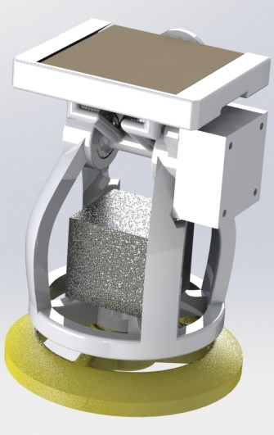
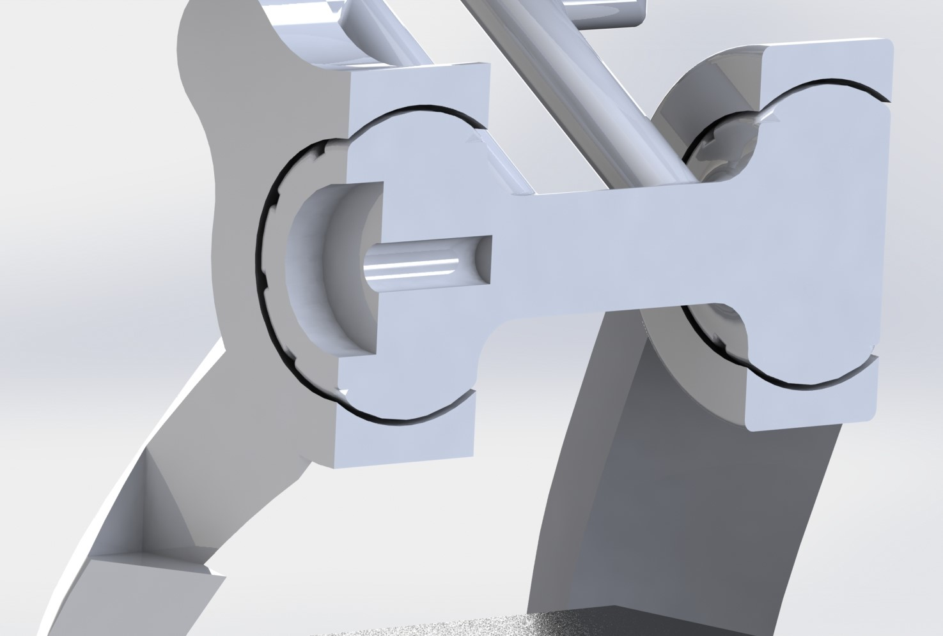
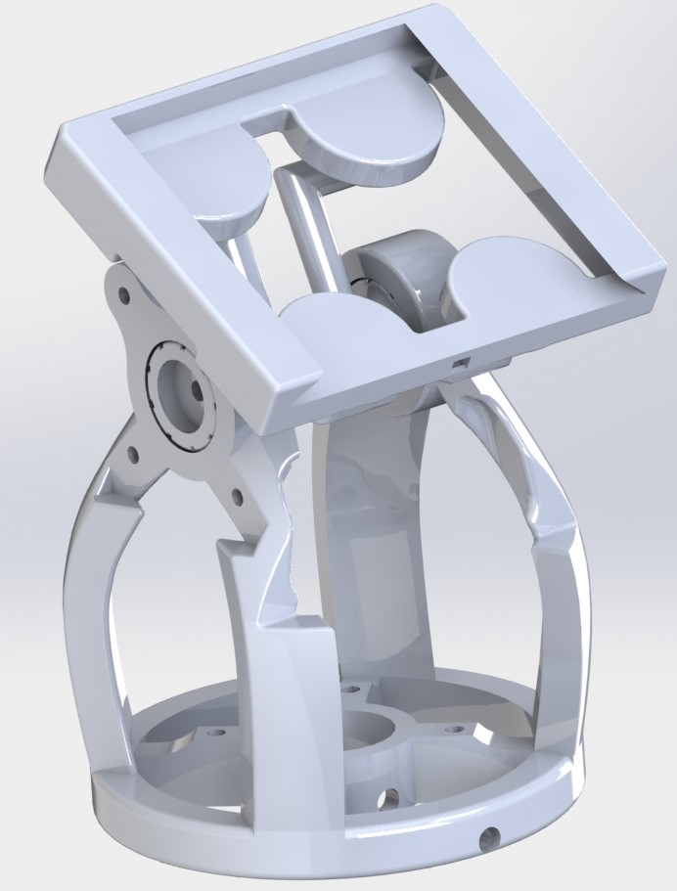
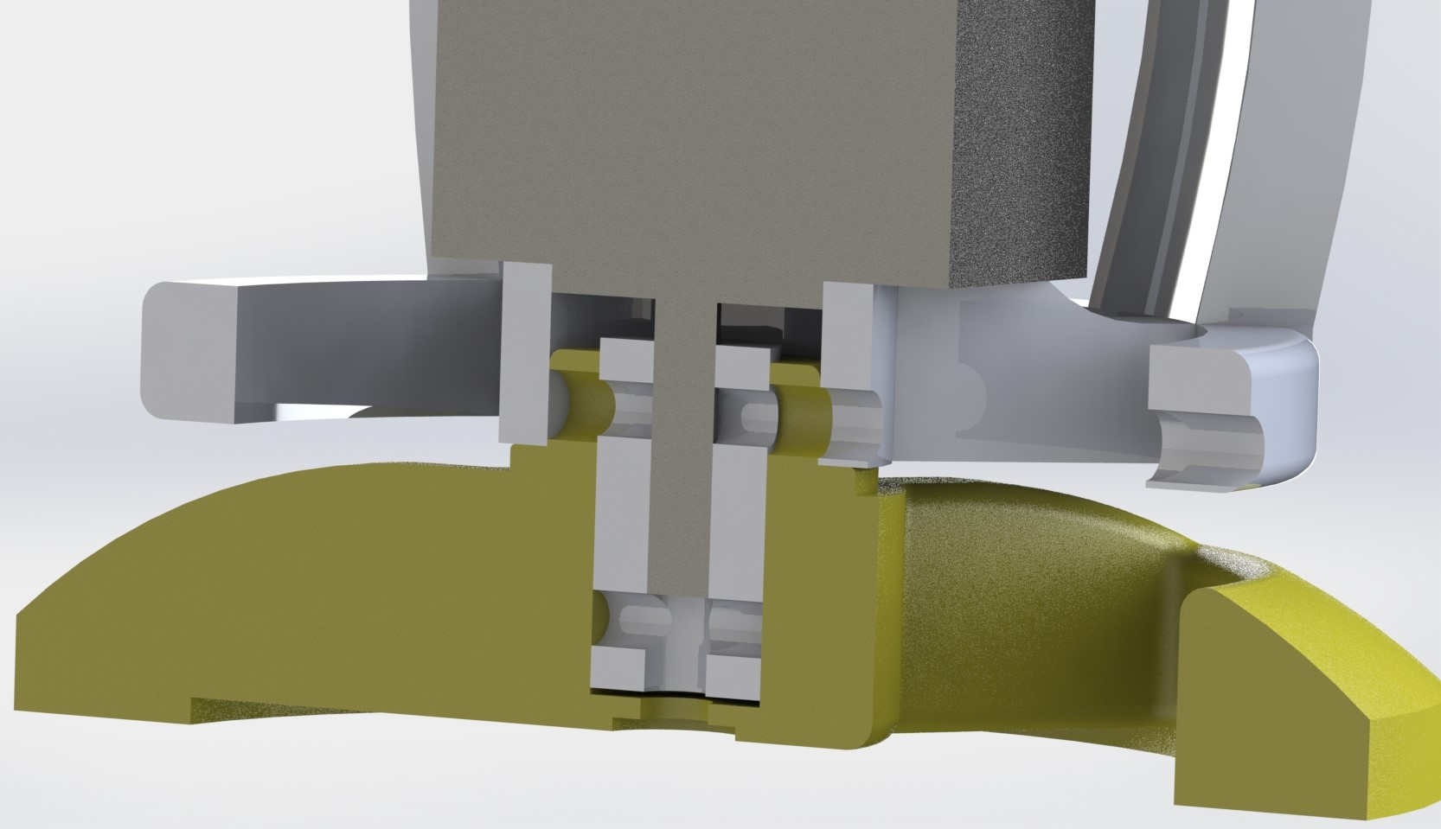
Overall Architecture
Altitude’s joint
Global system
Upper part – 2 in 1
Azimuth’s joint with coupler

Slide 5
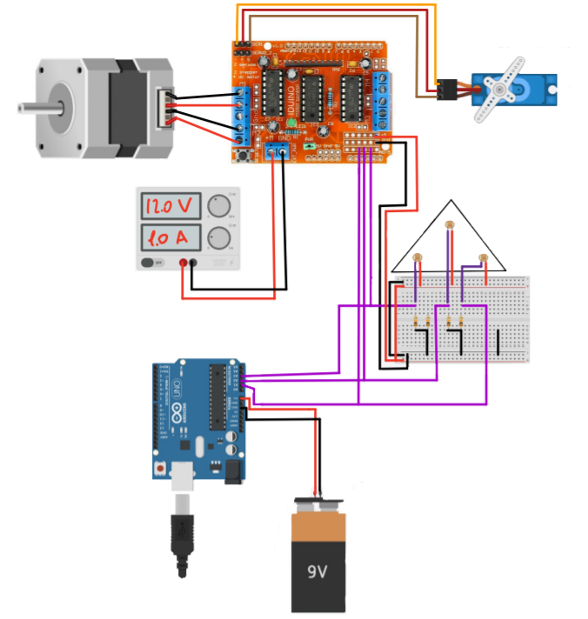
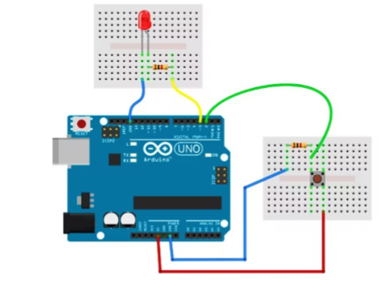
Electronics
Electric Circuit
Arduino UNO
Motor Shield L298D
Light Intensity Acquisition:
LDR x3
Initial Condition Control:
LED x1
Buttom x1
10k Pull-down Resistor
Elevation Control:
Servo motor Hitec HS-55 x1
Azimuth Control:
Stepper motor 17HS15
Power Supply:
Battery 9V
Power supply 12[V] 1 [A]
Initial Condition
Notes:
Remember to explain all the technical stuff (how we did initial condition and why, ecc ecc), powe supply

Slide 6
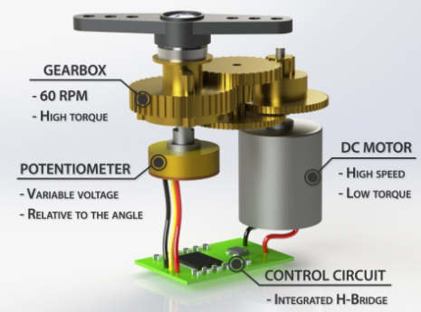
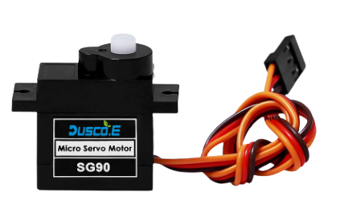
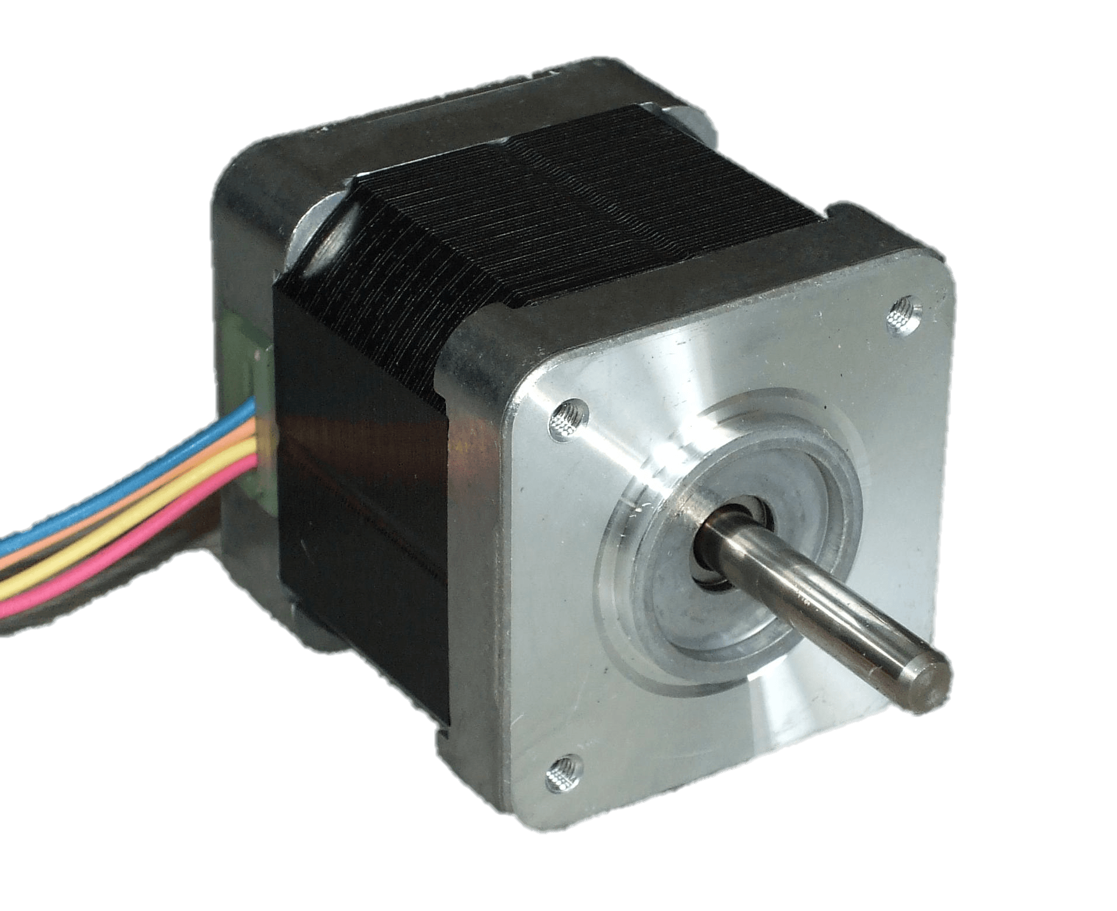
Motorisation
Servo motor → Altitude’s joint
Through L298D
Library Arduino : stepper
Stepper motor → Azimuth’s joint
Controlled using single step and double coil
Through L298D → The driver do the all calculation
Library Arduino : AF_stepper
Vitesse : 10 rpm (more couple, less speed)
Pros / Cons
Direct angle input
Less power supply
Good at prototyping
Noise
Less precise position
180 deg of range
Pros / Cons
Very precise position
No noise
360 deg
Step input
Big power consumption

Slide 7
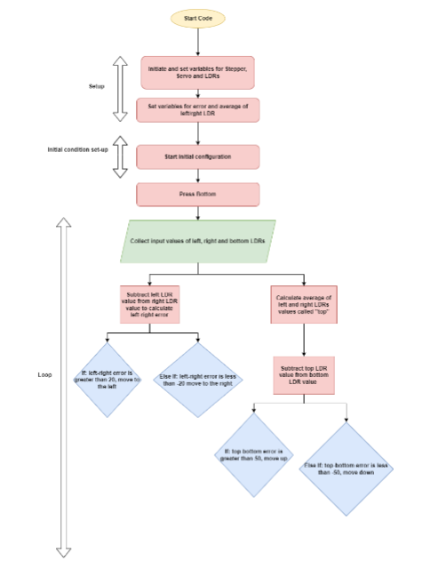
IDE Steps
Initialization of the variables
Initial configuration mode
Data acquisition from LDRs and motors
Computational Algorithm
Motors Control

Slide 8
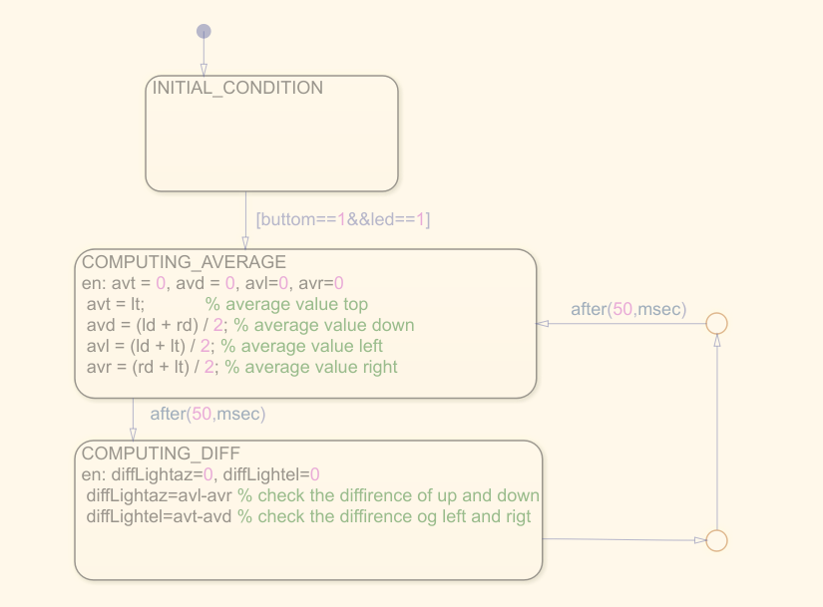
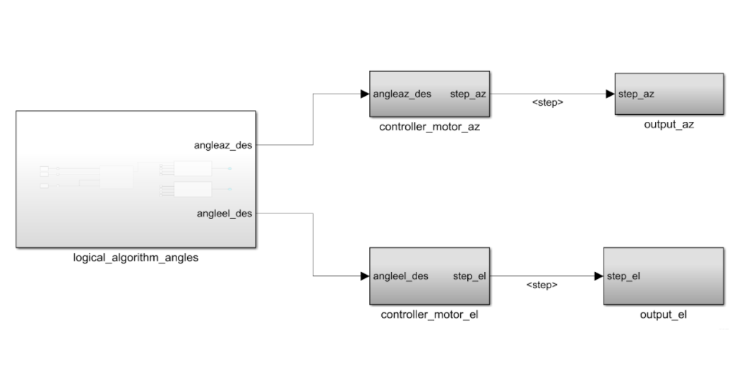
Improvements
Algorithm implemented on Stateflow
Direct Matlab Control
ULN2003
Others
Refreshing period by adapting the refreshing rate of the control loop depending of the light intensity
Trajectory optimization by controlling the motion of each axis one at time
3. Power supply optimization by displacing in a better way the servo motor or using the energy produced by the solar panel itself
4. Wiring optimization by wires fixing and introducing also a fixed base

Slide 9
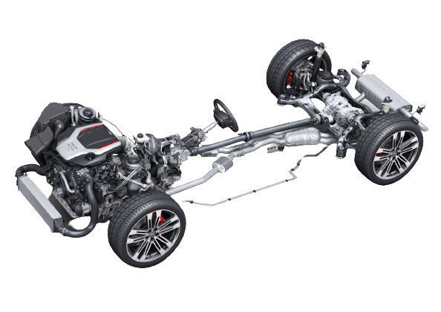
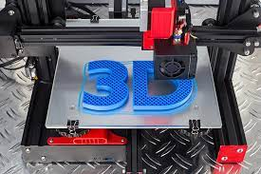

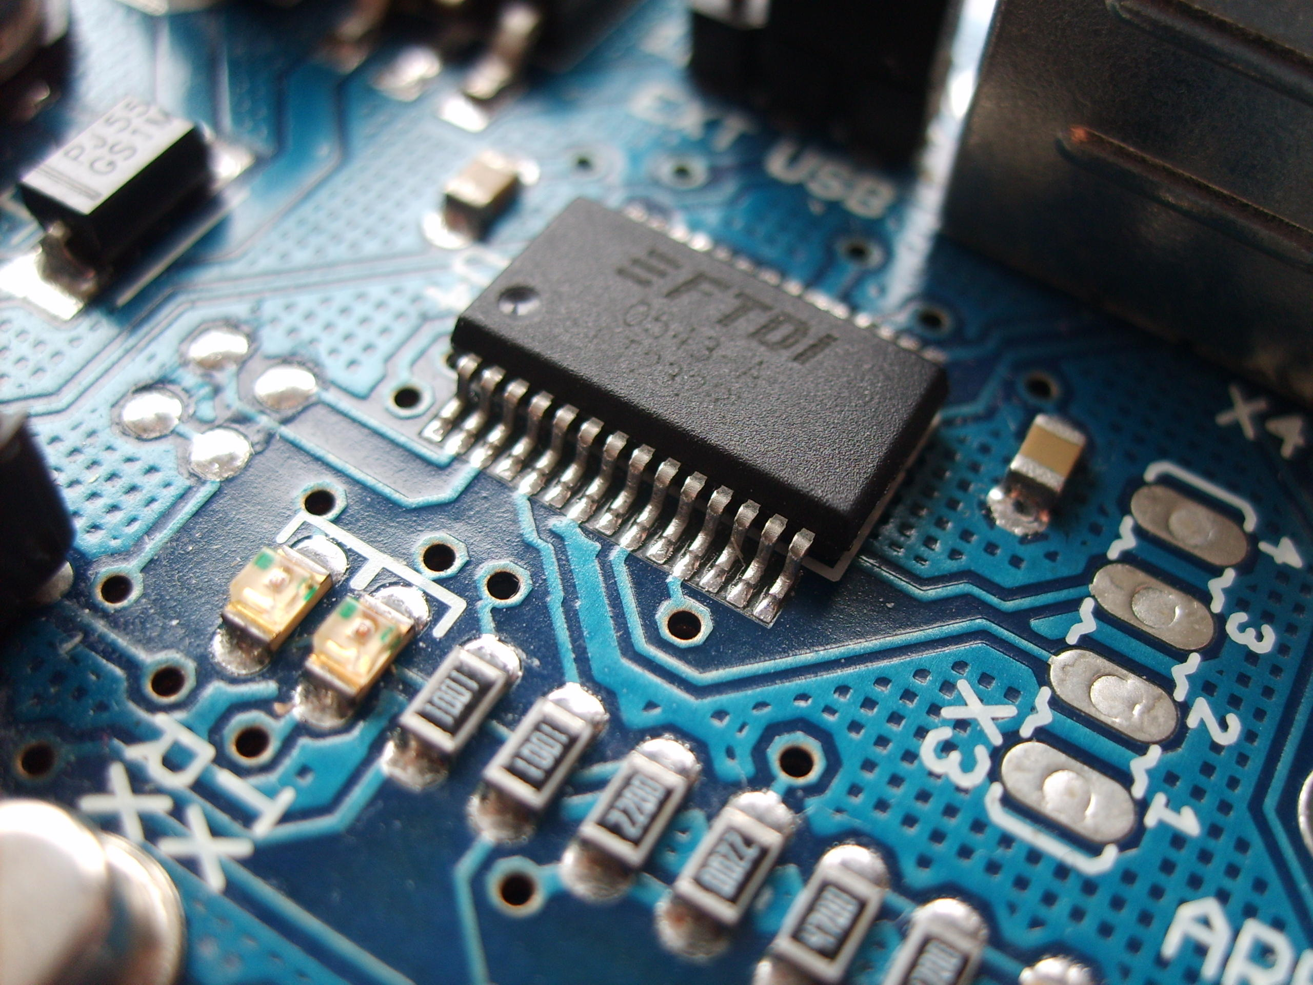
Conclusion
This project → Affected by the Additive manufacturing project (CAD, print…)
Good to create a project from 0
Using 2 servo instead of 1 stepper to have a “pick and place” system
Project succeed → Specification filled / Time-schedule OK
Drive system
SKILLS GAINED :
3D printing
Project management
Electronics programming

Slide 10
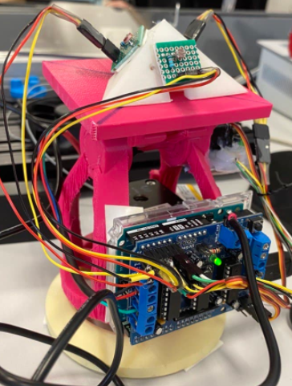
Thanks you feel free to ask questions (French or English :)

