Slide 1
Analysis of the number of facilities serving populations and villages within slum areas in Nairobi. A Case Study of Kibera, Mathare and Kawangware Slums
Presenter: Nturibi Gacheri Lydiah

Slide 2
Introduction
The rate of urbanization has increased in the last few decades.
Urbanization is expected to increase to 88% by the year 2050.
Rapid urbanization can be attributed to natural population growth, rural-urban migration, reclassification of rural areas and increase of urban informal settlements.
Rapid urbanization has been shown to lead to disparities among urban populations in terms of economic and health well-being.
With increased unplanned growth, urban areas have experienced and continue to experience environmental degradation, urban sprawl and pollution.(Wamukoya, Kadengye, Iddi, & Chikozho, 2020)

Slide 3
Problem Statement
In 2014, 60-70% of Kenya’s urban population resided in slum areas. This translates to about 2 million people, crammed into only 5% of the city’s residential area.
These people are forced to live in inadequate housing with little access to clean water, sanitation, healthcare, schools and other essential services.
Government policies to rehabilitate slum areas have been slow with inadequate measures put in place to protect the people living in these areas or provide the relevant facilities. (Amnesty International, 2009)
There is a need to determine the facilities serving these people, as well as determine the number of people that have access to these facilities.

Slide 4
Objectives
To identify the most common facilities in each of the Kenyan slums at village level.
To correlate the number of facilities with population within each village.
To visualize the facilities serving populations within the slum areas.

Slide 5
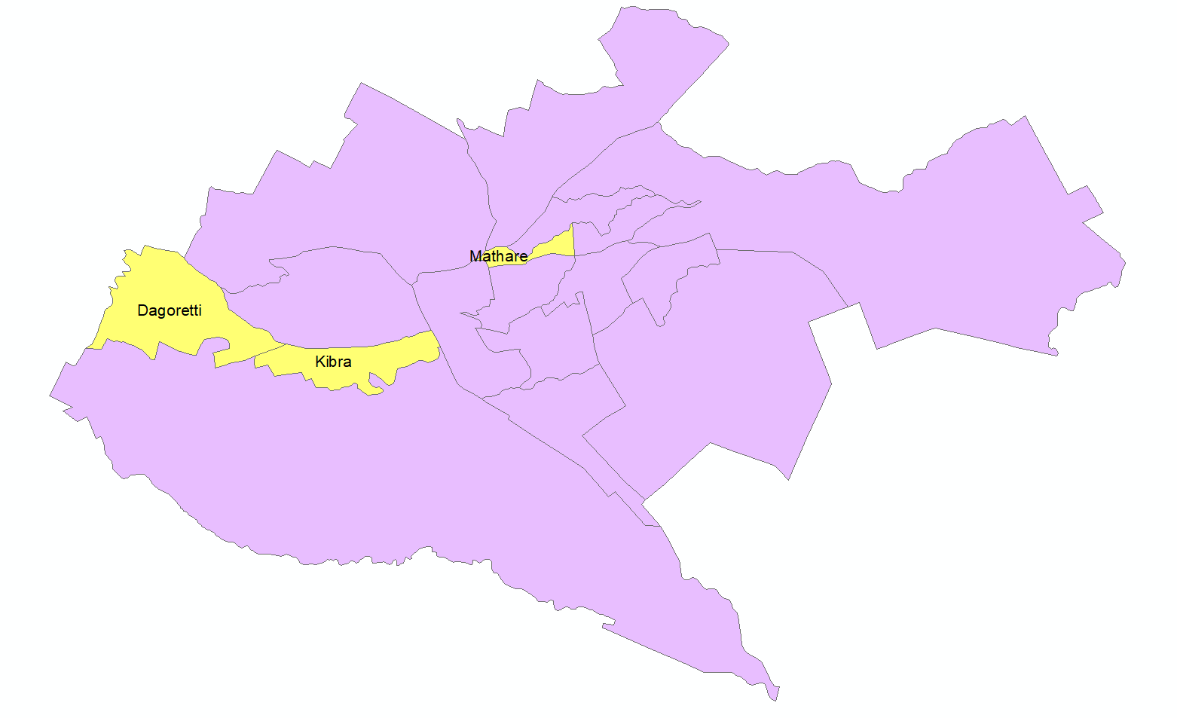
Study Area
The project focused mainly on three slums within Nairobi.
These are Kibera, Kawangware and Mathare slums.
Reason for choosing these three is because the data was readily available.

Slide 6
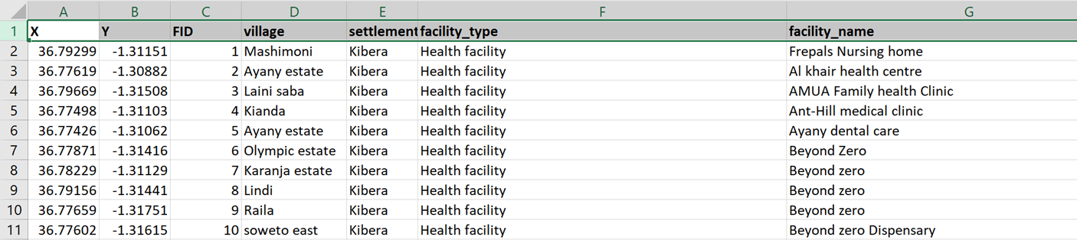
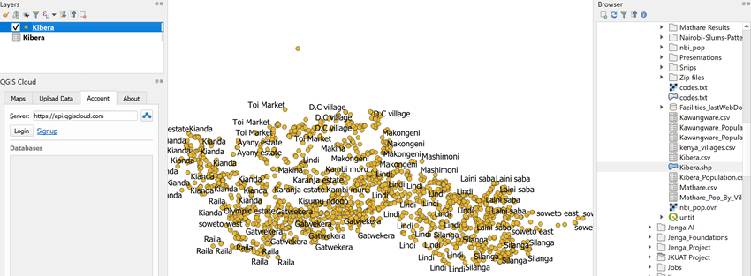
Generating the Population Dataset
Below is the same data loaded onto a GIS software, QGIS.
QGIS was used because it has readily available base maps.
The picture below shows a few records from the Kibera dataset.
The data is in spatial format, which is represented by the X and Y columns.

Slide 7
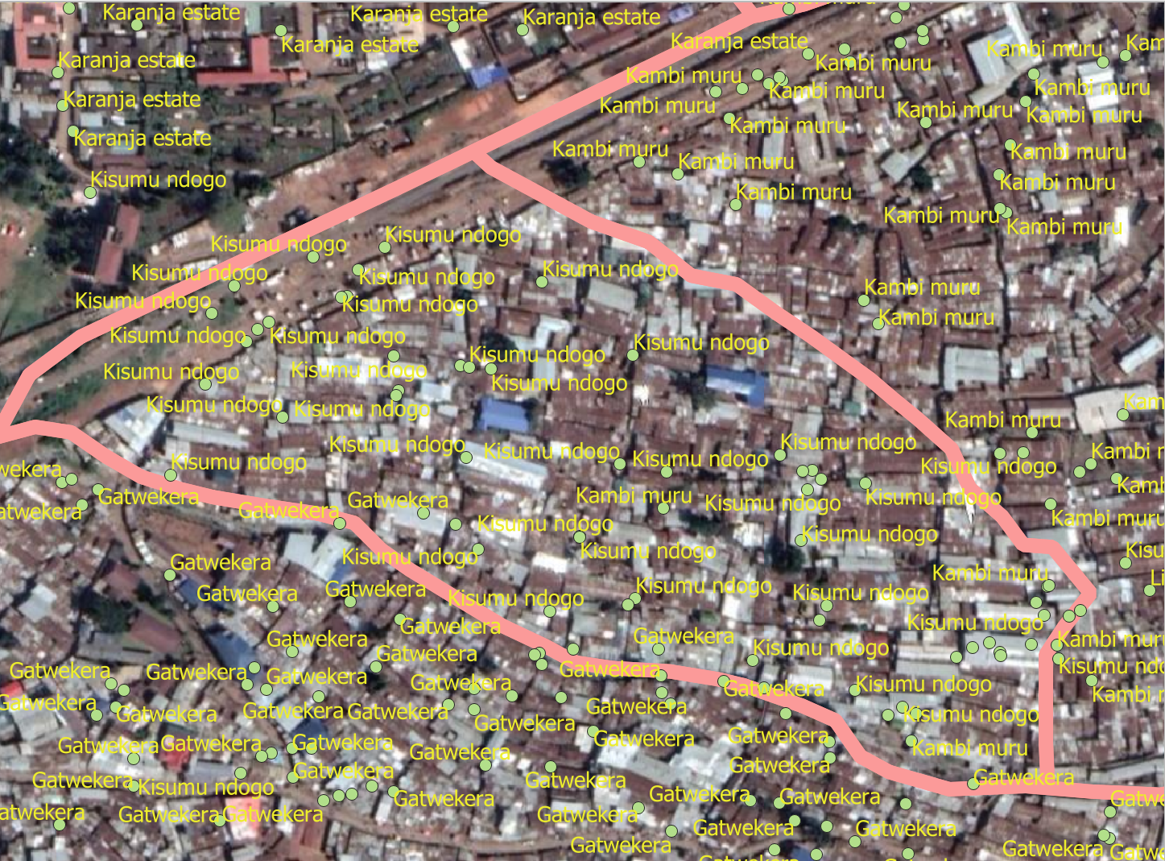
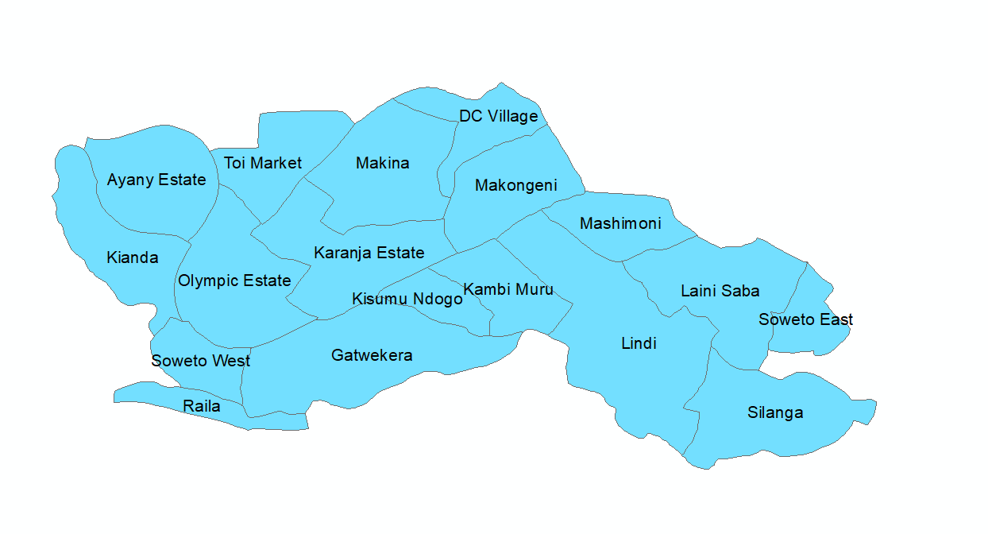
Generating the Population Dataset
Data on QGIS with the Google Satellite base map.
The final digitized villages, displayed on ArcGIS.

Slide 8
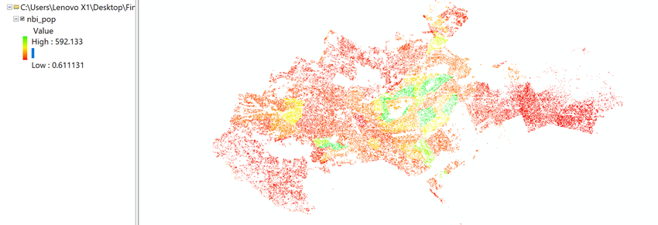
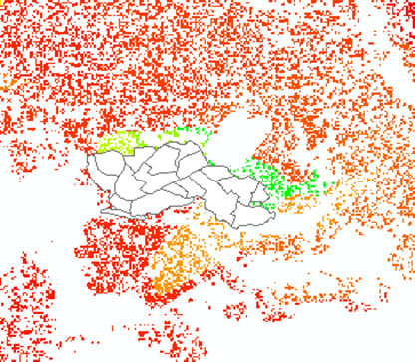
Generating the Population Dataset
Nairobi Facebook Population Data displayed on ArcGIS.
The green areas are more densely populated than the red areas.
Kibera Village Shapefile Shown on the population data.
Kibera population data for each village was extracted from Nairobi’s population using ArcGIS Zonal Statistics tool, and the data was extracted in .csv format.

Slide 9
Future Studies
There is a need to explore other slum settlements within Nairobi and other counties.
Building models for determining optimal locations for building communal facilities within the slum areas.
Develop a web-map that displays all the findings, to allow donors, well-wishers, as well as the Kenyan Government to identify optimal areas for locating communal facilities.

Slide 10
References
Amnesty International. (2009). The Unseen Majority: Nairobi's Two Million Slum-Dwellers. Amnesty International.
Wamukoya, M., Kadengye, D. T., Iddi, S., & Chikozho, C. (2020). The Nairobi Urban Health and Demographic Surveillance of slum dwellers, 2002-2019: Values, processes, and challenges. Journal of Global Epidemiology.

Slide 11

Thank you for your attention! Questions and Comments

