Slide 1
FAKE REVIEW
CLASSIFIER-INATOR
Or How I Learned to stop worrying and love online shopping

Slide 2
Daniel Cervantes
Edward Parada
Gianfranco Estevez

Slide 3
Table of Contents
1
The problem
2
The Data
3
The Application
4
The Conclusion
And its problems
Because we will be asked for that
Of data and more things
Of all this hard work

Slide 4
The Problem

Slide 5
Online shopping can be seen as risky, potential customers use reviews to find trustworthy products.

Slide 6

With the appearance of computer generated reviews (CG), this trust might be based on false reviews.

Slide 7
To find if a review is made by a true customer, an AI can be trained to find computer generated ones and filter them.

Slide 8
An AI allows for review classification just with a labeled review list
Once trained the validity of a review can be easily determined

Slide 9

This would allow the customers to filter reviews to only allow the most trustworthy ones, reducing scams, this would specially help low income students

Slide 10

The AI would lessen the impact of false reviews on the internet, allowing for a safer shopping experience

Slide 11
The data

Slide 12
The chosen dataset contains 4 columns. The first of this columns, category, defines what type of product was reviewed.
From the dataset, 10 categories were identified:
Clothing Shoes and Jewelry
Electronics
Home and Chicken
Kindle Store
Movies and TV
Pet Supplies
Sports and Outdoors
Tools and Home Improvement
Toys and Games
Books

Slide 13
The next column is rating. It is related to the rating given in the review. This value ranges from 1 to 5 and it describes the perceived quality of the product according to the reviewer.
It's expected that most of the fake reviews are either 5 out 5 stars, to boost the product's popularity; or negative, 1 out 5 stars, if the objective was to demerit other products.

Slide 14
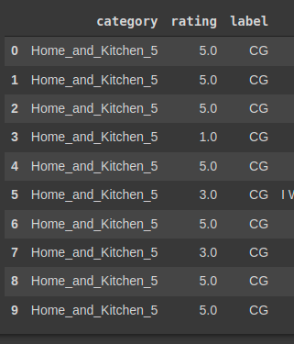
The next two columns were label which is our ground truth. It can be either "CG", "computer generated", or "OR", which stands for "original review". And text which contains the actual review left by the customer or bot.

Slide 15
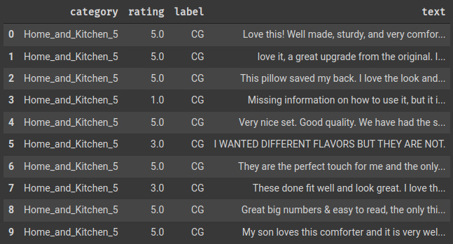
The last column is the most important one, the review content will be used to classify it

Slide 17
Data Processing
Extracting numerical values from text

Slide 18
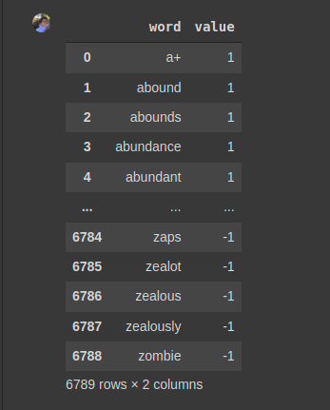
In order to extract the most out of the text for each of the reviews, we decided to extract the sentimentality value. In this context, sentimentality refers to the positive and negative feelings associated with words.

Slide 19
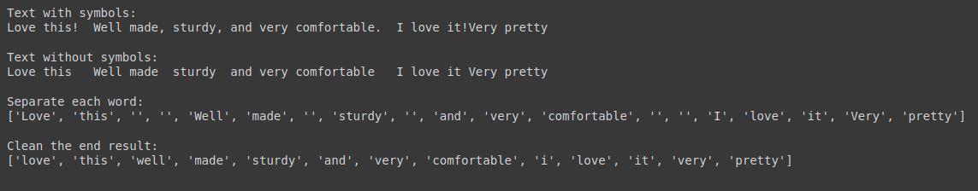
Next, it was established that we need to extract some of the basic components of how the text was written in terms of length, total words and characters of the review; and the repetition value, which is the total amount of words divided by the number of unique words in the review, Here’s the end result:

Slide 20
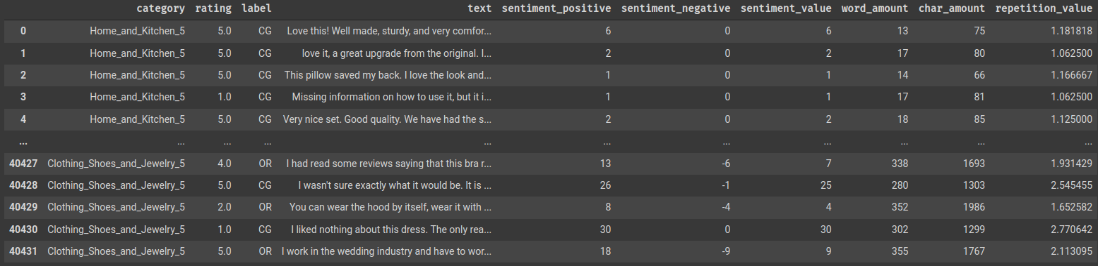

Slide 21
The Application

Slide 22
For the training the following columns were used:
(Also the label was remapped, CG would mean 0, OG meant 1)
'Rating'
'word_amount' 'char_amount' 'sentiment_value' 'sentiment_positive' 'sentiment_negative' 'repetition_value'

Slide 23
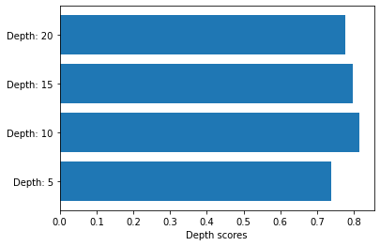
Decision Tree Classifier
Test size:
20%
Depth(s):
5, 10, 15, 20

Slide 24
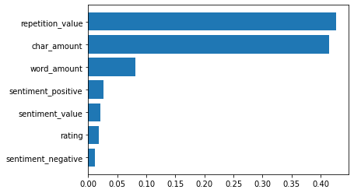
Decision Tree Classifier
Feature importances

Slide 25

Decision Tree Classifier
Cross Validation

Slide 26
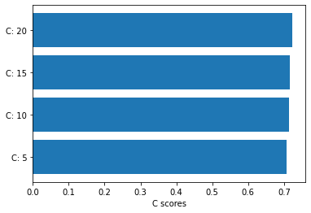
Support Vector Machine
Test size:
20%
Kernel:
rbf
C(s):
5, 10, 15, 20

Slide 27
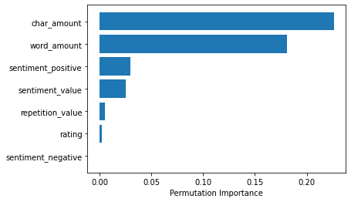
Support Vector Machine
Feature importances

Slide 28

Support Vector Machine
Cross Validation

Slide 29
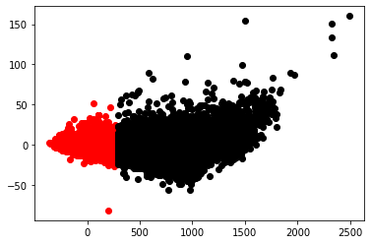
KMeans
Using char_amount as x axis and repetition_value as y axis

Slide 30
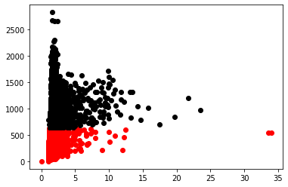
KMeans
Using PCA to accommodate for 2 axis

Slide 31
The Conclusion

Slide 32
After the development of the project, several conclusions could be drawn.
First, we managed to build a bot that was relatively good at telling apart fake reviews from real ones.
We also found than, in this particular application, Decision Trees are more capable of classifying a reviews in terms of accuracy while also being quite fast when compared with Support Vector Machines.

Slide 33
We managed to identify that one of the most important features while classifying is the length of the review.
And that, contrary to the expected, sentimentality is not as important as other factors.

Slide 34
Finally,
Bots are pretty cool

