Slide 1

Trail Cloud

Slide 2
Process Analysis
Order to cash
Purchase to pay
Service now ticketing

Slide 3
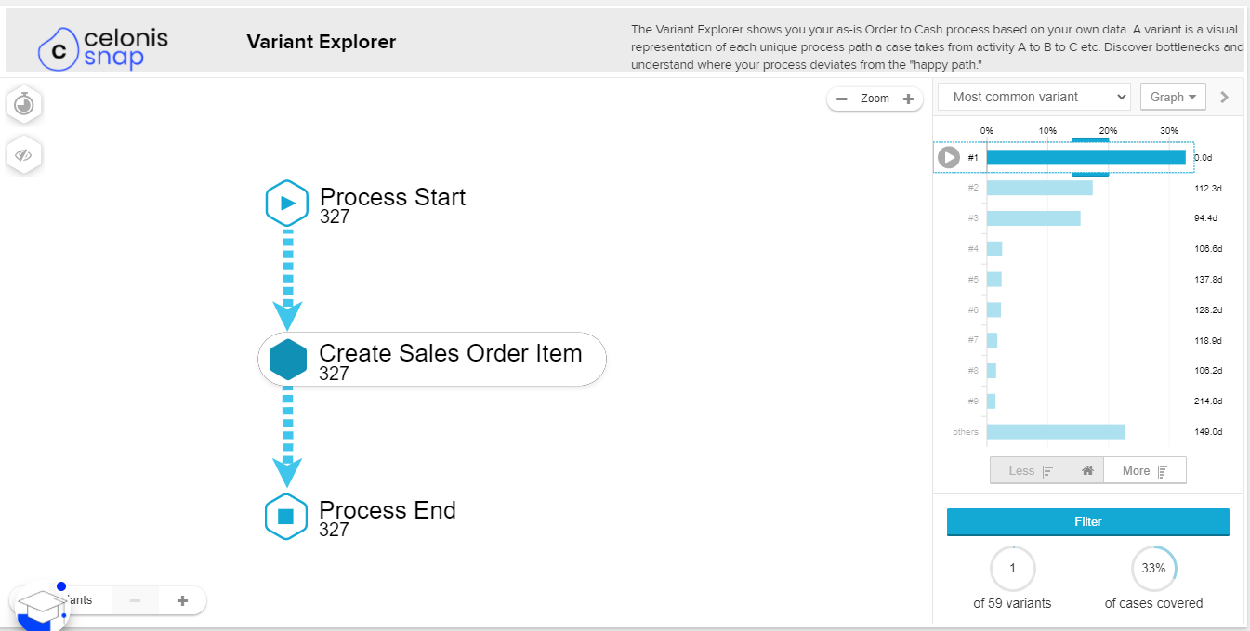
Order to cash

Slide 4
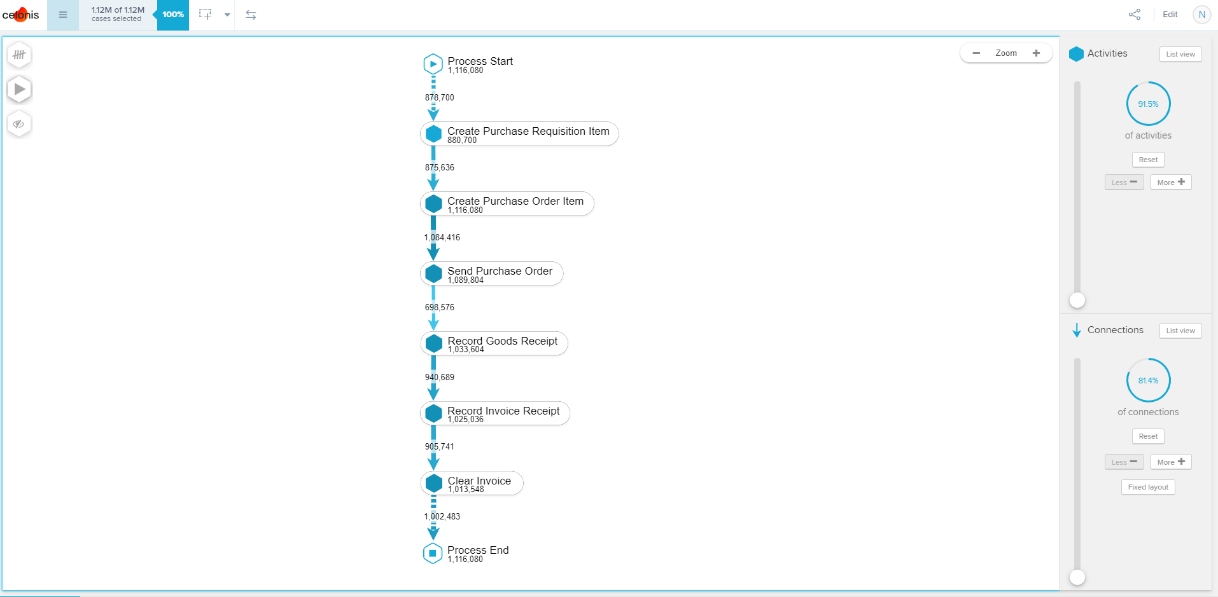
Purchase to pay

Slide 5
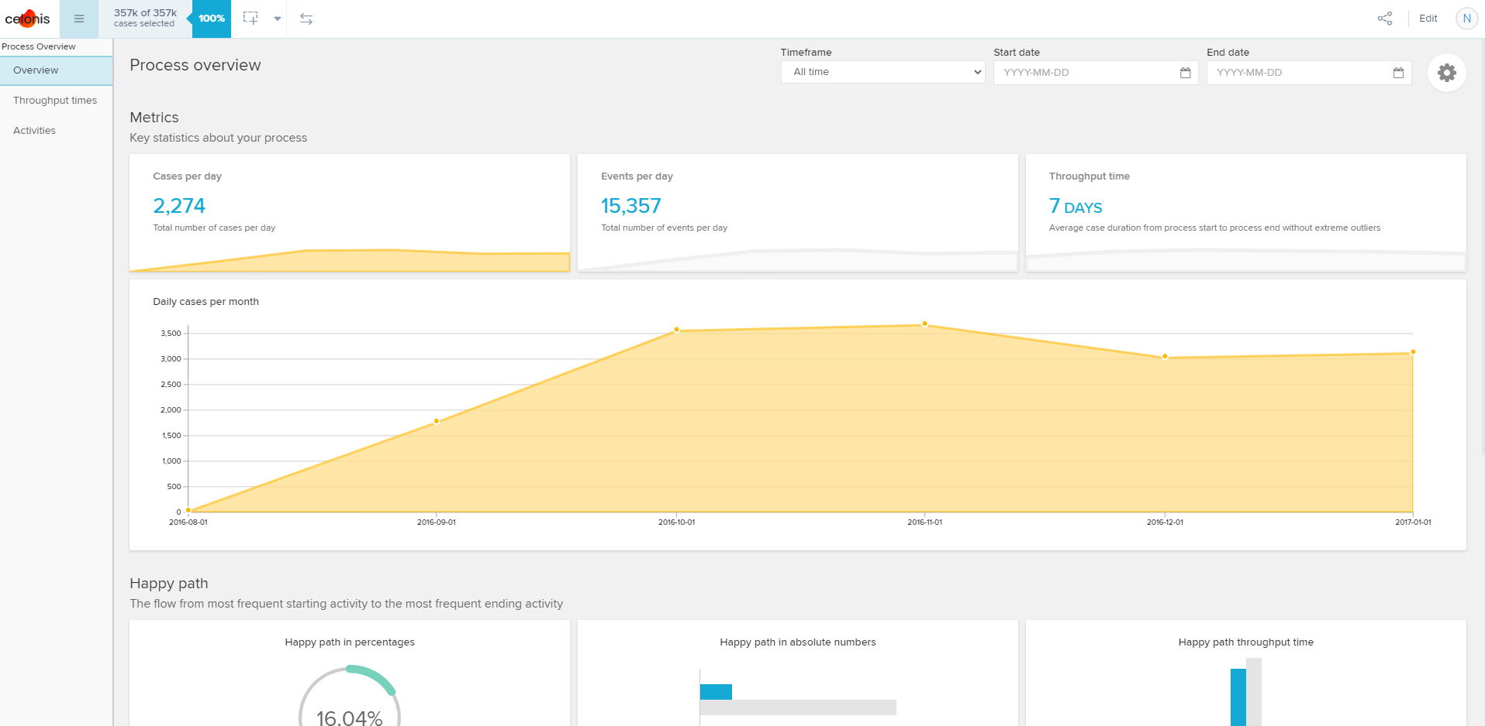
ServiceNow Ticketing

