Slide 1


DEPARTMENT OF COMPUTER SCIENCE & ENGINEERING
SCHOOL OF COMPUTING
10214CS601 MINOR PROJECT -1
SUMMER SEMESTER(2024-2025)
SEMESTER END PROJECT VIVA VOCE EXAMINATIONS
“AI- BASED SMART FARMING”
SUPERVISED BY
PRESENTED BY
Dr.N.RAJKUMAR,Ph.D.,
1.G. ESHWAR PRASAD | (VTU 21447) | (22UEID0045)
2.G.VIJITHA | (VTU 23187) | (22UECM0084)
3.M. CHARAN SAI | (VTU 23029) | (22UECM0169)
2 September 2024
DEPARTMENT OF COMPUTER SCIENCE & ENGINEERING
1

Slide 2
OVERVIEW
ABSTRACT
OBJECTIVE
INTRODUCTION
LITERATURE REVIEW (SOFT COPY OF PAPERS TO BE LINKED AS HYPERLINK)
DESIGN AND METHODOLOGIES
IMPLEMENTATION
TESTING
INPUT AND OUTPUT
INCLUDE DEMO VIDEO (You Tube URL of complete demonstration of project by All members as Voice over)
CONCLUSION
FUTURE ENHANCEMENTS
SOCIETAL IMPACT OF PROJECT
WEB REFERENCES LINK (TILL REVIEW DATE ALL LINKS TO BE INCLUDED DAY WISE)
PLAGIARISM REPORT OF PROJECT REPORT AND PPT
POSTER PRESENTATION
JOURNAL/CONFERENCE PUBLICATION PROOF
REFERENCES
02 December 2024
DEPARTMENT OF COMPUTER SCIENCE & ENGINEERING
2

Slide 3
ABSTRACT
INTRODUCTION:
AI-Based Smart Farming utilizes artificial intelligence technology to optimize agricultural practices.It Involves the use of sensors, drones, and data analytics to monitor and manage crops more efficiently.
AI algorithms can analyze data on weather conditions, soil health, and crop growth to provide real time insights for farmers. This technology helps farmers make data-driven decisions to improve crop yield, reduce costs, and minimize environmental impact.
PURPOSE:
Enhancing agricultural productivity by optimizing resource usage and crop management. Improving sustainability by reducing environmental impact through precise and efficient farming practices.Empowering armers with data-driven insights for better decision-making and increased yields.

Slide 4
Increasing operational efficiency by automating tasks such as irrigation, fertilization, and pest control. Enabling predictive maintenance to identify potential issues early and prevent crop losses. Facilitating remote monitoring and management of farms, providing real-time insights for proactive decision-making.
METHOD:
Implementing automation technologies such as drones and smart equipment to carry out tasks like irrigation and monitoring. Using sensors to collect data on soil health, weather conditions, and crop growth. Employing AI algorithms to analyze the data and provide insights for decision_x0002_making. Utilizing computer vision technology to identify plant diseases and pests for targeted treatment. Incorporating machine learning models to predict crop yields and optimize planting schedules. Integrating IoT devices to create a connected farm ecosystem for seamless data exchange and control.
RESULT:
The project successfully increase the crop yields and quality due to optimized resource management and proactive decision making.

Slide 5
Reduced operational costs through efficient use of resources and automation of farming processes.Improved sustainability by minimizing environmental impact and promoting eco- friendly farming practices.
Enhanced decision-making capabilities leading to better crop management and disease prevention.Increased efficiency in resource utilization such as water and fertilizers. Facilitation of precision agriculture techniques resulting in more targeted and effective farming practices.
CONCLUSION:
AI-based smart farming leverages advanced technologies like sensors, AI algorithms, automation,computer vision, machine learning, and IoT devices to revolutionize traditional farming practices.This approach leads to increased crop yields, enhanced quality, reduced costs, improved sustainability, and overall efficiency in agricultural operations.
Its adoption is driven by the need for sustainable, efficient, and data-driven farming practices. To fully realize its potential, it is essential to provide support, education, and resources to farmers and stakeholders, addressing challenges and ensuring the responsible use of technology in agriculture.

Slide 6
OBJECTIVES
AIM OF THE PROJECT:
The project seeks To empower individuals with the foundational skills and knowledge necessary for personal development, Socio-economic, advancement and active participation in their communities.
Enhancing crop productivity and quality through the implementation of AI technologies.Improving resource efficiency by optimizing the use of water, fertilizers, and other inputs. Empowering farmers with data-driven insights for informed decision-making and sustainable agricultural practices
SCOPE OF THE PROJECT:
The project targets individuals within marginalized communities who face barriers to accessingquality education . This may include children, adolescents , and adults of varying age groups and education back grounds.
Establishing a framework for remote monitoring and control of farming operations through mobile or web applications.

Slide 7
TIMELINE OF THE PROJECT
Task Name |  | Q1 2023 | Q2 2023 |  | Q3 2023 |  | Q4 2024
 |  | OCT 23 | NOV 23 |  | DEC 23 |  | JAN 23
Planning
Research
Design
Implementation
Follow Up

Slide 8
INTRODUCTION
AI-based smart farming, a computer vision approach transforming agriculture. AI technologies revolutionizing traditional farming methods for enhanced efficiency.Integration of AI for data_x0002_driven insights and precision agriculture. Aimed at boosting productivity, sustainability, and resource optimization.
Utilizing sensors and IoT devices for real-time data collection. AI algorithms analyzing data for informed decision-making in crop management. Automation and robotics implementation for tasks like planting and harvesting. Computer vision technology used for monitoring crop health and detecting pests.
Remote monitoring and control of farming operations through mobile or web platforms. Improved resource efficiency through optimized water and fertilizer usage. Enhancing crop quality and yield through AI-driven strategies.
Empowering farmers with technological tools for better decision-making. AI-based solutions aiding in disease detection and prevention in crops. Precision agriculture techniques optimizing field-level variability.Data analytics enabling predictive maintenance of farming equipment.AI-driven solutions assisting in climate-smart agriculture practices.
Increased adoption of AI technologies for sustainable farming practices.Collaboration of AI and agriculture for a more resilient food production system. Potential for AI to revolutionize the agricultural sector with smart farming.

Slide 9
LITERATURE REVIEW
Author’s Name | Paper name and publication details | Year of publication | Main content of the paper
Tuan Dinh Le, Dat Ho Tan | “Design and Deploy a Wireless Sensor Network for Precision Agriculture”. 2ndNational Foundation forScience and Technology Development Conferenceon Information and Computer Science” | 2019 | “Implementation, and deployment of wireless sensor network for precision agriculture. The collected data is stored and transmitted wirelessly to the farmers, which they can use to control and decide appropriate actions for their farm to manage the production and quality.”

Slide 10
Rajesh, K. Vishwakarma and K. Pradeep Singh | “AI in Agriculture: Present Applications and Impact.” | 2020 | One of the most critical applications of AI in agriculture is weather forecasting. With changing climates and increasing pollution, farmers can struggle to determine the right time to sow seeds. By using AI-powered weather forecasting systems, farmerscan analyze real time weather data.
Shwetha Rokhade, Guruprasad M K, Mallesh M S | ”IoT based smart crop- fieldmonitoring and automation irrigation system”,International Conference on Computer Communicationand Informatics (ICCCI). | 2021 | She proposed the solution for improving quality of Cropby controlling environmental parameters and proper aggregation of soil

Slide 11
Narendra Kumar Kumar Anil Kumar | ”Application of Internet of Thingsin Image Processing”, IEEE Delhi Section Conference (DELCON) | 2022 | The function of image processing in the field of the Internet of Things. In this paper, we have used the ESP32CAM WiFi Module with OV2640 Camera Module and the Arduino Uno R3 thatopen- source microcontroller board. We capture the plant image and use the cloud and big data-based prediction model for data analysis.
G. R. Poorinima, Farheen Taj | ”A smart agricultural model by intgrating IoT”, IEEE International Conference on Recent Trends in Electronics, Information and Communication Technology (RTEICT) | 2018 | She proposed a solution to increase the crop production and control the agricultural cost of the products using this predicted information. IoT device is used to sense the agricultural data and it is stored into the Cloud database.Cloud based Big data analysis is used to analyze the data viz. fertilizer requirements,analysis the crops, market and stock requirements for the crop.

Slide 12
K. Balamurugan, G. Sumithra, R. S. Amrutha. | “A Framework for Agriculture Management using Internet of Things (IoT)”. | 2019 | Internet of Things (IoT) is present and future of every field impacting everyone’s life. The new developments of Smart Farming with use of IoT, by day turning the face of conventional agriculture methods by not only making it optimal but also making it cost efficient for farmers and reducing crop wastage. The aim is to propose a technology which can generate messages on different platforms to notify farmers.
Tim Sandle Forbes et al., | Using drones for fertiliser spraying, is now a nobrainer agritech solution for many Indian farmers. In recent years, state governments, startups and educational institutions across the country have started offering rental schemes and training programmes for farmers to use agriculture drones for pesticide spraying. | 2023 | Agricultural Internet of Things has brought new changes to agricultural production. It not only increases agricultural output but can also effectively improve the quality of agricultural products, reduce labor costs, increase farmers’ income, and truly realize agricultural modernization and intelligence. This paper systematically summarizes the research status of agricultural IoT.

Slide 13
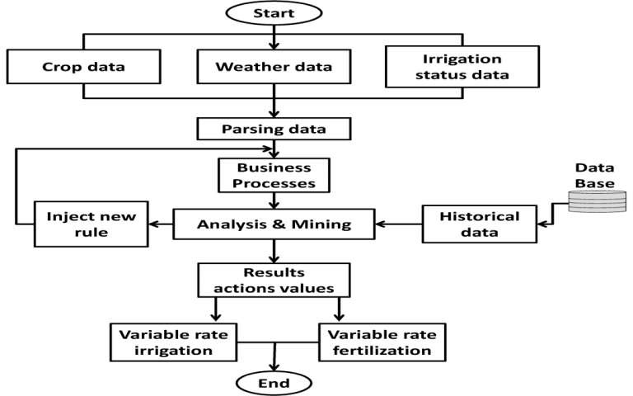
DESIGN AND METHODOLOGIES
MODULE 1: DECISION TREE

Slide 14
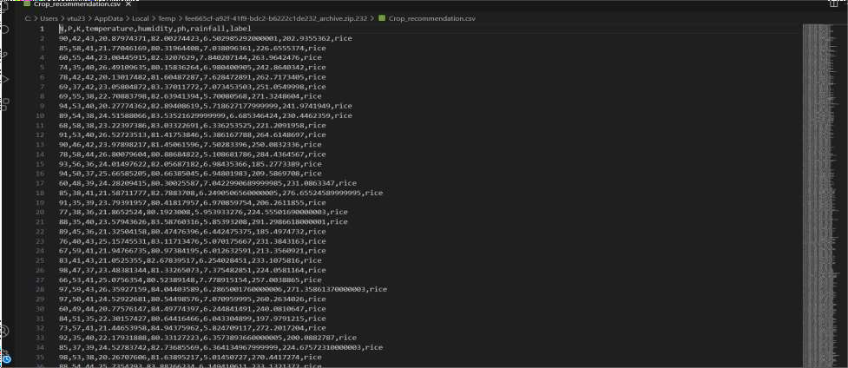
MODULE 1: Collection and Processing of Data
Step:1 Collection of Data

Slide 15
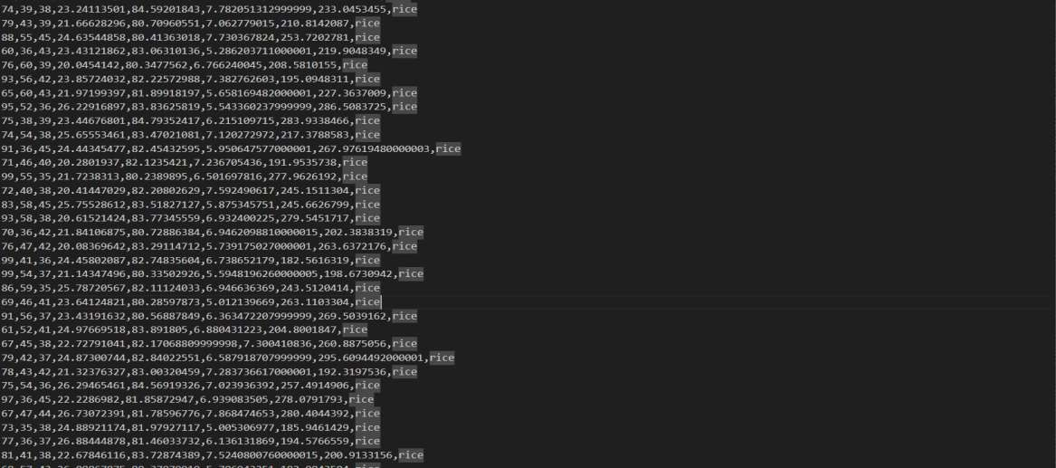

Slide 16
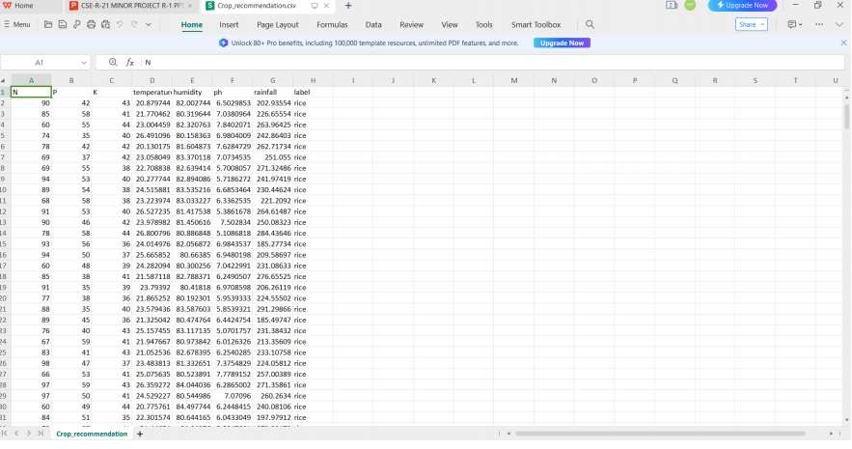
Step 2: Processing the data

Slide 17
Module 2- COMPUTER VISION ALGORITHM
Computer vision algorithms are integral to AI-based smart farming, enabling various advanced functionalities that help in optimizing agricultural practices, improving crop health, and increasing yields. Here’s how computer vision is used in smart farming:
Plant Disease DetectionImage Classification: Computer vision can analyze images of plants to detect diseases. Using deep learning models like Convolutional Neural Networks (CNNs), the system can classify and identify diseases from images of leaves, stems, or fruits.Real-time Monitoring: Cameras placed in the field can continuously monitor plants. When a disease is detected, the system can alert farmers, allowing for early intervention and reducing crop loss.
Weed Detection and Removal:Object Detection: Computer vision algorithms can distinguish between crops and weeds in a field. This information can be used to guide automated weeding machines or drones to target and remove weeds without harming the crops.Precision Instead of spraying herbicides over an entire field, computer vision can help in applying them only where weeds are detected, reducing chemical usage and costs.

Slide 18
Crop Monitoring and Yield Prediction:Growth Stage Analysis: By analyzing images taken over time, computer vision can track the growth stages of crops, helping farmers make decisions on irrigation, fertilization, and harvest timing.
Soil and Water Management:Soil Condition Monitoring: High-resolution images of the soil can be analyzed to detect moisture levels, erosion, and nutrient deficiencies. This information can be used to optimize irrigation schedules and fertilization.Flood and Drought Detection: Drones equipped with cameras can fly over large areas to monitor water distribution. Computer vision can detect signs of drought or overwatering, enabling corrective actions.
Pest Detection and Management:Pest Identification:Computer vision can identify plants by analyzing their images.This helps in early detection and targeted pest control, minimizing the damage to crops.
Automated Traps and Repellents: Systems equipped with computer vision can activate traps .

Slide 19
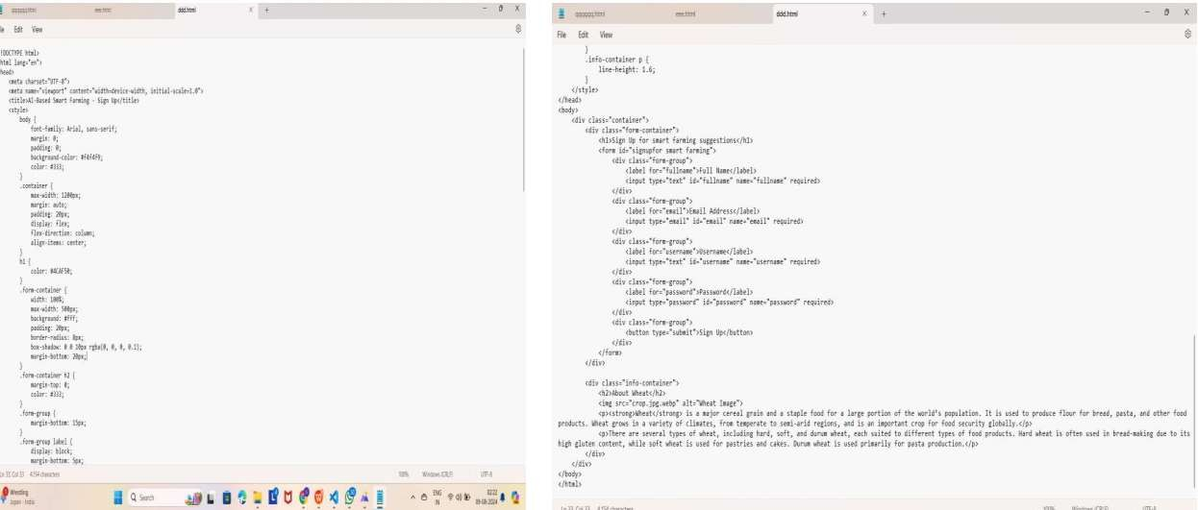
Step 3: Using Computer Vision algorithm

Slide 20
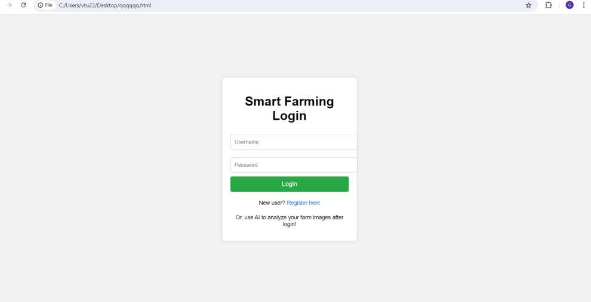
Step 4: The output

Slide 21
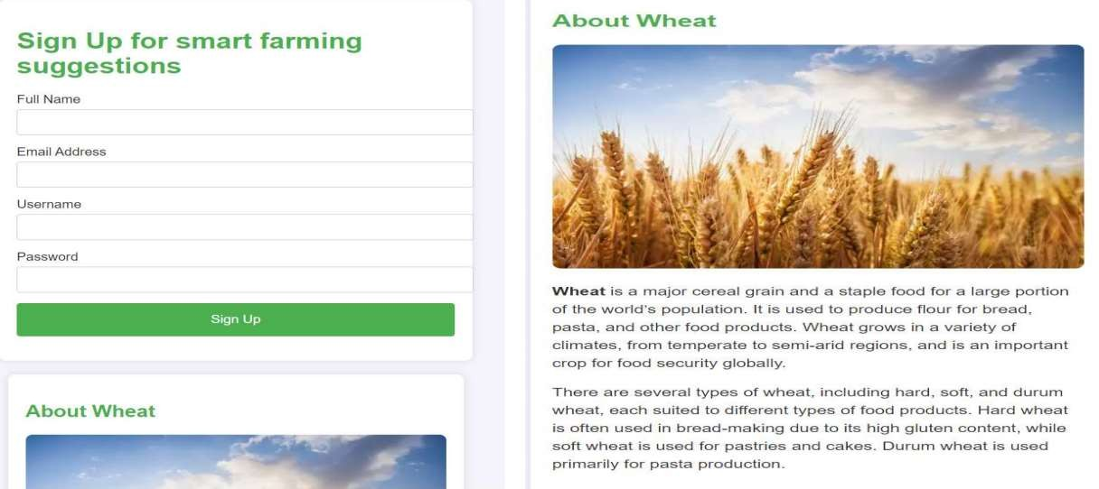

Slide 22
IMPLEMENTATION
Architecture Diagram
Data –Flow Diagram
Use Case Diagram
Class Diagram
Activity Diagram
Sequence Diagram
Collaboration Diagram
E-R Diagram

Slide 23
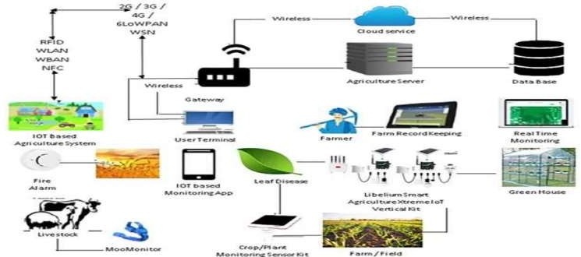
Architecture Diagram
Utilize sensors and IoT devices to gather data on weather, soil conditions, and crop health.Transmit the collected data to a central system or cloud for processing. Use AI algorithms to analyze the data and extract valuable insights for decision-making. Implement AI-driven decision-making processes for crop management, resource optimization, and pest control.
Integrate automation and robotics for tasks like planting, irrigation, and harvesting based on AI recommendations. Develop systems for remote monitoring and control of farming operations using AI-powered platforms. Establish feedback loop to continuously improve algorithms and decision-making based on real-time data.

Slide 24
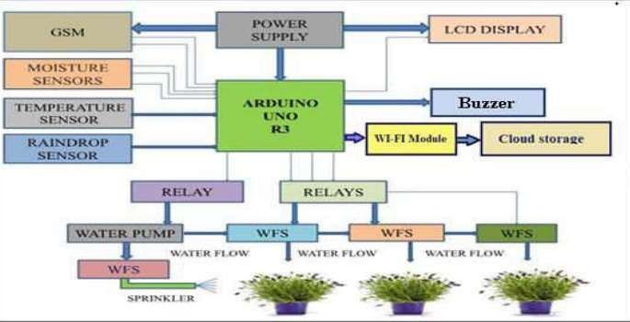
Data –Flow Diagram
Automated irrigation system using Arduino and sensors. Sensors collect data on soil moisture, temperature, and rainfall. The Arduino Uno R3 board processes the sensor data. Based on the processed data, the Arduino determines if irrigation is needed. If irrigation is needed, the Arduino activates relays to control the water pump and sprinklers. The system can be monitored and controlled remotely via a GSM module, Wi-Fi module, and cloud storage, allowing for real-time adjustments and data analysis.

Slide 25
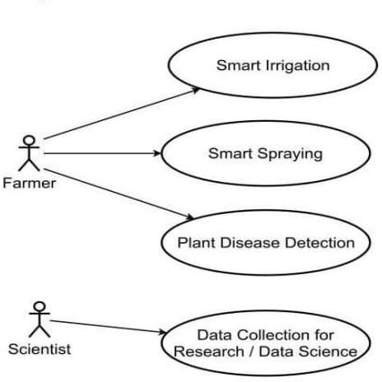
Use Case Diagram

Slide 26
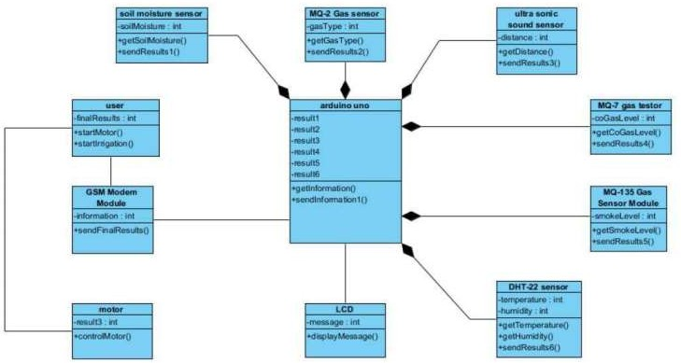
Class Diagram

Slide 27
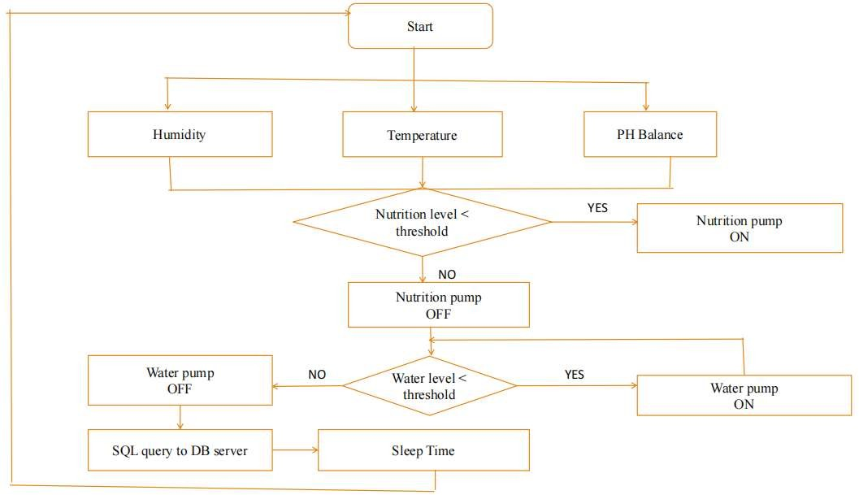
Activity Diagram

Slide 28
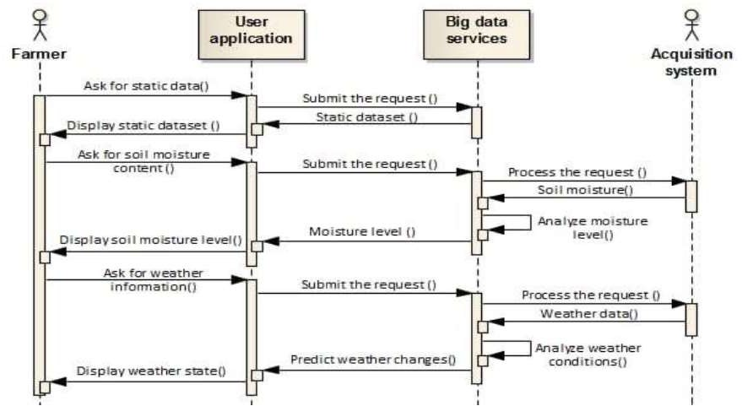
Sequence Diagram

Slide 29
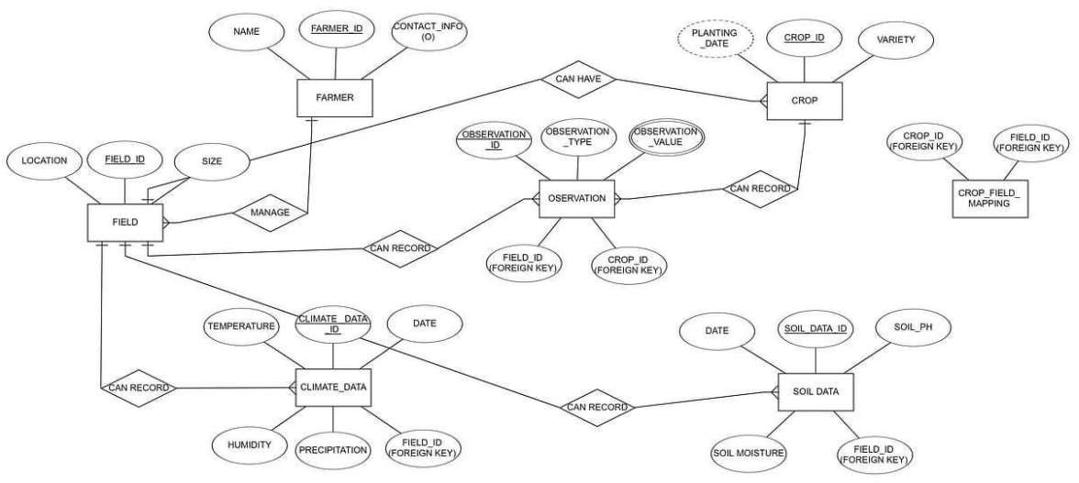
E-R Diagram

Slide 30
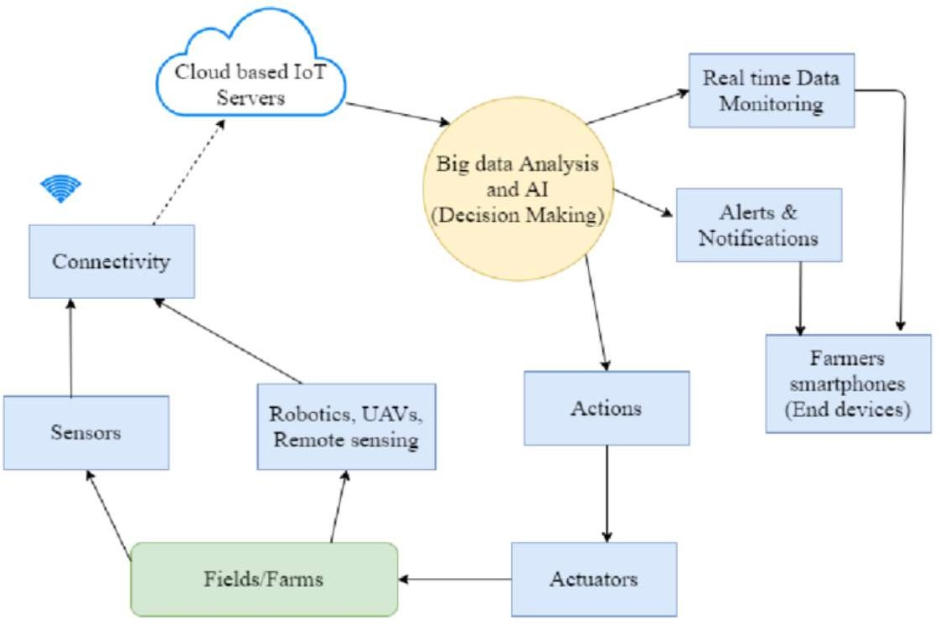
Collaboration Diagram(AI-BASED SMART FARMING)

Slide 31
TESTING
UNIT TESTING
INTEGRATION TESTING
SYSTEM TESTING
ACCEPTENCE TESTING
REGRESSION TESTING
FIELD TESTNG

Slide 32
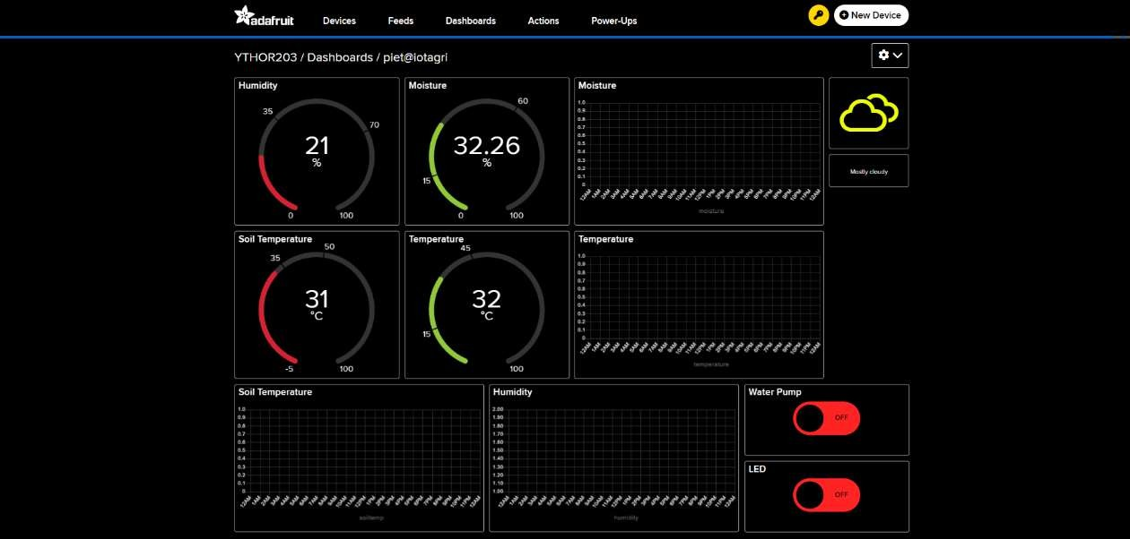
UNIT TESTING

Slide 33
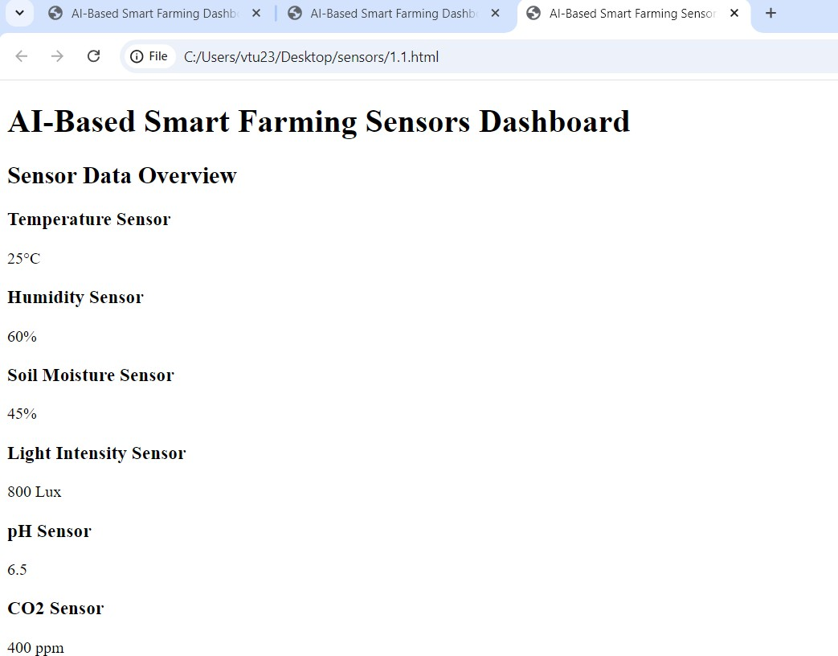
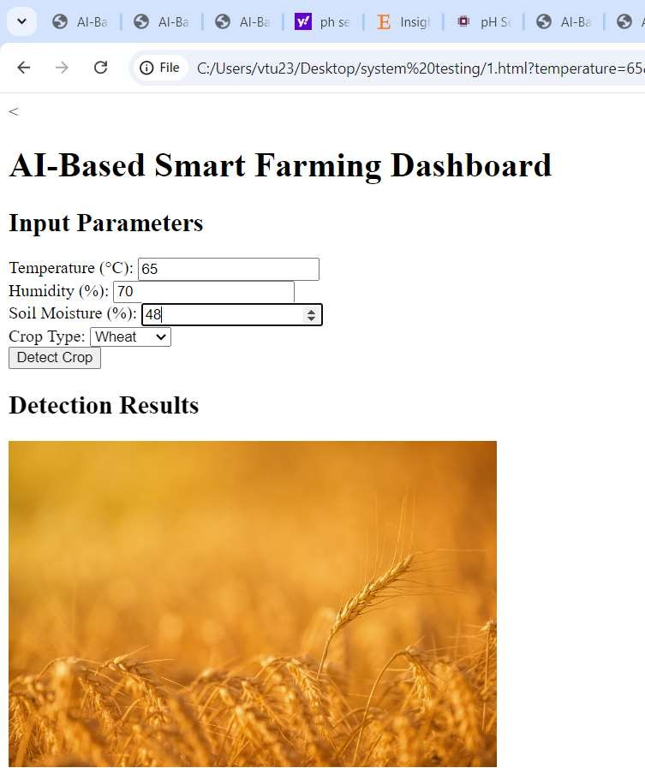
INTEGRATION TESTING
SYSTEM TESTING

Slide 34
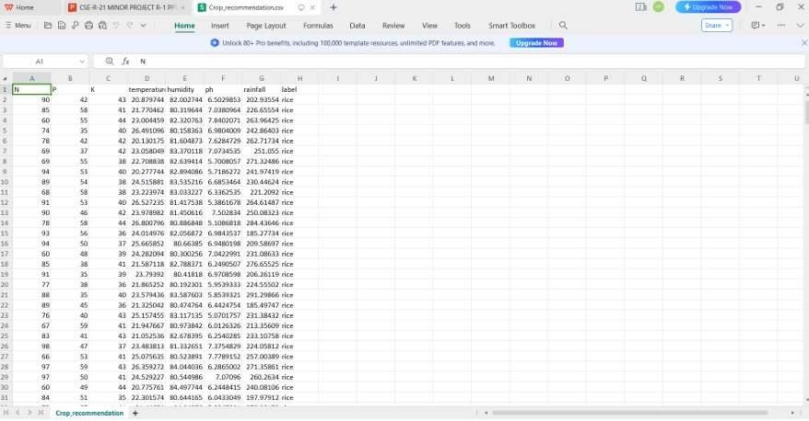
INPUT AND OUTPUT
DATASET IMAGE

Slide 35
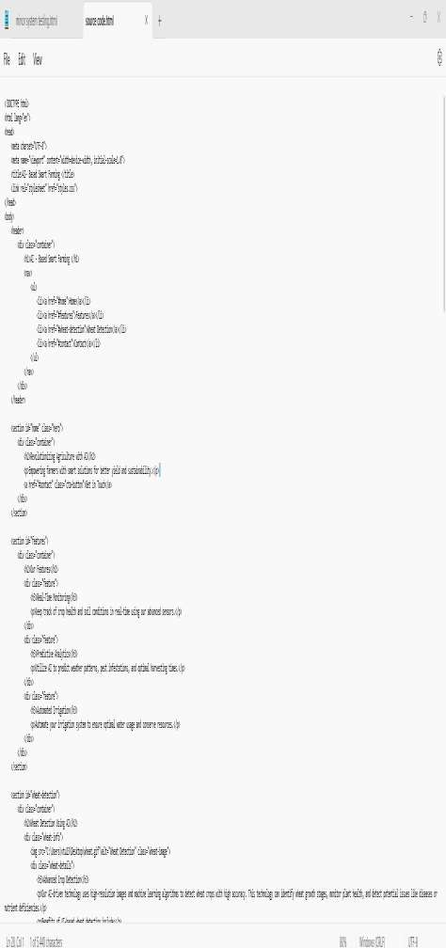
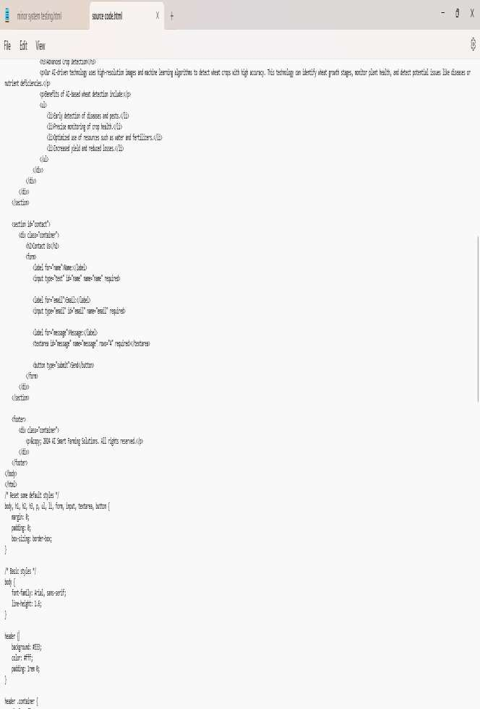
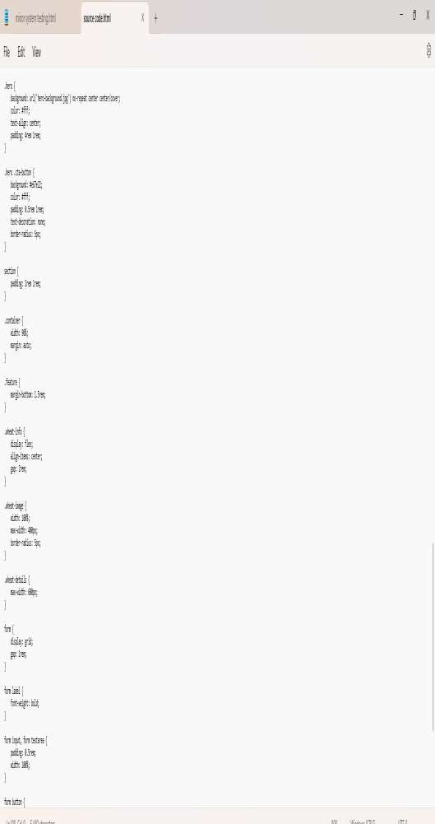
SOURCE CODE

Slide 36
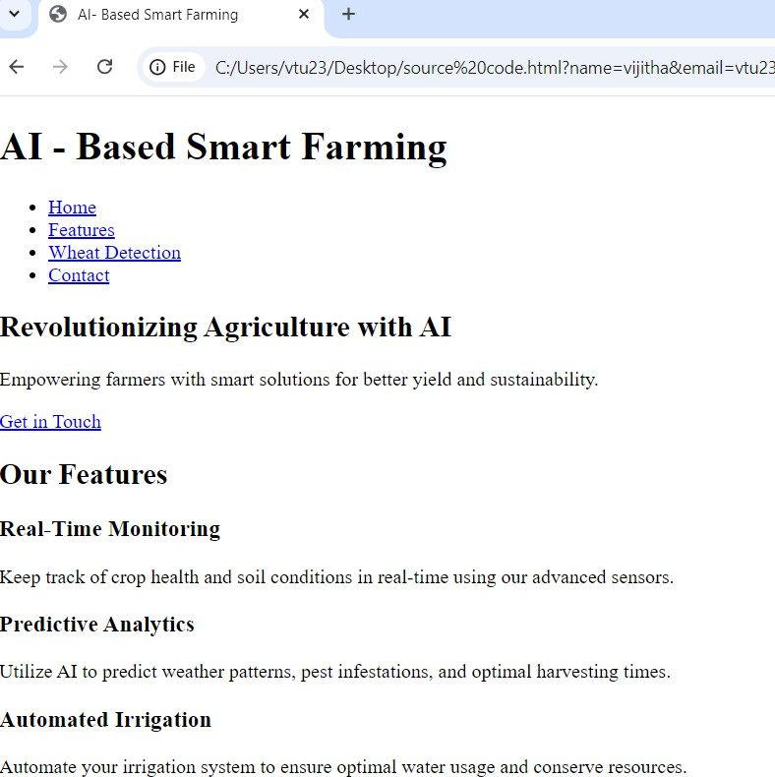
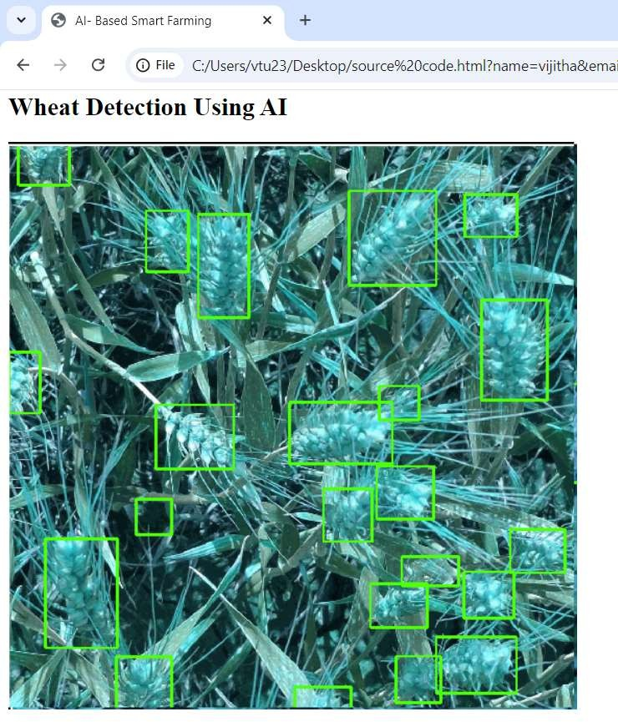
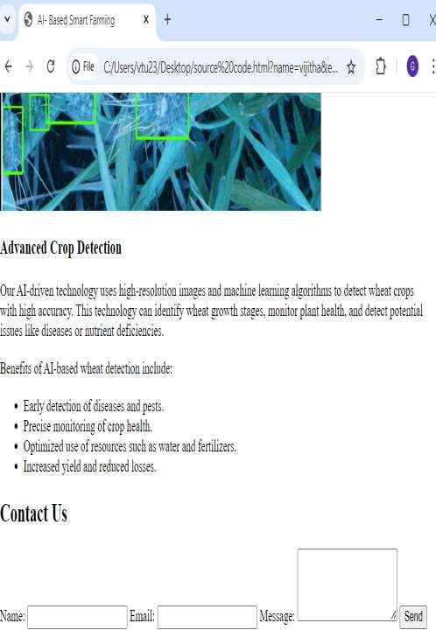
OUTPUT

Slide 37
CONCLUSION
Improved Efficiency
Sustainability
Enhanced crop Health
Data-Driven Decision-Making
Cost Reduction
Challenges Remain
In conclusion, smart farming represents a significant step forward in the agricultural sector. Its adoption is driven by the need for sustainable, efficient, and data-driven farming practices. To fully realize its potential, it is essential to provide support, education, and resources to farmewrs and stakeholders, addressing challenges ans ensuring the responsible use of technology in agriculture.
However, the successful adoption of smart farming in jadcherla relies on addressing various challenges, such as high initial investments, limited technical expertise, and connectivity issues.

Slide 38
FUTURE ENHANCEMENTS
Future enhancements for an AI-based smart farming project focused on crop health, pest detection, and weather conditions could significantly boost both functionality and usability. One major enhancement would be implementing advanced predictive analysis, where AI algorithms could forecast crop yields, predict pest outbreaks, and provide location-specific weather forecasts based on real-time and historical data
Integrating IoT devices like soil moisture, nutrient, and humidity sensors would enable continuous monitoring, allowing for more accurate AI-driven insights. Automated pest and disease management could also be developed, where algorithms suggest targeted treatments and control methods, with potential integration of robotic sprayers for precise application, minimizing chemical use
Personalized crop recommendations could be generated based on soil data, climate, and historical patterns, helping farmers make informed decisions about crop rotation and water usage. For ease of use, a mobile app and voice-activated assistant would enable farmers to receive alerts, interact with the system, and report issues directly from the field.
Enhanced image recognition models would improve the system’s ability to detect a wider range of plant diseases, pests, and nutrient deficiencies across multiple crop types. Finally, a smart irrigation and fertilization scheduling feature could adjust automatically based on weather predictions, soil conditions, and crop growth stages, optimizing resource use and improving crop health.
.

Slide 39
SOCIETAL IMPACT OF PROJECT
.
The societal impact of an AI-based smart farming project is substantial, especially as it addresses critical challenges in food security, environmental sustainability, and rural livelihoods. By enabling early detection of crop diseases, pests, and adverse weather conditions, such a project could help reduce crop losses, stabilize food production, and improve the resilience of the agricultural sector against climate change.
Automated and optimized irrigation and fertilization systems would help conserve water and reduce chemical runoff, promoting more sustainable farming practices that protect local ecosystems and soil health. Additionally, the project could enhance productivity for smallholder farmers, boosting their income and supporting local economies, which is especially impactful in rural communities. The use of AI and IoT technology in farming also drives innovation and creates new tech-driven job opportunities in agricultural technology.
Ultimately, this project supports sustainable agricultural development, aiming to increase food availability while minimizing environmental impacts, thereby contributing to global goals for sustainability and poverty reduction.

Slide 40
Web references/video links
https://youtu.be/zJcSod-L-Ps?si=yIT5iU-F37azGcUv
https://youtu.be/wIM4lO1Mt2M?si=3v14-eIt_ffpRvmH https://youtu.be/_R9Q_iuyvdc?si=6ylywQWY
rp6-n5lP https://youtu.be/cDKc68hEKRQ?si=d7fxKRd0Ka

Slide 41
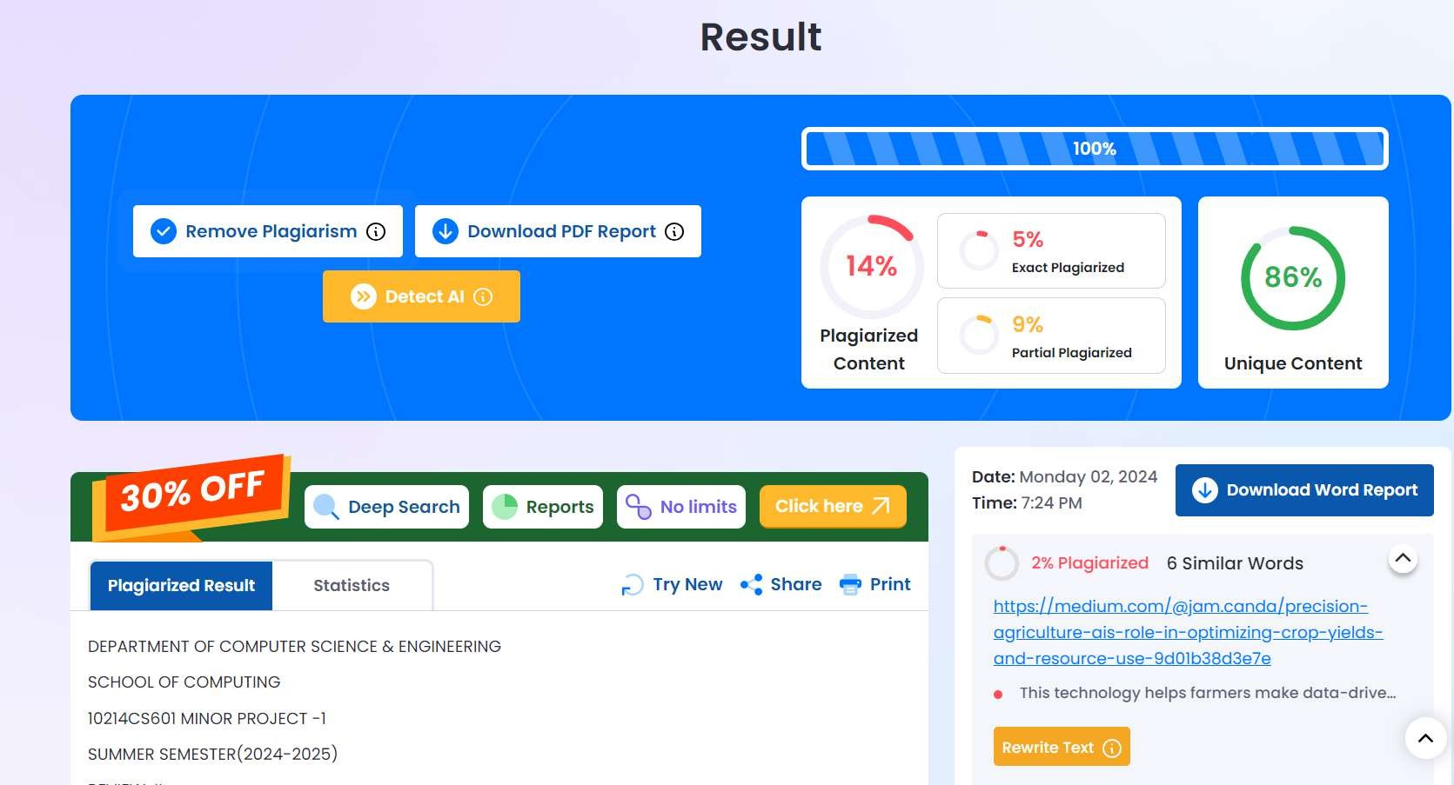
Plagiarism Report of PPT

Slide 42
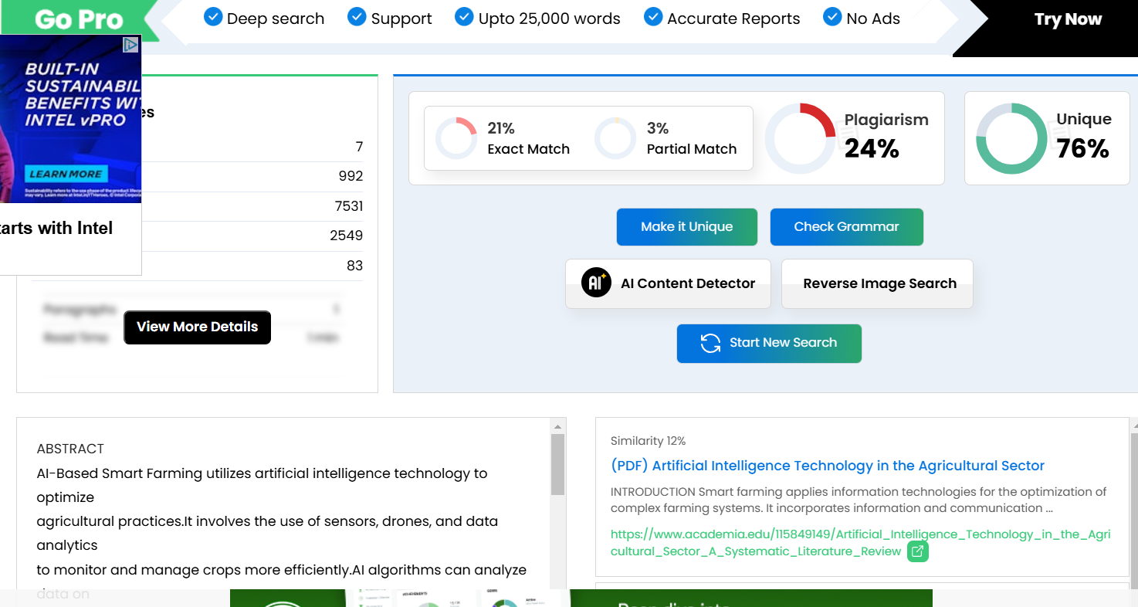

Slide 43
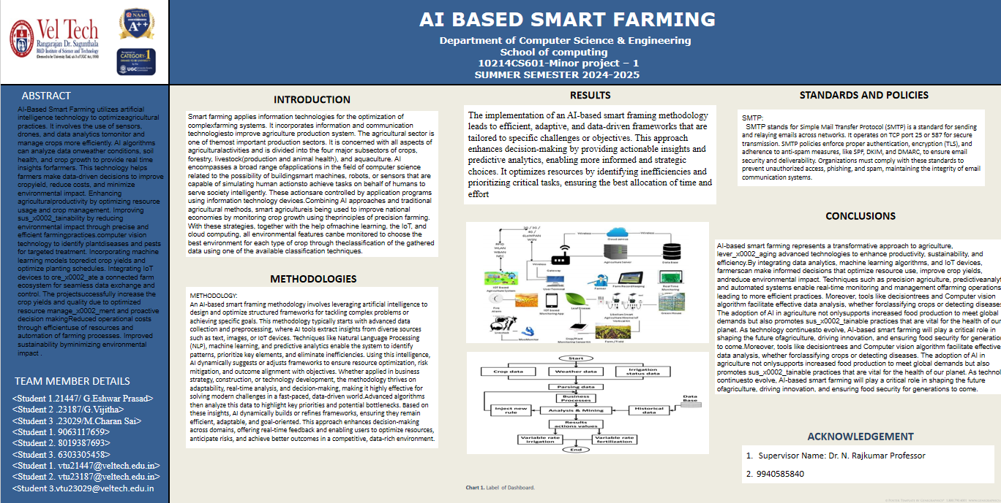
POSTER PRESENTATION

Slide 44
REFERENCES
[1] Tuan Dinh Le, Dat Ho Tan, “ Design and Deploy a Wireless Sensor Network for Precision Agriculture”. 2ndNational Foundation for Science and Technology Development Conference on Information and Computer Science, Published in 2019.
[2] Rajesh, K. Vishwakarma and K. Pradeep Singh, ”AI in Agriculture: Present Applications and Impact” , Published in 2020.
[3] Shwetha Rokhade, Guruprasad M K, Mallesh M S, ”IoT based smart crop-field monitoring and automation irrigation system”, International Conference on Computer Communication and Informatics (ICCCI), Department of CSE, Govt. Engineering college, Huvinahadagali, India, Published in 2021.
[4] Narendra Kumar, Krishna Kumar, Anil Kumar, ”Application of Internet of Things in Image Processing”, IEEE Delhi Section Conference (DELCON), Pub- lished in 2022.

Slide 45


