Slide 1

Introducing
This short course aims to get you to the point of having wxPython plus its demonstration suite installed and running.
It assumes python 2.7 or >3.3 is already installed and pip is working, (any proxy issues resolved).

Slide 2
What is wxPython?
It is a set of python bindings for wxWidgets!
OK – what is wxWidgets
wxWidgets is a comprehensive set of GUI components.
It is Free, Gratis & Open Source.
Both are licensed under a permissive licence that allows redistribution without imposing copyleft.

Slide 3
Prerequisites for Installation
A computer – Windows, OS-X or Linux
If you don’t have python installed on your machine, i.e. you are on Windows, do that first!
Python can be Version 2.7 or later than 3.3.
You will need an internet connection during installation.
If your machine is behind a firewall you may also need some help to find out how to set the pip proxy up.

Slide 4
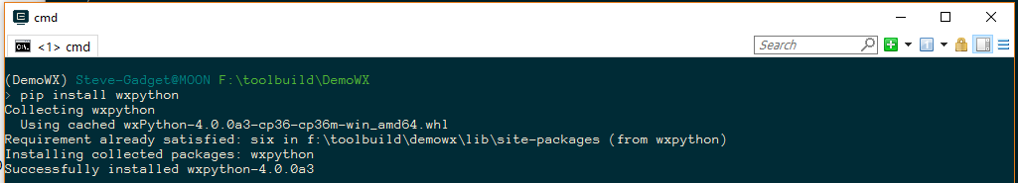
Install wxPython
Simply open a terminal or command prompt & type:
pip install wxpython
It really is that easy!
Now you have wxPython installed!

Slide 5
Install the Demo Suite
Currently the demo suite is online under: https://sourceforge.net/projects/wxpython/files/wxPython4/extras/
We cannot fetch directly from SourceForge but the line:
python -m webbrowser -t https://sourceforge.net/projects/wxpython/files/wxPython4/extras/4.0.0a3/wxPython-demo-4.0.0a3.tar.gz/download
Will open the browser to download it at the current version.
Once download is finished copy, or move, it to a suitable directory.

Slide 6
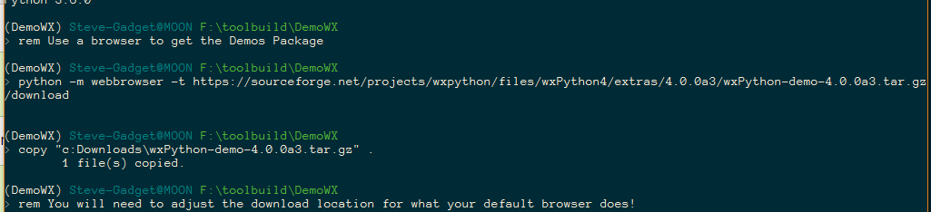
Here is what I did on Windows 10:
Now we have the “problem” that the demo is in a .tar.gz file that some platforms don’t handle.

Slide 7
Python to the Rescue
Luckily python can handle this for us!
Python -m tarfile -e wxPython-demo-4.0.0a3.tar.gz
Does the job nicely, if your download is a different version you will need to change the line to match.
This will result in a subdirectory:
wxPython-demo-4.0.0a3

Slide 8
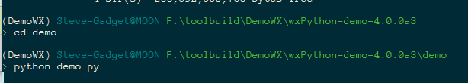
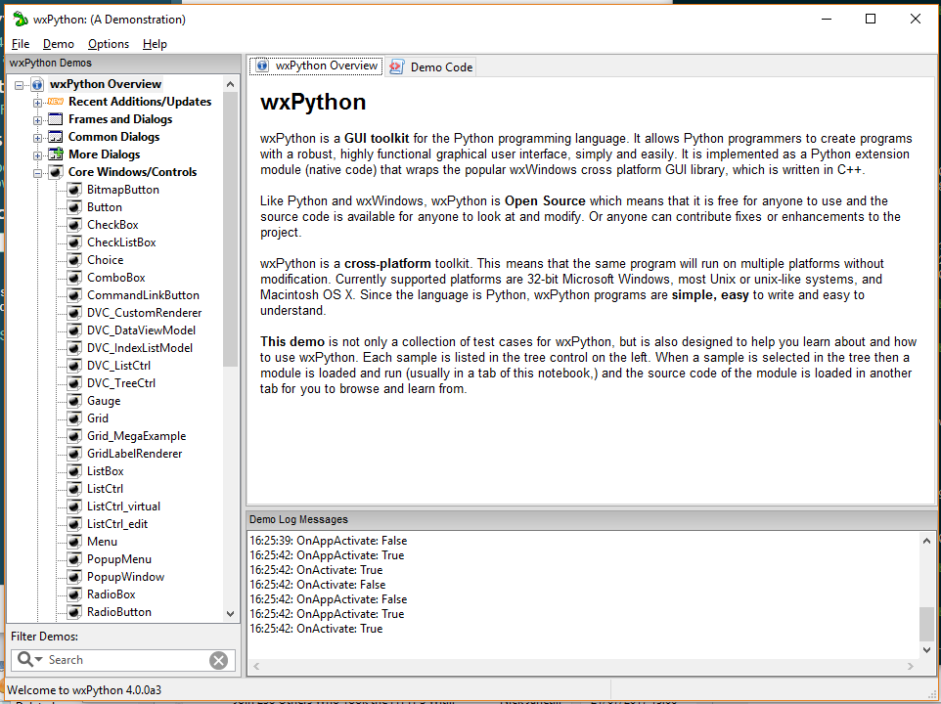
Now to run the demo!
cd wxPython-demo-4.0.0a3\demo
python demo.py
Demo Starts:

Slide 9
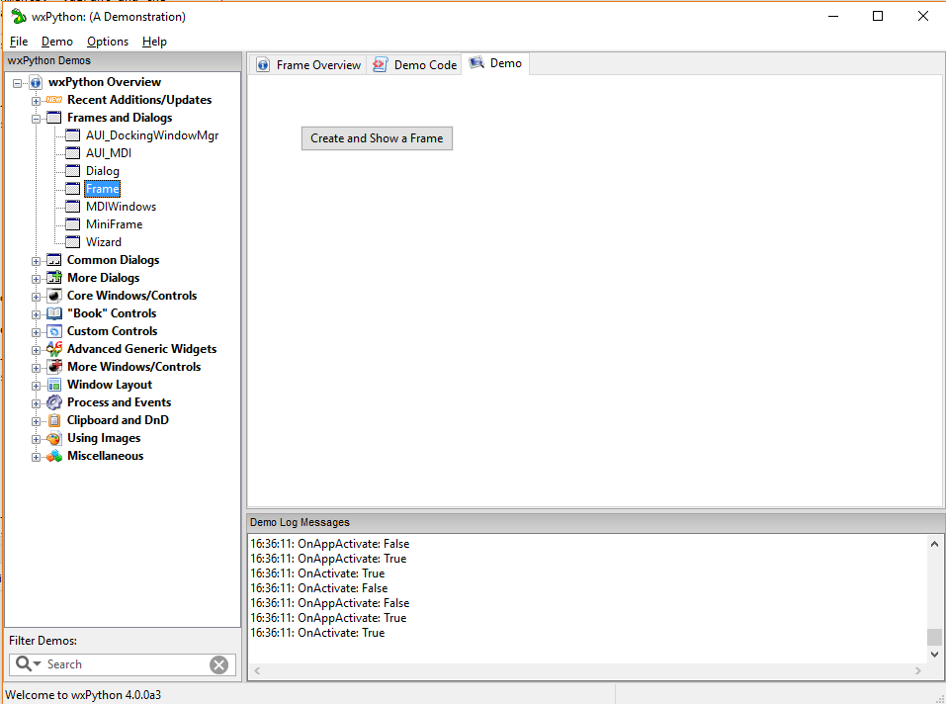
Anatomy of a Simple Demo
Categorised
Tree
Tabs
Area
Launch
Button
Log
Messages
Search

Slide 10
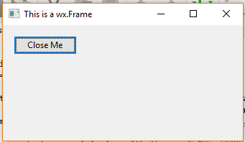
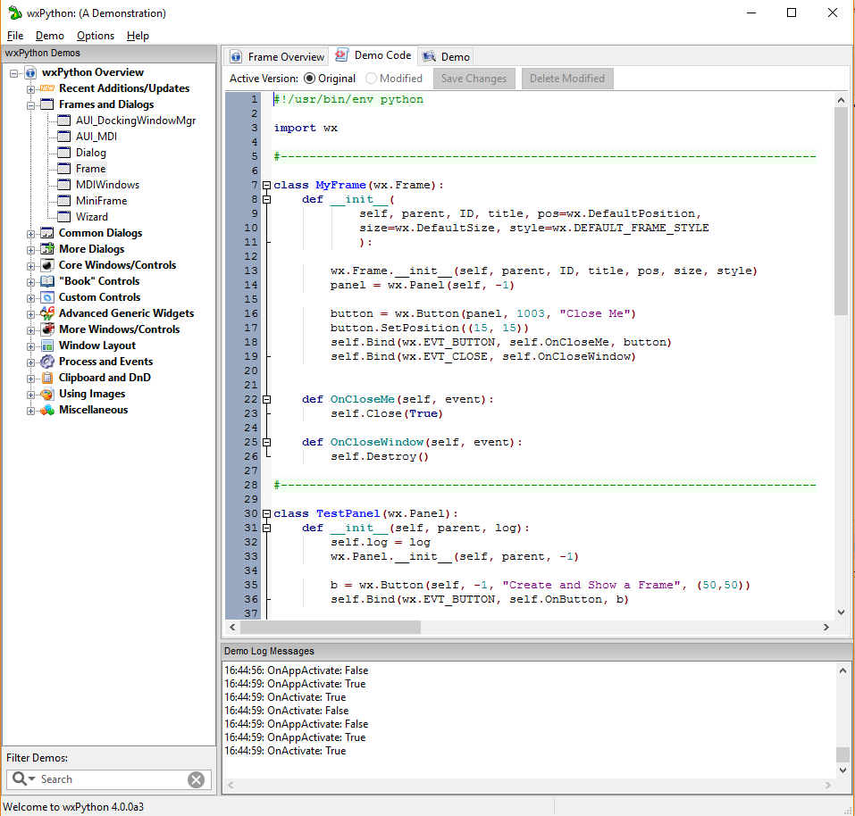
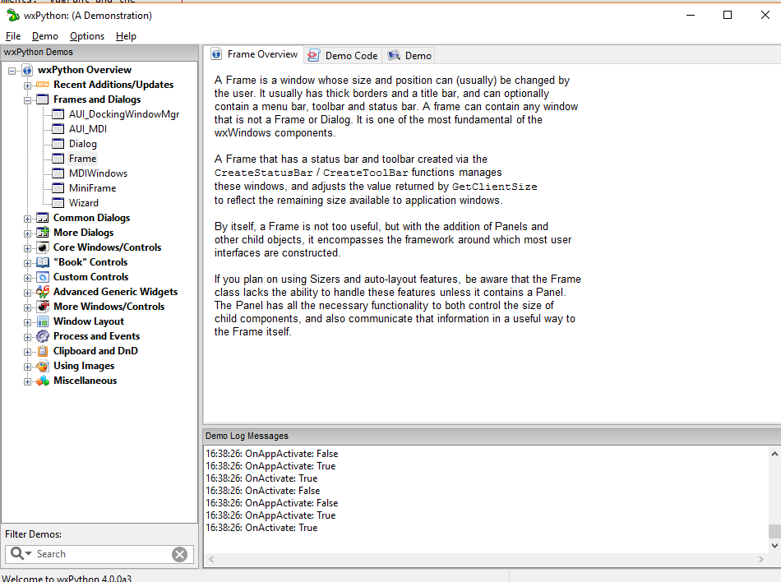
Clicking Launch Button
Overview & Code Tabs

Slide 11
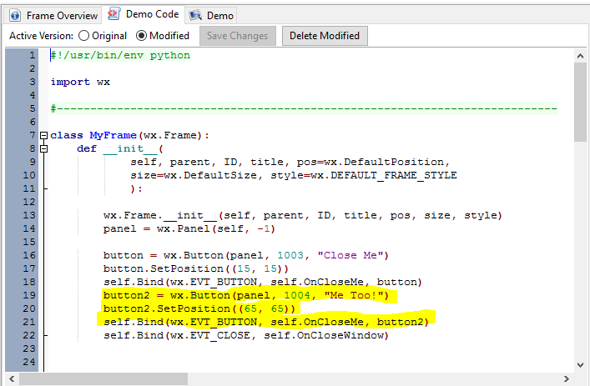
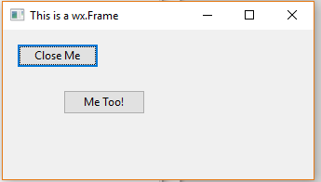
Change & Try in Demo Code tab
The demo
is the
mod
It has
been
saved
Added
Code
Run from
Demo Tab

Slide 12
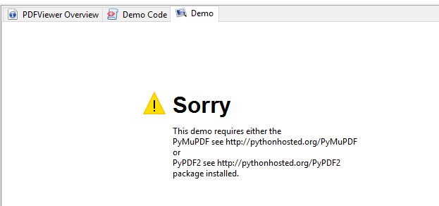
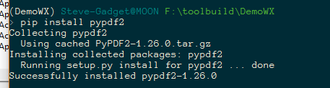
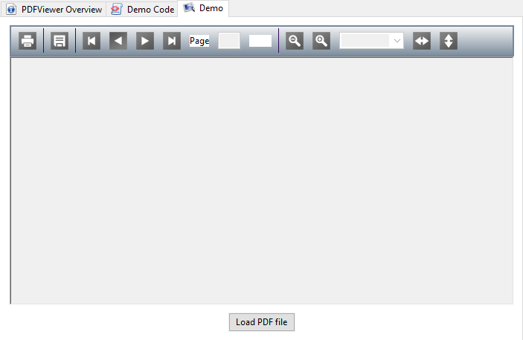
Dealing with Dependencies
Some demos
have dependencies
but they tell you!
Fix with pip:
Next time:

Slide 13
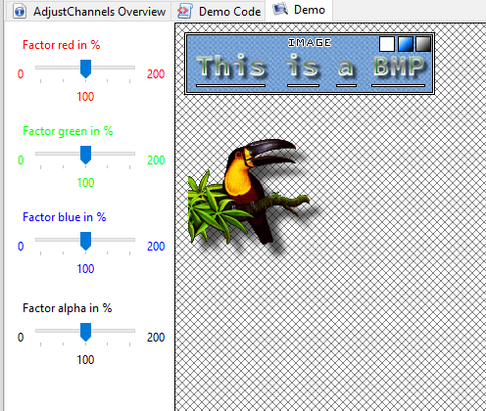
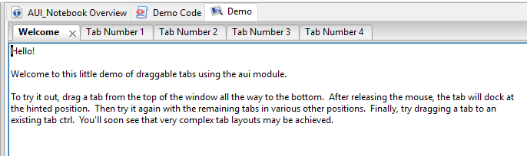
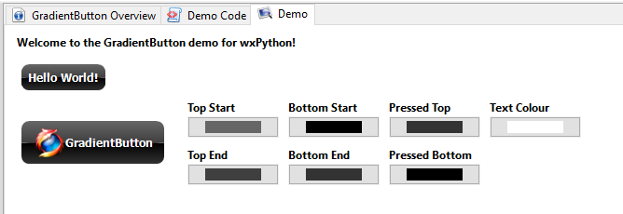
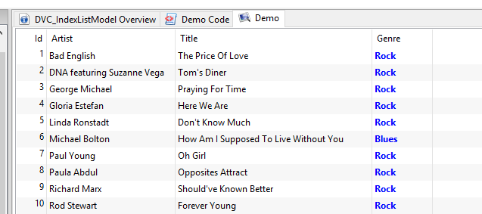
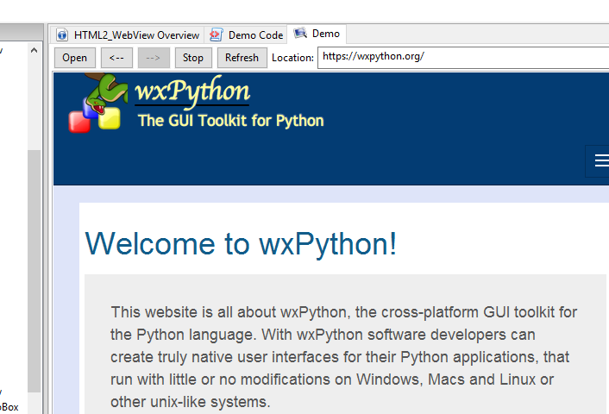
Explorer & Have Fun
Explore the various demos to get an idea of what in wxPython.

Slide 14
Next Time
We will write our own GUI with some of the basic controls.

