Slide 1







API GATEKEEPER
TEAM NAME: CYDRAXIS
TEAM MEMBERS :
T CHETHAN VINAYAK
K CHANDANA
G DIVYA SRI
COLLEGE NAME: THE APOLLO UNIVERSITY
PROBLEM STATEMENT ID: C2
OUR SPONSERS

Slide 2
PROBLEM STATEMENT WITH PROBLEM ID : C2
API Gatekeeper - Backend APIs are attacked constantly with injections, bots, and abuse. Many small apps have no protection. Build a gatekeeper that inspects each request and blocks suspicious or malicious ones. It should log attacks and show a simple dashboard of what was blocked.
PROPOSED SOLUTION
API Gatekeeper is a lightweight reverse-proxy security gateway that protects REST APIs without backend code changes. It inspects requests, detects attacks such as injections, SSRF, bots, and request floods, and blocks suspicious traffic. It logs security events mapped to OWASP, CWE, and MITRE ATT&CK, while a live dashboard displays attack analytics and a Security Scorecard measuring detection rate, false positives, and latency.

Slide 3

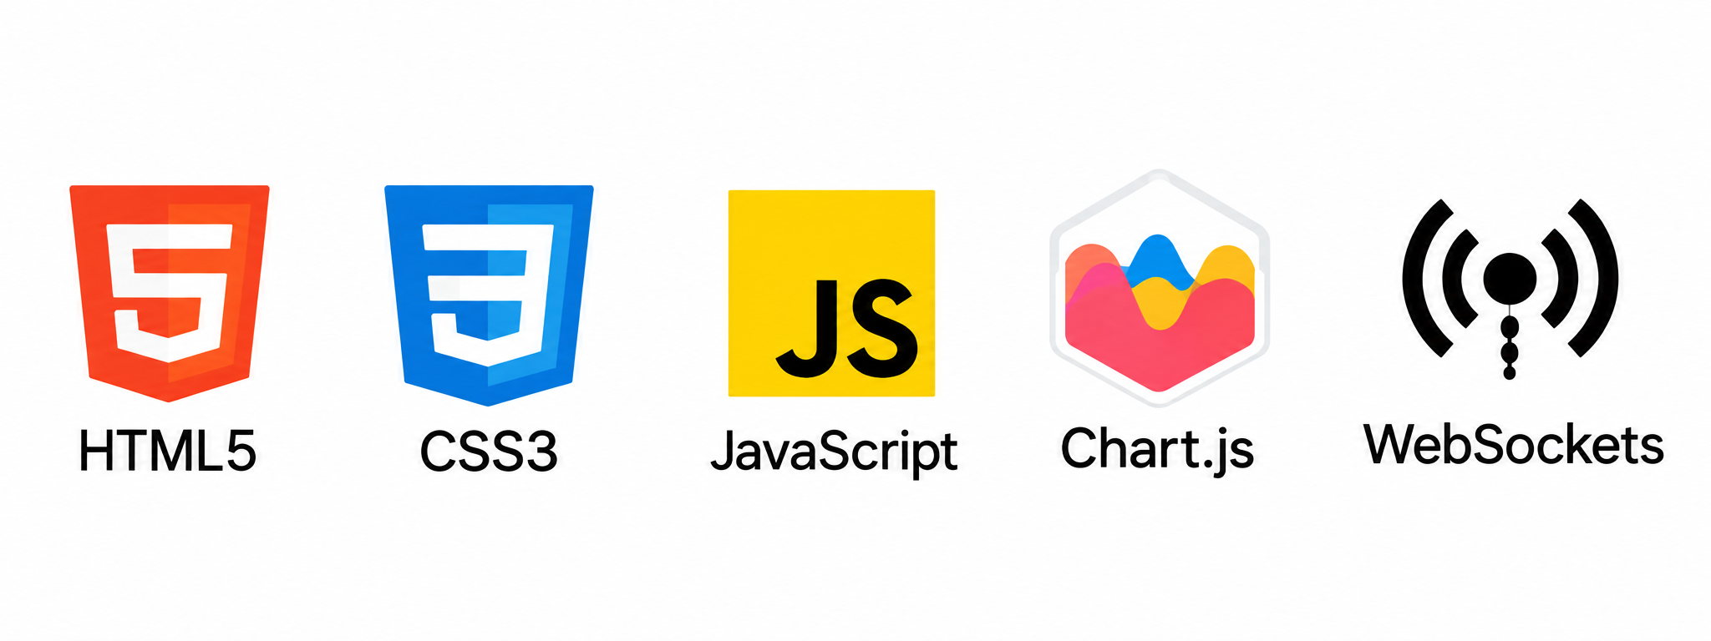
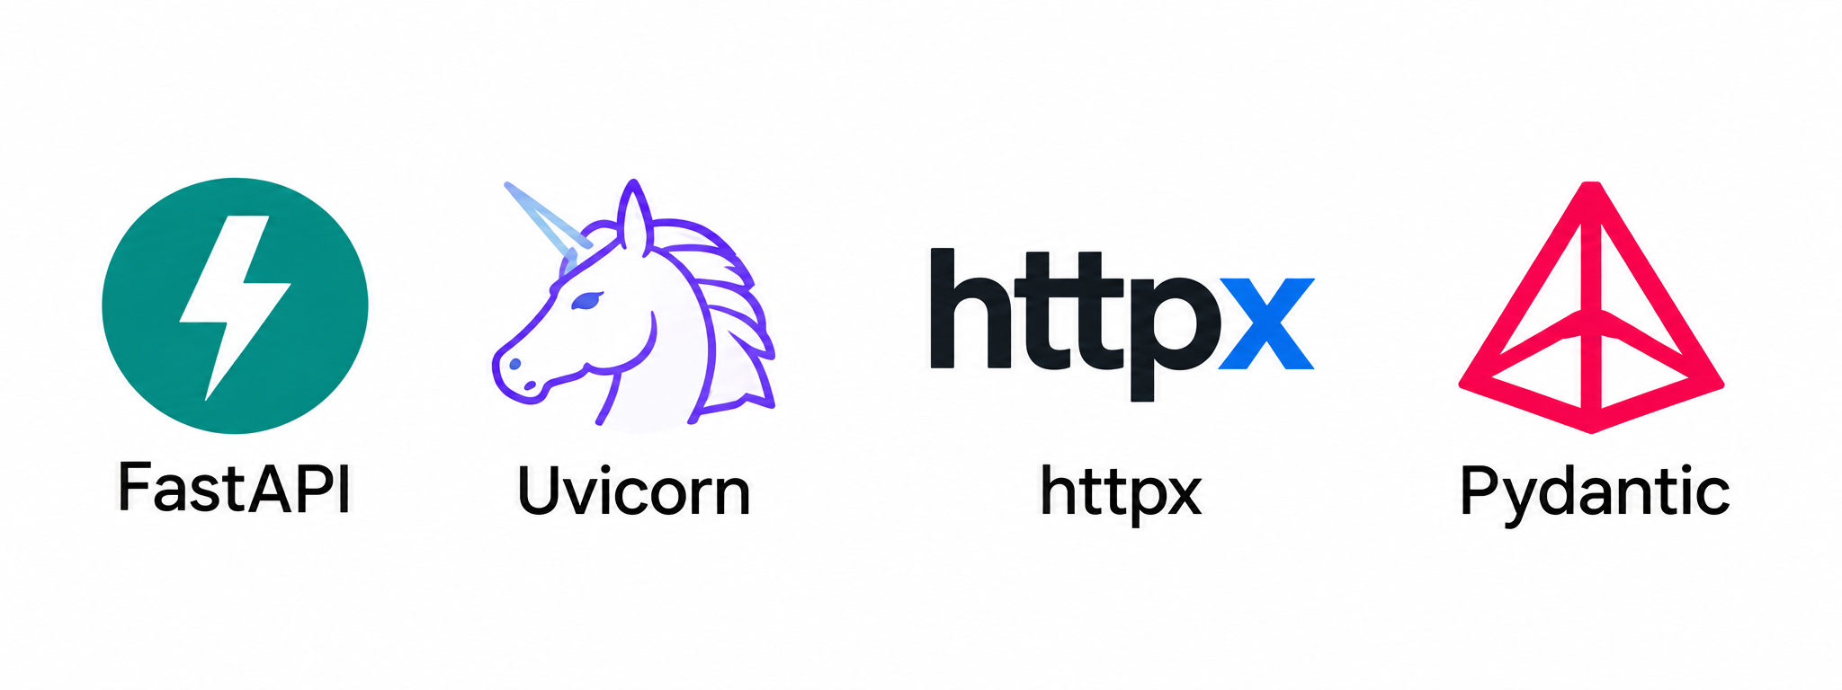

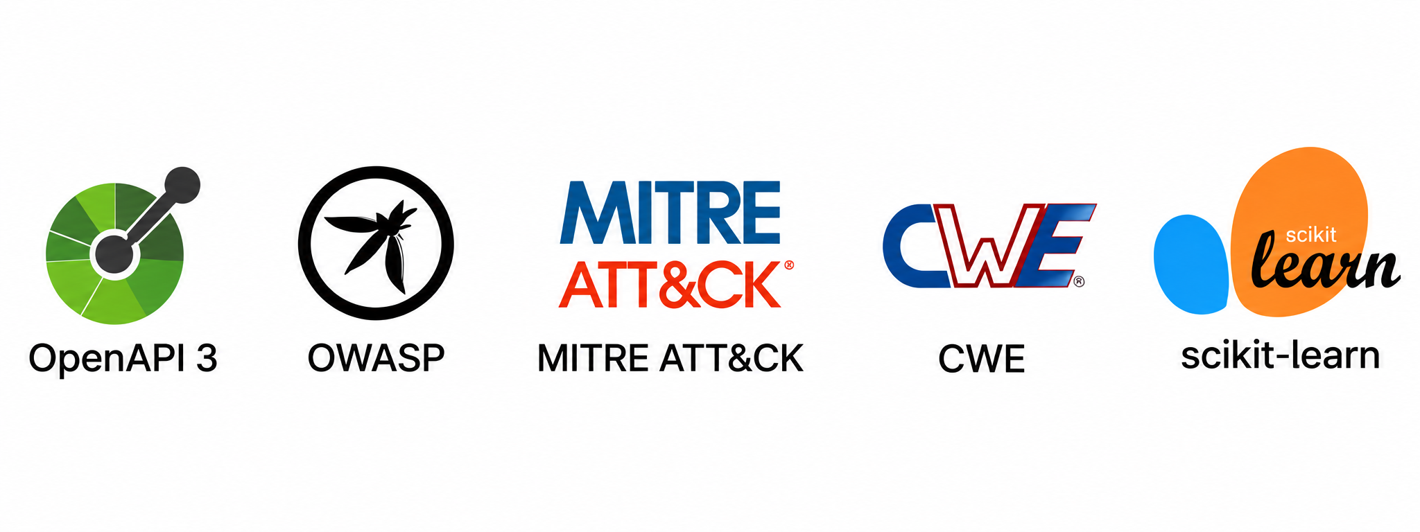
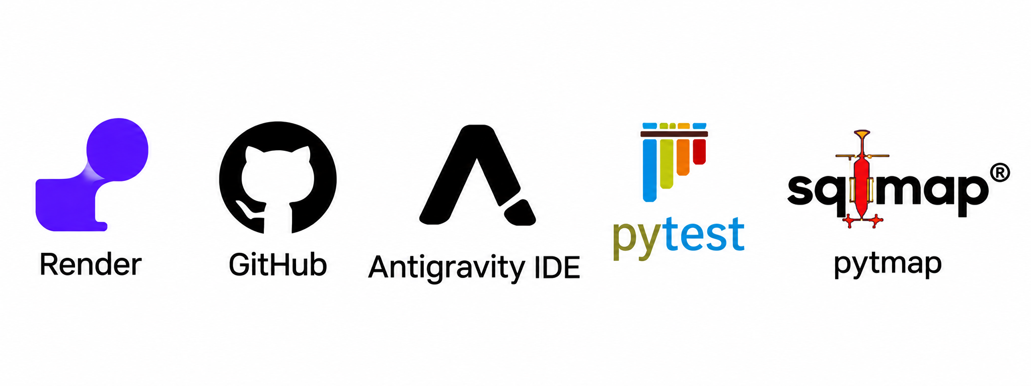
TECHNOLOGY STACK
01
PROGRAMMING
LANGUAGES:
02
FRONTEND
TECHNOLOGIES
03
BACKEND
TECHNOLOGIES
04
DATABASE AND
STORAGE
05
06
CLOUD, DEPLOYMENT
AND DEVELOPMENT TOOLS
A/ML AND APIS

Slide 4
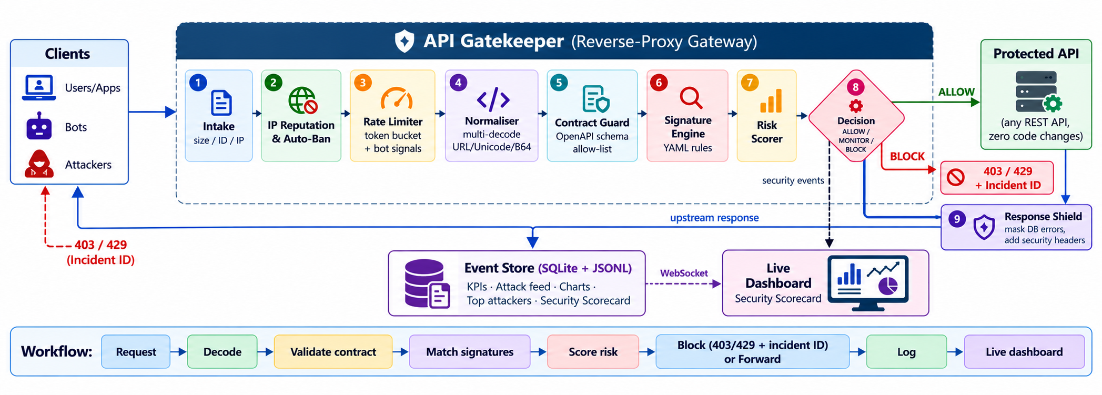
SOLUTION ARCHITECTURE &
WORKFLOW DIAGRAM

Slide 5


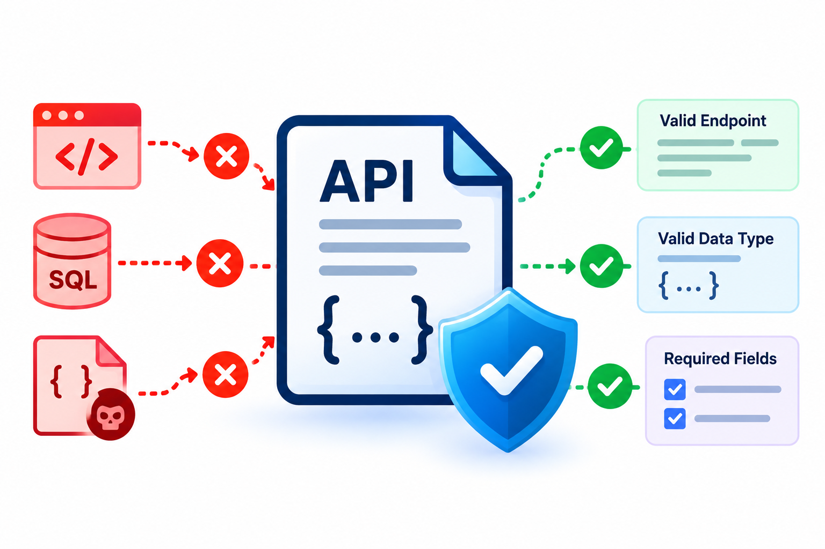
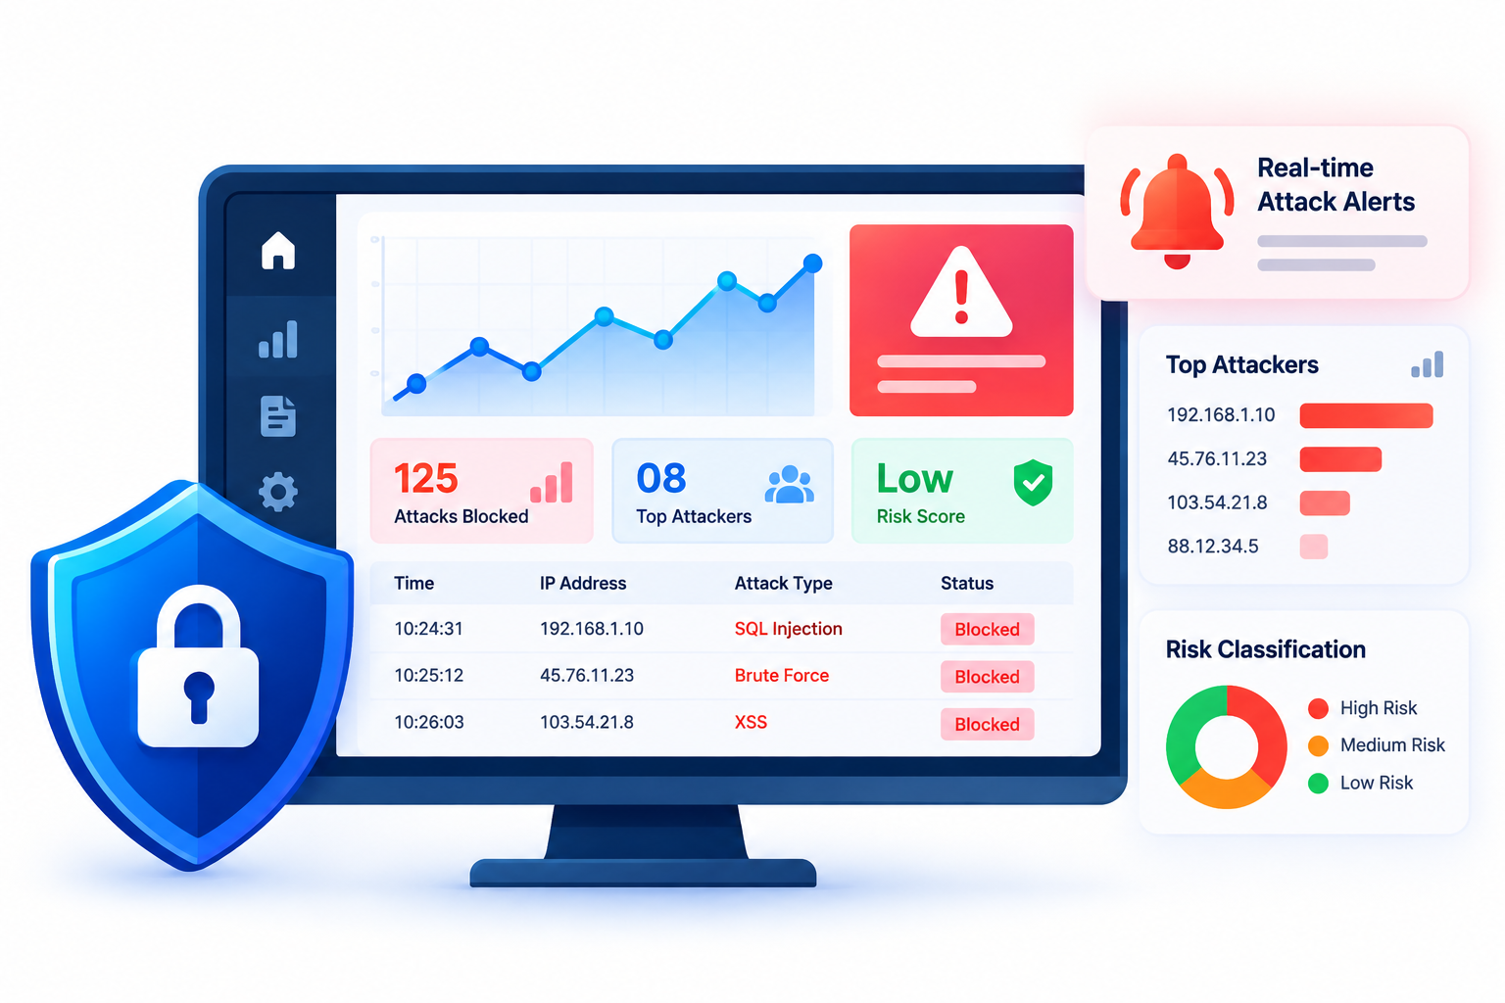
KEY FEATURES &
INNOVATION SHOWCASE
FEATURE 1:
Layered Attack Blocking
Decodes hidden payloads and detects attacks such as SQL injection, XSS, SSRF and command injection using configurable security rules.
FEATURE 2:
Bot & Abuse Defence
Uses rate limiting, suspicious-bot detection and temporary IP bans to reduce automated attacks and repeated abuse.
FEATURE 3:
API Contract Guard
Validates requests against the API’s OpenAPI specification and detects unknown endpoints, invalid data types and unexpected fields.
FEATURE 4:
Live Attack Analytics
Displays real-time attack alerts, top attackers, risk scores and security classifications through a live dashboard.
WHAT MAKES YOUR SOLUTION UNIQUE?
YOUR UNIQUE SELLING POINT
A built-in Security Scorecard measures attack detection, false positives and processing overhead using test attacks and legitimate traffic.
Lightweight API protection with zero backend code changes, explainable security decisions and measurable performance.
.

Slide 6
IMPACT, FEASIBILITY &
FUTURE SCOPE
IMPACT
FUTURE SCOPE
Target users / beneficiaries:
Students, startups, SMEs and REST API developers.
Planned improvements:
ML-based anomaly detection
GraphQL and gRPC support
JWT-aware security checks
Automated security alerts
Expected benefits:
Blocks common attacks, reduces API abuse and provides security monitoring with zero backend code changes.
Scalability or next steps:
Redis-based distributed rate limiting
Docker and Kubernetes deployment
SIEM integration
Hosted API security platform for SMEs
How will you measure success?
Target: ≥95% detection
≤2% false positives
p95 latency <20 ms.

