Slide 1
Crowd sourcing of diseases and pests information
PIP2001 Capstone Project
Review-2
Batch Number: CSE-G27
Under the Supervision of,
Ms. Rohini A
Assistant Professor
School of Computer Science and Engineering
Presidency University
Roll Number | Student Name
20211CSE0067 20211CSE0112 20211CSE0114 20211CSE0125 | Gaduputi Treteswar Naidu Kasturi Deepak Reddy Masu Teja Darisi Phani Bala Jaswanth
Name of the Program: CSE
Name of the HoD: Dr. Asif Mohammed H.B
Name of the Program Project Coordinator: Mr. Amarnath J.
Name of the School Project Coordinators: Dr. Sampath A K

Slide 2
Overview of the Project
Content:
Purpose:
To create a platform for farmers to report plant diseases via images.
Provide expert solutions to crop-related issues.
Key Features:
Farmers upload images of diseased plants.
Experts provide responses and solutions.
Includes cultivation tips and video tutorials.
Supports multiple languages for better accessibility.

Slide 3
Project Objectives
Develop a User-Friendly Mobile Application
Design and develop an intuitive mobile application that enables farmers to easily navigate and report crop diseases by uploading images and symptoms.
Ensure the app is accessible to farmers with varying levels of technological expertise and literacy.
Implement Community Collaboration for Disease Management
Facilitate peer-to-peer interaction by creating a community feed where users can share crop disease reports and solutions.
Enable upvoting/downvoting mechanisms to highlight the most useful and accurate responses.
Provide Cultivation Tips and Educational Resources
Create a comprehensive library of crop-specific cultivation tips, including soil preparation, pest management, and harvesting techniques.

Slide 4
Ensure Multilingual Support for Inclusivity
Incorporate multiple languages into the app to ensure farmers from diverse linguistic backgrounds can access the platform without language barriers.
Allow users to easily switch languages within the app.
Enable Real-Time Disease Reporting and Feedback
Develop a reporting system where users can upload images and provide descriptions of symptoms, enabling quick disease diagnosis and solutions.
Implement real-time notifications to inform users of community responses and expert insights.

Slide 5
System Workflow and Features
Content:
Farmer Side:
Uploads images with descriptions of plant diseases.
Accesses cultivation tips and educational videos.
Expert Side:
Reviews uploaded images and provides advice.
Approves or flags reports for accuracy.
Backend:
Firebase used for authentication, image storage, and real-time updates.

Slide 6
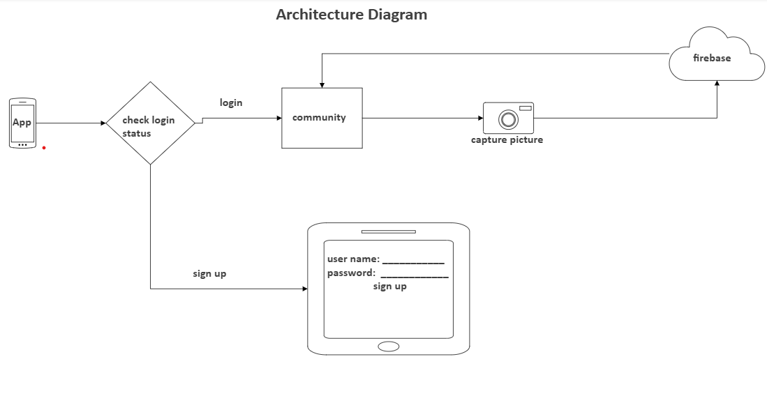
Fig 1: System Architectural Diagram

Slide 7
Key Functionalities
Content:
Image Upload and Disease Reporting:
Farmers can take pictures and submit reports.
Expert Review Panel:
Experts reply with solutions and advice.
Educational Videos:
Short videos on common diseases and farming techniques.
Cultivation Guides:
Crop-specific tips and step-by-step instructions.
Multilingual Support:
Language switching to accommodate diverse users.

Slide 8
Firebase Usage in the Project
Content:
Authentication:
Secure farmer and expert login functionality.
Database:
Stores user details, image reports, and expert replies.
Real-Time Updates:
Ensures instant feedback from experts.
Storage:
Used for uploading and retrieving disease images and video tutorials.

Slide 9
Current Challenges"
Content:
Ensuring high-quality image uploads from farmers.
Maintaining user engagement, especially from rural areas.
Addressing network limitations in low-connectivity regions.
Translating guides and videos accurately for multilingual support.

Slide 10
Planned Improvements
Content:
AI-Based Preliminary Diagnosis:
Automatically identify diseases based on uploaded images.
Geolocation Integration:
Map disease outbreaks to visualize trends.
Expert Panel Expansion:
Increase the number of experts for faster responses.

Slide 11
Outcomes
Enhanced Crop Disease Detection:
The mobile application will provide farmers with an easy-to-use platform for reporting and identifying crop diseases, leading to early detection and more effective disease management.
The ability to upload images and describe symptoms will allow users to receive immediate feedback, improving the decision-making process.

Slide 12
Community Engagement and Collaboration:
By creating a community feed where users can interact, share experiences, and provide solutions, the application will foster collaboration among farmers, agronomists, and other agricultural experts.
The upvote/downvote system will ensure that only the most helpful and accurate information is visible, helping to build trust within the community.
Accessible Cultivation Resources:
The cultivation tips module, including instructional videos and a library of resources, will empower farmers with practical knowledge to improve their farming practices, leading to increased crop yields and healthier crops.
The resources will be easily accessible and tailored to different crop types, such as apples, bananas, maize, etc.

Slide 13
Conclusion
The mobile application developed in this project effectively addresses several critical challenges faced by farmers, with a primary focus on the management of crop diseases and optimizing cultivation practices. By providing a platform that integrates disease reporting, access to educational resources, and fosters community collaboration, the application empowers farmers to make informed decisions about their crops, improving productivity and minimizing losses.
The app's successful implementation of features such as disease reporting with image uploads, community interaction through discussion feeds, and access to cultivation tips has proven to be a valuable resource for bridging the knowledge gap in agriculture. Furthermore, the inclusion of multilingual support has expanded the app’s reach, ensuring that farmers from diverse linguistic and cultural backgrounds can easily access the platform and benefit from its functionalities.

Slide 14
The application’s scalable infrastructure, built on Firebase, offers the flexibility to accommodate growing user numbers and expanding features. Future iterations of the app will integrate machine learning algorithms to enhance disease diagnosis accuracy and predictive capabilities. Additionally, incorporating a wider range of educational content, such as weather forecasts and market price tracking, will provide even more value to farmers, helping them make informed decisions beyond disease management.
One of the key successes of the project is its potential to foster community-driven support, which is crucial for small-scale farmers who often lack direct access to expert advice. The collaborative features, including the upvote/downvote system and expert verification, have successfully engaged users in providing valuable insights and solutions. This sense of community helps ensure that farmers have a reliable resource for disease diagnosis, pest management, and other critical farming information.

Slide 15
Project Timeline
 | October | November | December | January
Analysis
Design
Develop
Deployment

Slide 16


