Slide 1
Crowd sourcing of diseases and pests information
PIP2001 Capstone Project
Review-3
Batch Number: CSE-G27
Under the Supervision of,
Ms. Rohini A
Assistant Professor
School of Computer Science and Engineering
Presidency University
Roll Number | Student Name
20211CSE0067 20211CSE0112 20211CSE0114 20211CSE0125 | Gaduputi Treteswar Naidu Kasturi Deepak Reddy Masu Teja Darisi Phani Bala Jaswanth
Name of the Program: CSE
Name of the HoD: Dr. Asif Mohammed H.B
Name of the Program Project Coordinator: Mr. Amarnath J.
Name of the School Project Coordinators: Dr. Sampath A K

Slide 2
Overview of the Project
Purpose:
Enable farmers to upload images of diseased crops.
Provide expert responses to address issues.
Features:
Video tutorials and cultivation tips for better farming practices.
Multilingual support for inclusivity.
Secure data storage and retrieval using Firebase.

Slide 3
Updated Objectives
Develop a User-Friendly Mobile Application
Implement Community Collaboration for Disease Management
Enable Expert Consultation Services
Encourage Eco-Friendly Practices
Enhance Agricultural Knowledge and Community Engagement

Slide 4
Optimize Backend Performance Using Firebase
Implement Community Moderation Features
Enable Real-Time Disease Reporting and Feedback
Ensure Multilingual Support for Inclusivity
Provide Cultivation Tips and Educational Resources

Slide 5
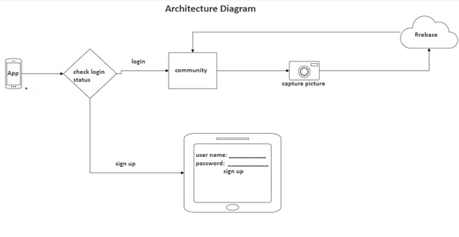
Architecture Diagram
Fig 1 : Architectural Diagram

Slide 6
Components of the Architecture:
Mobile Application (Frontend):
Developed using Android Studio and Java for the user interface and application logic.
Provides features such as disease reporting, viewing community responses, and accessing cultivation tips and videos.
Backend Server:
Firebase is used for data storage, real-time updates, and user authentication. It provides a cloud-based solution that scales easily and handles large amounts of data efficiently.
Database:
Firebase's Firestore is used to store user data, disease reports and responses.

Slide 7
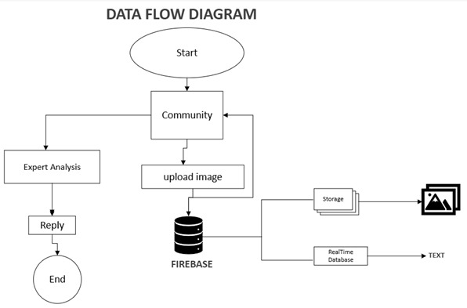
Data Flow Diagram
Fig 2: Data Flow Diagram

Slide 8
User Authentication:
Firebase Authentication provides a secure and simple way to manage user logins and profiles using email and password.
Data Management:
Firebase Firestore stores user data, including disease reports, community responses, and user profiles. It also stores cultivation resources like written tips and video content.
Real-Time Updates:
Firebase's real-time database ensures that changes made by one user (e.g., posting a new disease report or response) are immediately reflected for other users. This feature enhances collaboration and ensures up-to-date information.

Slide 9
Moderation & Reputation System:
Implemented a system where users earn points based on the quality of their contributions (e.g., accurate disease solutions).
Flagging and reporting inappropriate content ensures that the community remains helpful and constructive.
Video Streaming:
Short videos related to cultivation practices and disease management are stored in Firebase Storage and can be streamed directly within the app. Videos are optimized for different network conditions to ensure smooth playback.

Slide 10
Features Implemented in Review 3
Image Upload and Feedback: Farmers can upload images, and experts reply with solutions.
Video Tutorials: Added videos for pest management and farming techniques.
Cultivation Tips: Step-by-step guides for specific crops.
Firebase Integration: Secure data storage and real-time updates for reports and replies.
Offline Mode for Guides: Farmers can access cultivation tips even without internet.

Slide 11
Challenges Faced and Overcome
Content:
Challenge 1: Low-resolution images affecting expert feedback.
Resolution: Added prompts for better image quality during uploads.
Challenge 2: Network issues in rural areas.
Resolution: Offline access for cultivation tips and videos.
Challenge 3: Initial delays in expert response times.
Resolution: Improved expert notification system via Firebase.

Slide 12
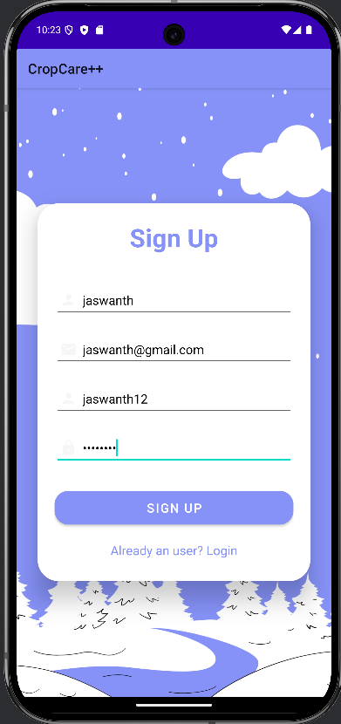
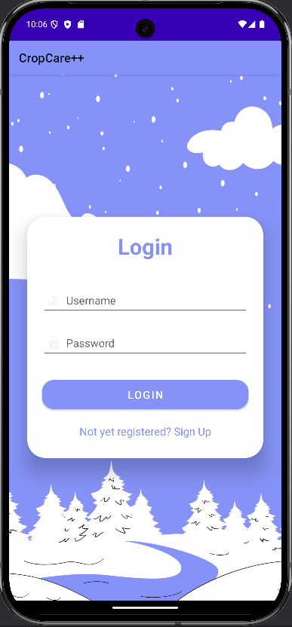
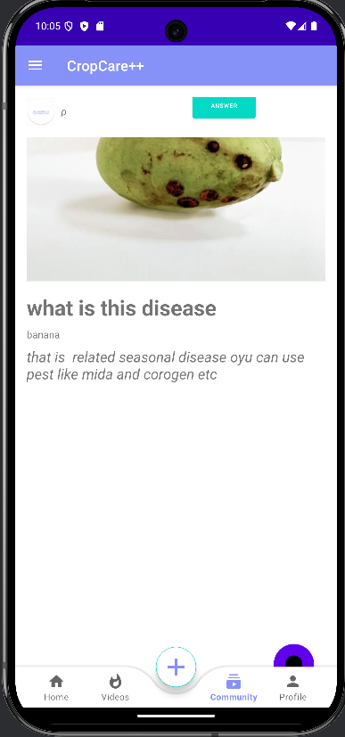
Results and Performance

Slide 13
User Interface Design
The application will feature a clean, intuitive, and responsive user interface. The key elements of the UI are:
User Registration and Profile Setup:
Simple registration process using email for authentication.
Profile customization, including location, crop types, and preferred language settings.
Disease Reporting Mechanism:
Users can upload images of affected crops along with a description of symptoms.
The system will tag each report for follow-up and categorization, helping in future searches.

Slide 14
Community Feed:
Users can post disease reports, and other users can reply with solutions.
Features such as upvote/downvote will determine the visibility of responses.
Cultivation Tips & Video Content:
A categorized library of cultivation tips and instructional videos on topics like pest management, fertilization, and harvesting.
Video streaming and content delivery is handled through Firebase Storage, ensuring smooth access to educational resources.

Slide 15
Project Timeline
 | October | November | December | January
Analysis
Design
Develop
Deployment

Slide 16


