Slide 1
CROWD SOURCING OF DISEASES AND PESTS INFORMATION
PIP2001 Capstone Project
Review-1
Batch Number: CSE-G28
Under the Supervision of,
Ms. Rohini A
Assistant Professor
School of Computer Science and Engineering
Presidency University
Roll Number | Student Name
20211CSE0067 20211CSE0114 20211CSE0112 20211CSE0125 | Gaduputi Treteswar Naidu Reddy Masu Teja Kasturi Deepak Darisi Phani Bala Jaswanth
Name of the Program: CSE
Name of the HoD: Dr.Asif Mohammed H.B
Name of the Program Project Coordinator: Mr. Amarnath J.L
Name of the School Project Coordinators: Dr. Sampath A K / Dr. Abdul Khadar A / Mr. Md Ziaur Rahman

Slide 2
Introduction
Crowdsourcing has become a perfect approach in many fields; and with the support of collecting disease and pest information, this technology is picking up steam. In this approach, the collective knowledge and participation of a large, distributed group of people from various walks of life are utilized to gather, analyze, and report data on diseases affecting crops, livestock, or human health.
Conventional disease and pest monitoring is expert-based surveillance, though effective, always overdue, and, therefore expensive. Crowdsourcing offers a complementary approach in that it's possible to capture information in real-time from non-experts, such as farmers, community members, and citizen scientists, in images, descriptions as well as geolocated data given the prevalence of smartphones, digital tools, and online platforms to assure ease of reporting any sighting or outbreak.

Slide 3
Literature Review
Pethuraj and Selvaraj (2019) demonstrated the role of farmers in monitoring crop diseases in India, showing how crowdsourced data helped identify pest outbreaks early. Similarly, Carranza et al. (2021) discussed mobile applications like PlantVillage that use AI for crop disease diagnosis, offering quick feedback to farmers.
For instance, AI-based systems like the one employed by PlantVillage Nuru use machine learning to process crowdsourced images of diseased plants and provide instant feedback on potential diseases (Ramcharan et al., 2019). In the domain of pest surveillance, smart sensors and drones are increasingly being used in conjunction with crowdsourced reports to provide a more comprehensive monitoring framework (Goel et al., 2020).
A critical review by Freitag et al. (2016) outlines the difficulties in maintaining accuracy in crowdsourced data, particularly when contributions come from non-experts. They argue that ensuring data validation through expert review or automated quality checks is essential for improving the reliability of crowdsourced systems. Similarly, Haklay (2013) emphasizes the need for sustained participant motivation, as crowdsourcing platforms often suffer from high dropout rates among users once initial enthusiasm fades.

Slide 4
Existing method Drawback
Non-expert Contributions: Crowdsourced data often comes from non-experts, such as farmers or the general public, who may misidentify diseases or pests. Incorrect diagnoses or misreported sightings can skew results, leading to ineffective interventions.
Inconsistent Reporting: The quality of reports may vary widely, as some users provide incomplete, vague, or low-resolution data. This inconsistency makes it difficult to maintain a standardized dataset.
Limited Validation Mechanisms: Many platforms do not have robust methods to verify the accuracy of user-submitted data. While some systems rely on experts to validate reports, this process can be slow and resource-intensive, reducing the real-time value of crowdsourcing.
Time Lag in Data Processing: Some crowdsourcing platforms are not designed for real-time data processing. This can lead to delays between when data is submitted and when it is analysed or acted upon.

Slide 5
Proposed Method
Develop a mobile application and a corresponding web portal for users (farmers, experts, admins) to report pest or disease occurrences. The app would allow users to submit geotagged photos, descriptions of the problem, location data, and additional data like crop type, symptoms, or affected areas.
Provide contributors with user-friendly tutorials, visual guides, and resources to help them identify pests or diseases more accurately.
To address the issue of fake contributors, verification of submissions will be carried out by the admin. By implementing a manual verification process, the system ensures that only accurate and legitimate information is accepted, minimizing the impact of false reports.

Slide 6
Objectives
Facilitate Real-time Reporting of Pests and Diseases: Enable farmers and field workers to report pest and disease incidents in real-time, including uploading images and descriptions for accurate identification.
Create a Collaborative Knowledge Base: To develop a centralized platform where users can contribute and access verified information about pest and disease occurrences, forming a dynamic and localized knowledge repository.
Provide Access to Expert Advice: Incorporate a feature where agricultural experts can review reports and share best practices to help manage specific pest and disease issues.

Slide 7
Methodology/Modules
Mobile Application: To develop a mobile app using Android Studio for farmers and citizens to report sightings of diseases or pests.
Geotagging:
Automatically captures the location of the report.
Photo Upload:
Users can submit images of affected plants.
SMS-Based Reporting: Useful in areas with limited internet access. Farmers can report pest or disease incidents via SMS.

Slide 8
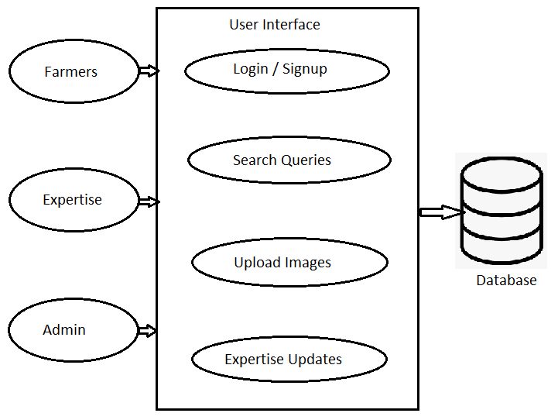
Architecture

Slide 9
Hardware/software components
Mobile Application :
Android Studio
Database :
FireBase
Geo Location Services :
Google maps API
Analytics and Reporting:
Power BI

Slide 10
Timeline of Project
 | October | November | December | January
Analysis
Design
Develop
Deployment

Slide 11
Expected Outcomes
Develop a robust database schema that efficiently stores and retrieves pest and disease data, ensuring quick access and scalability.
Easy access to expert advice through the platform without needing to travel or wait for help.
Increased Yield and Agricultural Productivity and increase farmers income.
Community Knowledge Sharing and giving professional advice and recommendations.
Less crop damage by quick reporting and advising farmers.

Slide 12
Conclusion
The crowdsourcing project for disease and pest information holds significant potential for transforming the way we monitor, manage, and respond to agricultural and public health threats. By utilizing mobile apps, SMS reporting, data integration tools the project empowers farmers, researchers, and citizens to actively participate in identifying and reporting cases of pests and diseases. This decentralized approach enables rapid detection, supports timely response efforts, and creates a comprehensive solutions for diverse locations.

Slide 13
Github Link
The Github link provided should have public access permission.
Github Link
https://github.com/GaduputiTreteswarNaidu/Crowd-Sourcing-of-Diseases-and-Pests-Information

Slide 14
References
https://www.researchgate.net/publication/335135141_Crowdsourcing_real-time_viral_disease_and_pest_information_A_case_of_nation-wide_cassava_disease_surveillance_in_a_developing_country
https://ieeexplore.ieee.org/stamp/stamp.jsp?arnumber=10147225
https://www.mdpi.com/2073-4395/11/10/1951
https://www.sciencedirect.com/science/article/abs/pii/S0168169917300479

Slide 15
https://link.springer.com/article/10.1007/s10530-021-02631-3
https://ojs.aaai.org/index.php/HCOMP/article/view/13322/13170
https://mel.cgiar.org/uploads/reporting/dx4o2Pw0MTqtRgFQjLx7VWEzciq4Bn.pdf
https://academic.oup.com/jid/article/228/11/1479/7301001

Slide 16
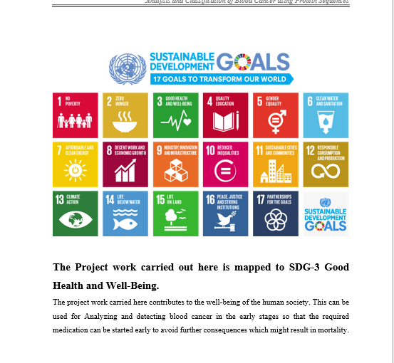
Project work mapping with SDG

Slide 17
Thank You

