Slide 1
MGT 875 | SERVICE MANAGEMENT
Dexcom
Continuous Glucose Monitoring as a Service for Social Impact
Team 4: Gai Sawant, Gina Aikens, Hsinyun Chang, Jude Bart-Plange, Sharon Chen

Slide 2
SOCIAL IMPACT CASE
The Global Diabetes Crisis
537M
11.1%
$966B
3.5M
Adults with diabetes globally (IDF 2025)
Of global adults ages 20-79 affected
Annual global healthcare costs from diabetes
Annual deaths attributed to diabetes complications
Alignment with UN Sustainable Development Goals
SDG 3 · Good Health & Well-Being
SDG 10 · Reduced Inequalities
SDG 17 · Partnerships for Goals
Reducing diabetes-related mortality, improving glucose management, enabling preventive care
Stelo OTC access, Patient Assistance Program, Community Glucose Monitoring Project for uninsured
Collaborations with insulin pump makers, EHR systems, payers, and public health programs

Slide 3
SERVICE STRATEGY & INNOVATION
The Service Profit Chain at Dexcom
Internal
Quality
Employee
Satisfaction
Service
Value
Patient
Loyalty
Social &
Financial ROI
Manufacturing
R&D investments
FDA compliance
Clinical & tech
expertise
Academy training
Real-time data
Clinical outcomes
Peace of mind
Re-subscription
Clinician trust
Ward-of-mouth
A1C reduction
Hospitalization ↓
$4.7B revenue
Service Innovation & Digital Transformation
Competitive Positioning
AI-powered meal logging launched Q3 2025 — personalized glucose impact insights
Dexcom Clarity: retrospective analytics platform for clinicians and patients
Open API / developer ecosystem — 3rd party apps (Signos, Levels, Nutrisense) drive new segments
Automated Insulin Delivery (AID) integration: Omnipod 5, iLet Bionic Pancreas, Tandem

Slide 4
SERVICE OPERATIONS & CUSTOMER JOURNEY
Dexcom's Multi-Sided Service Platform
1
2
3
4
5
Awareness
Access
Onboarding
Daily Use
Re-supply
Patient diagnosed
Doctor recommends
Insurance checks
Prescription/OTC
DME or pharmacy
Activation app
Sensor placement
App setup
Clinician training
Real-time readings
Alerts & trends
Share w/ caregivers
Auto-refill
Insurance renewal
Sensor replacement
Front Stage vs. Back Stage Operations
FRONT STAGE (Visible to Patient)
BACK STAGE (Invisible to Patient)
Mobile app, glucose alerts, Dexcom Clarity reports, Share feature, customer support, sensor packaging & instructions
Sensor manufacturing (US & Malaysia), FDA regulatory compliance, insurance & DME partnerships, R&D ($157M/quarter), cloud data infrastructure

Slide 5
VALUE CREATION × VALUE CAPTURE
Where is Dexcom now — and where can it go next?
VALUE CAPTURE
WHERE DEXCOM WAS
TRANSITION ZONE
Value-in-use
Sell the sensor.
Stelo subscription + GenAI.
Maximizing long-term benefit to the patient over time
G6/G7 device sold via DME channel; revenue = units shipped; patient relationship mediated by payer & pharmacy. No direct data relationship.
OTC subscription model; 50%+ renewal rate; GenAI Weekly Insights; Oura Ring integration. Still capturing exchange value but creating use value through AI coaching.
Value-in-exchange
MISSED OPPORTUNITY
★ WHERE DEXCOM IS GOING
One-time transaction: device or sensor sale
Outcomes-based payer contracts.
Biosensing health platform.
Dexcom has real-world outcome data (A1C, hospitalizations) but does not yet monetize it. Shared-savings contracts with Medicare Advantage payers remain untapped.
AI coach + multi-biomarker sensing + WHO/LMIC partnerships + platform API. Monetize outcomes, not transactions. Long-term patient relationship = lifetime health value.
↑
VALUE CREATION →
Value-in-exchange
Value-in-use
(sensor as product — sell the hardware)
(CGM as ongoing health service — outcomes delivered)

Slide 6
CURRENT STATE SUMMARY
What’s Going Well
Gaps & Challenges
Scale: >2.8 million customers at year-end 2024
Dexcom Warriors Community: 30,000+ people sharing stories and support others with diabetes
Access Pathways: Pharmacy savings program, Insurance coverage navigation, Patient Assistance Program portal
Research Engine: 200+ peer-reviewed journal articles and 350+ clinical trials worldwide in 2024
Mission Alignment: 89% of employees said they can see a clear link between their work and Dexcom’s mission
Reliability Issues: FDA recall and corrections tied to alert reliability
Manufacturing Compliance: FDA Warning Letter raised quality-system requirements
Interoperability Gap: Uneven integration across devices/apps creates inconsistent user experience
Access: Reimbursement pressure limits affordability, slowing adoption & widening inequity
Sustainability Constraint : Disposable sensors and transmitters generates significant plastic waste; Limited recycling options
Source: Company, Dexcom Sustainability Report (April 2025), https://www.fda.gov/inspections-compliance-enforcement-and-criminal-investigations/warning-letters/dexcom-inc-700835-03042025

Slide 7
FUTURE EXPANSION PLAN
RIGHT AWAY
Stabilize Core Service
1 YEAR
Horizontal Integration
3 YEARS
Prevention Infrastructure
Fix G7 Reliability Issues Sensor accuracy, app stability, supply continuity
Reduce Onboarding Friction Simplify activation & insurance workflows to prevent early churn; Dexcom Warriors
Ensure Infrastructure Readiness Minimize execution risk before scaling up
Sustainability for Scale Reduce packaging/material footprint; Design for future recycling
Open Ecosystem Partnerships Dexcom API; Integrate with wearables; Health dashboards & data platforms
Expand beyond Diabetes (Stelo) Enter prevention segment; Shift from passive management to preventive monitoring
Expand Distribution Equity Partner with NGOs/public health payers to expand access to low-income households
Data Intelligence Infrastructure Build a synthetic data & research engine for predictive analytics & drug development research; Build AI-powered risk modeling
Notes:
Right away – Focus on retention & relationship marketing
G7 Reliability
Streamline Onboarding
1 year –
Sustainability pilot for sensor waste
Focus in on Stelo (Specificity) - Platform economy: Open Dexcom API to enable third-party clinical tools; revenue-share model with impact validators; horizonal integration (Oura Ring)
3 year –
Dexcom for Low-Income US households + countries (partner with NGOs – UNDP) - change in payer
Use patient data to generate synthetic data to create a research marketplace (pharma)

Slide 8
06 FUTURE GROWTH | IMPACT & ROI PROJECTIONS
Social Impact ROI
A1C Reduction
FUTURE: Scale to 1M uninsured patients → prevent 200K hospitalizations/yr
NOW: Community project: −2.4% in 6 months
Access Expansion
FUTURE: Target: 10M users by 2028 through LMIC expansion
NOW: 2.8M users globally (tiny fraction of 537M)
Healthcare Cost Savings
FUTURE: 10M users × $5K savings = $50B societal value created
NOW: $10,000+ annual savings per well-managed diabetic
Mortality Reduction
FUTURE: At scale: measurably reduce diabetes-related mortality in target markets
NOW: CGM proven to reduce severe hypoglycemia events by 40%+
Financial Investment Required
Short-term fix costs ~$50–100M | 1-Year program ~$200M | 3-Year vision ~$500M total → Expected revenue uplift: +$1–2B by 2028 at current growth trajectory

Slide 9
06 RISK MANAGEMENT
Key Risks & Mitigation Plan
Regulatory & Quality Risk
MITIGATION: Invest early in quality systems (FDA aligned), remove redundant manufacturing capacity, phased geographic rollout, dedicated regulatory team for LMIC markets.
Scaling to 10M users increases regulatory exposure, manufacturing complexity, and risk of device quality failures.
Affordability & Access Risk
MITIGATION: Tiered pricing model, employer & NGO partnerships, outcome-based reimbursement models, subscription financing options.
Targeting uninsured and LMIC populations may fail due to pricing barriers.
Operational Strain & Service Profit Chain Risk
MITIGATION: Invest in frontline workforce & Training, real-time service metrics (NPS, resolution time), phased scaling, localized support teams in new markets.
Rapid growth can degrade service quality (customer support, onboarding, logistics), breaking the Service Profit Chain.
Data Privacy & Trust Risk
MITIGATION: Privacy-by-design architecture, explicit consent frameworks, federated analytics instead of raw data sharing, transparent governance reporting.
Expanded data usage increases cybersecurity and ethical scrutiny.

Slide 10
CONCLUSION
Dexcom's Opportunity to Lead
Service Management for Social Impact
Dexcom sits at a pivotal intersection: a profitable, high-growth technology company whose core service simultaneously saves lives and reduces suffering for hundreds of millions of people. The frameworks from this course — service quality, customer journeys, the service profit chain, and innovation strategy — all converge on one insight:
The greatest untapped lever for Dexcom is not product innovation — it's service access. Fixing reliability, scaling equity, and deepening the patient journey will unlock both the next billion in revenue and the next million lives improved.
Thank you

Slide 11
Appendix

Slide 12
01 COMPANY OVERVIEW
Who is Dexcom?
Revenue Growth ($B)
Founded in 1999 in San Diego, CA, Dexcom pioneered the continuous glucose monitoring (CGM) industry. The company's mission is to empower people with real-time glucose data, reducing the burden and danger of finger-prick testing.
Product Portfolio
Dexcom G7
Flagship CGM for insulin users — 10.5 days, prescription required
Dexcom G7 15 Day
Latest launch (Dec 2025) — 15.5-day wear, 8.0% MARD accuracy
Stelo by Dexcom
2.8M+
50+
$5.2B
OTC CGM launched 2024 — no prescription, ~$99/month, Type 2 non-insulin
Dexcom ONE+
Users (2024)
Countries
2026E Revenue
Affordable international version for broader global access

Slide 13
03 MODULE 1 | DEMAND, CAPACITY & SERVICE QUALITY
Demand Shaping Strategies
Service Quality (SERVQUAL Lens)
Segmentation
Reliability
Type 1 (intensive insulin) vs. Type 2 basal vs. Type 2 non-insulin (Stelo) → tailored products per segment
G7 inaccuracies Day 1; unauthorized design change found in FDA inspection
Responsiveness
Insurance Coverage Expansion
24/7 alerts; Share feature for caregivers; but replacement process rated slow by users
Medicare coverage expanded Jan 2025; 90% of T1D on commercial insurance now covered; OTC Stelo removes prescription barrier
Assurance
FDA-cleared, clinically validated; strong clinical trial evidence base
Provider Engagement
50,000 new prescribers added in 2024; Dexcom Academy platform for HCP education launched 2025
Empathy
Warrior program; personalized app insights; Dexcom Follow for caregivers
Community Programs
Tangibles
Community Glucose Monitoring Project: free CGMs to uninsured T2D patients; A1C dropped from 9.4% → 7.1% in 6 months
Wearable sensor + app; waterproof; Apple Watch integration; AI meal logging

Slide 14
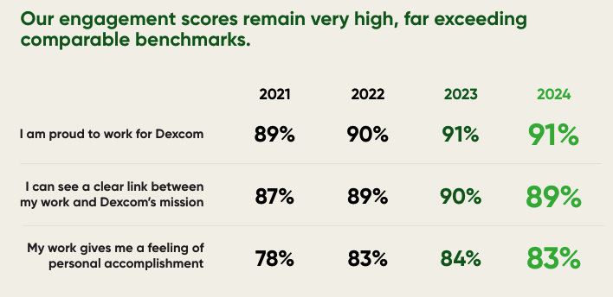
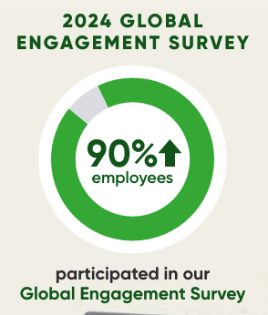
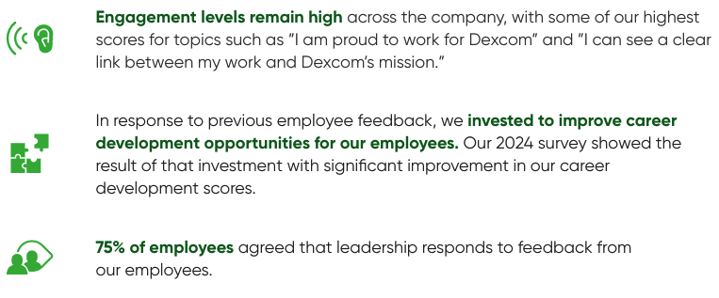
EMPLOYEE ENGAGEMENT
Source: Company, Dexcom Sustainability Report (April 2025)
Notes:
Right away – Focus on retention & relationship marketing
G7 Reliability
Streamline Onboarding
1 year –
Sustainability pilot for sensor waste
Focus in on Stelo (Specificity) - Platform economy: Open Dexcom API to enable third-party clinical tools; revenue-share model with impact validators; horizonal integration (Oura Ring)
3 year –
Dexcom for Low-Income US households + countries (partner with NGOs – UNDP) - change in payer
Use patient data to generate synthetic data to create a research marketplace (pharma)

