Slide 1






Channels
# pm-group-1 🚨
# yellow-learning-t…🚨
# innovator-project…
# mgt561-product-... 🚨
# hot-takes
# som-events
Skipping Class ⚠️
Direct Messages
Gai Sawant
Larissa Colores Maia
Abhishek Dudeja
Andrew Chang
Peter Yang
Slack
Intelligent Notifications
Urgent, Relevant, Automatic

Slide 2


Return to office mandates drive demand for innovative “Future of Work” solutions, prioritizing productivity and delightful customer experience
AC
Company
Future of Work
Salesforce is a cloud-based software company that provides a suite of tools for customer relationship management and that acquired Slack in 2021
Many companies embraced remote working during the pandemic
Slack customer base growth accelerated, playing a key role in enabling remote work
As many organizations face a return to office mandate or a shift to hybrid working models, Slack must adapt to ensure its success
Specifically, Slack can help bridge the gap between remote and in-person work environments by streamlining communications
As the future of work continues to evolve, tools like Slack will play a crucial role in enabling remote and hybrid work models, supporting collaboration, and enhancing overall productivity
Product
Slack is a communications platform designed for organizations, offering messaging, files sharing, integration with several tools and automation of workflows. Slack helps teams to be connected, and experienced significant growth with the increasing adoption of remorse working
Notes:
1/5 AC

Slide 3
Customer surveys & interviews unearthed key pain points – specifically, in searching for messages or clearing overloaded notifications – even for large, premium Slack users
AC
The Intelligent Notifications feature addresses key pain points that will be exacerbated by return to office shifts
Example Persona & Customer Journey
Search & Organisation Issues
Users struggle to find past messages, files, and announcements due to Slack’s limited search and cluttered threads
Notification Overload
A key pain point is lack of intelligent notification management, causing users to get overwhelmed and lose track of high priority messages
Persona:
Large company with premium plans and high customization needs, such as Cisco or Crowdstrike
Customer Journey:
The user struggles to stay on top of their Slack backlog due to notification overload.
They miss key messages, especially when they are in the office.
They waste time searching for specific information within cluttered Slack channels and threads.
These inefficiencies leads to decreased productivity and lower satisfaction with Slack.
We identified and validated this problem through extensive customer research
User Interviews and UGC analysis
Gathering insights from diverse user groups and UGC helped identify these insights
Real-Life Use Cases
People shared specific examples of their concerns with Slack right now, especially compared to other platforms
Notes:
2/5 AC

Slide 4
Our goal is to serve the Advanced user segment by delivering a feature that boosts their efficiency in responding to Slack messages while working in the office.
LM
TAM
Approximately 20M advanced users in the U.S. are on premium plans and are employed at large orgs
Opportunity Size
Largest opportunity size ($51M), higher than Intermediate and Basic User segments
Highest willingness to pay, largest revenue potential
Competition
The competition in Advanced User segment indicates it is an attractive market.
New features provide opportunities for differentiation and standing out.
Demand for Advanced Features
Advanced users have demand for advanced features, in areas including workflow, notification, integration, and automation.
Strategic Alignment
We aim to deliver a positive impact on user retention and monetization within our core segment, especially as business needs and workforce dynamics to evolve with RTO policies:
The feature helps prevent churn by keeping Slack essential to workplace communication
It can unlock a new stream of income by being offered as a paid add-on for existing clients who have implemented or are planning to implement RTO policies
Notes:
⅖ LM

Slide 5
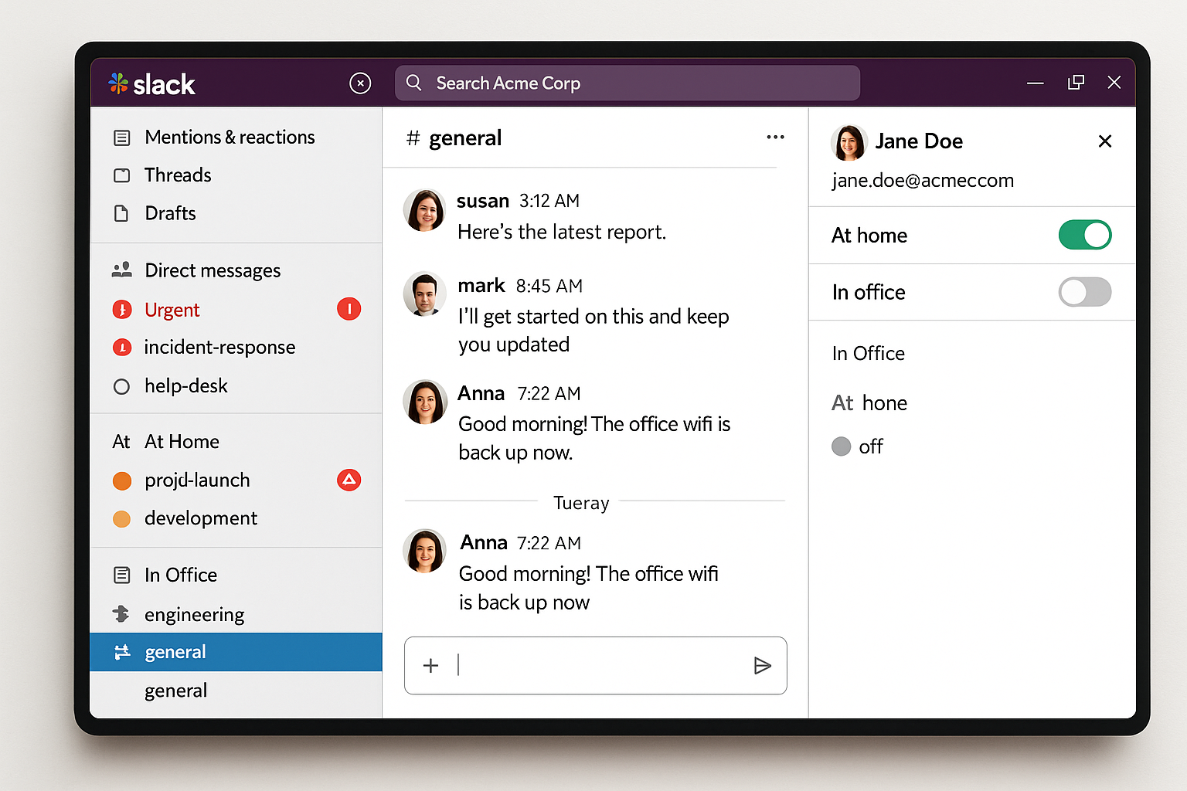
We selected requirements that deliver value to target users without introducing substantial development complexity
LM
MVP Mockup:
Must Have
Turn on an "in-the-office" status, initiating the feature prioritization process
Ability to turn off the feature (through menu or toggle)
Mechanism (algorithmic or manual) to define the "high priority" messages
Different UX for high priority messages: segregation via a different section on sidebar or color coding
Nice to Have (not in the MVP scope)
Set up automatic message to answer not prioritized messages
Custom rules to redirect high priority messages to reporting manager or team lead in the absence of the individual
The must-have requirements tackle the challenge of notification prioritization during in-office work without significantly increasing the complexity of MVP development
Notes:
⅗ LM

Slide 6
Solving Notification Overload for High-Value, Advanced Slack Users
General User
“There are too many Slack features.”
Easy to turn feature on-off as per need.
Hybrid Worker
“When I’m WFH, it’s harder to tell what’s urgent or being discussed in person. It’s also hard to track down my teammates.”
Context-aware prioritization surfaces important messages more clearly when WFH & highlights your messages in-turn.
Cross - Functional Collaborator
“I'm spread across many teams and channels. I often miss important updates because of volume, not intent.”
Flags high-priority messages using sender importance, channel history, and keywords; shows them in a dedicated sidebar.
Manager / Team Lead
“I need urgent messages escalated when a team member is OOO, without chasing them down.”
Auto-redirect rules and escalation options for high-priority messages when the recipient is unavailable
Notes:
3/5

Slide 7
How We’ll Measure Impact: Metrics, Signals, and their Importance
Category
Metric
Target/Threshold
Primary
⏱️ Median Message Read Latency
< 28.8 mins median latency
📩 Average Unread Notifications
< 11.9 unread messages at EOD
Secondary
👍 CSAT / Prioritization Feedback
≥60% positive feedback
⚠️ Complaint Rate
<25% increase in tickets from baseline
Guardrail
🔄 WFH Toggle Usage
<20% toggle use (min 1 day/week)
🚫 Opt-Out Rate
>30% opt-out
📉 Message Volume Drop
>10% volume drop per User
Aligned with Activation and Retention stages of Slack’s AAARR funnel
Focused on responsiveness, satisfaction, and engagement
Designed for hybrid & RTO users, critical to Slack’s future growth
Support Slack’s OKRs: Improved productivity & user satisfaction
Notes:
⅘ - GS

Slide 8




Evaluation Framework: Hypotheses for Feature Adoption, Impact, and User Response
Outcome
Success Criteria
Message Responsiveness
H1: >10% faster median message-read latency vs control
H0: ≤10% improvement
Notification Overload
H1: >15% reduction in unread messages after 24 hrs
H0: ≤15% decrease or no significant change
User Sentiment
H1: No increase or net decrease in complaints/support tickets
H0: ≥10% increase
Feature Adoption
H1: ≥30% of test users opt in & engage weekly
H0: <30% opt-in or irregular use
Notes:
⅘ - GS

Slide 9


Experiment Setup: Testing Notification Features with Power Users
AD
A/B Testing
Salesforce employees who match our “advanced” Slack user persona (in a large number of channels or receive a high volume of messages daily, and who have a mix of WFH and in-office days)
Control Group (500 users): Continue using the standard Slack app
Treatment Group (500 users): Use Slack with the new Intelligent Notification system installed
Randomize at user level, minimize selection bias
Each group has similar distribution of message volume, roles, and work patterns, and falls in the median range of advanced users
Risks
Initial usage may not be reflective of long term adoption i.e novelty effect
To reduce biases, overlap with other beta testing efforts and dogfooding must be minimised for the group in consideration
External events such as quarterly planning, critical incidents, or company-wide reorgs can lead to misleading observations owing to a change in notification flow
Notes:
5/5

