Slide 1
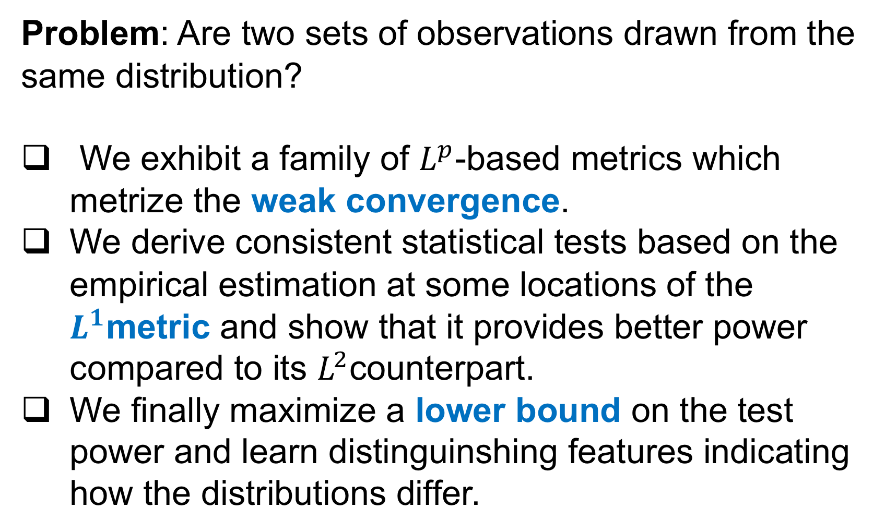
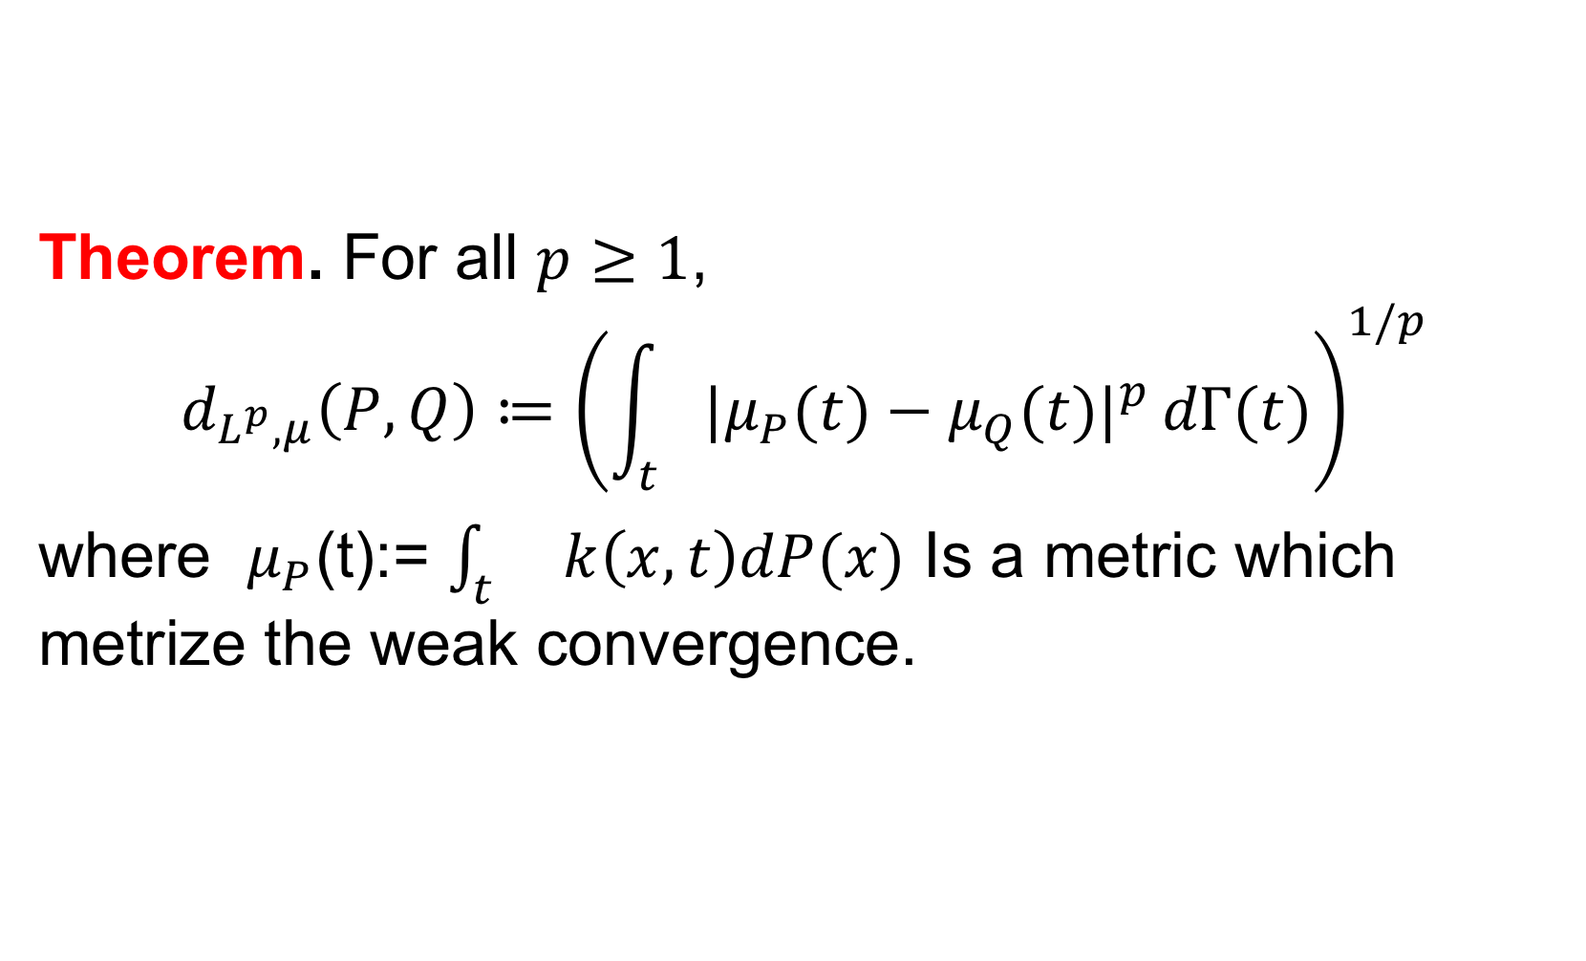

Comparing distributions: $ℓ_{1}$geometry improves kernel two-sample testing Meyer Scetbon, Gaël Varoquaux Inria, Université Paris-Saclay
Overview
ME and SCF tests
Lower Bound
Test Power vs. dimension
Problem: Are two sets of observations drawn from the same distribution?
We exhibit a family of $L^{p}$-based metrics which metrize the weak convergence.
We derive consistent statistical tests based on the empirical estimation at some locations of the $L^{1}$metric and show that it provides better power compared to its $L^{2}$counterpart.
We finally maximize a lower bound on the test power and learn distinguinshing features indicating how the distributions differ.
Samples
Weak Convergence
Why$ℓ_{1}≫ℓ_{2} ?$
Test Power vs. Sample Size
Higgs dataset
Theorem. For all $p≥1$,
$$d_{L^{p},μ}\left(P,Q\right)≔{\left(\int_{t}{{|μ}_{P}(t)−μ_{Q}(t)|^{p}}dΓ(t)\right)}^{1/p}$$
where $μ_{P}$(t):= $\int_{t}{ }k\left(x,t\right)dP(x)$ Is a metric which metrize the weak convergence.

