Slide 1
Canine Skeleton/Mesh Reconstruction
CSr/CMR

Slide 2
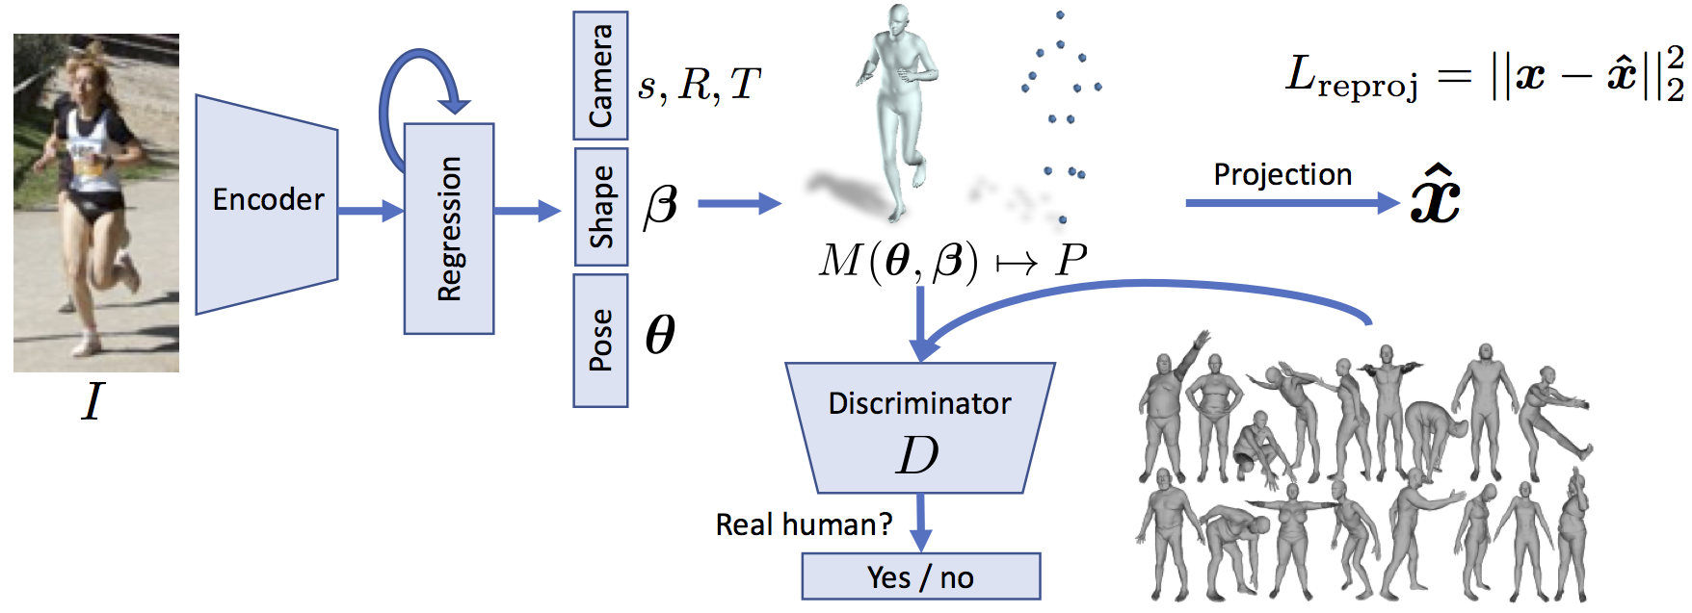
Our work is based upon the human mesh recovery (HMR) framework by Kanazawa et al.

Slide 3
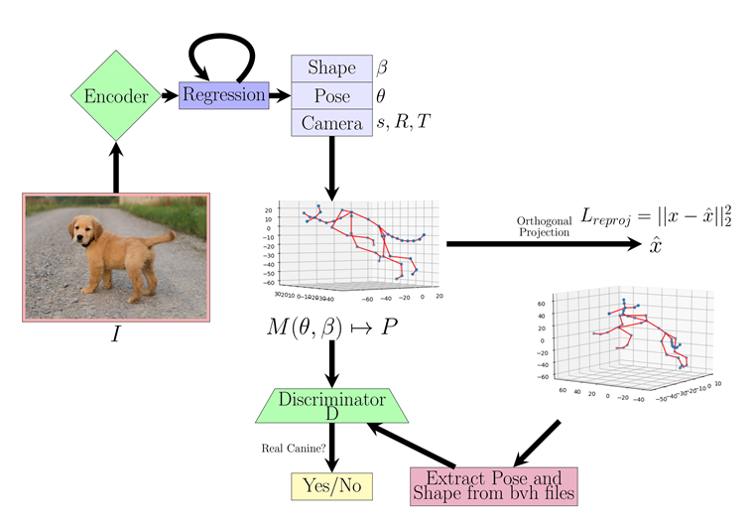
Our framework differs slightly from that of HMR.
We use joint offsets and angles for the shape and pose respectively.
Our main issue concerns the fact that unlike with HMR, there are, in effect, no sufficent 2D joint datasets for animals let alone canines.
As a result we have created such a dataset.
Unlike HMR, we also lacked paired 3D joint coordinate data.
This is an issue we hope to correct in the future using synthetic data.

Slide 4
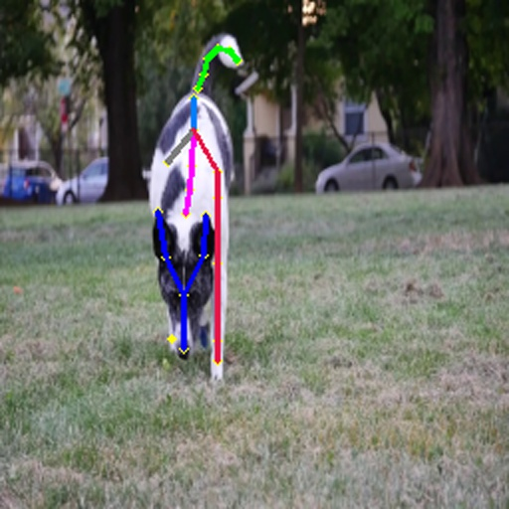
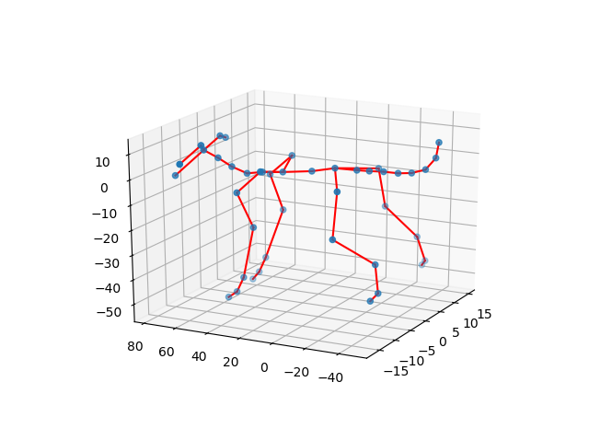
An example image with plotted 2D joint coordinates can be seen in the images to the left.
This dataset was generated via DeepLabCut.
The image to the right is an example from our synthetic Shape and Pose datasets.
This was created via manually editing bvh files.

Slide 5
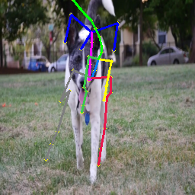
An example of our 3D joint coordinates form the bvh files can be seen plotted on the 2D images.
Note – These coordinates and the image are not paired leading to a mismatch.

