Slide 1
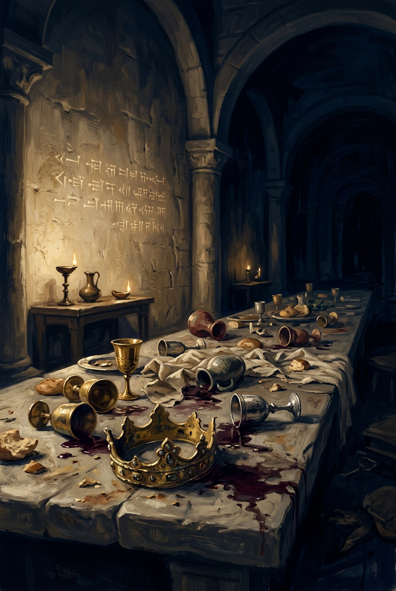
SILENCED SAINTS
PREACH THE FORGOTTEN · SERMON KIT 3
The Weightless
King
Belshazzar
Daniel 5:1–31
A SERMON FOR THE PULPIT · 55–60 MINUTES
FIRST EDITION · OCTOBER 2026

Slide 2
01 · THE BIG IDEA
DANIEL 5:1–31
A king held the vessels of God.
The God who held his breath
wrote the sentence.
The room was full of gold. The scale was empty.
PREACH THE FORGOTTEN · SERMON KIT 3
02 / 12

Slide 3
02 · THE FEAST
DANIEL 5:1–4
A party with God’s cups.
I
II
III
IV
The king
The lords
The vessels
The gods
A host with
something to prove.
A thousand witnesses.
No one tells the truth.
Holy cups
turned to barware.
Gold, silver, wood.
They cannot see.
A vessel carries the treasure.
A trophy displays the owner.
The sacred became decoration.
PREACH THE FORGOTTEN · SERMON KIT 3
03 / 12

Slide 4
03 · THE HAND
DANIEL 5:5–6
The room went silent.
I
II
III
DANIEL 5:5
DANIEL 5:5
DANIEL 5:6
A human hand.
No warning.
Opposite
the lampstand.
His color
drained.
The God who is spirit writes with fingers.
In the light, where no one could miss it.
The king’s body preached the truth.
The room that owned the night
could not hold its king upright.
PREACH THE FORGOTTEN · SERMON KIT 3
04 / 12

Slide 5
04 · THE VERDICT
DANIEL 5:27
The scale no gold could tip.
TEKEL
The king had a thousand lords, the temple’s gold, and a title. On God’s scale, none of it had weight. The verdict was not “try harder.” It was “found wanting.”
All the gold in the room had no weight on that scale.
weighed
and found wanting
The sentence was already written before the king knew his name was in it.
PREACH THE FORGOTTEN · SERMON KIT 3
05 / 12

Slide 6
05 · THE REFUSAL
DANIEL 5:17
The prophet would not be bought.
“Let your gifts be for yourself... Nevertheless, I will read the writing.”
He refused the reward, not the task.
The word of God is not a product. The prophet is not a performer.
DANIEL 5:17
THE KING
DANIEL
PURPLE
FREE
a price for the truth
nothing left to lose
“Let your gifts be for yourself.” — Daniel 5:17
PREACH THE FORGOTTEN · SERMON KIT 3
06 / 12

Slide 7
06 · THE NIGHT
DANIEL 5:30
That very night
the king was killed.
One verse for a funeral.
PREACH THE FORGOTTEN · SERMON KIT 3
07 / 12

Slide 8
07 · THE GOSPEL
COLOSSIANS 2:14
“This he set aside, nailing it to the cross.”
COLOSSIANS 2:14
The sentence we deserved fell on him.
The verdict was not canceled; it was carried.
The writing on the wall was a sentence. The writing on the cross is a pardon.
PREACH THE FORGOTTEN · SERMON KIT 3
08 / 12

Slide 9
08 · THE TRUE KING
2 CORINTHIANS 5:21
“For our sake he made him to be sin who knew no sin.”
2 CORINTHIANS 5:21
The King who had all weight became weightless for us.
In him, we are found.
The scale did not go away. It went to the cross.
PREACH THE FORGOTTEN · SERMON KIT 3
09 / 12

Slide 10
09 · THE RESPONSE
FOUR RESPONSES
What do you do with the weight?
01
02
Stop decorating
with the sacred.
Read the
handwriting.
The vessels were holy. The party was not. Do not use God’s things for your own glory.
You already have warnings, Scripture, and consequences. Do not wait for a hand on the wall.
03
04
Do not buy
the verdict.
Number
your days.
Purple and gold cannot purchase truth. Come empty-handed.
The party is not forever. Wisdom weighs the time it has.
The scale is not your neighbor’s life. It is the glory of God.
PREACH THE FORGOTTEN · SERMON KIT 3
10 / 12

Slide 11
10 · THE INVITATION
DANIEL 5:23
Come empty-handed.
Not clean up the party. Not buy the sentence. Come.
The writing on the wall was a sentence.
The writing on the cross is a pardon.
PREACH THE FORGOTTEN · SERMON KIT 3
11 / 12

Slide 12
SILENCED SAINTS · PREACH THE FORGOTTEN · SERMON KIT 3
The writing on the wall
was a sentence.
The writing on the cross is a pardon.
Do not spend your one life decorating the wrong table.
FIRST EDITION · OCTOBER 2026
12 / 12

