Slide 1
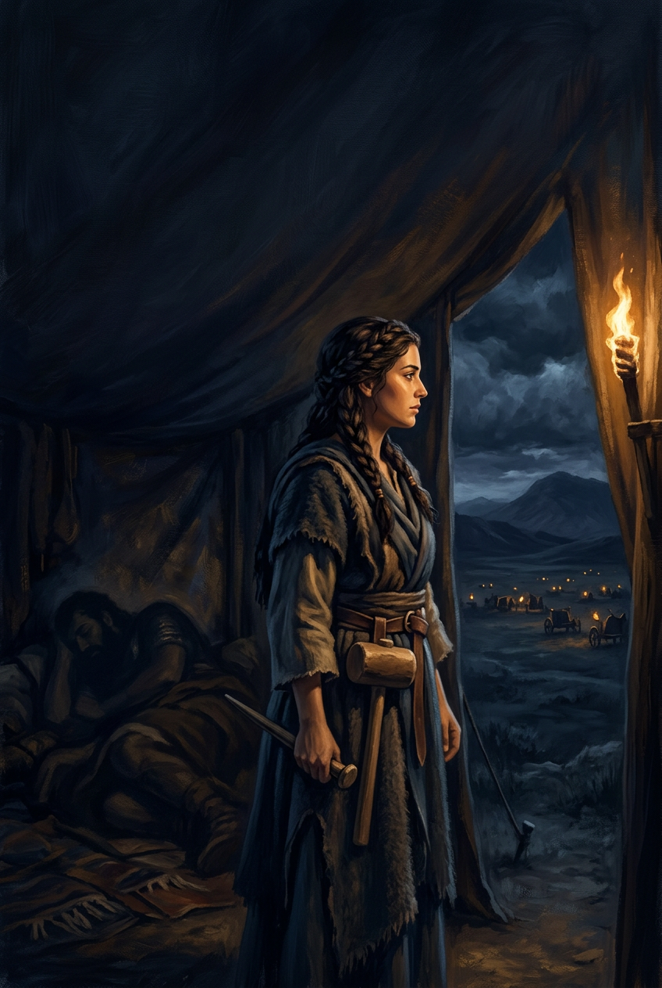
SILENCED SAINTS
PREACH THE FORGOTTEN · SERMON KIT 5
The Woman Who
Ended the War
Jael
Judges 4:1–24
A SERMON FOR THE PULPIT · 55–60 MINUTES
FIRST EDITION · OCTOBER 2026

Slide 2
01 · THE BIG IDEA
JUDGES 4:1–24
Jael drove a peg through the enemy.
Jesus took the nails for us.
The war is over.
God wins through the unlikely. The victory is His.
PREACH THE FORGOTTEN · SERMON KIT 5
02 / 12

Slide 3
02 · THE OPPRESSION
JUDGES 4:1–3
Twenty years under iron.
I
II
III
IV
The king
The general
The people
The cry
Jabin of Hazor.
A cruel reign.
Sisera.
Nine hundred chariots.
No chariots.
No hope.
They cried out.
The LORD heard.
The enemy was strong.
The LORD was stronger.
God heard the cry.
PREACH THE FORGOTTEN · SERMON KIT 5
03 / 12

Slide 4
03 · THE CALL
JUDGES 4:4–9
A prophetess, a general, a promise.
I
II
III
JUDGES 4:4–6
JUDGES 4:8
JUDGES 4:9
Deborah.
Prophetess.
Barak.
If you go…
The honor.
A woman.
She speaks for God.
Faith with fear.
God reverses the order.
The battle was already won.
The glory would go to the unlikely.
PREACH THE FORGOTTEN · SERMON KIT 5
04 / 12

Slide 5
04 · THE BATTLE
JUDGES 4:14–16
The LORD routed Sisera.
10,000
Deborah cried, “Up! For this is the day in which the LORD has given Sisera into your hand.” Barak went down from Tabor, and the LORD routed the army. The stars fought. The river swept. Not a man was left.
Does not the LORD go out before you?
Israelite troops
against 900 iron chariots
The victory was not Barak’s. It was the LORD’s.
PREACH THE FORGOTTEN · SERMON KIT 5
05 / 12

Slide 6
05 · THE OPEN DOOR
JUDGES 4:17–20
He ran to the wrong tent.
“Turn aside, my lord; turn aside to me; do not be afraid.”
A treaty of peace. A woman alone.
He asked for water. She gave him milk. He asked her to lie.
JUDGES 4:18
THE COVER
THE DOOR
RUG
NO
she covered him
the lie he asked for
He thought he had found shelter. He had walked into the hand of God.
PREACH THE FORGOTTEN · SERMON KIT 5
06 / 12

Slide 7
06 · THE PEG
JUDGES 4:21
The hammer fell.
The war ended.
A woman, a peg, and the God who wins through the unlikely.
PREACH THE FORGOTTEN · SERMON KIT 5
07 / 12

Slide 8
07 · THE SONG
JUDGES 5:24
“Most blessed of women be Jael, the wife of Heber the Kenite, of tent-dwelling women most blessed.”
JUDGES 5:24
An outsider held the hammer.
The LORD held the victory.
Blessed is the one who answers, not the one the world expects.
PREACH THE FORGOTTEN · SERMON KIT 5
08 / 12

Slide 9
08 · BLESSED AMONG WOMEN
LUKE 1:42
“Blessed are you among women, and blessed is the fruit of your womb!”
LUKE 1:42
Jael drove a peg into the enemy.
Jesus took the nails for his enemies.
One woman ended a war. One Son ended the war with God.
PREACH THE FORGOTTEN · SERMON KIT 5
09 / 12

Slide 10
09 · THE RESPONSE
FOUR RESPONSES
What do you do with the tent peg?
01
02
Do not wait
for the perfect moment.
Do not mistake
peace for passivity.
Act in the window God gives you. Obedience is often an interruption.
Comfort is not the same as faithfulness. False peace is still a cage.
03
04
Use what is
in your hand.
Give the victory
to God.
A peg, a hammer, a home, a story. Offer the ordinary to God.
The stars fought. The river swept. The LORD won. Let Him have the glory.
The LORD does not need a chariot. He needs a willing hand.
PREACH THE FORGOTTEN · SERMON KIT 5
10 / 12

Slide 11
10 · THE INVITATION
JUDGES 4:23–24
The war is over.
Not because you are strong. Because he is.
Jael’s peg ended one war.
Jesus’ cross ended the war that mattered.
PREACH THE FORGOTTEN · SERMON KIT 5
11 / 12

Slide 12
SILENCED SAINTS · PREACH THE FORGOTTEN · SERMON KIT 5
The tent peg
ended a war.
The nails ended the enmity.
The sun has risen. The door is open. Go in peace.
FIRST EDITION · OCTOBER 2026
12 / 12

