Slide 1
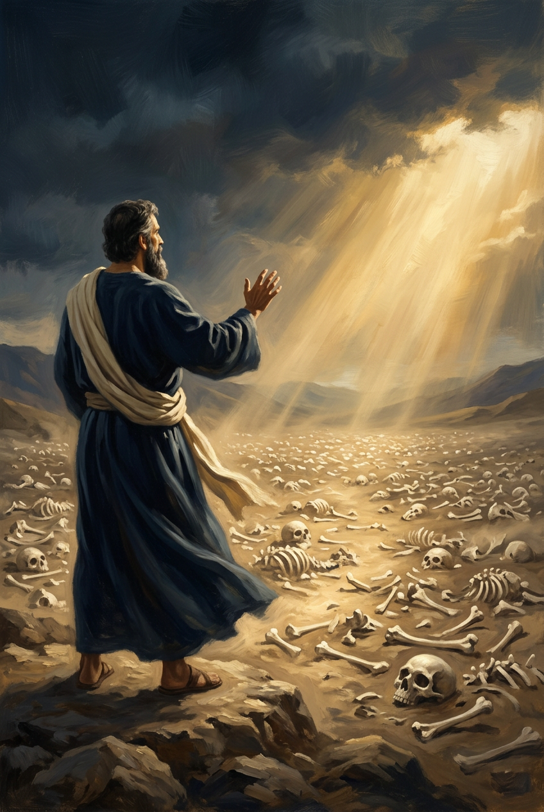
SILENCED SAINTS
PREACH THE FORGOTTEN · SERMON KIT 8
The Valley
Breathes
Ezekiel
Ezekiel 37:1–14
A SERMON FOR THE PULPIT · 55–60 MINUTES
FIRST EDITION · OCTOBER 2026

Slide 2
01 · THE BIG IDEA
EZEKIEL 37:1–14
A valley of dry bones.
A prophet with a word.
A God who breathes.
The bones do not try. God speaks, and the dead live.
PREACH THE FORGOTTEN · SERMON KIT 8
02 / 12

Slide 3
02 · THE VALLEY
EZEKIEL 37:1–2
The ground was covered with bones.
I
II
III
IV
The valley
The bones
The number
The dryness
Open.
Nothing hidden.
Scattered.
On the surface.
Very many.
A nation-sized death.
Very dry.
No life left.
No mourners. No names.
Only bones, and a question.
A battlefield without an army.
PREACH THE FORGOTTEN · SERMON KIT 8
03 / 12

Slide 4
03 · THE QUESTION
EZEKIEL 37:3
Can these bones live?
I
II
III
THE OPTIMIST
THE PESSIMIST
THE PROPHET
We can fix it.
It is over.
You know.
The answer in our hands.
The sentence in our hands.
The answer in God’s hands.
The question is a mirror.
Faith hands God the impossible.
PREACH THE FORGOTTEN · SERMON KIT 8
04 / 12

Slide 5
04 · THE WORD
EZEKIEL 37:4–6
God speaks to what cannot hear.
I WILL
The prophet supplies the voice, not the life. Bone comes to bone, sinew to sinew, flesh to flesh, skin to skin. Then the valley goes quiet: the body is assembled, but there is no breath.
“O dry bones, hear the word of the LORD.”
the subject of life
The dead live because He speaks.
The word builds a body. Only the Spirit gives breath.
PREACH THE FORGOTTEN · SERMON KIT 8
05 / 12

Slide 6
05 · THE PAUSE
EZEKIEL 37:8
Is an assembled body alive?
“We have the structure. Isn’t that enough?”
The bones came together. There was no breath in them.
Organization is not resurrection.
THE OBJECTION
THE BODY
THE SPIRIT
FORMED
BREATH
and still dead
and life
Do not settle for bones in order.
PREACH THE FORGOTTEN · SERMON KIT 8
06 / 12

Slide 7
06 · THE SPIRIT
EZEKIEL 37:9–10
The wind is not ours.
The dead are raised.
The Spirit turns a graveyard into an army.
PREACH THE FORGOTTEN · SERMON KIT 8
07 / 12

Slide 8
07 · THE PROMISE
EZEKIEL 37:14
“I will put my Spirit within you, and you shall live, and I will place you in your own land.”
EZEKIEL 37:14
A new heart.
A living people.
The graves open because God keeps His word.
PREACH THE FORGOTTEN · SERMON KIT 8
08 / 12

Slide 9
08 · THE GREATER RESURRECTION
EPHESIANS 2:4–5
“Even when we were dead in our trespasses, God made us alive together with Christ.”
EPHESIANS 2:4–5
Jesus entered the grave.
He walked out alive.
The empty tomb is the guarantee.
PREACH THE FORGOTTEN · SERMON KIT 8
09 / 12

Slide 10
09 · THE RESPONSE
FOUR RESPONSES
What do you do in the valley?
01
02
Tell God
the truth.
Stop saving
yourself.
Lament is faith speaking from the ash heap.
Dead bones cannot raise the dead.
03
04
Speak the word.
Pray for the wind.
Do not settle
for a corpse.
Word and Spirit. Do both.
Order without life is a coffin.
Grace first. Then obedience.
PREACH THE FORGOTTEN · SERMON KIT 8
10 / 12

Slide 11
10 · THE INVITATION
JOHN 11:25
The valley is real.
God entered it.
Come to the living Lord.
He is your life.
PREACH THE FORGOTTEN · SERMON KIT 8
11 / 12

Slide 12
SILENCED SAINTS · PREACH THE FORGOTTEN · SERMON KIT 8
The tomb is empty.
The valley breathes.
Can these bones live? Look at the empty tomb.
Go and speak to the bones.
FIRST EDITION · OCTOBER 2026
12 / 12

