Slide 1
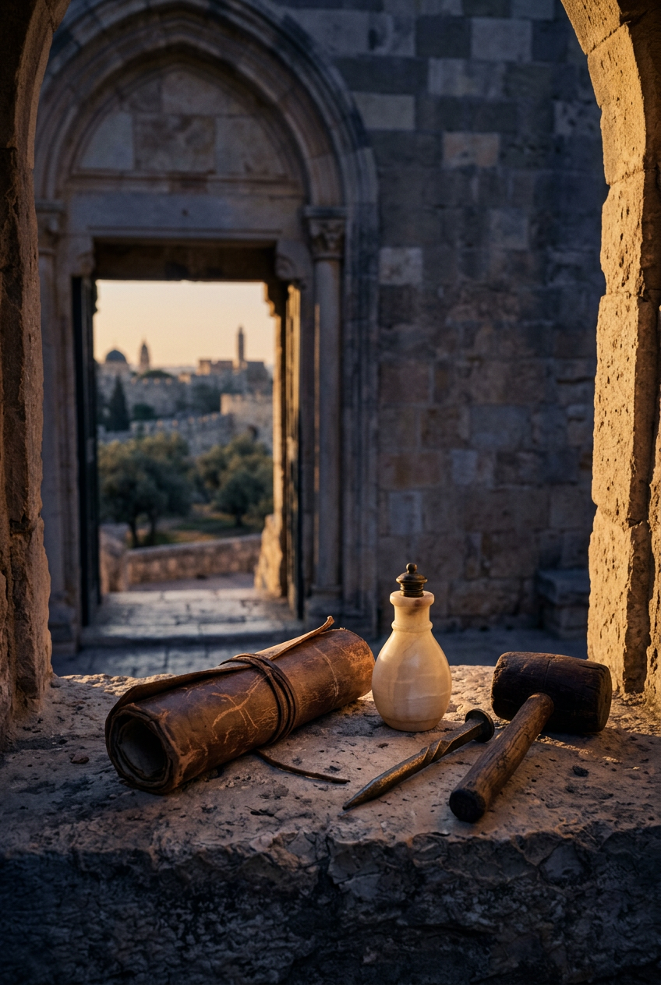
SILENCED SAINTS
PREACH THE FORGOTTEN · SERMON KIT 1
What the Room
Called Waste
Mary of Bethany
John 12:1–8
A SERMON FOR THE PULPIT · 55–60 MINUTES
FIRST EDITION · OCTOBER 2026

Slide 2
01 · THE BIG IDEA
JOHN 12:1–8
Love that has understood the cross
stops calculating
what devotion is worth.
The cross is where the question “What is Jesus worth?” gets its answer.
PREACH THE FORGOTTEN · SERMON KIT 1
02 / 12

Slide 3
02 · THE ROOM
SIX DAYS BEFORE PASSOVER
The room was full of evidence.
I
II
III
IV
Simon
Lazarus
Martha
Jesus
Known as a leper.
He hosted the table.
Four days dead.
Then eating dinner.
Serving the brother
Jesus raised.
The wanted man
who came anyway.
The room was full of evidence.
And the room was about to call love a waste.
Evidence is not the same thing as faith.
PREACH THE FORGOTTEN · SERMON KIT 1
03 / 12

Slide 4
03 · THE DISCIPLE
THREE SCENES AT HIS FEET
She had been listening.
I
II
III
LUKE 10
JOHN 11
JOHN 12
She sat
at his feet.
She wept
at his feet.
She anointed
at his feet.
She chose the good portion.
Jesus wept with her.
The room called it waste.
The room was waiting for a crown.
Mary had been listening to a burial.
PREACH THE FORGOTTEN · SERMON KIT 1
04 / 12

Slide 5
04 · THE JAR
JOHN 12:3–5
The jar that could not be saved.
300
A sealed flask could have been opened slowly — a little now, the rest saved for later. Mary broke it. It could not be resealed. The whole year went out at once.
She is not giving him a portion. She is giving him the container.
denarii
roughly a year’s wages
The whole body. The whole jar. The whole year.
PREACH THE FORGOTTEN · SERMON KIT 1
05 / 12

Slide 6
05 · THE OBJECTION
JOHN 12:4–6
The math in the room.
“Why was this ointment not sold for three hundred denarii and given to the poor?”
It is a good question. That is what makes it dangerous.
The most dangerous objections sound reasonable, moral, even spiritual.
JOHN 12:5
MARY’S JAR
JUDAS’ PRICE
300
30
denarii · a year’s wages
pieces of silver · a slave’s price
Jesus is not dismissing the poor. He quotes Deuteronomy 15:11 — the verse that commands generosity — and answers the math.
PREACH THE FORGOTTEN · SERMON KIT 1
06 / 12

Slide 7
06 · THE VERDICT
MARK 14:6
The room called it waste.
Jesus called it beautiful.
Same act. Two judgments. One of them is true.
PREACH THE FORGOTTEN · SERMON KIT 1
07 / 12

Slide 8
07 · THE BURIAL
THE PASSOVER LAMB
She prepared him for a funeral.
“She has anointed my body beforehand for burial.”
MARK 14:8
The room awaited a crown. Mary prepared a burial.
The cross is love without calculation.
The passion begins at a dinner table.
PREACH THE FORGOTTEN · SERMON KIT 1
08 / 12

Slide 9
08 · THE GOSPEL
MATTHEW 28:6
He is not here; he has risen.
The tomb was empty. The burial was not the end.
He did not come for the room that got it right.
He came for the room that got it wrong.
PREACH THE FORGOTTEN · SERMON KIT 1
09 / 12

Slide 10
09 · THE RESPONSE
FOUR RESPONSES
What do you do with the jar?
01
02
Name the jar.
Do one uncalculated act.
Say it plainly to God. You cannot break what you will not name.
One thing this week that only makes sense if Jesus is who he says he is.
03
04
Stop auditing
someone else’s devotion.
Make room for grief.
You are not the auditor of another person’s love.
Jesus wept. There is room at his feet for your tears.
You cannot manufacture this kind of love.
PREACH THE FORGOTTEN · SERMON KIT 1
10 / 12

Slide 11
10 · THE INVITATION
JOHN 12:1–8
Come closer.
Not try harder. Not be more generous. Come closer to the one who did not calculate.
You can come back. You can open your hands.
You can let him answer for you. You can stay.
PREACH THE FORGOTTEN · SERMON KIT 1
11 / 12

Slide 12
SILENCED SAINTS · PREACH THE FORGOTTEN · SERMON KIT 1
She broke the jar.
He emptied the tomb.
And he made sure she would never be forgotten.
Wherever the gospel is preached, she is still here. May the same be said of us.
FIRST EDITION · OCTOBER 2026
12 / 12

