Slide 1
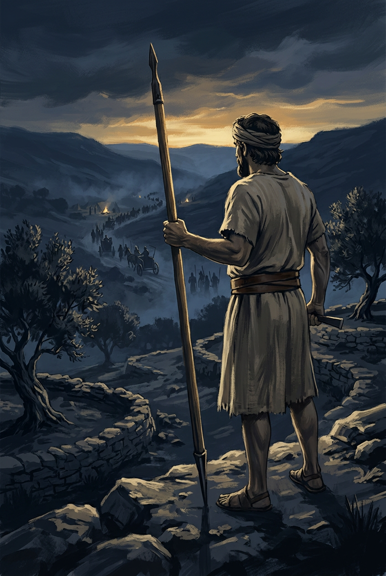
SILENCED SAINTS
PREACH THE FORGOTTEN · SERMON KIT 6
The One-Verse
Deliverer
Shamgar
Judges 3:31
A SERMON FOR THE PULPIT · 55–60 MINUTES
FIRST EDITION · OCTOBER 2026

Slide 2
01 · THE BIG IDEA
JUDGES 3:31
One verse.
One goad.
One nation saved.
The size of your mention is not the size of your work.
PREACH THE FORGOTTEN · SERMON KIT 6
02 / 12

Slide 3
02 · THE WORLD
JUDGES 5:6–8
The roads went quiet.
I
II
III
IV
The highways
The villages
The weapons
The cry
Abandoned.
No one travels.
Ceased.
Life pulled inward.
None.
No shield or spear.
Heard.
The LORD raises up.
A nation disarmed.
A God who sees.
Iron held the roads.
PREACH THE FORGOTTEN · SERMON KIT 6
03 / 12

Slide 4
03 · THE MAN
JUDGES 3:31
A name from the edge.
I
II
III
JUDGES 3:31
JUDGES 3:31
JUDGES 3:31
Shamgar.
A name.
Son of Anath.
The father.
After Ehud.
The era.
Meaning uncertain.
A name at the border.
One deliverer follows another.
No call scene.
No speech. Just a field.
PREACH THE FORGOTTEN · SERMON KIT 6
04 / 12

Slide 5
04 · THE FIELD
JUDGES 3:31
Six hundred fell.
600
A farmer with an eight-foot pole met a trained column, and the column stopped coming. The text gives a summary, not a battle plan. The point is the disproportion.
He also saved Israel.
Philistines
with an oxgoad
One man. One tool. One deliverance.
PREACH THE FORGOTTEN · SERMON KIT 6
05 / 12

Slide 6
05 · THE OBJECTION
ONE VERSE
Is one sentence enough?
“One verse is not enough to build a story on.”
But the verse ends with the verdict every judge is measured by.
The record is short. The salvation is real.
THE OBJECTION
THE RECORD
THE VERDICT
ONE
SAVED
verse
a nation
The size of your mention is not the size of your work.
PREACH THE FORGOTTEN · SERMON KIT 6
06 / 12

Slide 7
06 · THE TOOL
JUDGES 3:31
An oxgoad in his hand.
The power of God in his work.
God uses the tool that is already in the hand of the faithful.
PREACH THE FORGOTTEN · SERMON KIT 6
07 / 12

Slide 8
07 · THE RECORD
JUDGES 3:31
“After him was Shamgar the son of Anath, who killed 600 of the Philistines with an oxgoad, and he also saved Israel.”
JUDGES 3:31
The record is short.
The salvation is real.
The canon counts verses. Heaven counts deliverance.
PREACH THE FORGOTTEN · SERMON KIT 6
08 / 12

Slide 9
08 · THE GREATER DELIVERER
PHILIPPIANS 2:9–11
“God has highly exalted him and bestowed on him the name that is above every name.”
PHILIPPIANS 2:9
Shamgar saved a nation and got one sentence.
Jesus saved the world and was given the Name.
The one-verse deliverer points to the Word made flesh.
PREACH THE FORGOTTEN · SERMON KIT 6
09 / 12

Slide 10
09 · THE RESPONSE
FOUR RESPONSES
What do you do with one verse?
01
02
Work the field
you were given.
Use the tool
in your hand.
The field is the platform. Serve where God has placed you.
A skill, a story, a home, a prayer. Offer the ordinary to God.
03
04
Refuse the comparison
of mentions.
Trust the God
who sees it all.
The size of your mention is not the size of your work.
He sees in secret. His ledger lasts.
One verse is enough when it is held by the God of the whole book.
PREACH THE FORGOTTEN · SERMON KIT 6
10 / 12

Slide 11
10 · THE INVITATION
JUDGES 3:31
He also saved Israel.
The Savior still saves.
Not with a sword.
With a cross.
PREACH THE FORGOTTEN · SERMON KIT 6
11 / 12

Slide 12
SILENCED SAINTS · PREACH THE FORGOTTEN · SERMON KIT 6
One sentence.
One Savior.
The record is short. The salvation is full.
Go and work the field He has given you.
FIRST EDITION · OCTOBER 2026
12 / 12

