Slide 1
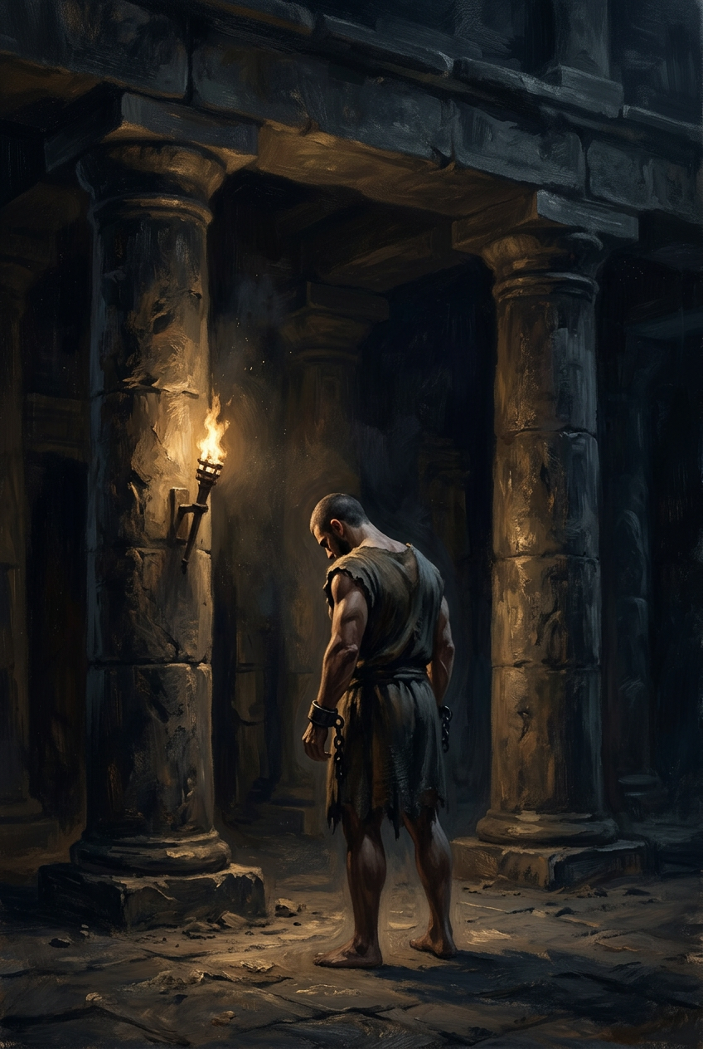
SILENCED SAINTS
PREACH THE FORGOTTEN · SERMON KIT 4
The Man Who
Pulled Down
the House
Samson
Judges 16:4–31
A SERMON FOR THE PULPIT · 55–60 MINUTES
FIRST EDITION · OCTOBER 2026

Slide 2
01 · THE BIG IDEA
JUDGES 16:4–31
Samson pulled down the house
and died in the rubble.
Jesus rose from his.
Strength was never the point. The source was.
PREACH THE FORGOTTEN · SERMON KIT 4
02 / 12

Slide 3
02 · THE GIFT
JUDGES 13–15
Set apart before he was born.
I
II
III
IV
The calling
The sign
The source
The pattern
Nazirite from
the womb.
Uncut hair.
A visible vow.
The Spirit
of the LORD.
Right in
his own eyes.
The gift was real.
The Giver was forgotten.
The sign is not the source.
PREACH THE FORGOTTEN · SERMON KIT 4
03 / 12

Slide 4
03 · THE SECRET
JUDGES 16:4–17
Three lies and one truth.
I
II
III
JUDGES 16:7
JUDGES 16:11
JUDGES 16:17
Seven
bowstrings.
New
ropes.
All his
heart.
He snaps them like thread.
He breaks them like thread.
He tells her the secret.
He guarded the secret.
He forgot the Source.
PREACH THE FORGOTTEN · SERMON KIT 4
04 / 12

Slide 5
04 · THE PRICE
JUDGES 16:5
A secret with a price tag.
5,500
The Philistines did not want Samson dead. They wanted to know where his strength came from. The price was not for his head. It was for his secret.
They did not want his head. They wanted his secret.
pieces of silver
five lords · 1,100 each
The secret was never in his hair. It was in the LORD.
PREACH THE FORGOTTEN · SERMON KIT 4
05 / 12

Slide 6
05 · THE NIGHT
JUDGES 16:20
He did not know.
“I will go out as at other times and shake myself free.” But he did not know that the LORD had left him.
The old motions. The old assumption.
He reached for the strength and found only his own arm. The source had gone.
JUDGES 16:20
THE SIGN
THE SOURCE
HAIR
LORD
cut in the dark
gone before he knew
The most dangerous sentence in the story: “as at other times.”
PREACH THE FORGOTTEN · SERMON KIT 4
06 / 12

Slide 7
06 · THE COLLAPSE
JUDGES 16:30
The temple fell.
So did he.
He killed more in his death than in his life. It is a body count, not a trophy.
PREACH THE FORGOTTEN · SERMON KIT 4
07 / 12

Slide 8
07 · THE GOSPEL
JOHN 2:19–22
“Destroy this temple, and in three days I will raise it up.”
JOHN 2:19–22
Samson pulled down the house and died.
Jesus let his body be pulled down and rose.
Samson is what we are. Jesus is what we need.
PREACH THE FORGOTTEN · SERMON KIT 4
08 / 12

Slide 9
08 · THE TRUE TEMPLE
2 CORINTHIANS 12:9
“My grace is sufficient for you, for my power is made perfect in weakness.”
2 CORINTHIANS 12:9
The gospel does not recruit heroes.
It raises the dead.
The strongest man died blind. The Son of God went into the dark and came out alive.
PREACH THE FORGOTTEN · SERMON KIT 4
09 / 12

Slide 10
09 · THE RESPONSE
FOUR RESPONSES
What do you do with the strength?
01
02
Name the gift,
not the muscle.
Do not confuse
the sign.
The Spirit was the source. Your strength is a gift to steward, not a self to worship.
Ministry, knowledge, and reputation are good. They are not the source.
03
04
Tell the truth
about your eyes.
Pray the
small prayer.
You cannot see your own blind spots alone. Let someone close tell you the truth.
“Remember me” is enough. The thief on the cross prayed it too.
The sign is not the source. The routine is not the relationship.
PREACH THE FORGOTTEN · SERMON KIT 4
10 / 12

Slide 11
10 · THE INVITATION
JUDGES 16:28
Come out of the dark.
Not stronger. Not cleaner. Not with a plan. Just honest.
Samson died in the dark.
Jesus rose in the light.
PREACH THE FORGOTTEN · SERMON KIT 4
11 / 12

Slide 12
SILENCED SAINTS · PREACH THE FORGOTTEN · SERMON KIT 4
The strongest man
died in the dark.
The Son of God went in for him.
He came out alive. He is still calling people out of the dark.
FIRST EDITION · OCTOBER 2026
12 / 12

