Slide 1
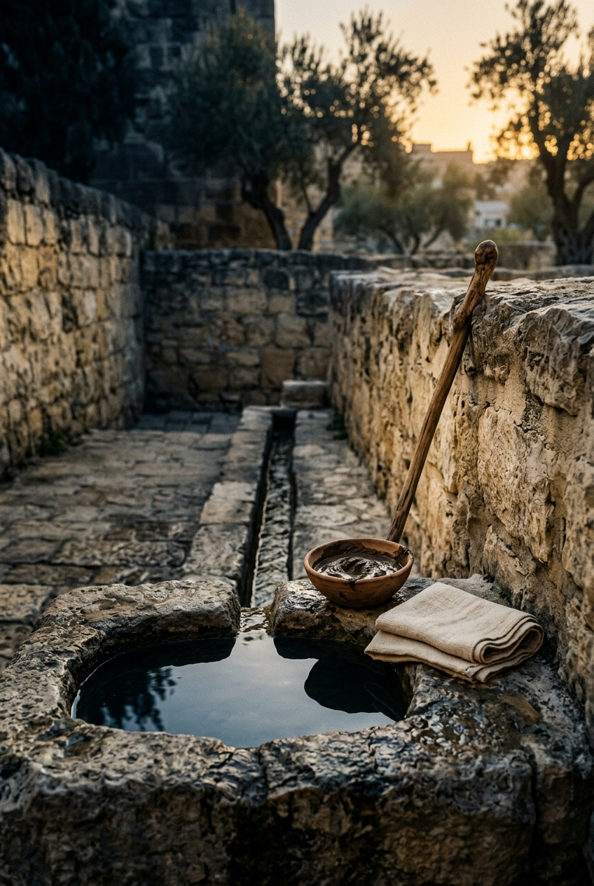
SILENCED SAINTS
PREACH THE FORGOTTEN · SERMON KIT 2
The Man Who
Never Asked
The Man Born Blind
John 9:1–41
A SERMON FOR THE PULPIT · 55–60 MINUTES
FIRST EDITION · OCTOBER 2026

Slide 2
01 · THE BIG IDEA
JOHN 9:1–41
The light comes to the man
who never asked, and goes
looking after him.
The light of the world walked toward a man who had no idea he was waiting for it.
PREACH THE FORGOTTEN · SERMON KIT 2
02 / 12

Slide 3
02 · THE STREET
JOHN 9:1–2
A case file with a heartbeat.
I
II
III
IV
The disciples
The man
The room
Jesus
Whose fault is it?
They want an equation.
Born blind.
Nobody asks him anything.
Watching.
Already deciding.
He sees a man,
not a problem.
The disciples saw a theological problem.
Jesus saw a man.
Grace arrives before the ask.
PREACH THE FORGOTTEN · SERMON KIT 2
03 / 12

Slide 4
03 · THE MAKING
JOHN 9:6–7
He went. He washed. He came back seeing.
I
II
III
JOHN 9:6
JOHN 9:7
JOHN 9:7
Mud
and dust.
The pool
called Sent.
He washed
and saw.
The Creator uses dirt again.
He walks in the dark by trust.
The light is not a theory.
He obeyed before he understood.
That is what faith looks like in the dark.
PREACH THE FORGOTTEN · SERMON KIT 2
04 / 12

Slide 5
04 · THE POOL
JOHN 9:6–7
The pool that is still there.
SENT
He could not see the water or the path. He went because the man who made mud told him to. The pool is real — the tunnel, the inscription, the 2004 discovery. The miracle is still a claim you must trust.
He walked to the pool in the dark. He came back in the light.
Siloam
the name means Sent
The evidence is real. It is not the same thing as faith.
PREACH THE FORGOTTEN · SERMON KIT 2
05 / 12

Slide 6
05 · THE INTERROGATION
JOHN 9:24–34
The room wants a better answer.
“Give glory to God. We know that this man is a sinner.”
They have a doctrine of the man. They do not have his eyes.
The parents go quiet. The neighbors disagree. The man keeps telling the truth.
JOHN 9:24
THE MAN
THE ROOM
ONE
NONE
thing he knows
answers that satisfy
“Whether he is a sinner I do not know. One thing I know: I was blind, now I see.” — John 9:25
PREACH THE FORGOTTEN · SERMON KIT 2
06 / 12

Slide 7
06 · THE VERDICT
JOHN 9:34
The room cast him out.
Jesus came looking.
Same man. Two verdicts. One of them is true.
PREACH THE FORGOTTEN · SERMON KIT 2
07 / 12

Slide 8
07 · THE FINDING
JOHN 9:35–38
“Do you believe in the Son of Man?”
JOHN 9:35
The first face he saw was the face of the one who healed him.
“Lord, I believe.” Worship in the street.
Thrown out of the house of God, he worships the Son of God in the street.
PREACH THE FORGOTTEN · SERMON KIT 2
08 / 12

Slide 9
08 · THE GOSPEL
JOHN 9:39–41
“I came into this world for judgment.”
JOHN 9:39
He did not come for the people who got it right.
He came for the people who found out they were blind.
The warning at the end of the chapter is for the church too.
PREACH THE FORGOTTEN · SERMON KIT 2
09 / 12

Slide 10
09 · THE RESPONSE
FOUR RESPONSES
What do you do with the light?
01
02
Stop writing
the case file.
Say what
you know.
“Whose fault is it?” is not the first question. Look at the person in front of you.
You do not need every answer. Tell the truth about your own eyes.
03
04
Go looking for
the cast-out.
Worship before
you see it all.
Someone near you was shown the door. Jesus is already outside.
The man believed with a partial Christology and a whole heart.
The light is not a theory. It is a person.
PREACH THE FORGOTTEN · SERMON KIT 2
10 / 12

Slide 11
10 · THE INVITATION
JOHN 9:5
Come while it is day.
Not try harder. Not see better. Come to the light.
You can tell him what you do not know.
You can say what you do know. You can come.
PREACH THE FORGOTTEN · SERMON KIT 2
11 / 12

Slide 12
SILENCED SAINTS · PREACH THE FORGOTTEN · SERMON KIT 2
They threw him out.
Jesus went looking.
And the man who never asked became a witness.
The light is still walking toward people who have not asked.
FIRST EDITION · OCTOBER 2026
12 / 12

