Slide 1
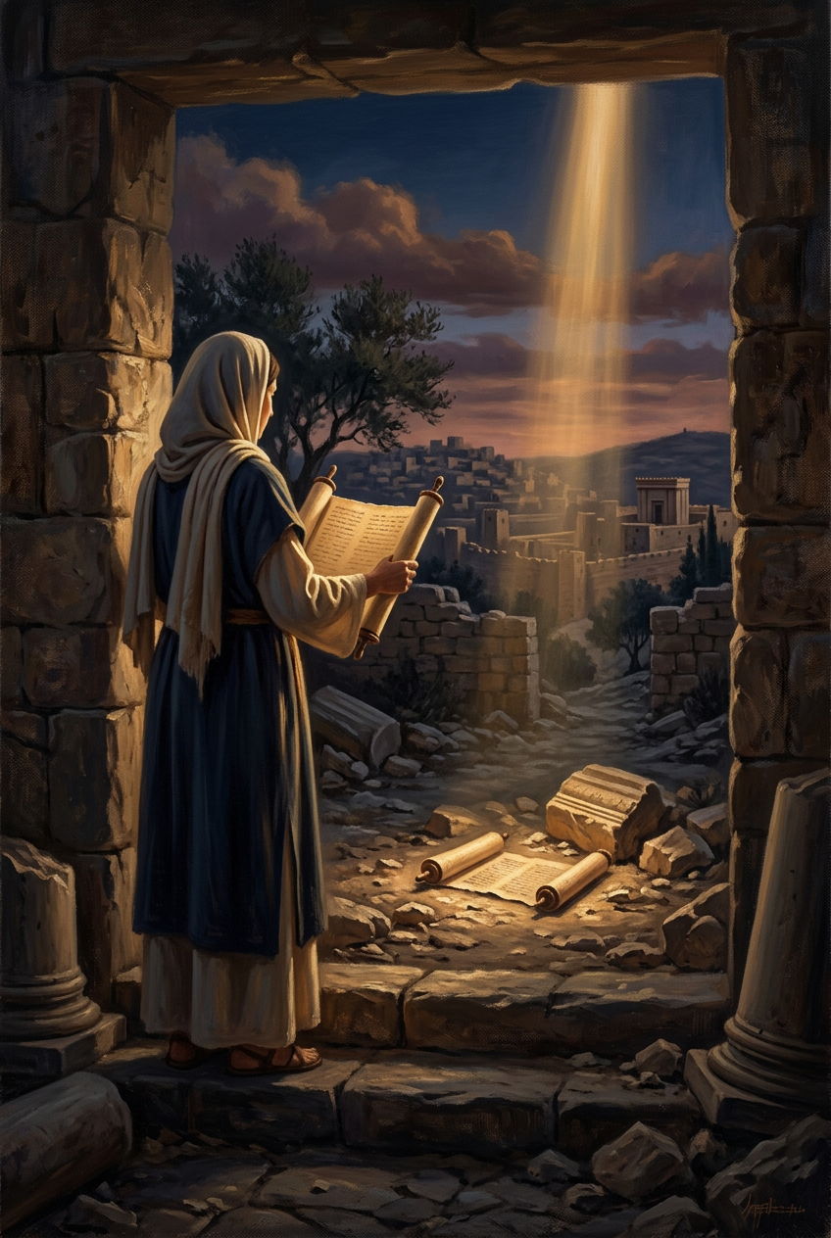
SILENCED SAINTS
PREACH THE FORGOTTEN · SERMON KIT 7
The Book in
the Rubble
Huldah
2 Kings 22:14–20
A SERMON FOR THE PULPIT · 55–60 MINUTES
FIRST EDITION · OCTOBER 2026

Slide 2
01 · THE BIG IDEA
2 KINGS 22:14–20
A book in the rubble.
A king in tears.
A nation on notice.
The word that wounds is the word that heals.
PREACH THE FORGOTTEN · SERMON KIT 7
02 / 12

Slide 3
02 · THE FIND
2 KINGS 22:3–11
The house of the LORD had a book it had forgotten.
I
II
III
IV
The house
The book
The king
The word
Repaired.
The work goes on.
Found.
In the dust.
Humbled.
Clothes torn.
Read.
A nation on notice.
The book was in the house.
The word was not in the heart.
A routine repair became a national reckoning.
PREACH THE FORGOTTEN · SERMON KIT 7
03 / 12

Slide 4
03 · THE DELEGATION
2 KINGS 22:12–14
Who do you send for when the book finds you?
I
II
III
2 KINGS 22:12
2 KINGS 22:12
2 KINGS 22:14
Hilkiah.
The high priest.
Shaphan.
The secretary.
Huldah.
The prophetess.
The keeper of the house.
The king’s pen.
The word of the LORD.
Five men. One woman.
God spoke through the unexpected.
PREACH THE FORGOTTEN · SERMON KIT 7
04 / 12

Slide 5
04 · THE PROPHETESS
2 KINGS 22:14
Five men went to the Second Quarter.
5
The high priest, the secretary, the king’s servant, and two senior officials walked across the city to a woman who spoke for God. The word was not in the palace or the temple. It was in the newer part of town.
“Tell the man who sent you to me.”
officials
to one prophetess
The messenger is tested by the message.
PREACH THE FORGOTTEN · SERMON KIT 7
05 / 12

Slide 6
05 · THE OBJECTION
2 KINGS 22:19
Is a tender heart enough?
“I have the book. Isn’t that enough?”
The book was in the house of the LORD, and the nation had forgotten it.
Hearing is not the same as obeying.
THE OBJECTION
THE BOOK
THE HEART
TRUE
TENDER
and read
and humbled
God hears the heart that trembles at His word.
PREACH THE FORGOTTEN · SERMON KIT 7
06 / 12

Slide 7
06 · THE WORD
2 KINGS 22:16–20
The judgment is certain.
The mercy is personal.
Huldah did not soften the first or universalize the second.
PREACH THE FORGOTTEN · SERMON KIT 7
07 / 12

Slide 8
07 · THE PROMISE
2 KINGS 22:19–20
“Because your heart was tender and you humbled yourself before the LORD… I also have heard you, declares the LORD.”
2 KINGS 22:19
A tender heart.
A heard prayer.
He was gathered before he saw the fall.
PREACH THE FORGOTTEN · SERMON KIT 7
08 / 12

Slide 9
08 · THE GREATER KING
GALATIANS 3:13
“Christ redeemed us from the curse of the law by becoming a curse for us.”
GALATIANS 3:13
Josiah reformed the nation.
Jesus took the curse.
The law could not save. The King could.
PREACH THE FORGOTTEN · SERMON KIT 7
09 / 12

Slide 10
09 · THE RESPONSE
FOUR RESPONSES
What do you do with a book that finds you?
01
02
Let the Word
wound you.
Bring your fear
to God.
The verdict comes before the comfort.
Go where the word is spoken.
03
04
Do not despise
the messenger.
Do the reform
He asks.
Test the message by the book.
Grace first. Then obedience.
The reform is not the savior. The King is.
PREACH THE FORGOTTEN · SERMON KIT 7
10 / 12

Slide 11
10 · THE INVITATION
2 KINGS 22:20
The book found Josiah.
The King finds us.
Not with a list.
With a cross.
PREACH THE FORGOTTEN · SERMON KIT 7
11 / 12

Slide 12
SILENCED SAINTS · PREACH THE FORGOTTEN · SERMON KIT 7
The word that wounds.
The King who heals.
The book found Josiah. The King finds us.
Go and live under the book.
FIRST EDITION · OCTOBER 2026
12 / 12

